Slide 1

Data Insights Challenge
Prepared by: Andrea Constantinof

Slide 2
Customer Journey and Insights Objective
Sign
up
Request
Appt
Attend
Appt
Bill
Appt
Objectives:
Identify insights to predict Requested and Successful appointments
Make data-driven recommendations

Slide 3
Exploratory Data Analyses
23 %
52 %
80 %
Sign
up
Request
Appt
Attend
Appt
Bill
Appt
1000 people
230 people
120 people
96 people
Current process has ~ 9.6% conversion rate

Slide 4
Sources that get People to Participate
Region | Source | Total Participants | Appt Booked | Percent Conversion (%)
Austin | facebook | 1380 | 161 | 11.67
Chicago | facebook | 1315 | 199 | 15.13
Denver | facebook | 963 | 161 | 16.72
San Diego | facebook | 509 | 49 | 9.63
San Francisco | facebook | 1205 | 167 | 13.86
San Jose | facebook | 595 | 86 | 14.45
Seattle | facebook | 1382 | 180 | 13.02
Washington DC | Direct | 5 | 0 | 0.00

Slide 5
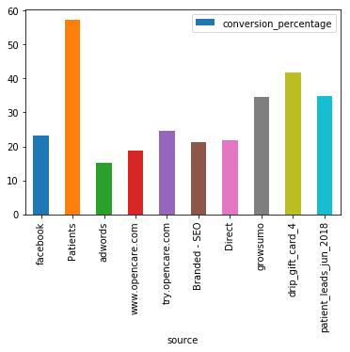
Sources that get People to Request an Appointment

Slide 6
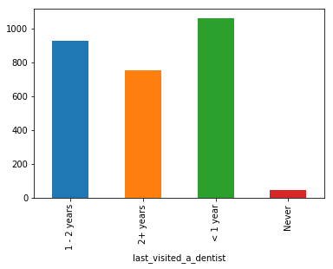
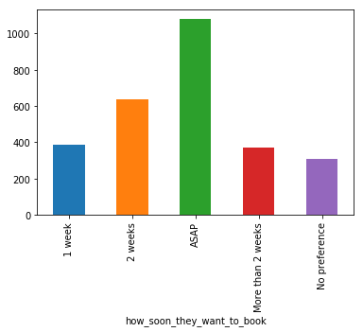
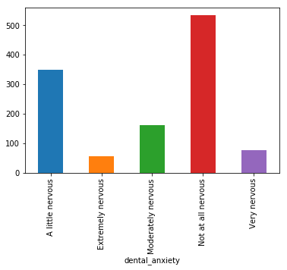
Overall Profile of Appointment Requests and Successful Appointments
Last Dentist Visit
Booking Preference
Dental Anxiety
Appointments Requested
Appointments Requested
Appointments Requested
1 - 2 years
2+ years
<1 year
Never
1 week
2 weeks
ASAP
+2wks
No Pref
A little nervous
Extremely nervous
Mod. nervous
Not at all nervous
Very nervous
Participants request and make successful appointments if they:
Have been to the dentist before
Want to make an apointment ASAP
Have no or low dental anxiety

Slide 7
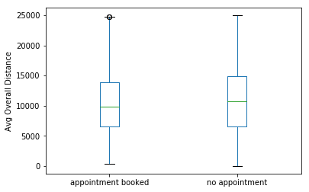
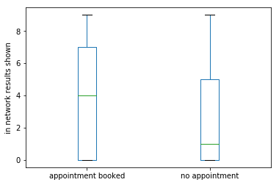
Key Factors Driving Appointment Requests
Avg Overall Distance
Appointment Requests
38% increase in appointment requests when the average overall distance is less than 11059
(pval < 0.001)
Number of in-network Results Shown
Appointment Requests
43% increase in appointment requests when more than 3 in-network results are shown
(pval < 0.001)

Slide 8
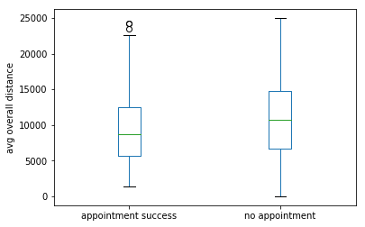
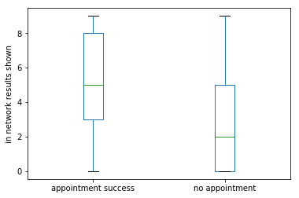
Key Factors Driving Successful Appointments
Avg Overall Distance
Successful Appointments
101% more successful appointments when the average overall distance is less than 11059
(pval < 0.001)
Number of in-network Results Shown
Successful Appointments
219% more successful appointments if the shown more than 3 in-network results
(pval < 0.001)

Slide 9
Recomendations
Show people more than 3 in-network results
Show people more results that are closer in overall distance
Expand marketing strategy with higher conversion rate (Patients)
Other Insights
These recommendations are consistent across locations

Slide 10
Appendix

Slide 11
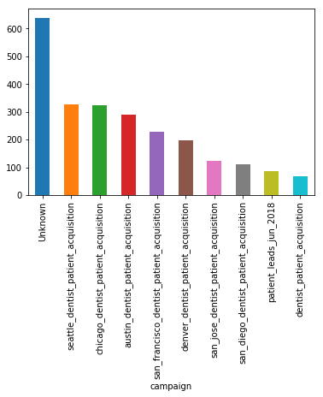
Campaigns that get People to Request an Appointment

