Slide 1


---------------

Slide 2
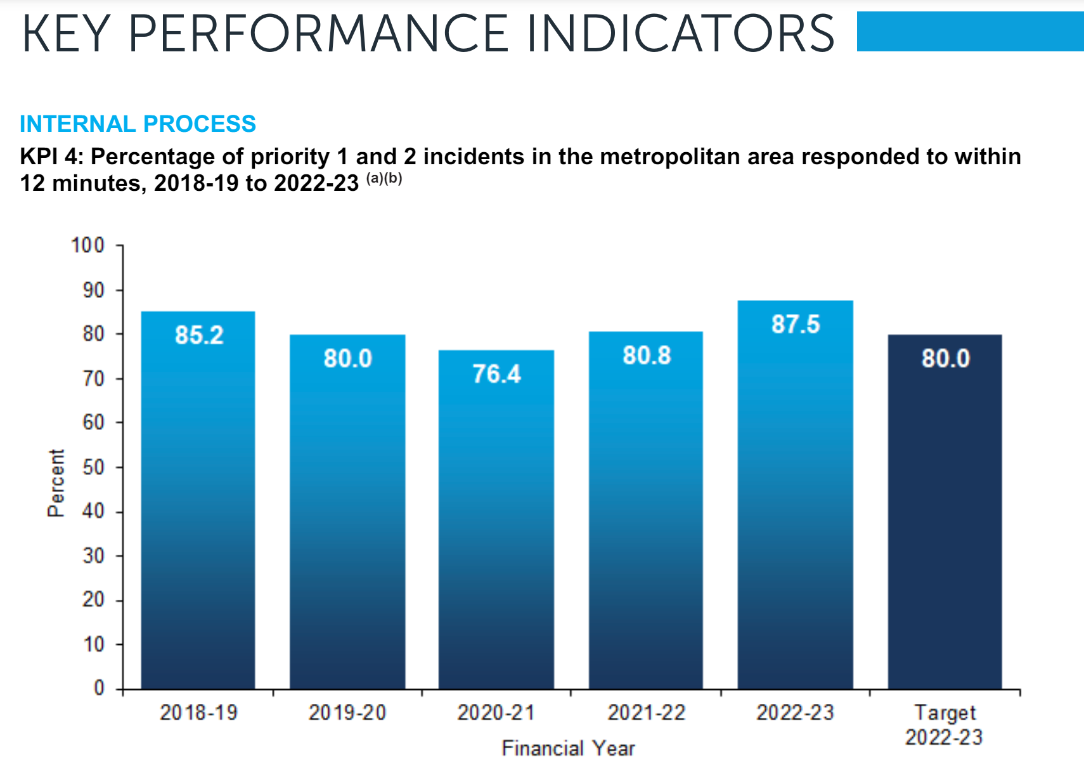
---------------
Challenge:
Optimising Emergency Response
Our system improves WAPOL Response time:
Achieve 12min Attendance KPI for Priority 1 & 2 incidents
Achieve Community expectation
WESTERN AUSTRALIA POLICE FORCE ANNUAL REPORT 2023

Slide 3


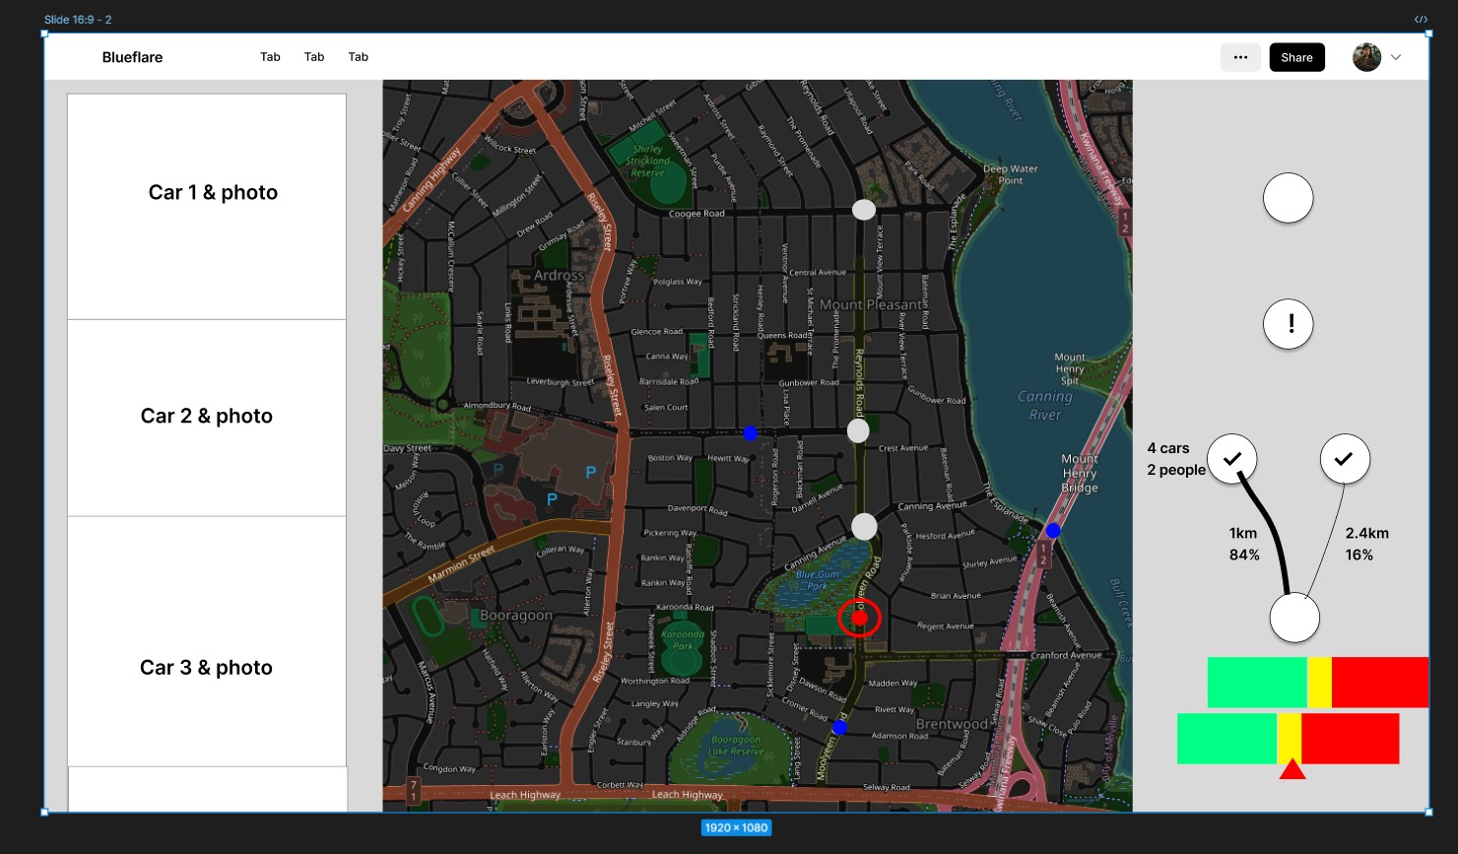

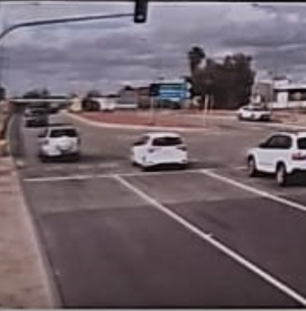

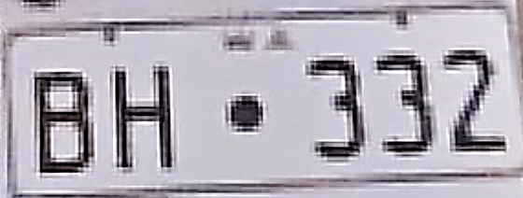
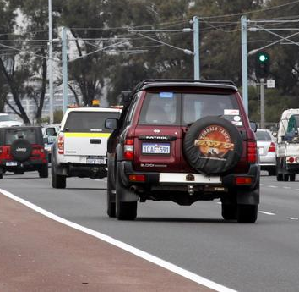
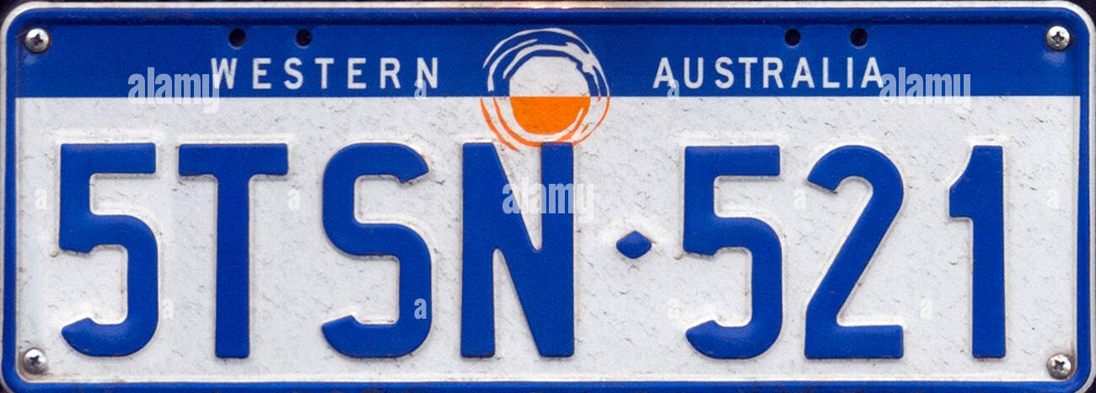
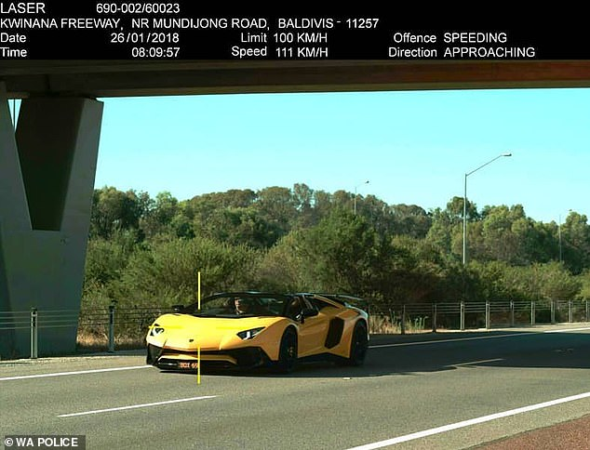
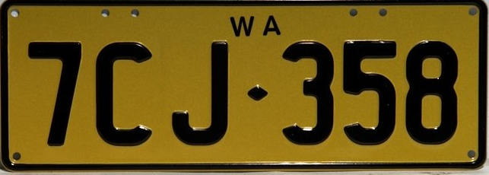
---------------
Introducing…
Traffic Signal Optimised routing

Slide 4
---------------
Blueflare takes traffic data from Apple Maps, Google Maps, Waze, SCAT
Available car – route calculation
Control intersection Traffic Lights

Slide 5
---------------
What we can do
Future Opportunities:
Machine Learning to optimise all available resources and intersection manipulation – looking at every available resources and determine which resource

