Slide 1
Production Line Robotic Manipulator as a Tandem Service
Intracom S.A. Telecom Solutions | 19.7 km Markopoulou Ave., GR 19002 | t: +30 2106671000 | f: +30 2106671001

Slide 2
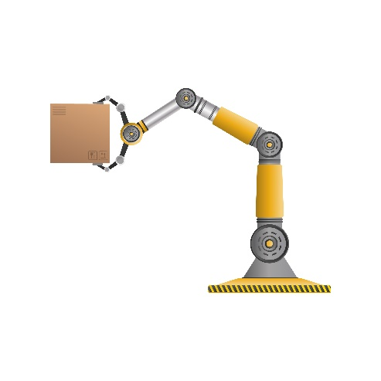


Production Line Robotic Manipulator as a Tandem Service

Slide 3


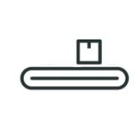

Production Line Robotic Manipulator as a Tandem Service
MOTION
PLANNING
OBJECT
DETECTION
CLASSIFY
OBJECT

Slide 4

Production Line Robotic Manipulator as a Tandem Service
Organise code in Ros Nodes
Indepenent execution
Language agnostic
Communication with Ros Topics
Publish and Subscribe logic
Open Source with a huge community of developers
Many plug and play libraries (don’t reinvent the wheel)
MOTION
PLANNING
OBJECT
DETECTION
CLASSIFY
OBJECT

Slide 5

Production Line Robotic Manipulator as a Tandem Service
MOTION
PLANNING
OBJECT
DETECTION
CLASSIFY
OBJECT

Slide 6

Simulation Environment
Maintained by Open Source Robotics Foundation (same as ROS)
Integrates well with ROS
Open-source software, plethora of 3rd party plugins and solutions

Slide 7
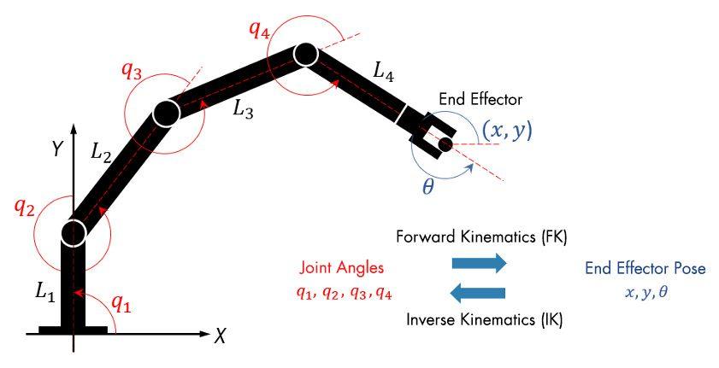
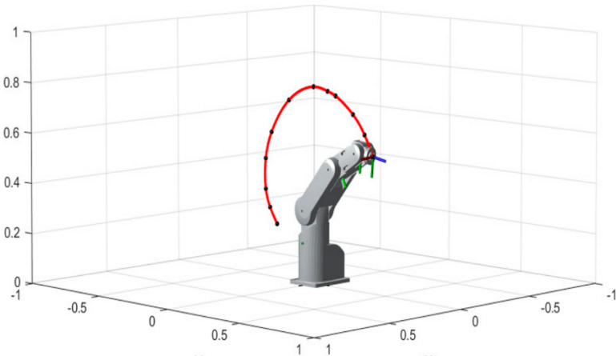
Motion Planning
Inverse Kinematics Calculation
Trajectory Planning

Slide 8

Motion Planning
Works on top of ros
Robot Agnostic (we just provide urdf)
Already wide adoption by large organisations (NASA, Google, Microsoft etc)

Slide 9
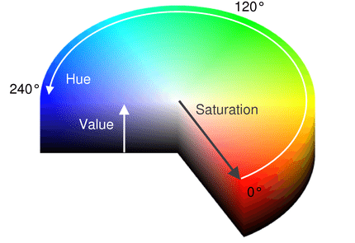
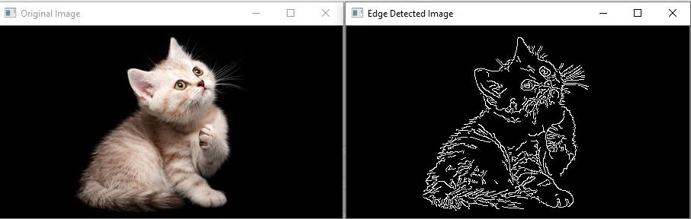
Object Detection
Object Detection with OpenCV
Color filtering using HSV image representation
Edge Detection with Canny Filter
Count objects by finding close contour lines
Consider each object a cluster of pixels
Use k-means to find object centroids

Slide 10
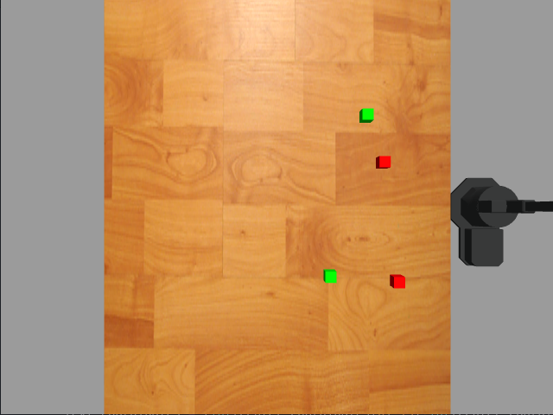

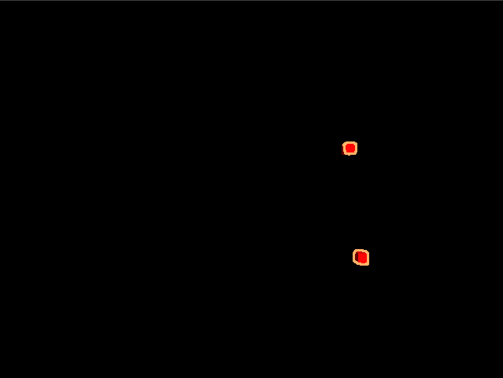
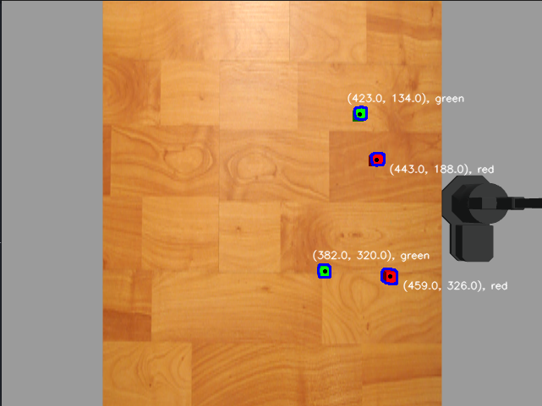
Object Detection
Object Detection with OpenCV
Color filtering using HSV image representation
Edge Detection with Canny Filter
Count objects by finding close contour lines
Consider each object a cluster of pixels
Use k-means to find object centroids

Slide 11
Bulletin format
NEXT STEPS
make it device agnostic
use depth camera for more complex shapes
use ML for object detection
add object classification
visual servoing (for moving conveyor belt)
containerize

Slide 13
For more information, visit
www.intracom-telecom.com

