Slide 1

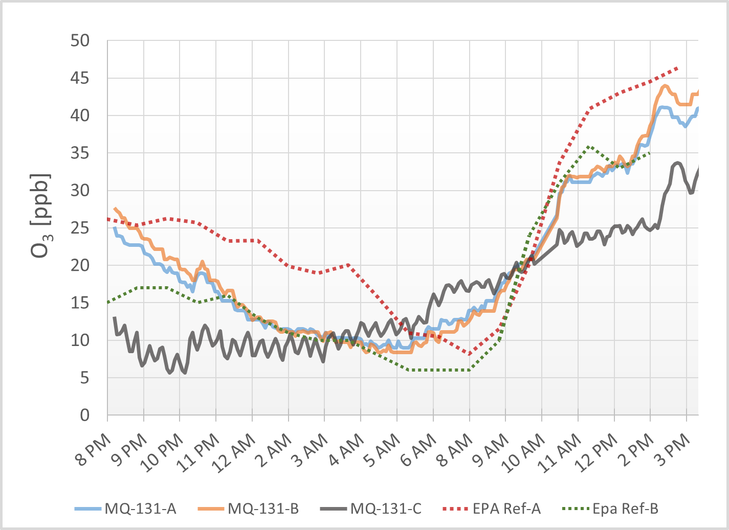
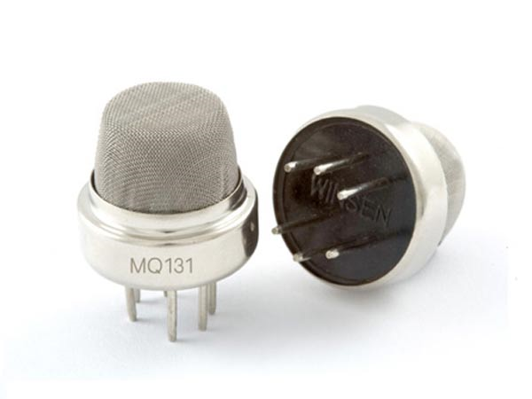
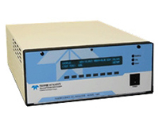
Improving Perpetrator Prediction Using BERT + LSTM Constant Marks & Michael Nutt
Clean Air
Affordable Science
MQ-131 and EPA-Ref
Air quality monitoring has become a necessity as rapid industrialization and urbanization threatens our cities and surroundings. In particular, high ozone levels may damage lungs and inflame chronic respiratory diseases.
The US EPA had developed an array of methods and instrumentation that while accurate are not affordable or practical for most individuals or small government entities.
The good news is that with modern electrochemical sensor technology you can purchase a complete air quality monitoring system for ~$10-100. These sensors can detect a variety of different substances in the atmosphere by measuring the changing resistance of a film made of metal oxide.
We characterized three low-cost MQ-131 Ozone sensors and compared them against two EPA reference monitors. The small monitoring system built around the MQ-131 and Arduino Uno cost approximately $55 USD.
We found that these sensors can provide meaningful data but with some caveats.
MQ-131 vs. EPA-Ref
Pros | Cons | Pros | Cons
Cheap Low-power Portable Available | High Drift Reduced sensitivity Frequent calibration | Low drift Accurate Sensitive | Expensive Bulky High-power
This illustration shows how different chemicals and substances move into and through the troposphere. Credit: U.S. Climate Change Science Program, 2003.

