Slide 1
Investigating the Relationship Between Degree Attainment and Per Capita Income
Constantine Zhang
Ha Nguyen
Kemal Ege Sural

Slide 2
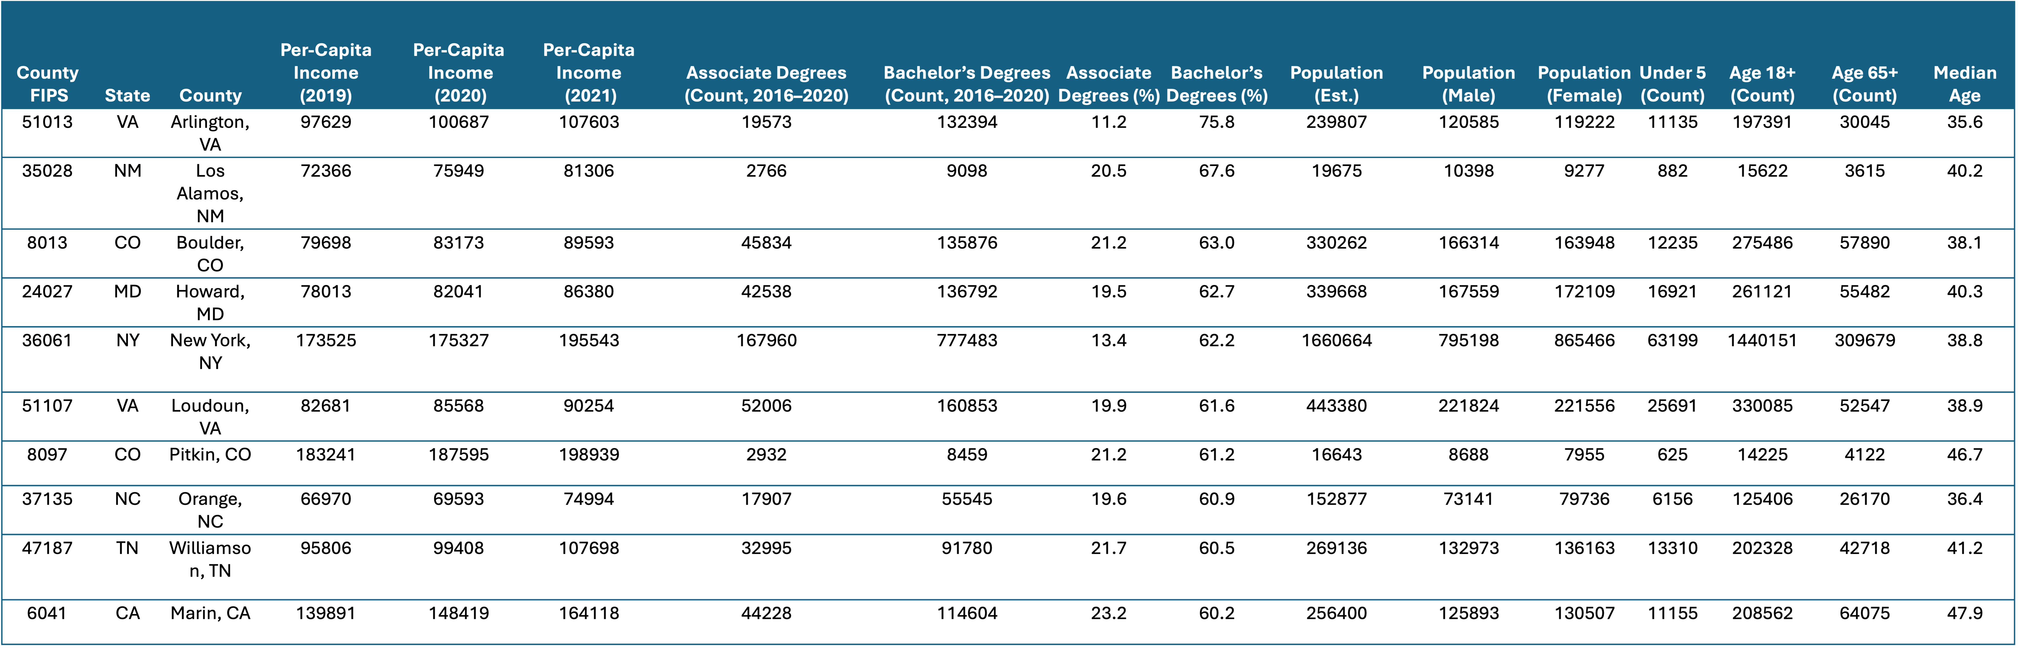
Dataset Overview

Slide 3
What do we know about this data set?
Unit of observation: U.S. county (identified by county_FIPS, with state and county names).
Size: 3,006 rows × 17 columns
Variables:
Income
Education (levels):
Population & age structure
Notes:
Limitations to keep in mind
Coverage is incomplete (3,006 counties ≠ full national universe) — some county-equivalents are missing, likely due to source gaps or merges.
Time alignment is uneven: income is by single years (2019–2021), while education variables are multi-year aggregates (2016–2020); bachelor_degree_percentage_2016_2019 also suggests a different window from the other bachelor/associate fields.

Slide 4
Our Question
Return of education on income, controlling for population & age structure
Data limitations:
Incomplete coverage (3,006 counties ≠ full national universe)
Uneven time alignment: income is by single years (2019–2021), while education variables are multi-year aggregates (2016–2020)
Additional useful information: race, number of firms in a county, spending on education per capita

Slide 5
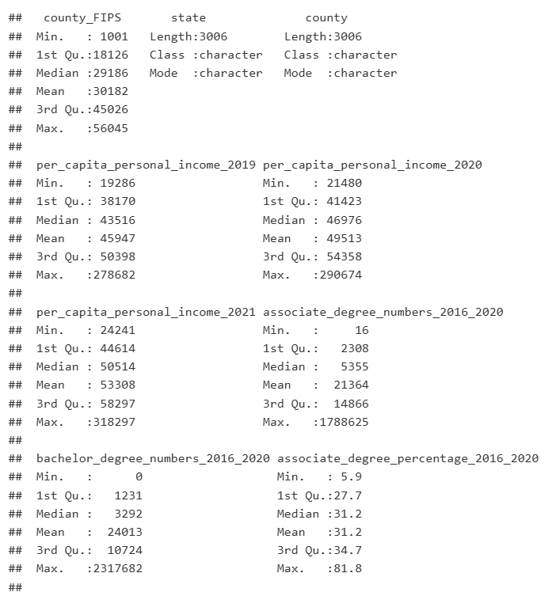
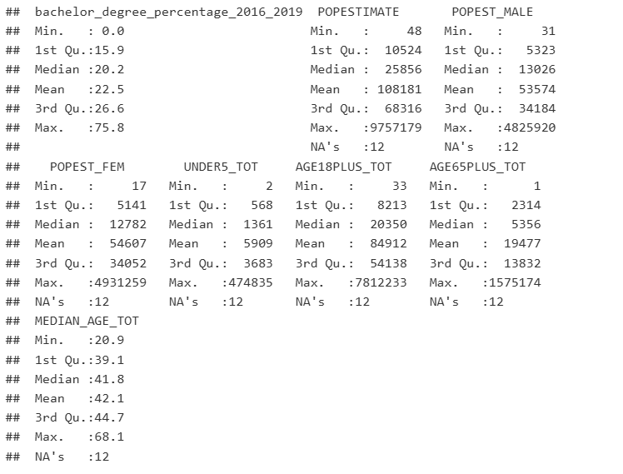
Summary statistics

Slide 6
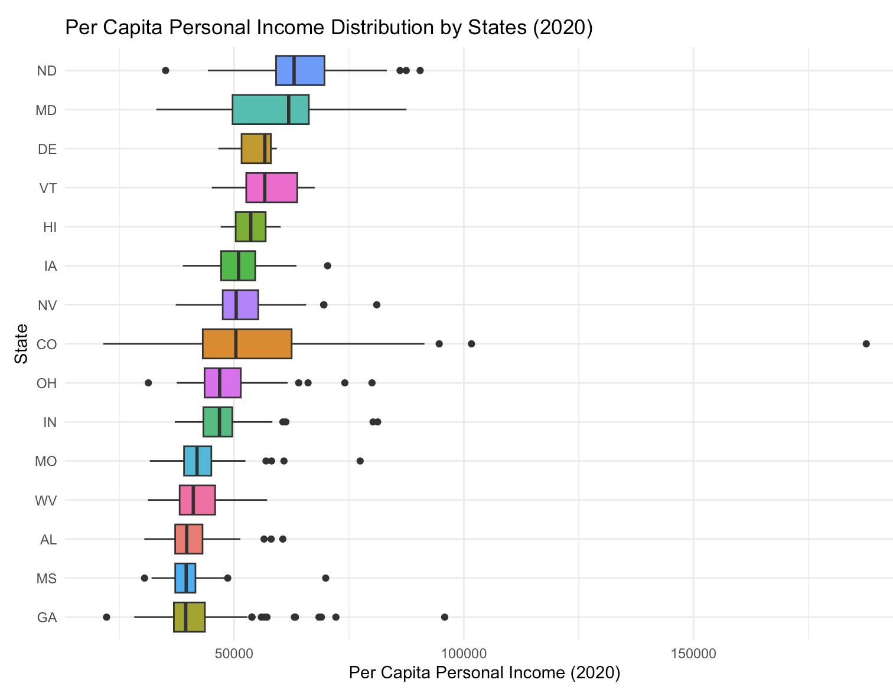
States are selected by median income
The box shows range of income
Outliers indicates wealthy counties

Slide 7
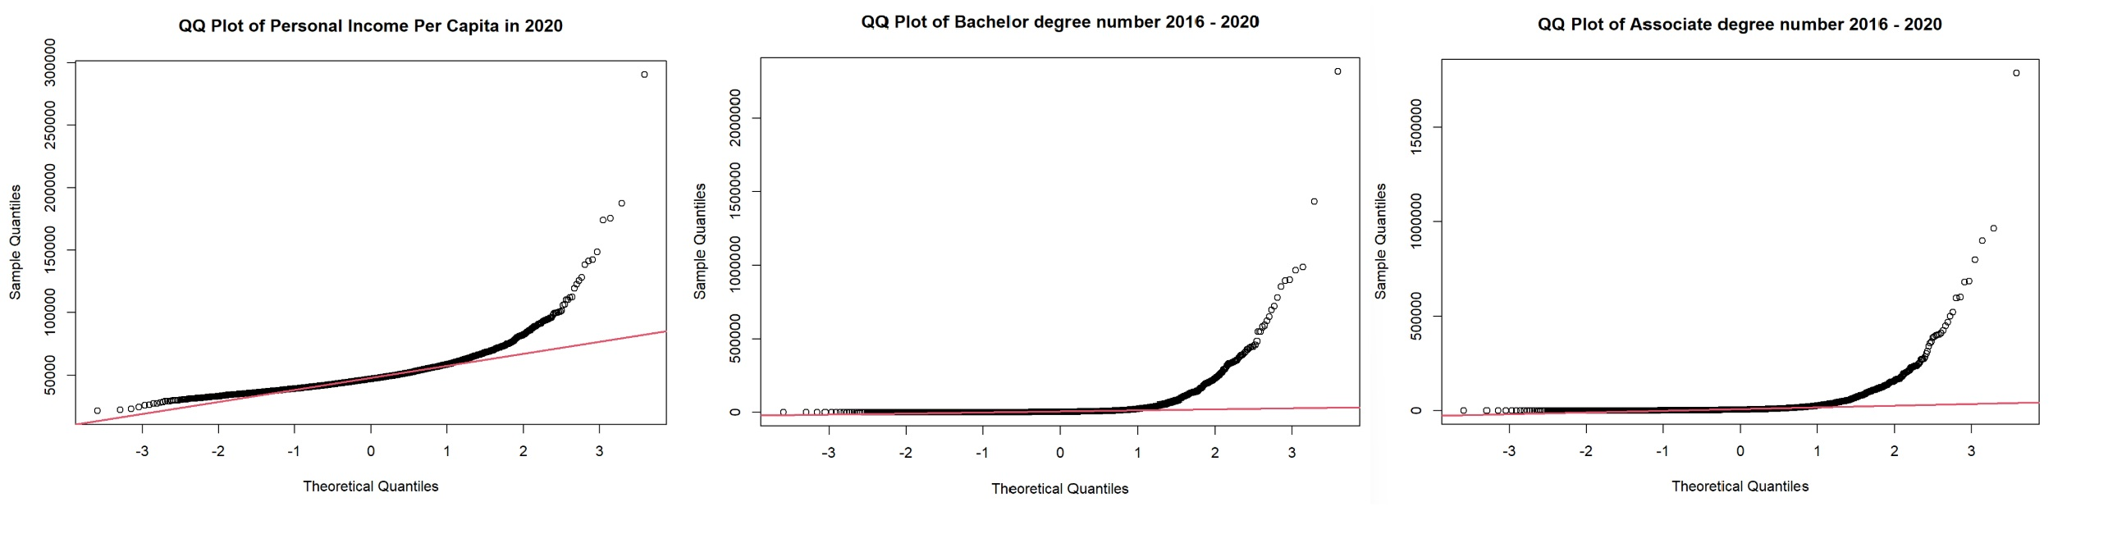
Testing for Normality
Per-capita income (2020): points bend above the line in the upper tail. Mild deviation in lower tail.
→ positive skew / heavy right tail (a few very high-income counties).
Bachelor/Associate numbers (2016–2020): extreme curvature and long upper tails. Many dots are piled near zero
→ lots of small counties + a few huge metros.
Notes:
all three QQ plots scream non-normal with a strong right tail. That’s expected at county level.
doing EDA + hypothesis tests, not regression. Normality of the raw variables is not required for:
χ² tests (no normality assumption) or ANNOVA

Slide 8
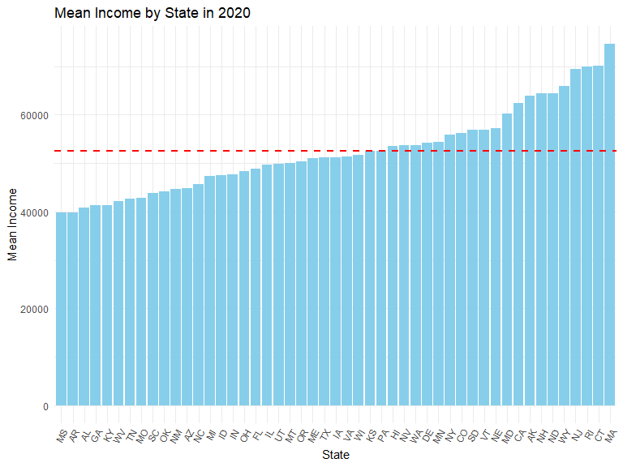

Slide 9
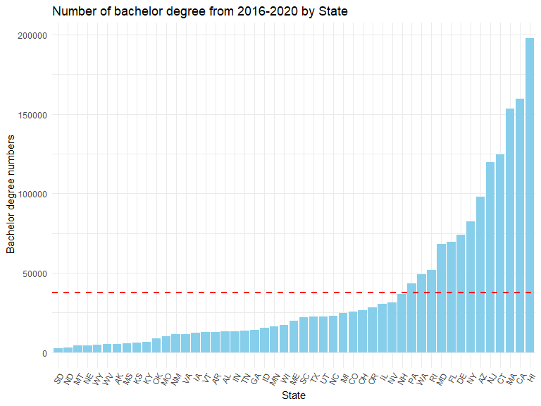

Slide 10
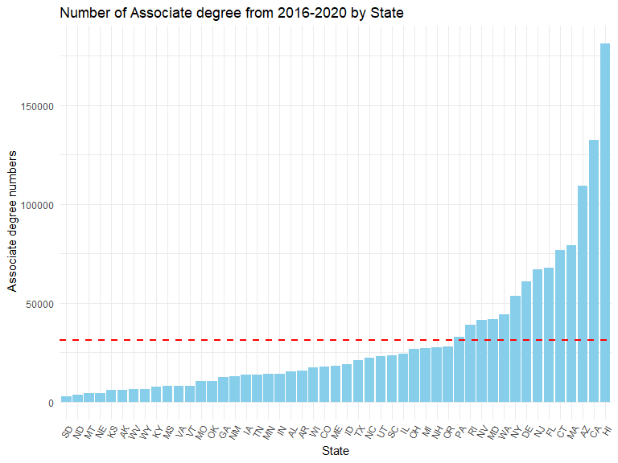

Slide 11
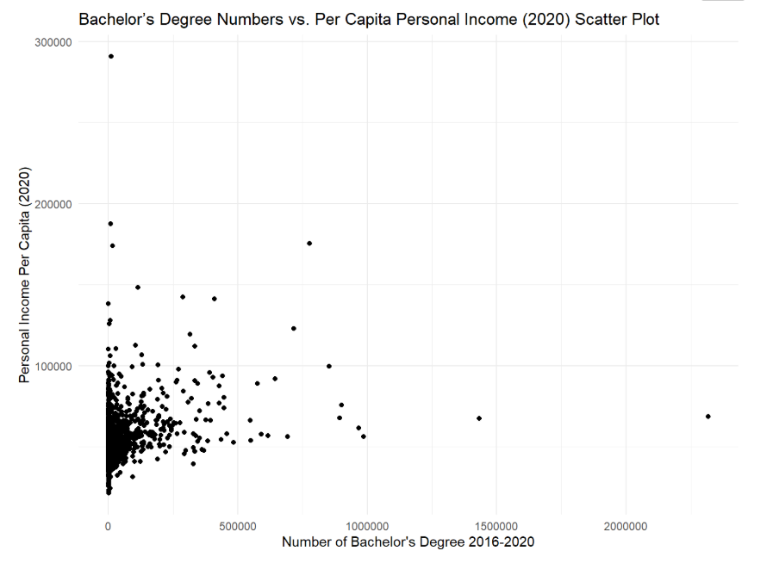

Slide 12
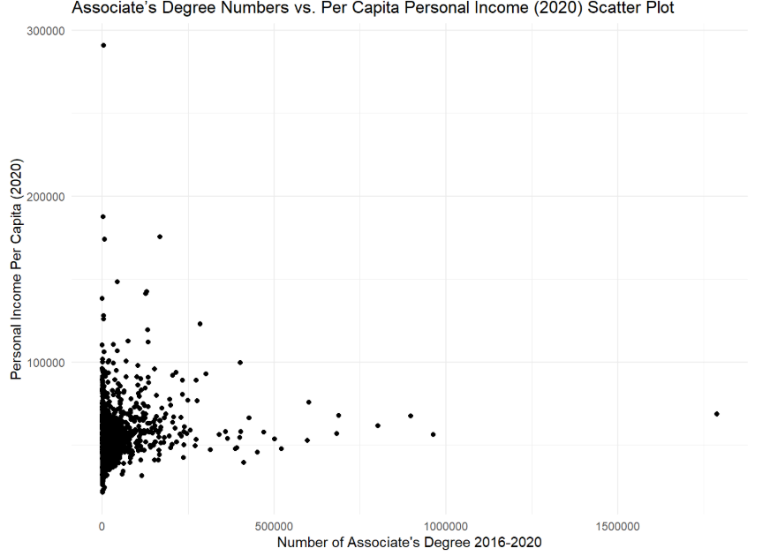

Slide 13
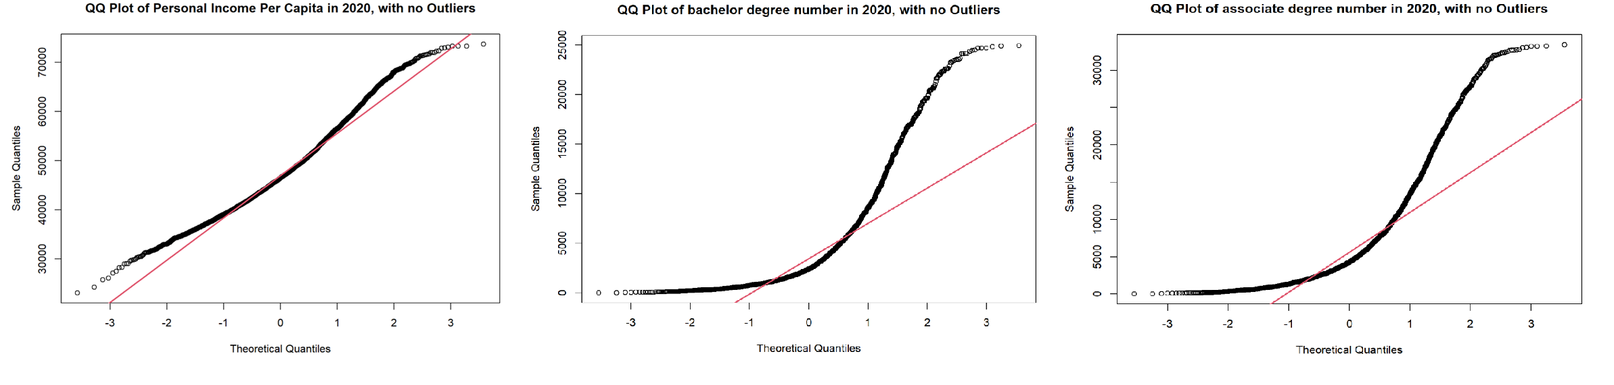
Excluding the extreme value
After removing extreme value:
Income (2020): Central quantiles align reasonably with normality; upper tail still heavy.
Degree counts (2020): S-curve persists, still markedly right-skewed; trimming reduces extremes but not the structural skew from population size.
Notes:
After trimming:
Income (2020): Central quantiles align reasonably with normality; upper tail still heavy.
Degree counts (2020): S-curve persists—still markedly right-skewed; trimming reduces extremes but not the structural skew from population size.

Slide 14
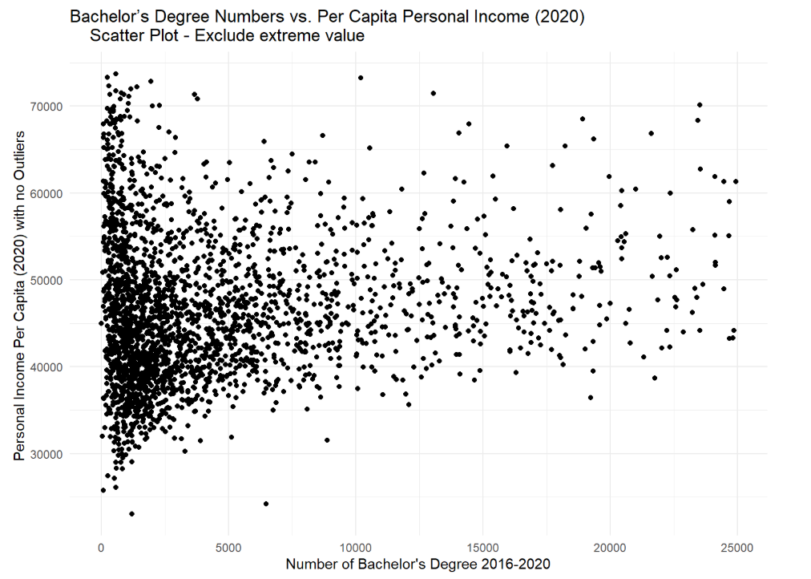
Excluding the extreme value

Slide 15
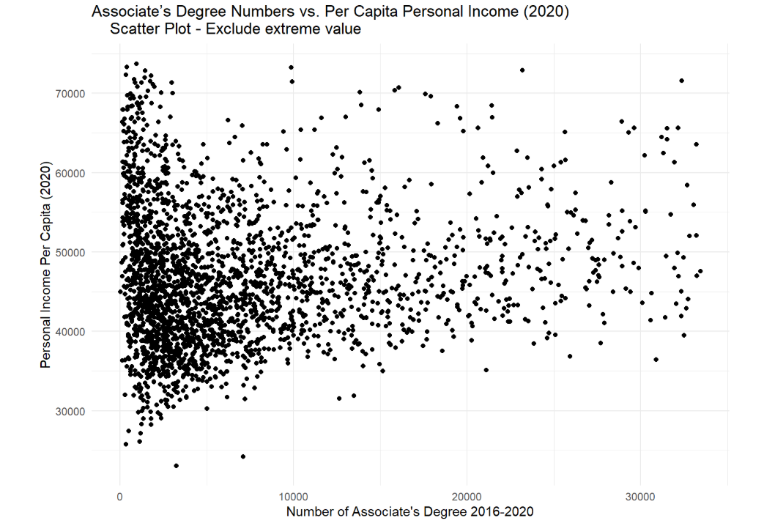
Excluding the extreme value

Slide 16
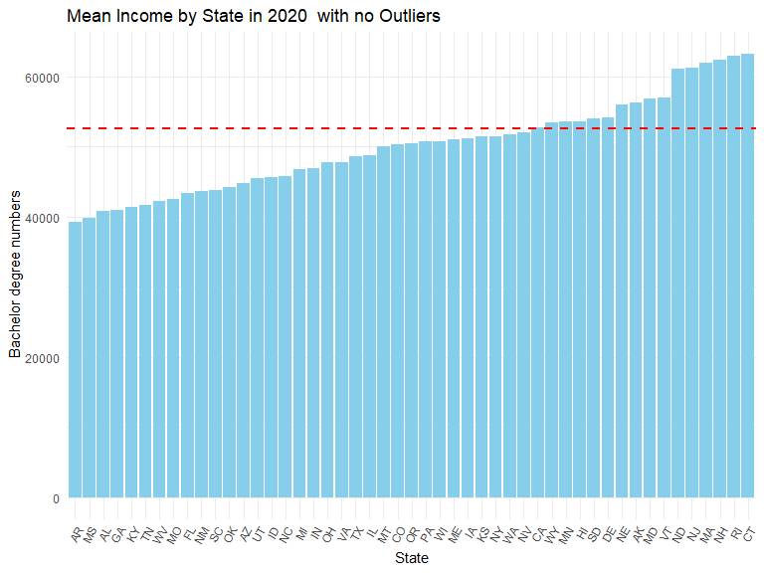

Slide 17
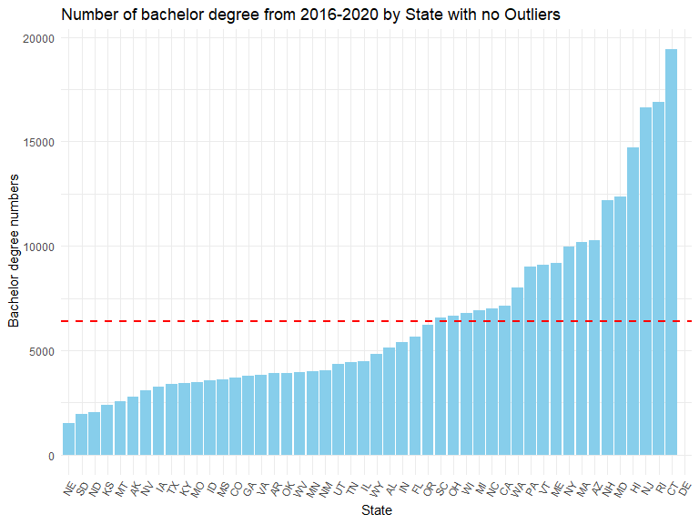

Slide 18
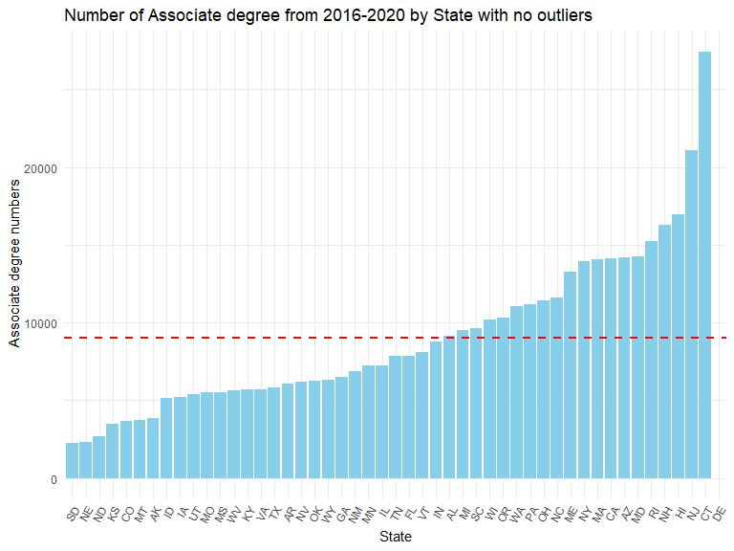

Slide 19
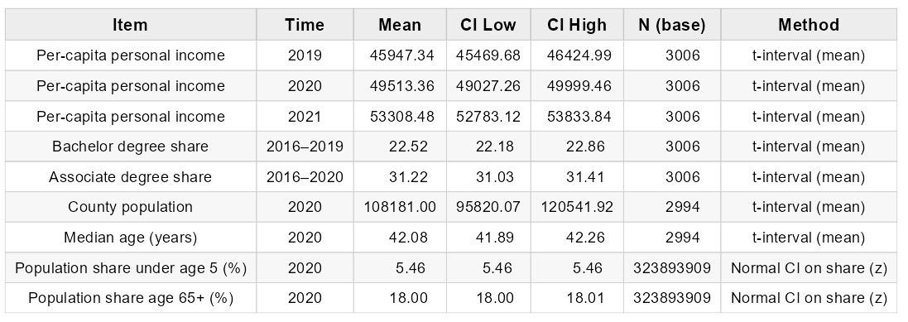
95% Confidence Interval

Slide 20
Per Capita Income Between Years
ANOVA Test Assumptions:
Normality
2. Homogeneity of variances
3. Independence of error (Can be assumed when sample is randomly selected)

Slide 21
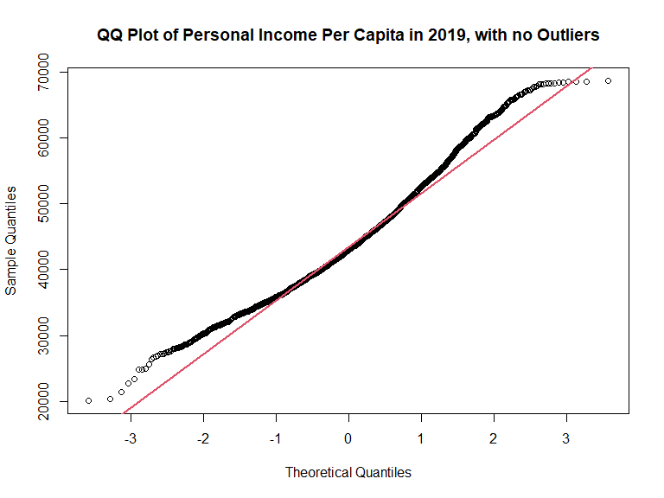
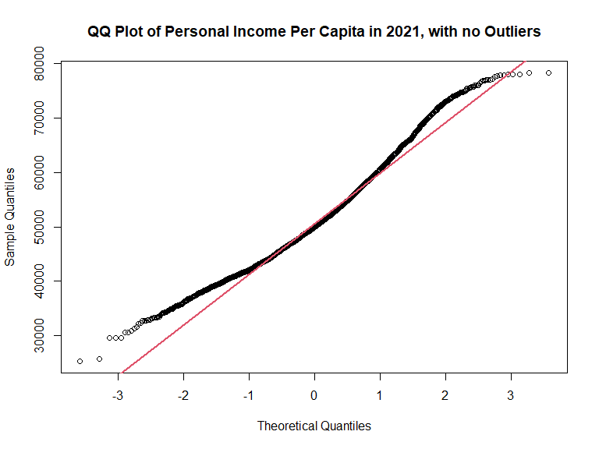
Normality

Slide 22
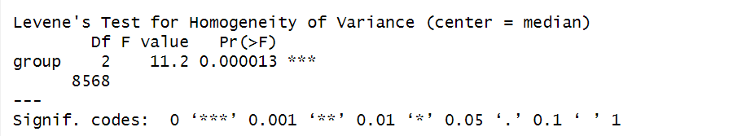
Homogeneity of variances
Null Hypothesis: Variances are equal across years
Alternative Hypothesis: Variances are not equal

Slide 23
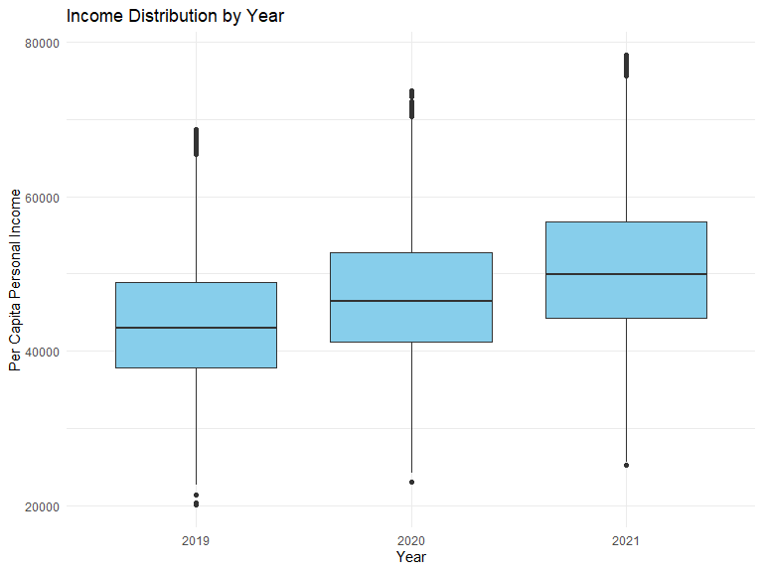

Slide 24
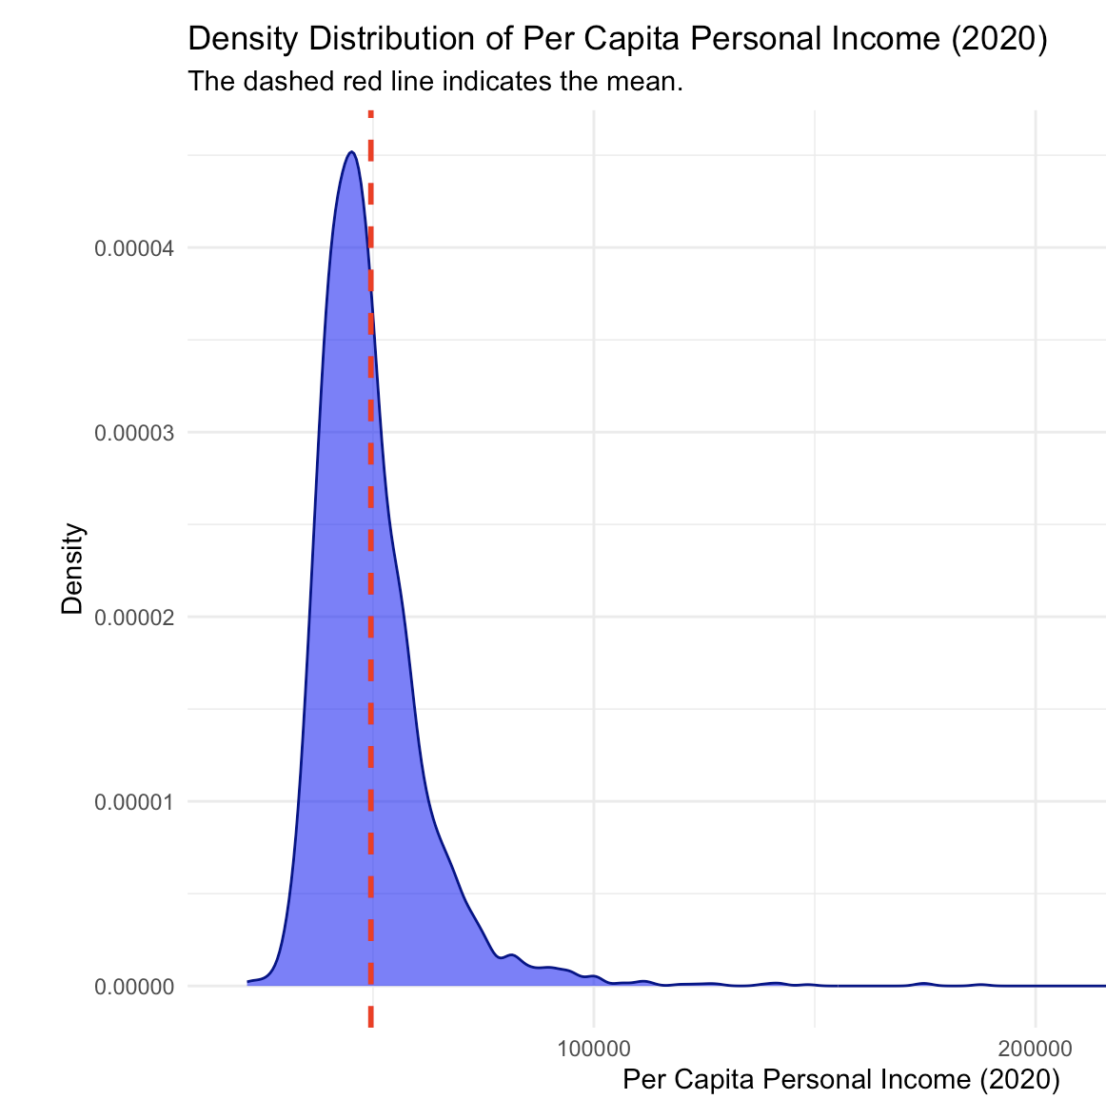
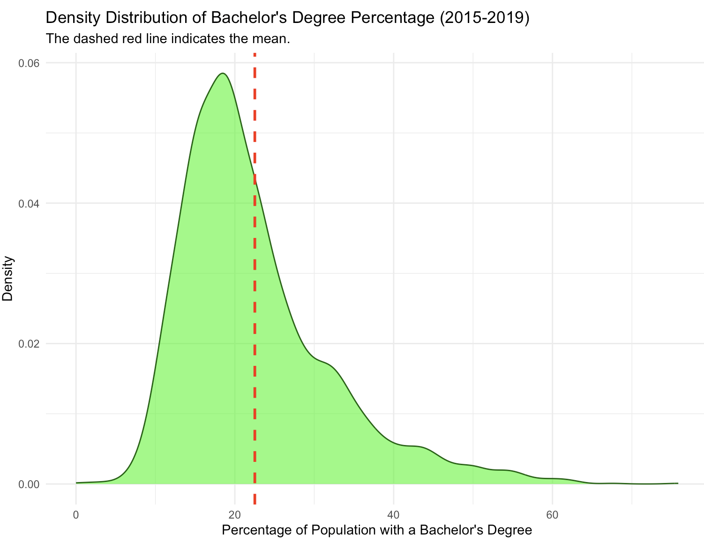
Density Distributions

Slide 25
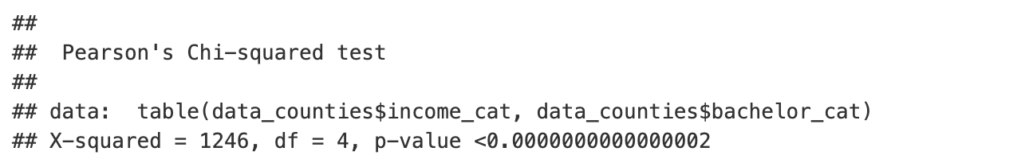
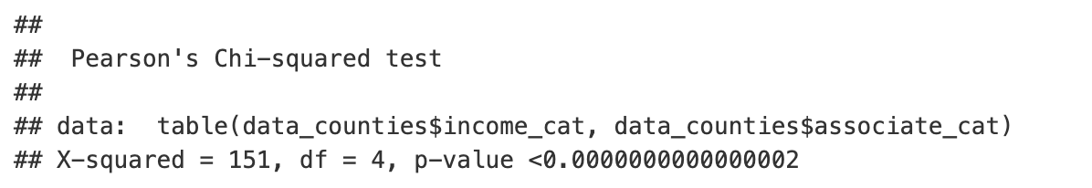
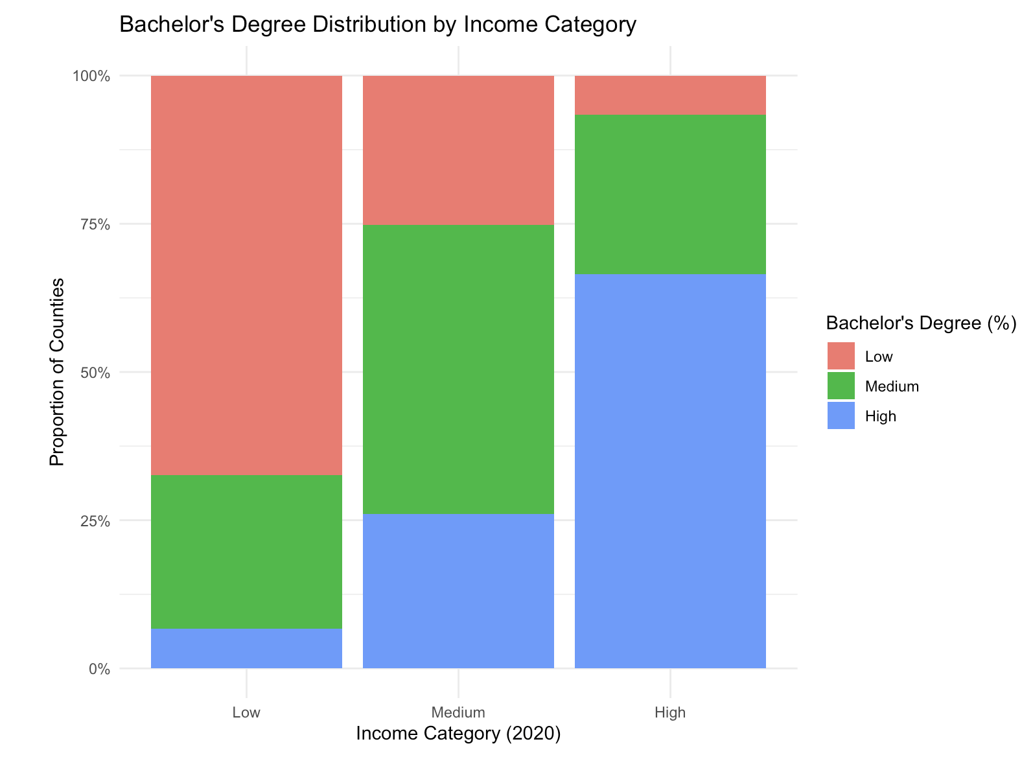
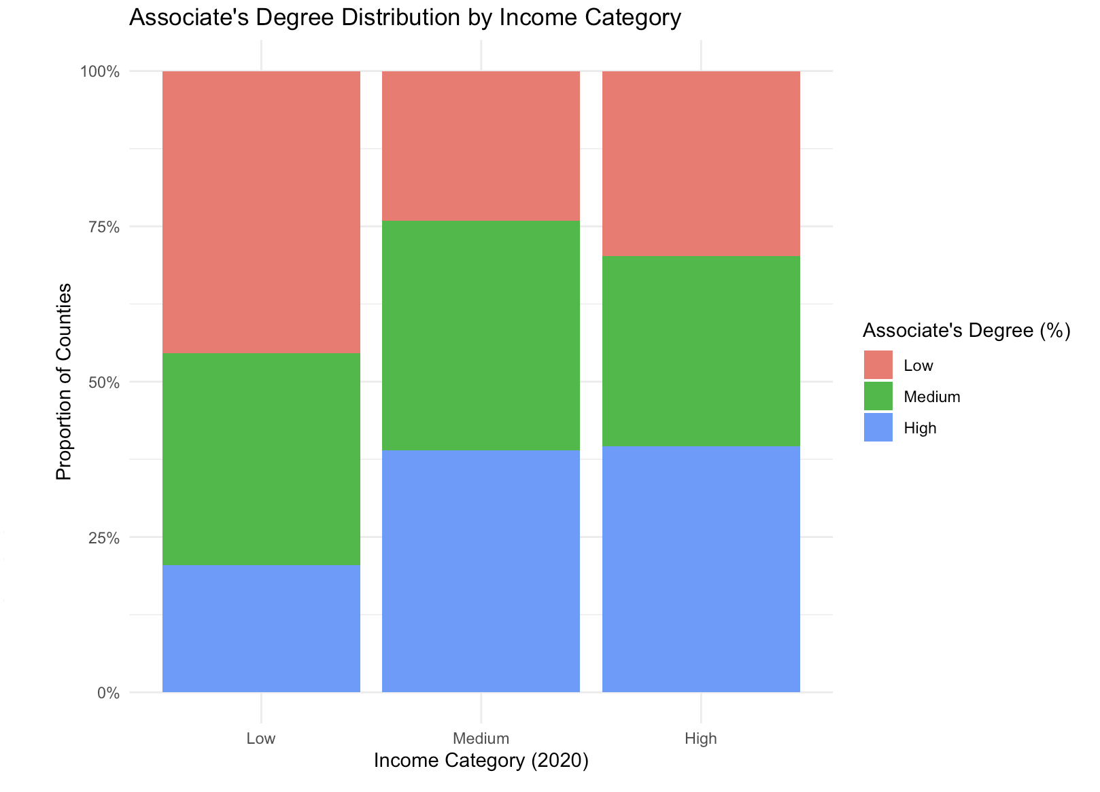
Chi-Squares Test
Personal Income vs. Bachelor degree
Personal Income vs. Associate degree

Slide 26
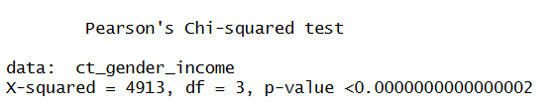
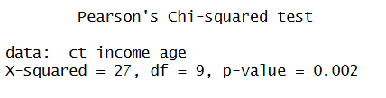
Chi-Squares Test
Personal Income vs. Gender
Personal Income vs. age
Hypotheses
H0: Gender composition is the same in every income quartile
H1: Gender composition differs for at least one income quartile.
Hypotheses
H0: Income-quartile and median-age–quartile are independent (county counts spread the same)
H1: Median age differs for at least one income quartile.
Income Quartile | Male Share (%) | Female Share (%)
Q1 (Lowest) | 50.1 | 49.9
Q2 | 49.7 | 50.3
Q3 | 49.5 | 50.5
Q4 (highest) | 49.4 | 50.6

Slide 27
References
Gunawan, R. (2021). Per Capita Income by County 2021 vs. Education [Data Set]. Kaggle. Retrieved from https://www.kaggle.com/datasets/ruddygunawan/per-capita-income-by-county-2021-vs-education
U.S. Census Bureau. (2023). County Population Totals: 2020-2023 [Data Table]. Retrieved from https://www.census.gov/data/tables/time-series/demo/popest/2020s-counties-detail.html

