Slide 1
Investigating the Relationship Between Degree Attainment and Per Capita Income
Constantine Zhang
Ha Nguyen
Kemal Ege Sural

Slide 2
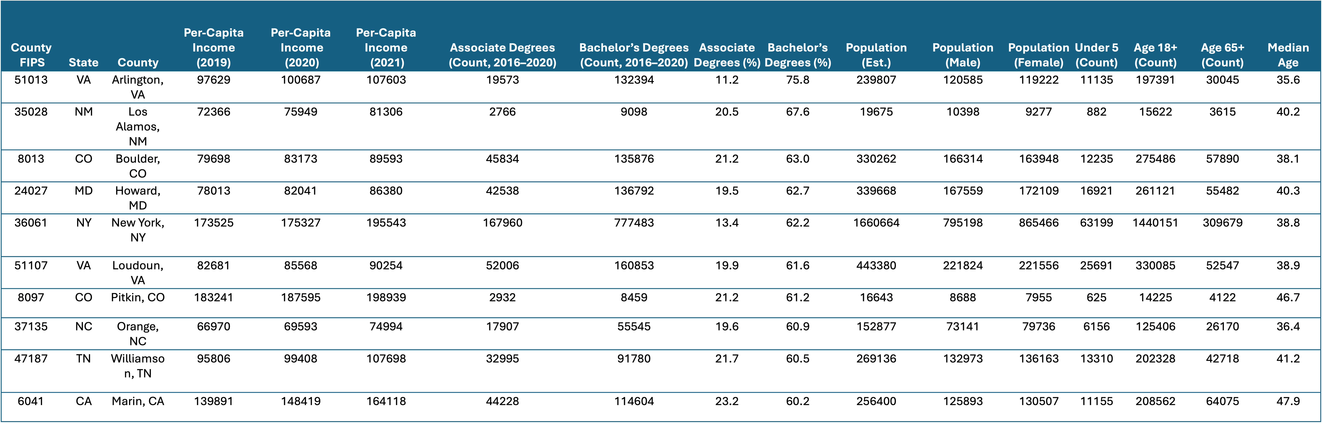
Dataset Overview

Slide 3
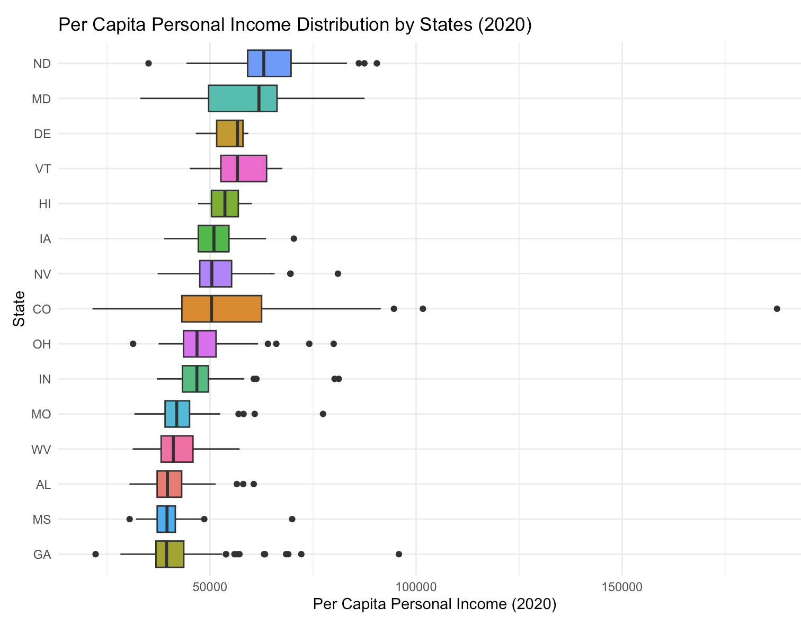
States are selected by median income
The box shows range of income
Outliers indicates wealthy counties

Slide 4
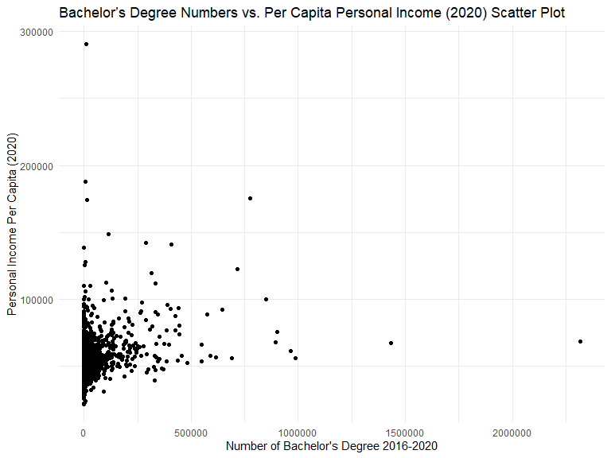

Slide 5
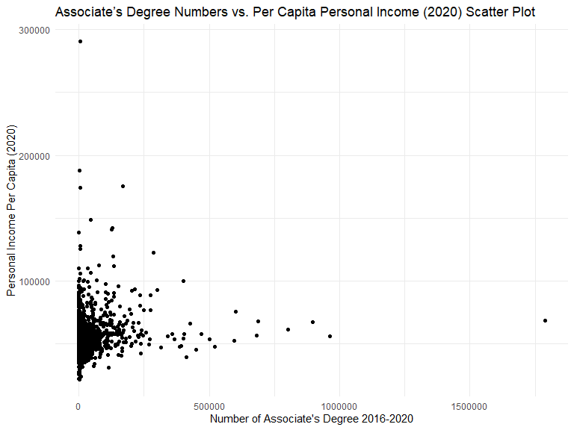

Slide 6
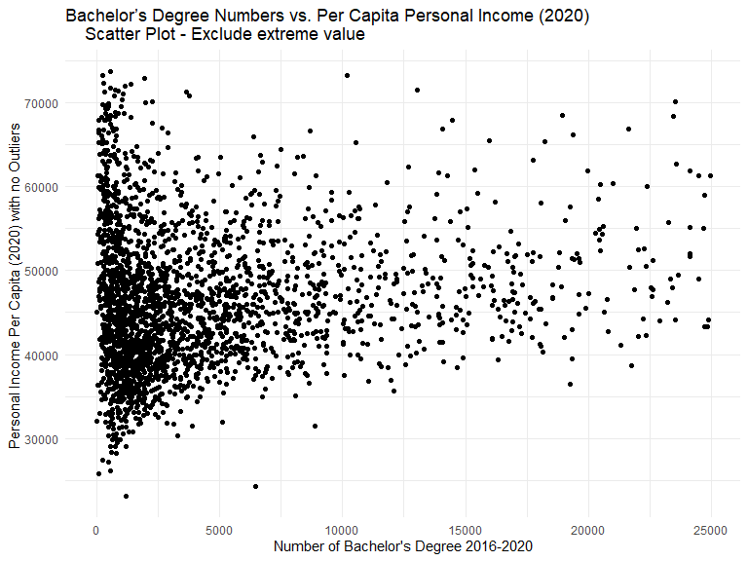

Slide 7
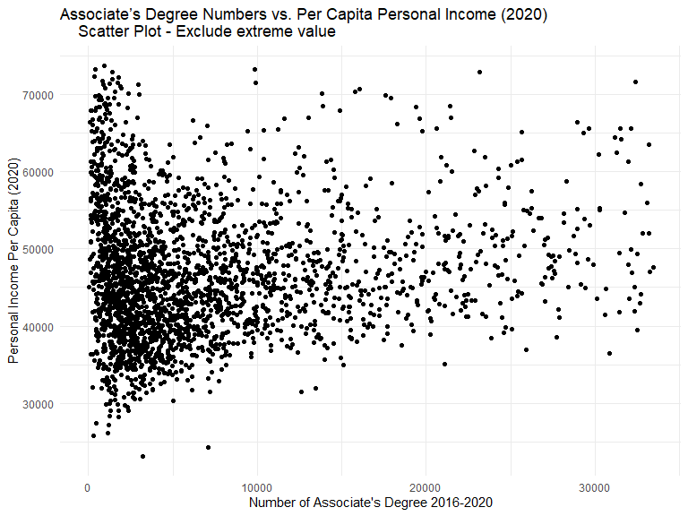

Slide 8

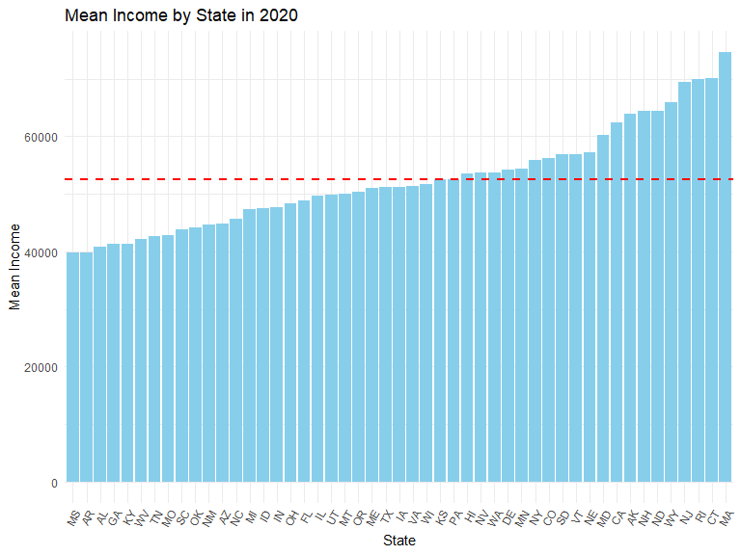
ANOVA TEST
Null Hypothesis: Mean per capita income between states is the same.
Alternative Hypothesis: At least one state has a different mean per capita income

Slide 9
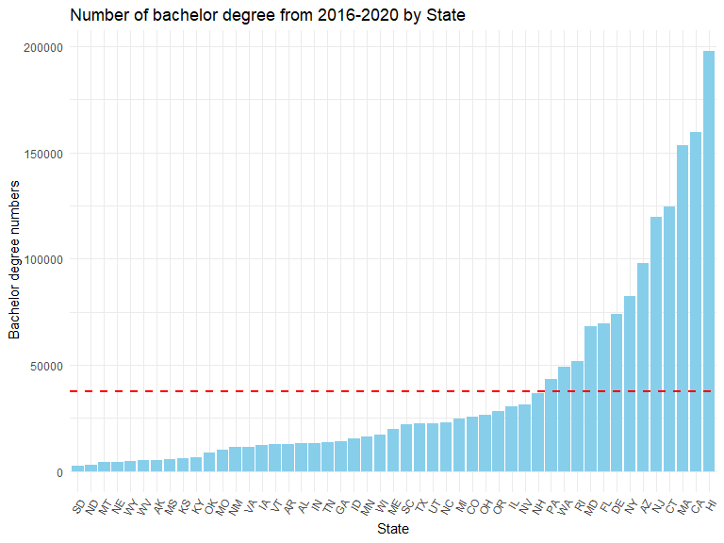
Null Hypothesis: The Mean number of bachelor’s degrees between states is the same in 2020.
Alternative Hypothesis: At least one state has a different mean number of bachelor’s degrees in 2020.

Slide 10

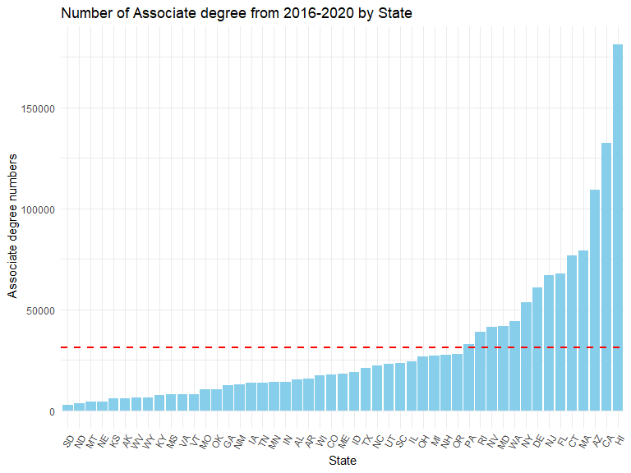
Null Hypothesis: The Mean number of associate’s degrees between states is the same in 2020.
Alternative Hypothesis: At least one state has a different mean number of associate’s degrees in 2020.

Slide 11
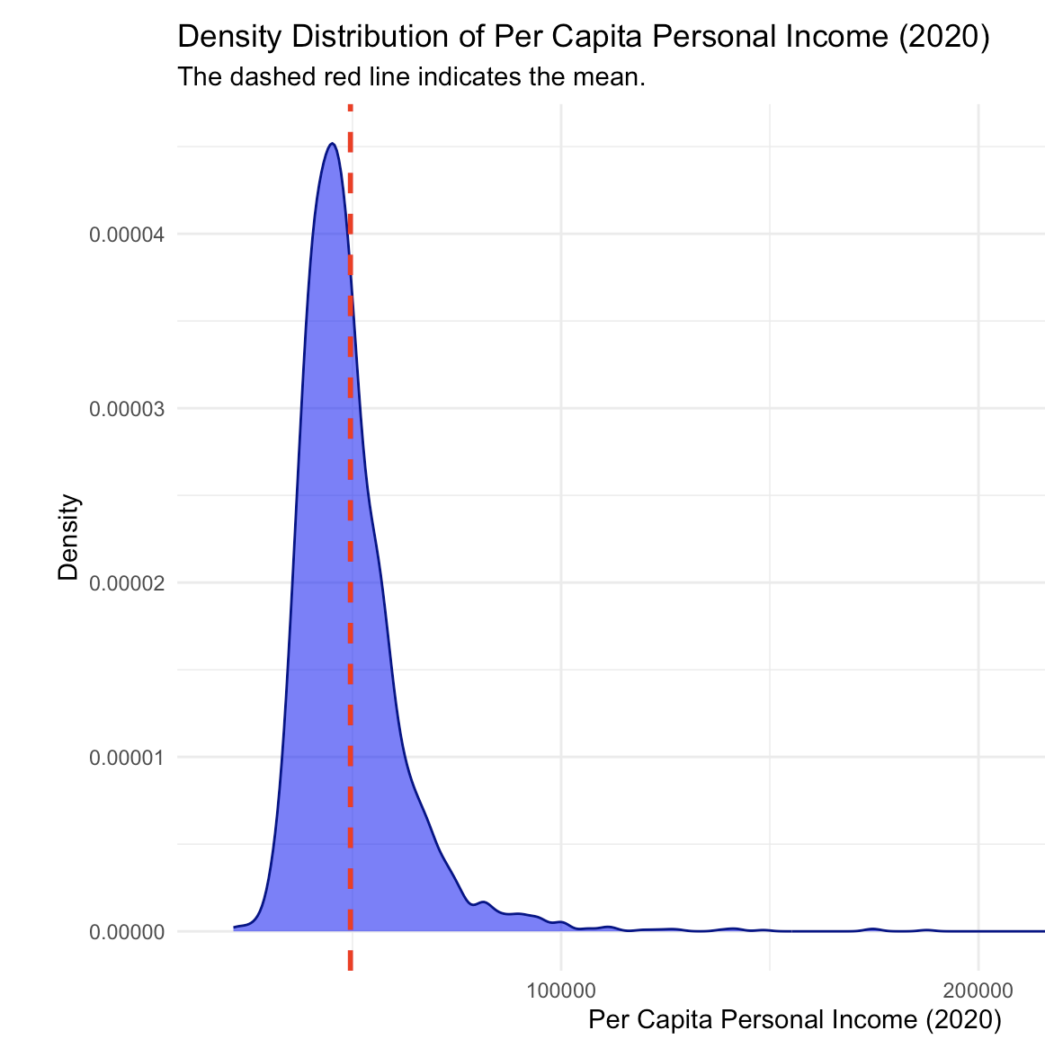
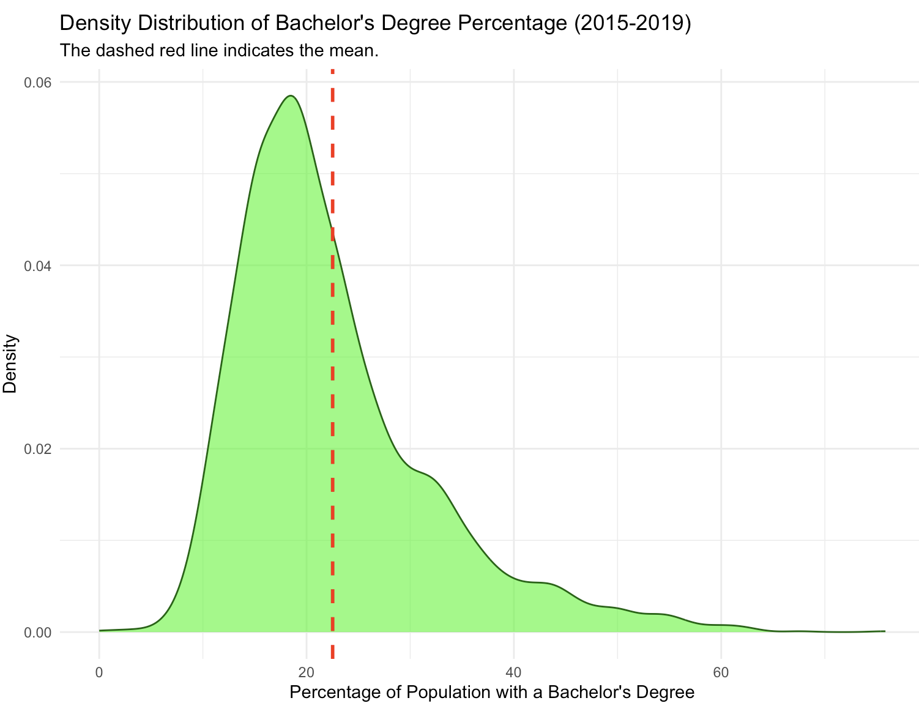
Density Distributions

Slide 12

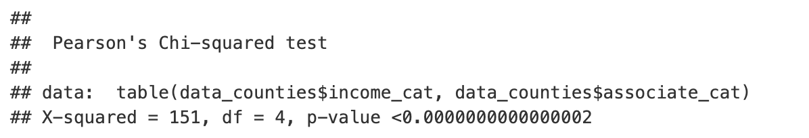
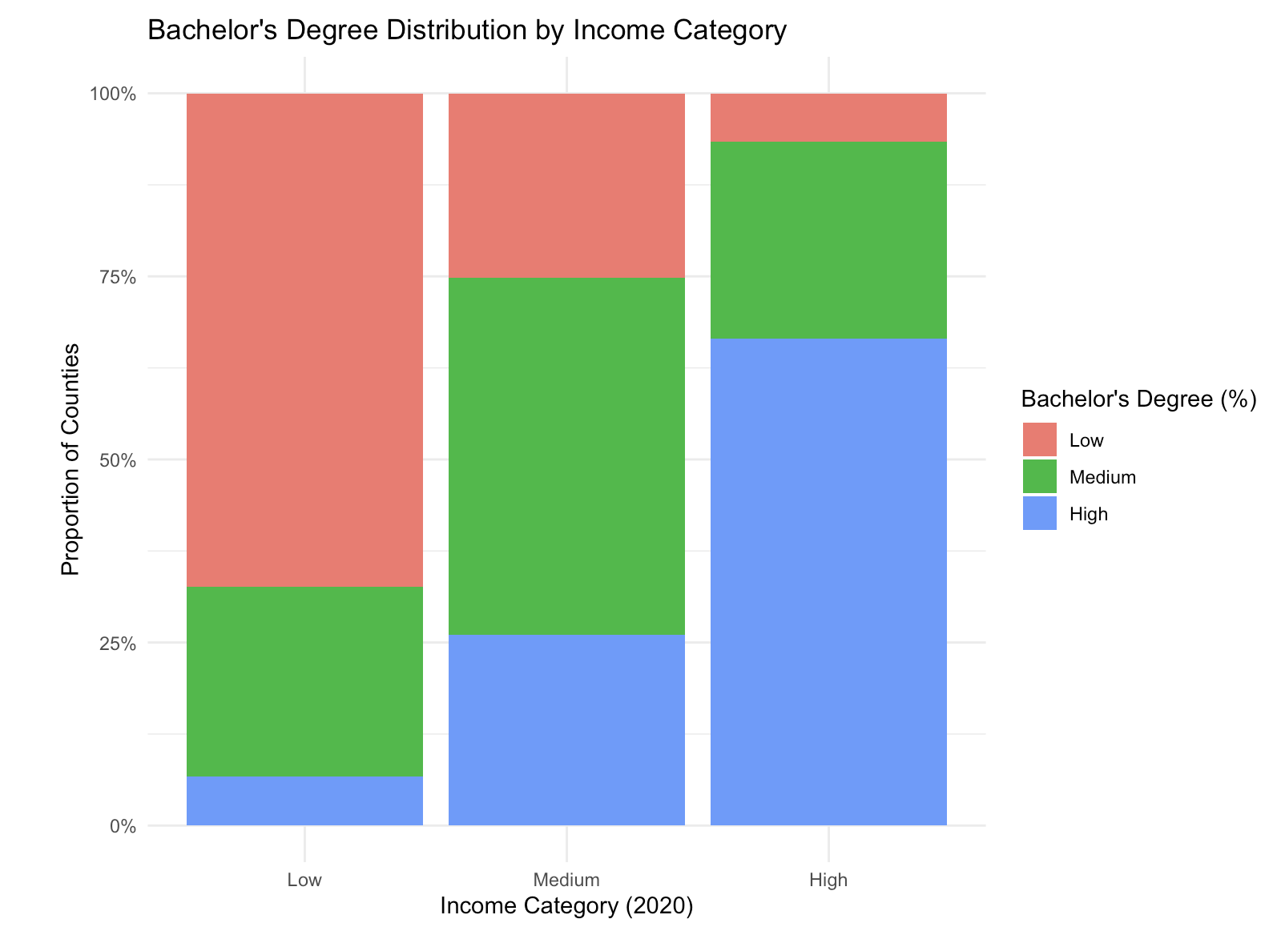
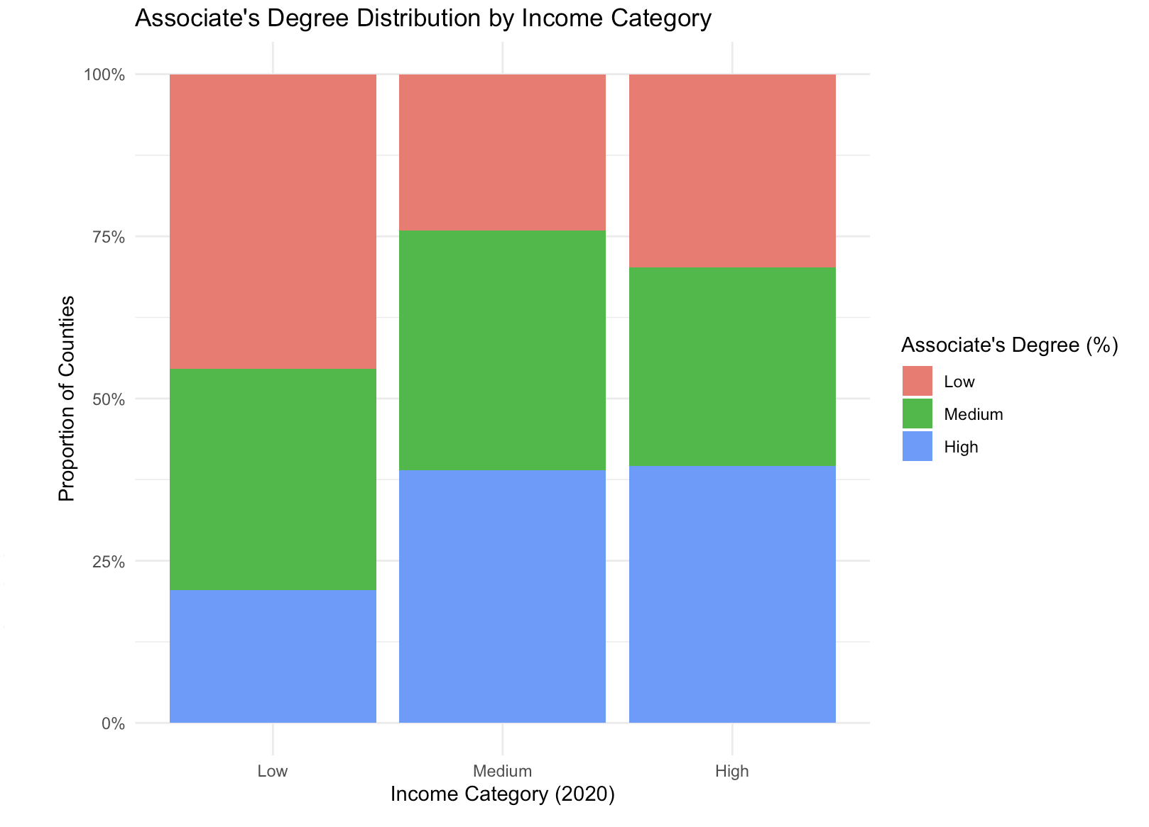
Chi-Squares Test
Personal Income vs. Bachelor degree
Personal Income vs. Associate degree

Slide 13
References
Gunawan, R. (2021). Per Capita Income by County 2021 vs. Education [Data Set]. Kaggle. Retrieved from https://www.kaggle.com/datasets/ruddygunawan/per-capita-income-by-county-2021-vs-education
U.S. Census Bureau. (2023). County Population Totals: 2020-2023 [Data Table]. Retrieved from https://www.census.gov/data/tables/time-series/demo/popest/2020s-counties-detail.html

