Slide 1
Investigating the Relationship Between Degree Attainment and Per Capita Income
Constantine Zhang
Ha Nguyen
Kemal Ege Sural

Slide 2
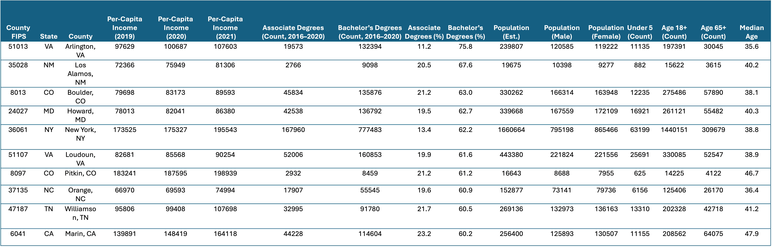
Dataset Overview

Slide 3
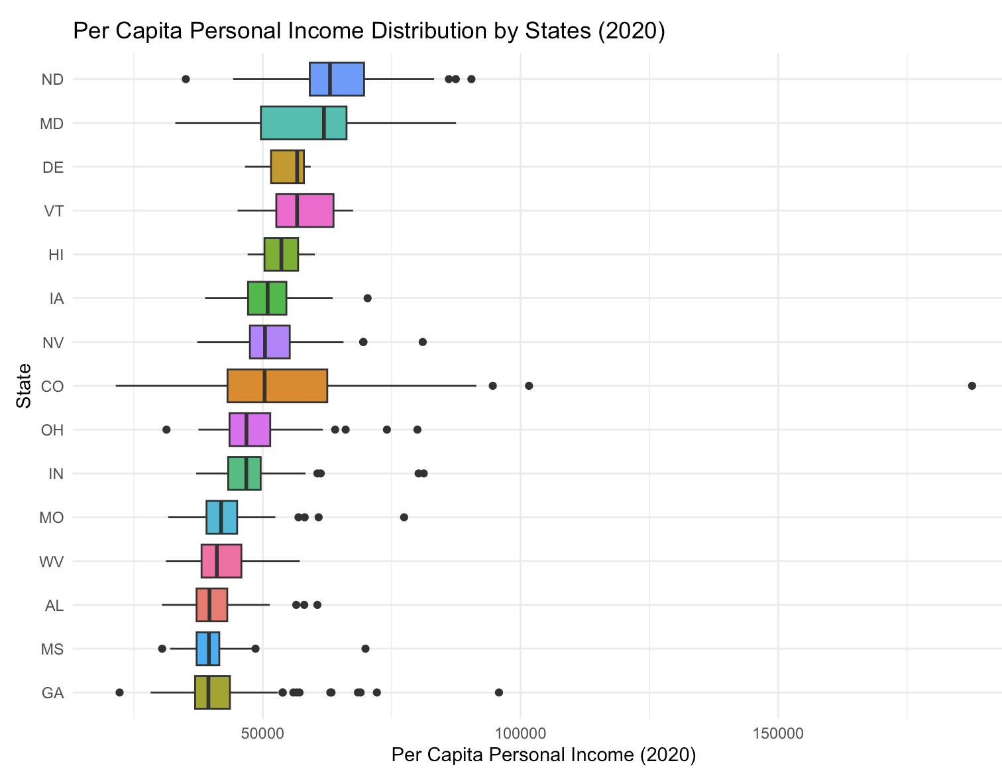
States are selected by median income
The box shows range of income
Outliers indicates wealthy counties

Slide 4
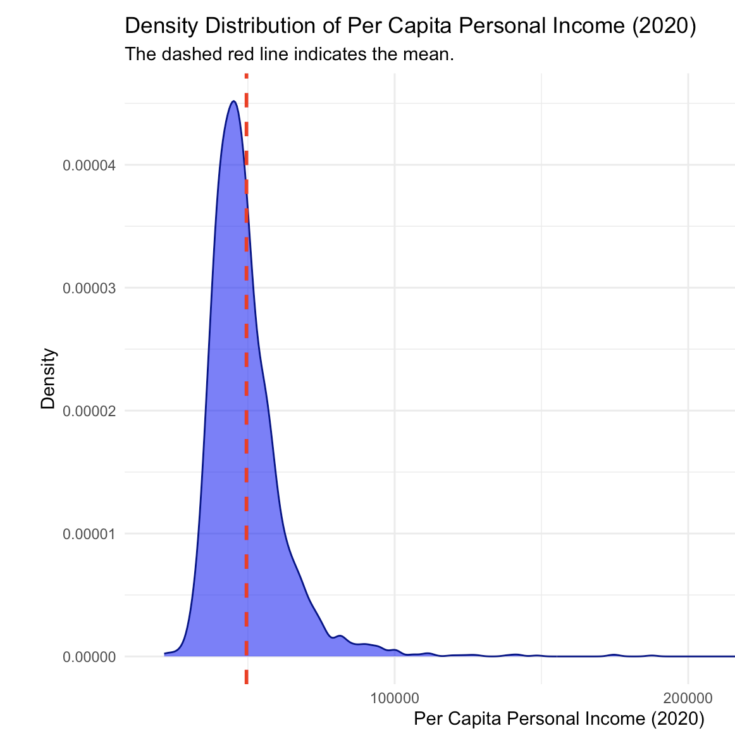
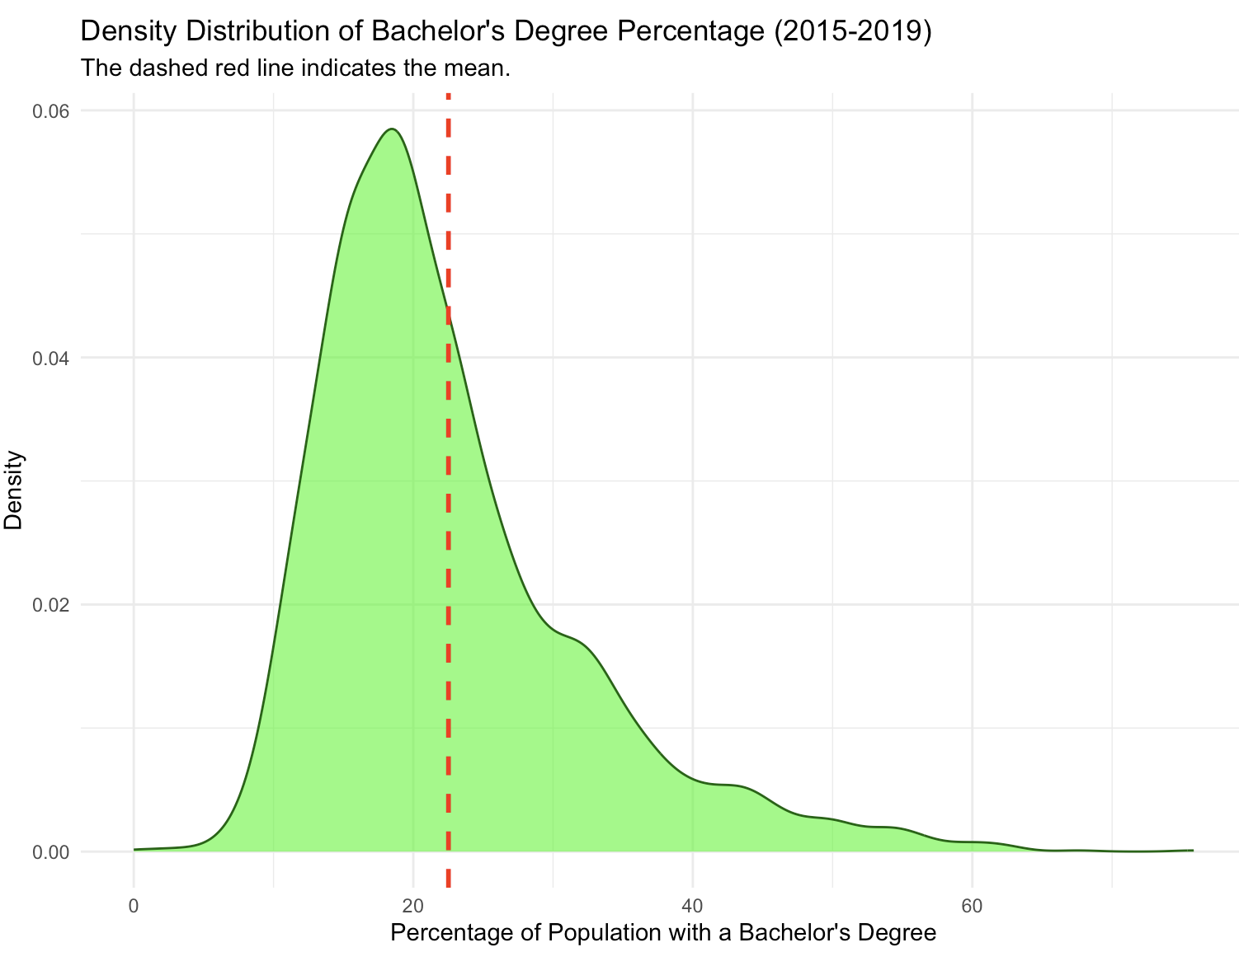
Density Distributions

Slide 5

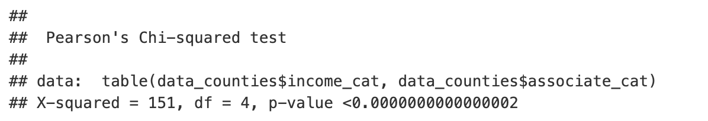
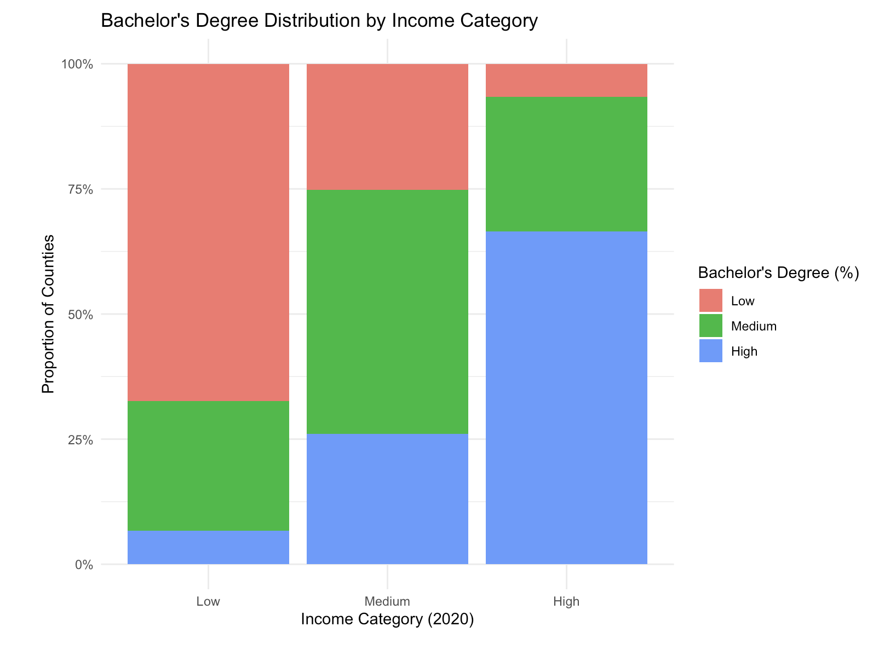
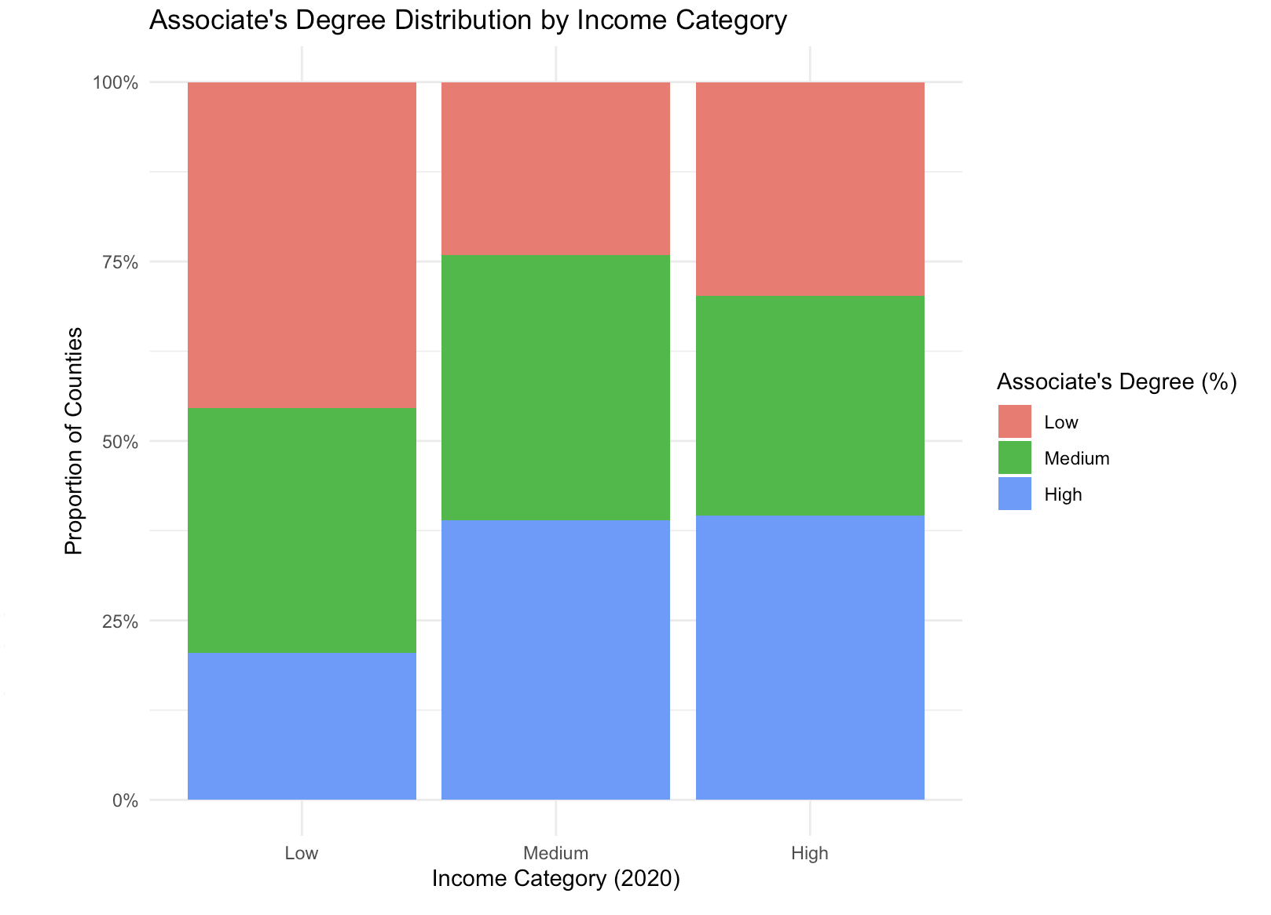
Chi-Squares Test
Personal Income vs. Bachelor degree
Personal Income vs. Associate degree

Slide 6
References
Gunawan, R. (2021). Per Capita Income by County 2021 vs. Education [Data Set]. Kaggle. Retrieved from https://www.kaggle.com/datasets/ruddygunawan/per-capita-income-by-county-2021-vs-education
U.S. Census Bureau, Population Division. (2025). Annual County and Puerto Rico Municipio Resident Population Estimates by Selected Age Groups and Sex: April 1, 2020 to July 1, 2024 (CC-EST2024-AGESEX). U.S. Census Bureau. Retrieved from Retrieved from https://www.census.gov/data/tables/time-series/demo/popest/2020s-counties-detail.html

