Slide 1

Create AI application in minutes with OpenAI API
2023, June

Slide 2

INTRO
In this demo session, we will go through how you can quickly getting started with OpenAI API to create an AI powered application in minutes, without the need to know AI programming, models or mathematics.

Slide 3
What is OpenAI
OpenAI describes itself as a commercial Artificial Intelligence(AI) API that provides general purpose “text-in, text-out” tool. So anyone can register on their website, and start getting access to powerful already trained (With trillions of text data from the internet) AI models that can do the following:

Slide 4
AI Models
An AI model is a software program that uses specific ML and DL algorithms and has been trained on set of data to perform specific tasks

Slide 5
OpenAI Models
The OpenAI API is powered by a diverse set of models with different capabilities and price points. You can also make limited customizations to original base models for your specific use case with fine-tuning.

Slide 6
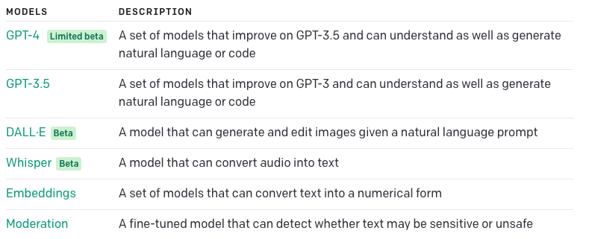
OpenAI Models

Slide 7
GPT - 3.5 Model
GPT-3.5 models can understand and generate natural language or code. Open AIr most capable and cost effective model in the GPT-3.5 family is gpt-3.5-turbo which has been optimized for chat but works well for traditional completions tasks as well.

Slide 8
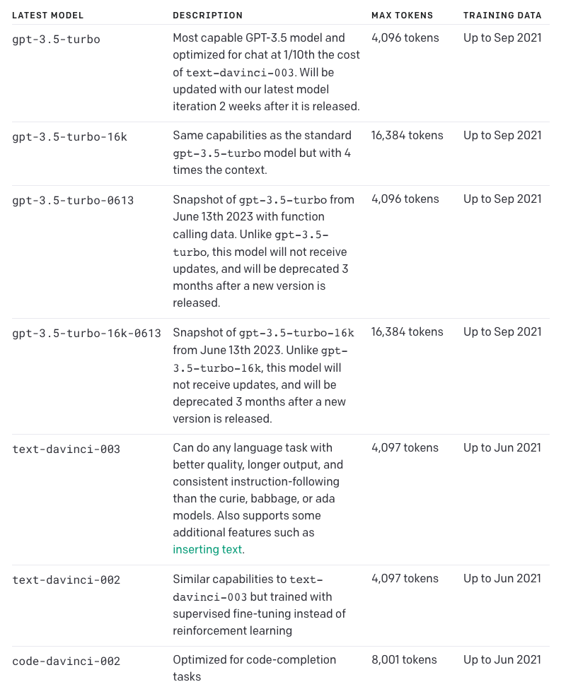
GPT - 3.5 Model

Slide 9
GPT - 4 Model
GPT-4 is a large multimodal model (accepting text inputs and emitting text outputs today, with image inputs coming in the future) that can solve difficult problems with greater accuracy than any of OpenAI previous models,

Slide 10
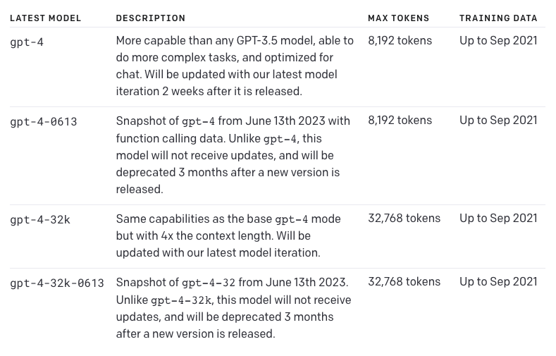
GPT - 4 Model

Slide 11
DALL-E
DALL·E is a AI system that can create realistic images and art from a description in natural language. Open AI currently support the ability, given a prommpt, to create a new image with a certain size, edit an existing image, or create variations of a user provided image.
The current DALL·E model available through our API is the 2nd iteration of DALL·E with more realistic, accurate, and 4x greater resolution images than the original model.

Slide 12
Whisper
Whisper is a general-purpose speech recognition model. It is trained on a large dataset of diverse audio and is also a multi-task model that can perform multilingual speech recognition as well as speech translation and language identification. The Whisper v2-large model is currently available through our API with the whisper-1 model name.

Slide 13
Embeddings
Embeddings are a numerical representation of text that can be used to measure the relateness between two pieces of text. Embeddings are useful for search, clustering, recommendations, anomaly detection, and classification tasks.

Slide 14
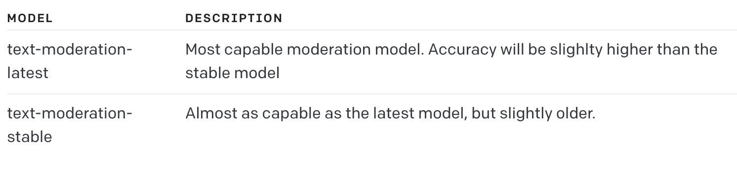
Moderation
The Moderation models are designed to check whether content complies with OpenAI's usage policies.

Slide 15
Tokens
In ChatGPT and other language models, a token refers to a unit of text that the model uses to generate language output. Specifically, a token is a sequence of characters or subwords that the model recognizes as a single unit for processing.

Slide 16

Demo

Slide 17
Thank you!

Slide 18
Q/A

