Slide 1
Next Up:
Tess Gauthier

Slide 2
3
3

Slide 3
2

Slide 4
1

Slide 5
Authoring and Using DSC v3 Resources
Tess Gauthier

Slide 6
Many thanks to our sponsors:

Slide 7
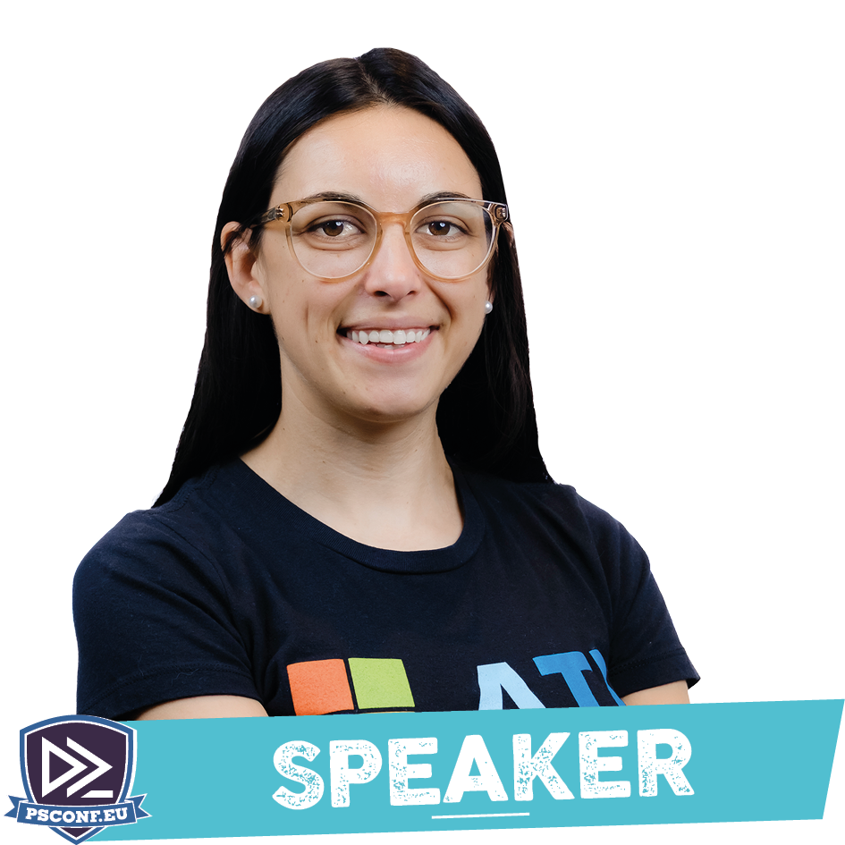
Tess Gauthier
(She/Her)
Software Engineer at Microsoft on the PowerShell/DSC/OpenSSH Team
Second PSConfEU!
Fun fact: I spent a semester studying in Germany at TU Dresden

Slide 8

Introduction: DSCv3
Declarative
Idempotent
Concepts:
Configurations
Resources
Adapters
Extensions

Slide 9
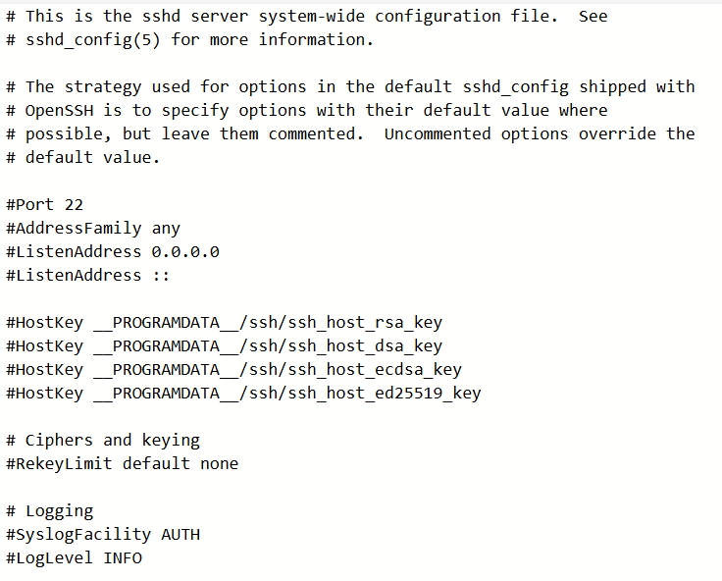
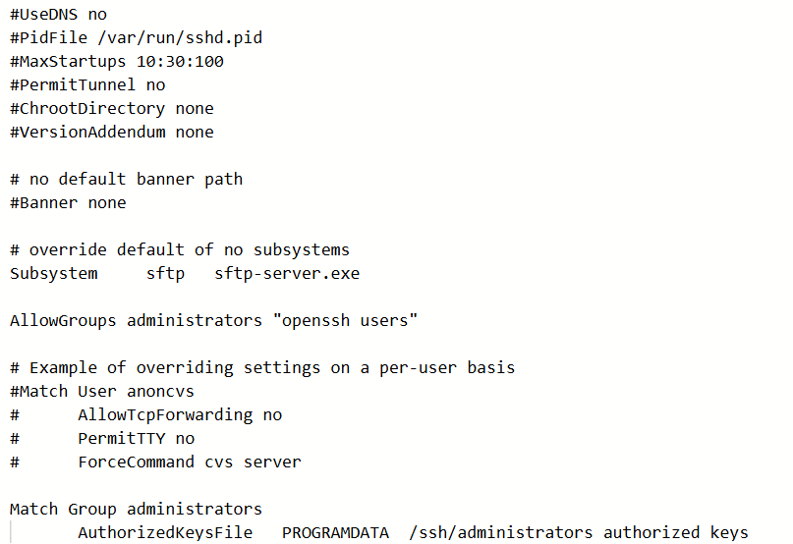
Introduction: SSHD_Config

Slide 10

Demo: Audit

Slide 11

Demo: Configure

Slide 12

Demo: Author

Slide 13



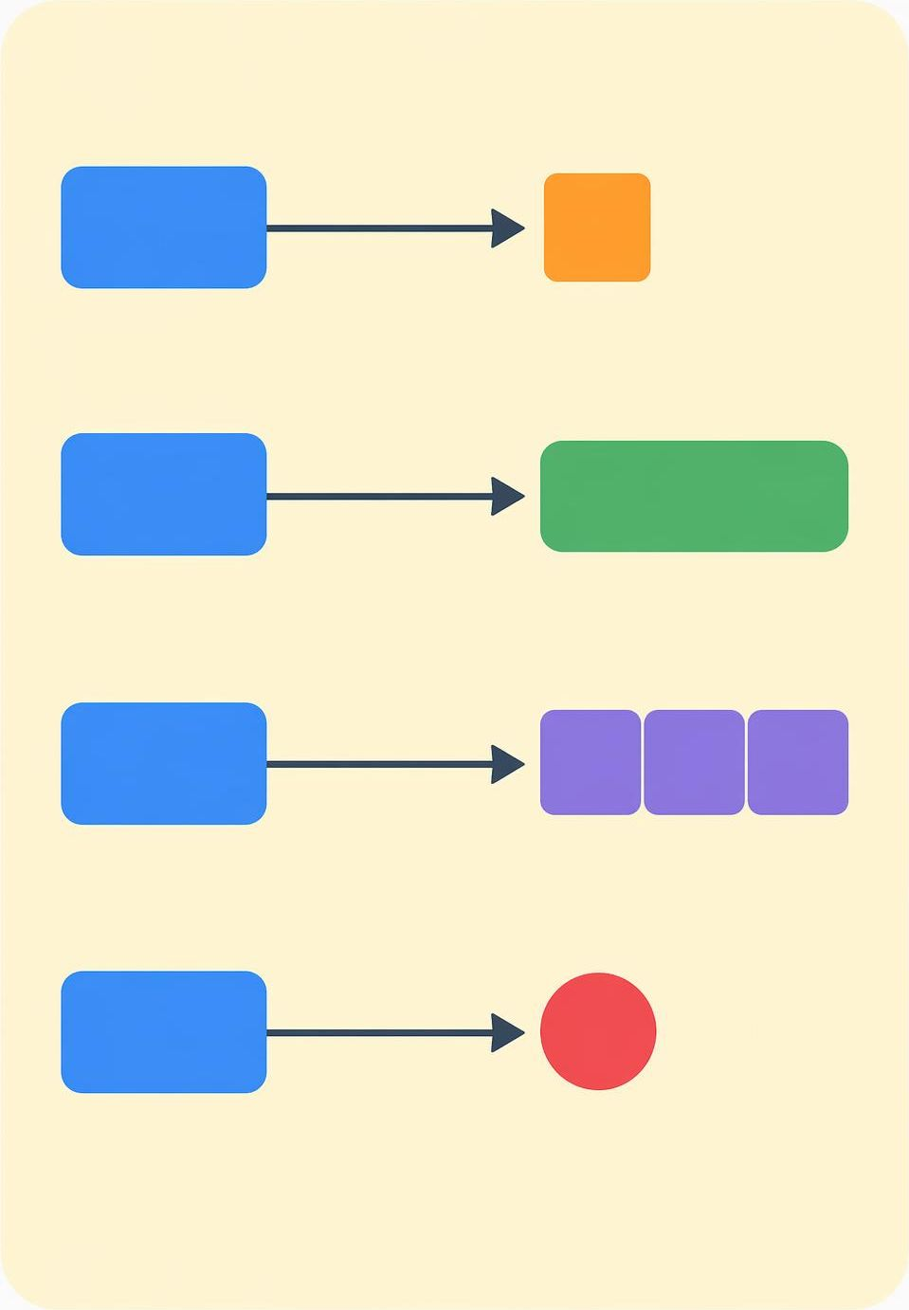
Resource Deep-Dive
https://tree-sitter.github.io/tree-sitter/

Slide 14

Takeaways
Keep resource behavior simple
Leverage canonical properties
_exist
_purge
Use DSC + sshd resources to audit and configure SSH Server settings at scale

Slide 15

Get Involved!
https://github.com/powershell/dsc
https://dsccommunity.org/
https://opendsc.dev/

Slide 16
Q&A
15 minutes

Slide 17
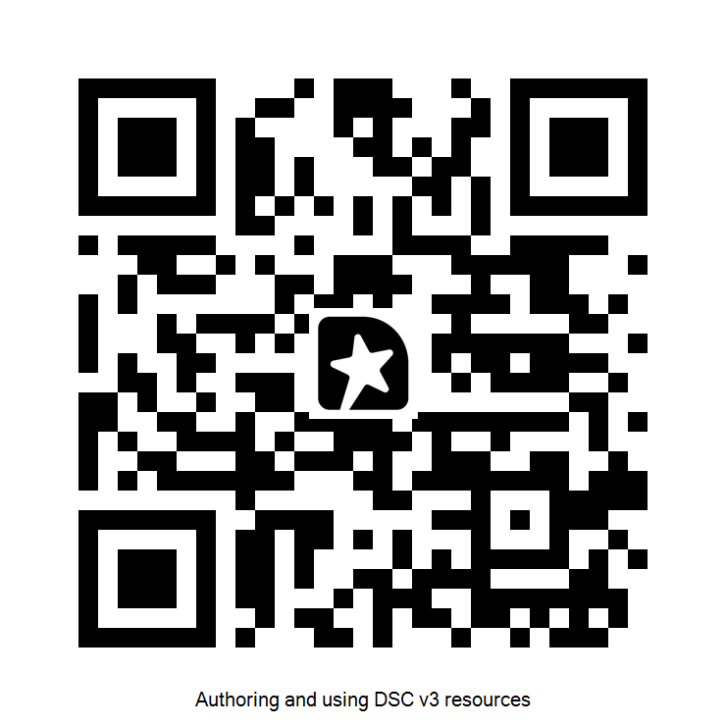
GIVE ME FEEDBACK
INSERT YOUR SESSION QRCODE HERE

