Slide 1
Next Up:
Tess Gauthier

Slide 2
3
3

Slide 3
2

Slide 4
1

Slide 5
Automate your Upstream Sync with GitHub Copilot and PowerShell MCP
Tess Gauthier

Slide 6
Many thanks to our sponsors:

Slide 7

Tess Gauthier
(She/Her)
Software Engineer at Microsoft on the PowerShell/DSC/OpenSSH Team
Second PSConfEU!
Fun fact: I spent a semester studying in Germany at TU Dresden

Slide 8
Agenda
Opportunity
Demo:
Merge phase
Build phase
Validation phase
End-to-end workflow
Takeaways

Slide 9
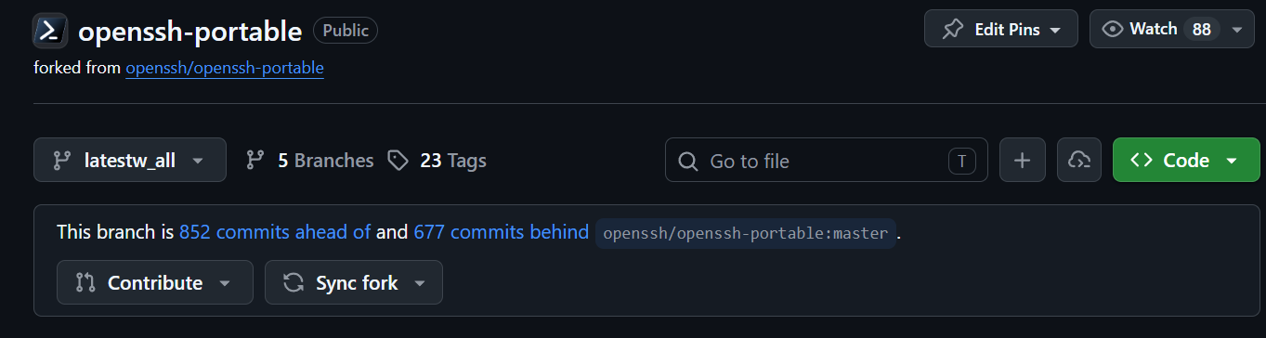
Opportunity

Slide 10
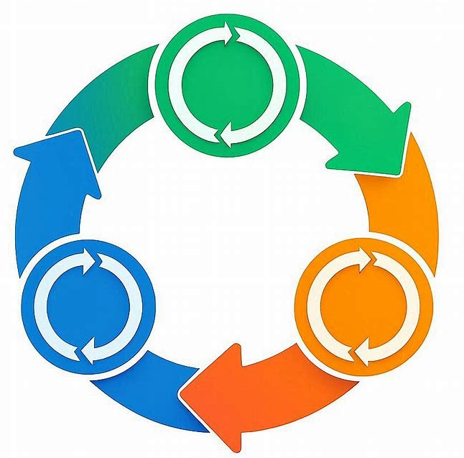
Workflow Overview
Merge
Test
Build

Slide 11
Demos
Merge Phase

Slide 12
Merge Phase Learnings
Iterate on sub-tasks
Get a batch of commits [tool]
Triage conflicts [instruction]
Tools: useful for deterministic actions
Instructions: useful for general patterns
Notes:
What workflows will you reimagine next?

Slide 13
Demos
Build Phase

Slide 14
Build Phase Learnings
Define when it’s necessary
Leverage existing work with MCPServerPS module
Define “success”
Notes:
What workflows will you reimagine next?

Slide 15
Demos
Validation Phase

Slide 16
Validation Phase Learnings
Define levels
Simple change → smoke test
Complex change → full test suite
Require summary in specified format
Notes:
What workflows will you reimagine next?

Slide 17
Demos
Full Workflow

Slide 18
*Please see demo recording,
removed due to file size constraints

Slide 19
Takeaways
Iterate on the best instructions/tools/skills for tasks
Define strict success metrics using checkpoints/gates
Leverage existing scripts & modules via the MCPServerPS module
https://github.com/daxian-dbw/MCPServerPS/pkgs/nuget/MCPServerPS
Notes:
What workflows will you reimagine next?

Slide 20
Q&A
15 minutes

Slide 21
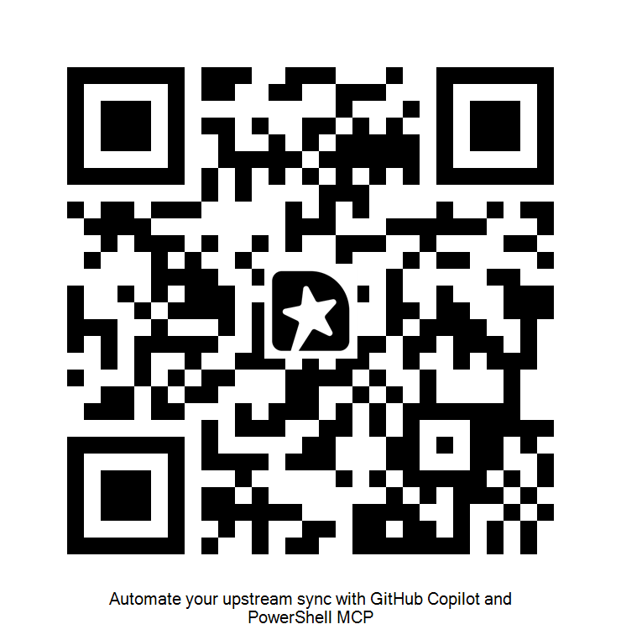
GIVE ME FEEDBACK
INSERT YOUR SESSION QRCODE HERE

