Slide 1
Next Up:
Marc-André Moreau

Slide 2
3
3

Slide 3
2

Slide 4
1

Slide 5
Implementing PSRemoting
at Devolutions: Lessons Learned
Marc-André Moreau

Slide 6
Many thanks to our sponsors:

Slide 7

Marc-André Moreau
Chief Technology Officer at Devolutions
Microsoft MVP (PowerShell & Windows)
Creator of the FreeRDP open-source project
I love PowerShell, .NET, Rust, network protocols and reversing Windows internals ☺
CTO, Devolutions

Slide 8
About Devolutions
Canadian software company building secure remote access and privileged access management solutions
Main products
Devolutions RDM— flagship product
Devolutions Server — self-hosted vault & PAM
Devolutions Cloud — cloud-hosted vault
Devolutions Gateway — JIT access & session monitoring
Devolutions PowerShell Universal — IT automation platform
Devolutions UniGetUI — GUI for package managers

Slide 9
What We'll Cover
PSRemoting Interactive Session Launching — how to launch an interactive PSRemoting session, embedded in RDM, and with secure credential injection
PSRemoting over SSH and Win32-OpenSSH — how to launch a PSRemoting over SSH connection from RDM when Win32-OpenSSH doesn’t support credential injection
PowerShell SDK and Local PSRemoting — how to work around assembly conflicts within a parent .NET host process by using a local PSRemoting connection instead
PSRemoting in the Browser — How to implement a true PSRemoting browser-based client that doesn’t require an agent on the destination host

Slide 10
PSRemoting Interactive Session Launching

Slide 11
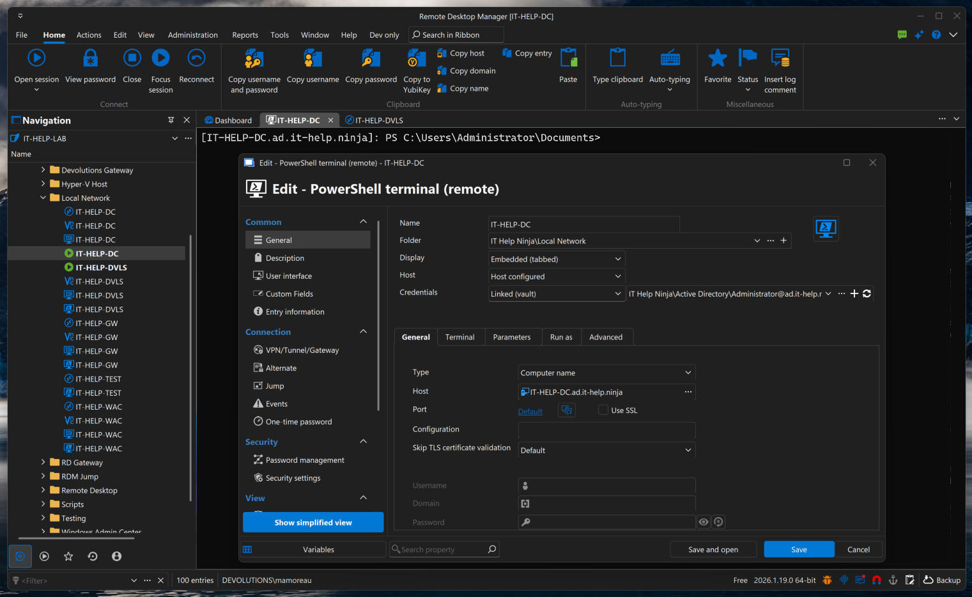
Remote PowerShell in Remote Desktop Manager

Slide 12
Embedded PowerShell in RDM
RDM launches a new PowerShell process, reparented into an embedded tab
Classic Console Host
Window reparenting worked, but with caveats
Console host appears externally for a moment before being reparented
Resizing doesn’t automatically sync rows/cols in PowerShell
Windows Terminal
Window reparenting is not possible with Windows Terminal
Built our own WT distro patched to accept a parent window from RDM
github.com/Devolutions/wt-distro

Slide 13
Secure Credential Injection
The Problem
RDM injects Enter-PSSession with credentials at launch via pwsh.exe args
Command-line args visible to any process on the system — credentials leaked
The Solution
Bootstrap snippet reads the real command from a temporary named pipe server
Enter-PSSession credentials delivered through the pipe, not the command line
Credential reconstructed in a variable — never displayed or written to history

Slide 14
How PSSecureCommand Works
RDM
Parent Process
Named Pipe Server
pscmd-{guid}
pwsh.exe
Child Process
Invoke-Expression
Credential in variable
Pipe destroyed after use
Single-use, no replay
github.com/awakecoding/PSSecureCommand

Slide 15
PSRemoting over SSH and Win32-OpenSSH

Slide 16
PSRemoting over SSH — Under the Hood
Client Side
Enter-PSSession -HostName finds the ssh executable
Launches ssh as child process with -s powershell subsystem flag
Hooks ssh’s stdin/stdout as the MS-PSRP transport
Server Side
sshd receives the “powershell” subsystem request
Looks up Subsystem powershell in sshd_config, launches pwsh -sshs
Hooks pwsh stdin/stdout as the other end of the transport
Key Insight
SSH is just a transport — it knows nothing about PowerShell
MS-PSRP flows end-to-end between two pwsh instances over stdio

Slide 17
PSRemoting over SSH — Architecture
Client Machine
Server Machine
PowerShell Client
Enter-PSSession -HostName
MS-PSRP
PowerShell Server
pwsh -sshs
stdin/stdout
stdin/stdout
OpenSSH Client
ssh user@host -s powershell
SSH Tunnel
OpenSSH Server (sshd)
Subsystem powershell /usr/bin/pwsh -sshs
sshd_config: Subsystem powershell /usr/bin/pwsh -sshs -NoLogo -NoProfile
SSH is just a transport pipe — MS-PSRP flows end-to-end between two pwsh instances over stdio

Slide 18
Patched Win32-OpenSSH for Password Injection
Windows’ ssh.exe has no API to inject passwords. We ship a patched distro in RDM.
1
2
3
4
RDM
Creates pipe, serves password once
Named Pipe
\\.\pipe\rdm-*
Patched ssh.exe
Reads pipe via SSH_ASKPASS_PIPE
SSH Server
-s powershell
SSH_ASKPASS_PIPE=rdm-askpass-{guid}
Created per-connection, serves password once, then destroyed. Never written to disk.
github.com/Devolutions/openssh-distro

Slide 19
A Future without OpenSSH in PowerShell
PowerShell is hardcoded to expect OpenSSH
This makes it very difficult to bring your own SSH stack with custom features
Enter-PSSession doesn’t accept –Credential for an SSH transport type
Problem: Win32-OpenSSH on Windows, vanilla OpenSSH elsewhere
The PowerShell team can only customize Win32-OpenSSH
OpenSSH project will likely never accept Win32-OpenSSH patches
Conclusion: enhancements like Entra ID auth in SSH have major constraints
Solution: Pure .NET SSH client stack for PSRemoting
Main issue beyond the .NET SSH stack is the .NET crypto stack
Only realistic way to improve SSH features in PowerShell long term

Slide 20
PowerShell SDK and Local PSRemoting

Slide 21
PowerShell SDK Limitations
The PowerShell SDK Bundles a Whole Copy of PowerShell
This is extremely confusing to users that expect your .NET app to use pwsh.exe
Bundling a whole copy of PowerShell contributes greatly to the .NET app size
Due to the dynamic nature of PowerShell, forget about NativeAOT and trimming
No way to import just “client” part of the PowerShell SDK without the server
Assembly Conflicts with parent .NET app
Your .NET app likely loads assemblies that conflicts with PowerShell modules
Workaround: run PowerShell in a separate process

Slide 22
Local PSRemoting via Subprocess
pwsh Subprocess in Server Mode
Launch pwsh as a subprocess in server mode
Similar to how pwsh works in SSH server mode
Transport is stdin/stdout instead of network — no WinRM needed
No Network Auth — No Problems
No TrustedHosts, no NTLM, no Kerberos required for local use
Out-of-process PowerShell host without network complexity
Assembly conflicts solved — modules load in isolated pwsh process
github.com/awakecoding/AwakeCoding.PSRemoting

Slide 23
Localhost WinRM: New Problems
PowerShell 7 WinRM Registration
Enable-PSRemoting must run from pwsh.exe, not powershell.exe
PS7 updates break session configs — fix by unregistering and re-running Enable-PSRemoting
awakecoding.com/posts/enable-powershell-winrm-remoting-in-powershell-7
TrustedHosts: A Misunderstood Setting
“Trusted” hosts are actually less trustworthy — it’s a security exception list
System-wide, can’t be overridden per-app — customers must modify it for DVLS
NTLM deprecation + non-domain-joined machines = no good auth option for local WinRM
awakecoding.com/posts/powershell-remoting-trusted-hosts-what-does-it-mean

Slide 24
Custom C# PSRemoting Stack
Support for local and remote MS-PSRP transport
Local PowerShell subprocess in server mode, through standard input/output
Named pipe transports were originally attempted, but stdin is much easier
Remote PowerShell using WinRM, with greater control on connection sequence
Custom C# MS-PSRP stack has none of the PowerShell SDK limitations
Used in a variety of places where the PowerShell SDK fails
Connecting through Devolutions Gateway for Devolutions PAM
Interactive PowerShell Remoting from RDM Android or iOS
Non-interactive script execution from RDM through Devolutions Gateway

Slide 25
Directions for a Future PowerShell SDK
Review PowerShell SDK distribution model
Split client into smaller package that is excludes the entire PowerShell server
Add option to include PowerShell application host into build output (Start-Job!)
Enable reusing external PowerShell installations instead of shipping a full copy
Make PowerShell SDK easier to rebuild from source for custom distributions

Slide 26
PSRemoting in the Browser

Slide 27
PSRemoting in the Browser — Javascript Stack
Original implementation was in Javascript
How it worked
Pure Javascript implementation of MS-PSRP – expertise from ITManager.net acquisition
NTLM & Kerberos in the browser via sspi-rs compiled to WASM with Javascript bindings
Devolutions Gateway bridged WebSocket ↔ WinRM (HTTP inside a WSS tunnel)
JIT KDC proxy in Gateway provided Kerberos line-of-sight alongside the WinRM connection
Interactive xterm.js terminal to reconstruct a complete PowerShell console host

Slide 28
PSRemoting in the Browser — IronPosh (Rust)
Brand new MS-PSRP stack in Rust, compiled to WASM, ported to the browser
How it works
Pure Rust PSRemoting stack compiled to WebAssembly
NTLM & Kerberos in the browser via sspi-rs, without bindings (Rust to Rust)
Devolutions Gateway bridges WebSocket ↔ WinRM (same as before, HTTP inside WSS)
JIT KDC proxy in Gateway provides Kerberos line-of-sight alongside the WinRM connection
Interactive xterm.js terminal to reconstruct a complete PowerShell console host
github.com/Devolutions/ironposh

Slide 29
PSRemoting in the Browser — Architecture
Browser
Devolutions Gateway
WinRM Server
IronPosh (Rust → WASM) PSRemoting client + sspi-rs NTLM / Kerberos in browser
WebSocket ↔ WinRM bridge Terminates WS, forwards MS-PSRP frames to WinRM
WinRM Service pwsh.exe session (MS-PSRP endpoint)
WebSocket (TLS)
WinRM (HTTP/S)
sspi-rs (in WASM) Requests Kerberos tickets for target SPN
JIT KDC Proxy Forwards AS/TGS requests to domain KDC on demand
Domain KDC (Active Directory) Issues Kerberos tickets
KDC Proxy (HTTPS)
Kerberos (TCP 88)
Devolutions Gateway provides line-of-sight to the KDC for the browser — no direct domain controller reachability required from the client
github.com/Devolutions/ironposh

Slide 30
Lessons Learned
The PowerShell SDK is a starting point, it’s not flexible enough
For advanced use cases like ours, you’ll want to build your own stack
WinRM is very much alive, while we observe very little SSH adoption
Why replace something that works very well in an Active Directory environment?
Local PSRemoting through subprocesses is extremely powerful
An assembly load context? What’s that? I have process isolation now!
We solved cross-platform Kerberos – use sspi-rs
Don’t build your own, it’s a very complex stack, reuse ours instead

Slide 31
Future Development Ideas for Devolutions
Custom PowerShell SDK distribution
Add missing pwsh.dll + apphost.exe as an option
Integrate multi-pwsh as an alternative to apphost.exe
Start patching things in the PowerShell core to meet our needs
Replace Win32-OpenSSH with pure .NET SSH client stack
Expose Enter-RdmPSSession cmdlet built on top of RDM core
Get rid of our custom Win32-OpenSSH distribution (less C libraries!)
Make gRPC a first-class PSRemoting transport type
No choice now that it’s been featured in Jeffrey Snover’s presentation ☺

Slide 32
Q&A
15 minutes

