Slide 1
Summary: Feature Curves

Slide 2
2d vs. 3d
Only for ISBI2013 and Pedunculus, because for Sopnetcompare, features can only be calculated in 2d, because sigma in 3d is too large for only 20 z-slices.

Slide 3
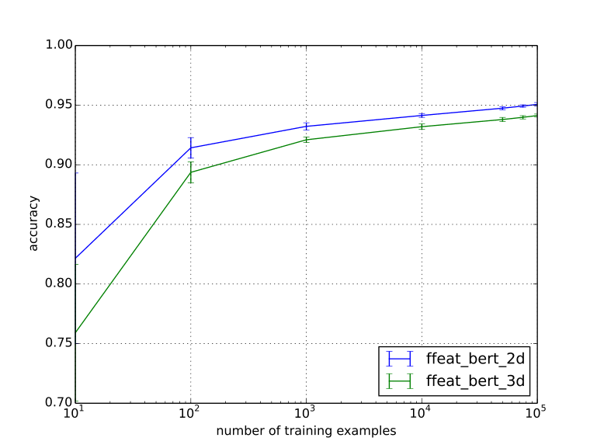

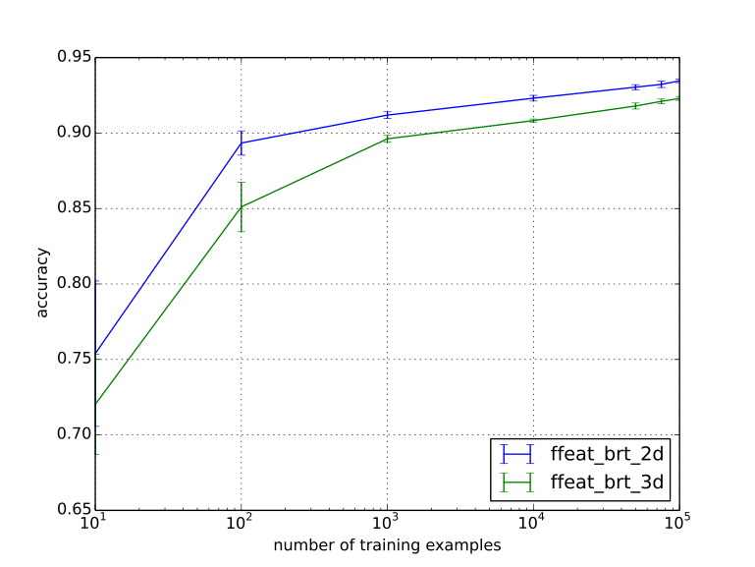
Pedunculus dataset:
Comparison of 2d vs 3d calculation of pixmaps for bert, ert and brt.
For all three, calculation in 2d is significantly beneficial

Slide 4
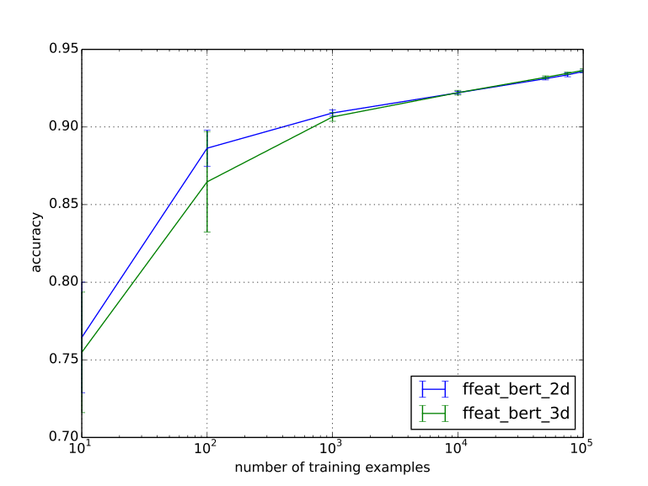
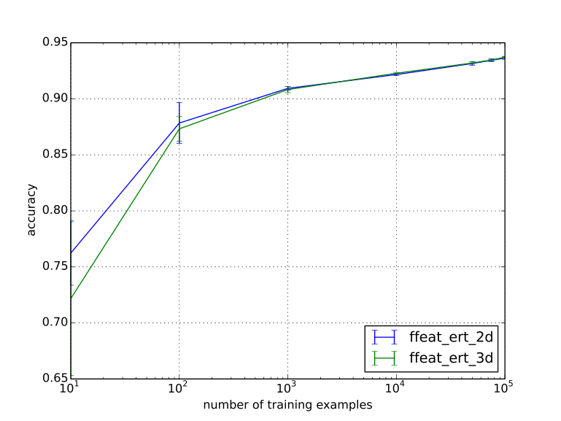
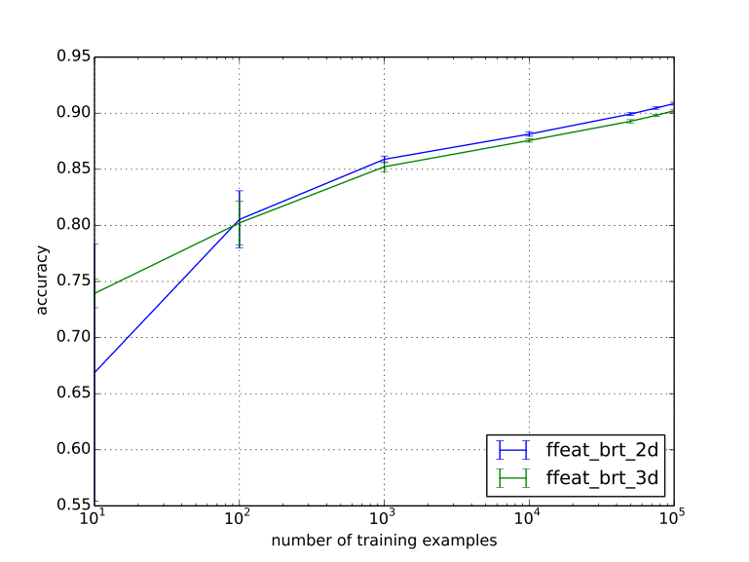
ISBI2013 dataset:
Comparison of 2d vs 3d calculation of pixmaps for bert, ert and brt.
For bert and ert, 2d is beneficial for few training instances, then the differences vanish.
For brt, 3d is beneficial for few instances, then 2d becomes a little better.

Slide 5
Comparison of feature combinations
For all three datasets.

Slide 6
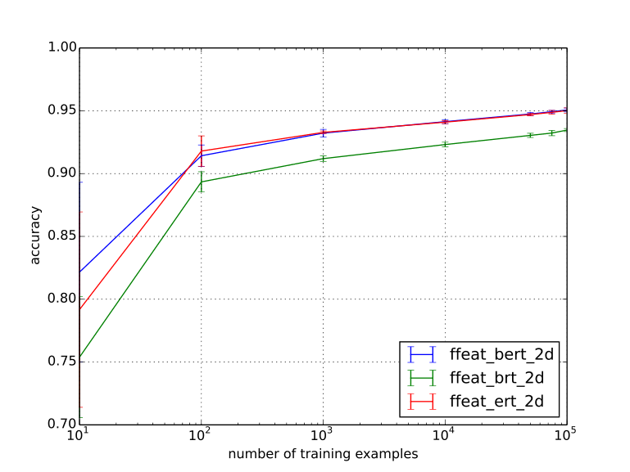
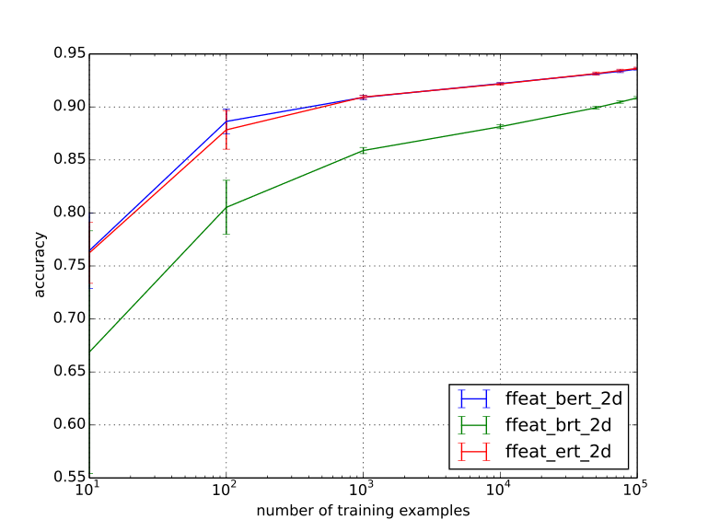
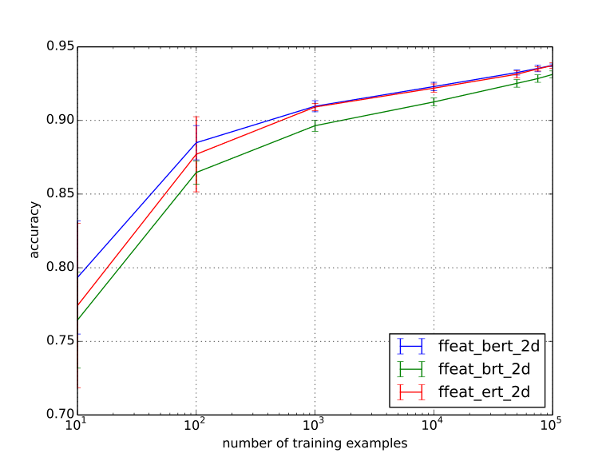
Pedunculus
ISBI2013
Sopnetcompare
Comparison of featurecombinations bert, ert and brt (2d for all).
For all 3 datasets: bert and ert behave quite similarly and are significantly better than brt.

Slide 7
Extrafeatures
For all three datasets

Slide 8
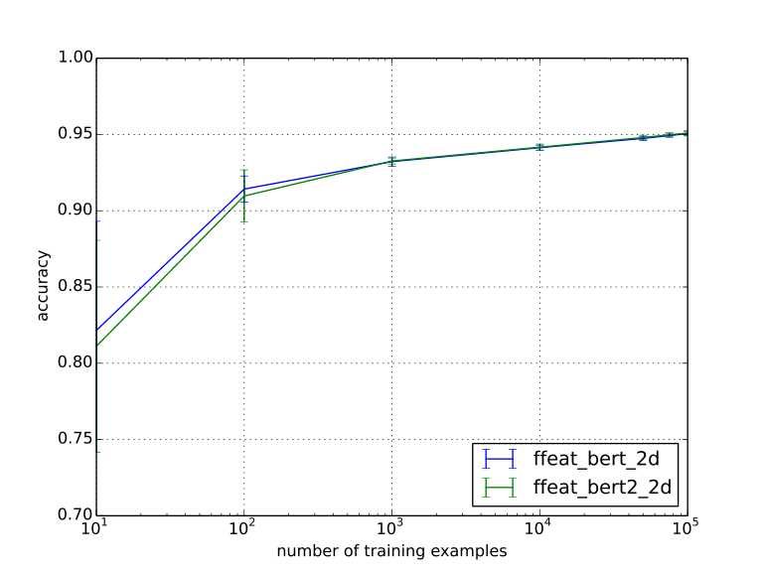
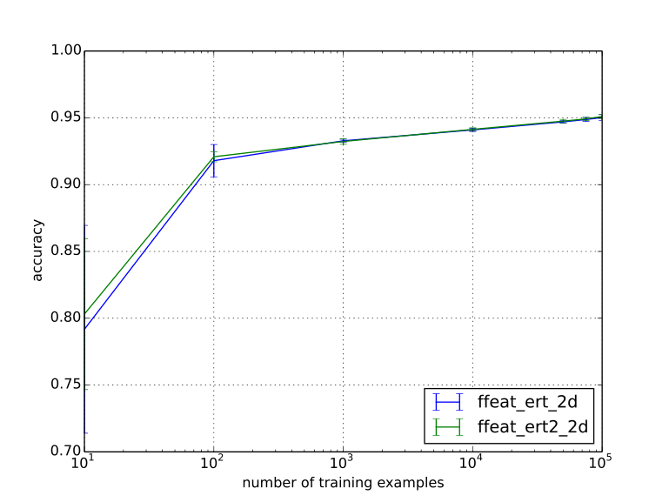
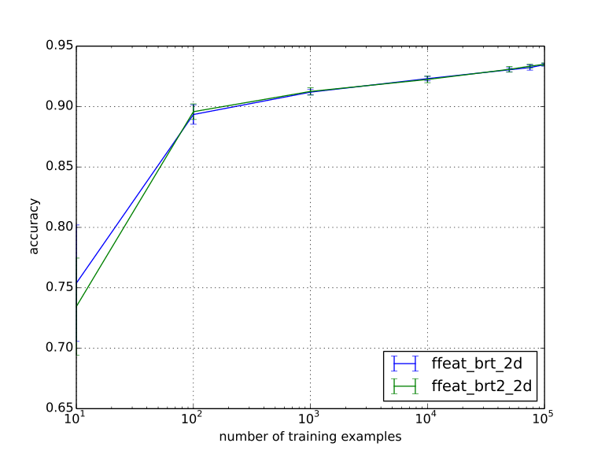
Pedunculus dataset:
Evaluation of extra features for z-edges for three feat combis.
For all three, extrafeats dont show significant differences.

Slide 9
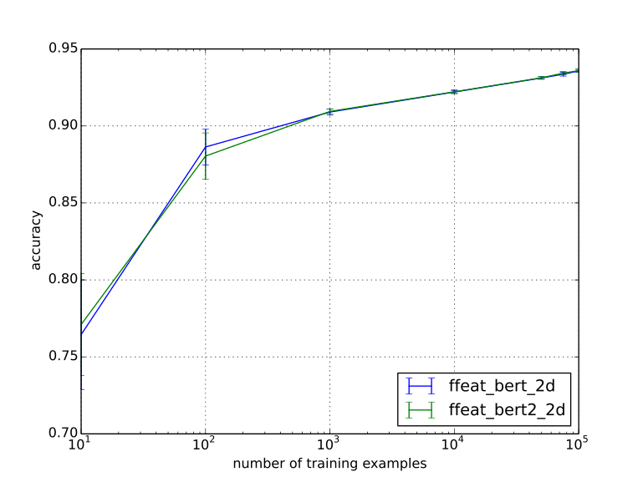
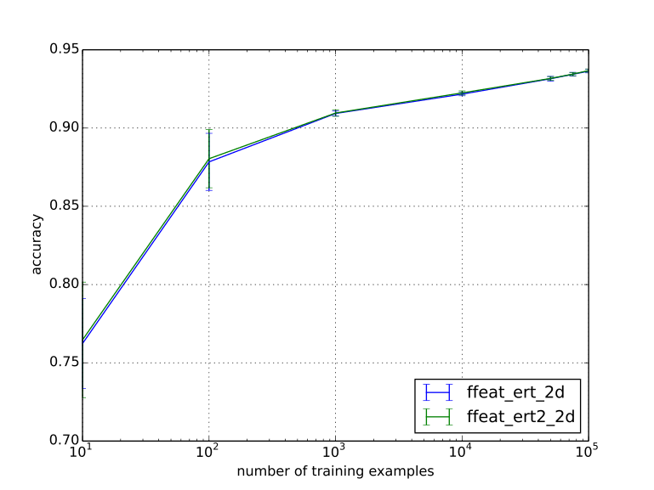
ISBI2013 dataset:
Evaluation of extra features for z-edges for three feat combis.
For all three, extrafeats dont show significant differences.

Slide 10
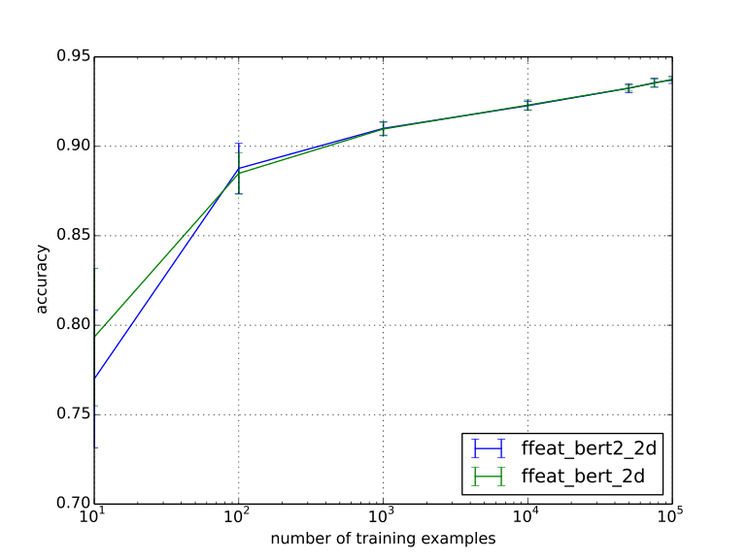
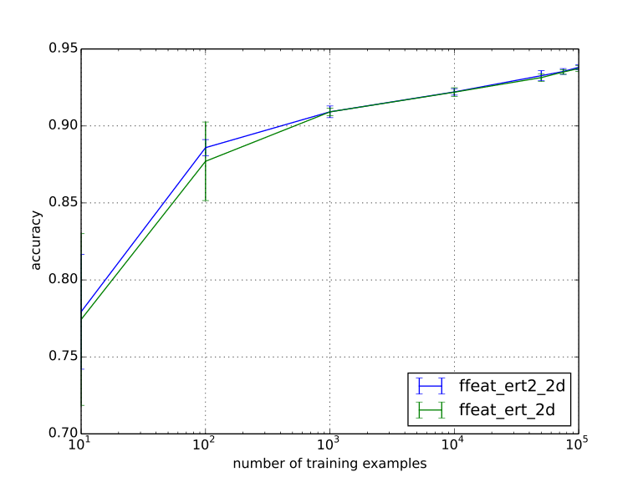
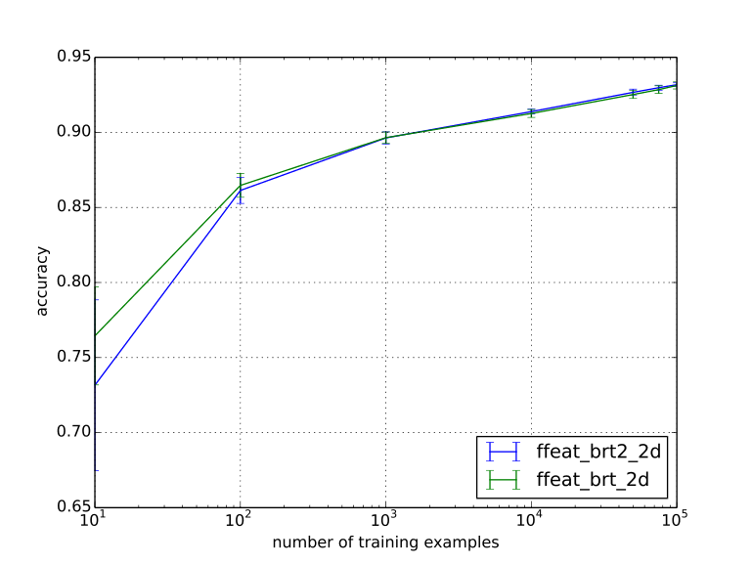
Sopnetcompare dataset:
Evaluation of extra features for z-edges for three feat combis.
For all three, extrafeats dont show significant differences.

Slide 11
Comparison with 2 RFs
For all three datasets.

Slide 12
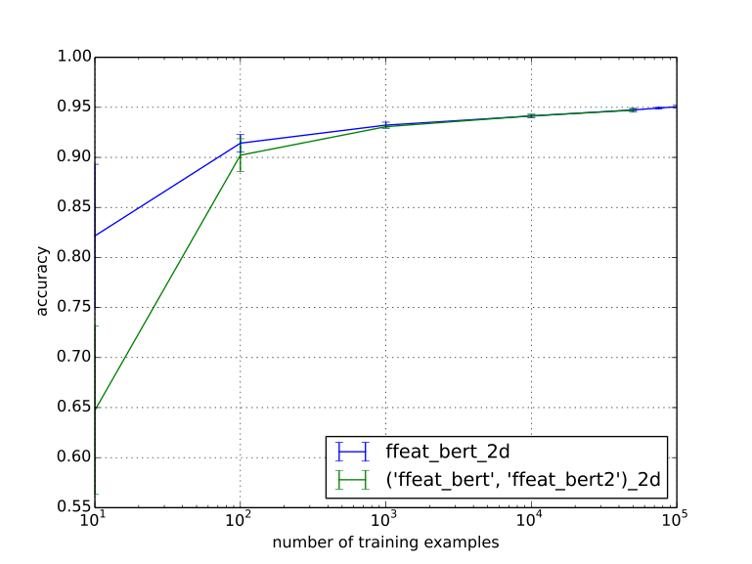
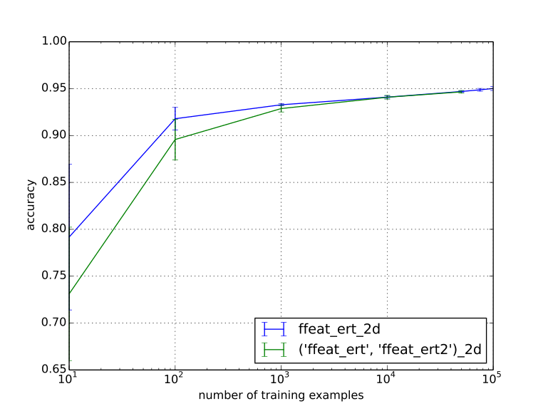
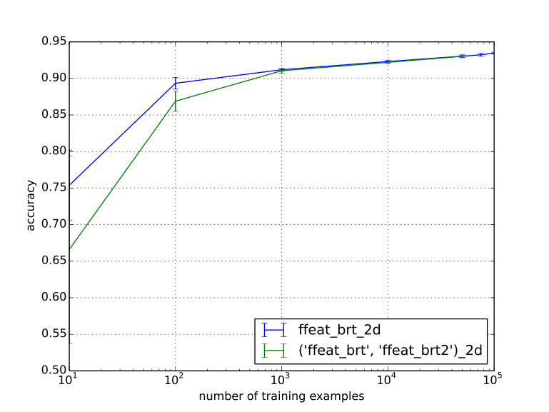
Pedunculus dataset:
Evaluation of learning 1 RF vs. two RF for three feat combis.
For all three, seems to converge to the same result, but 1 RF much faster.

Slide 13
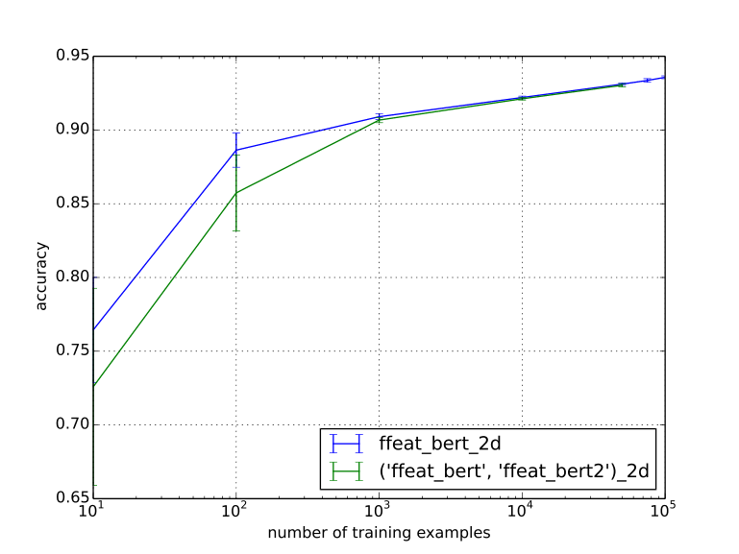
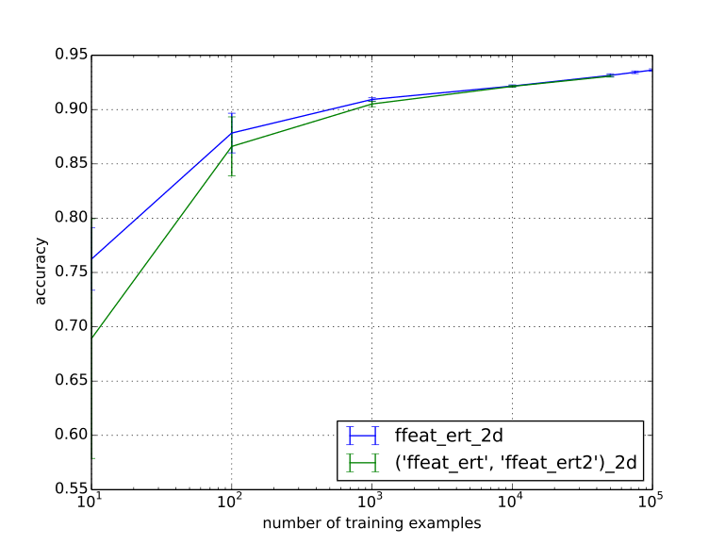
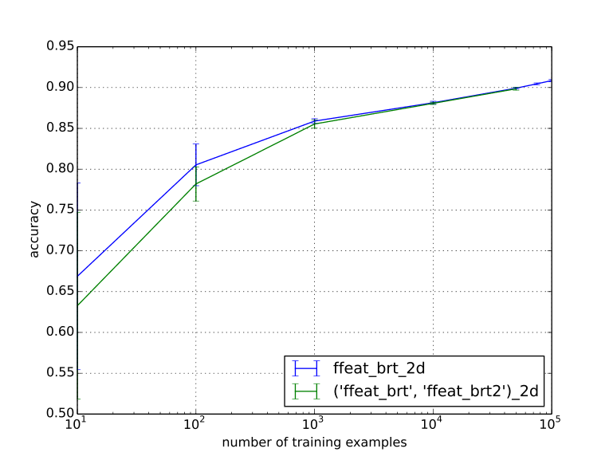
ISBI2013 dataset:
Evaluation of learning 1 RF vs. two RF for three feat combis.
For all three, seems to converge to the same result, but 1 RF much faster.

Slide 14
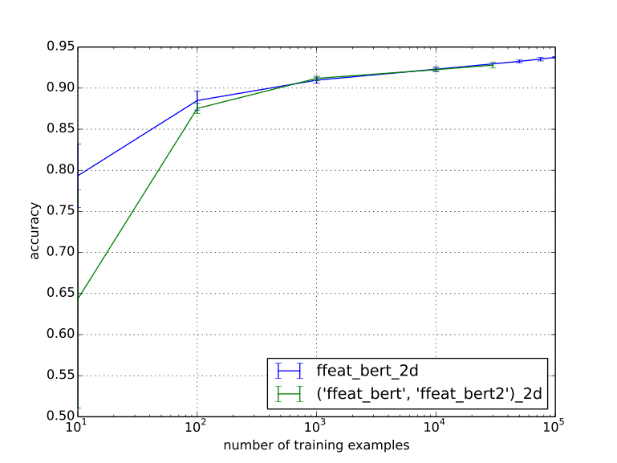
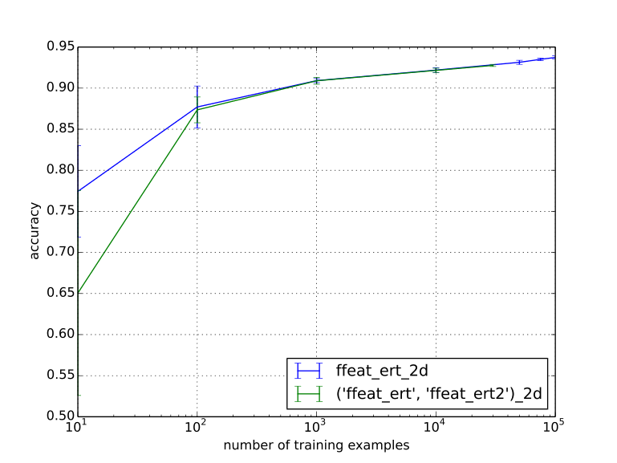
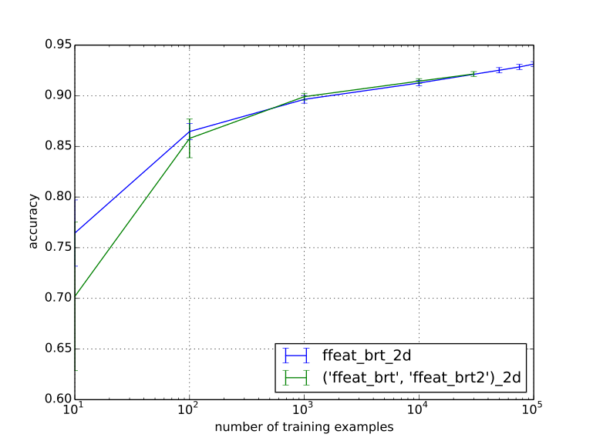
Sopnetcompare dataset:
Evaluation of learning 1 RF vs. two RF for three feat combis.
For all three, seems to converge to the same result, but 1 RF much faster.

Slide 15
Aniso Feature Computation
The features in make_pixfeats are computed with different ways of taking into account the anisotropy. This is done by scaling the sigma in z – direction.
We compare 4 methods:
  Strict 2d calculation
  Strict 3d calculation
  Scaling with 1 / 2
  Scaling with 1 / (factor of anisotropy)

Slide 16
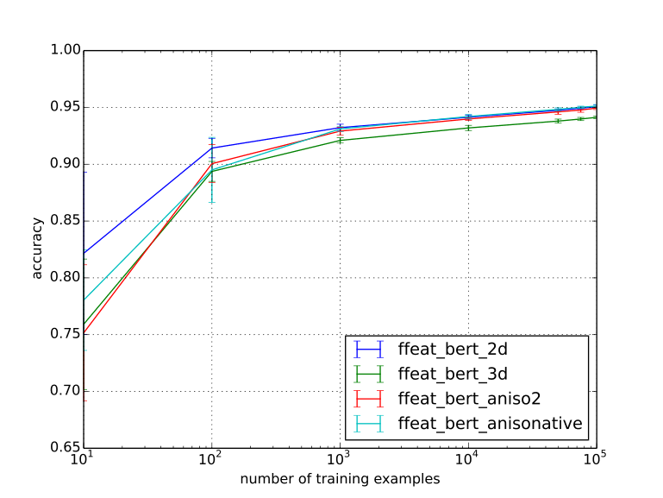
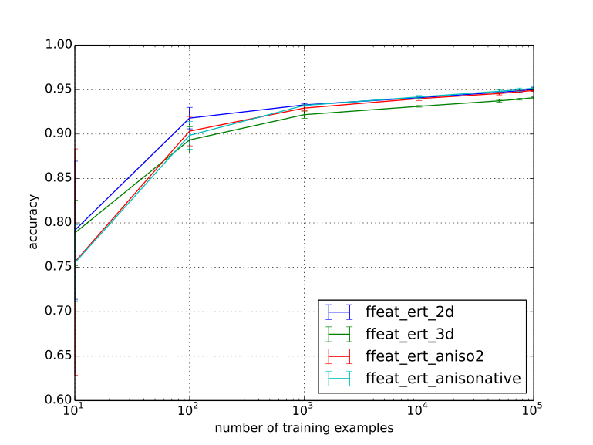
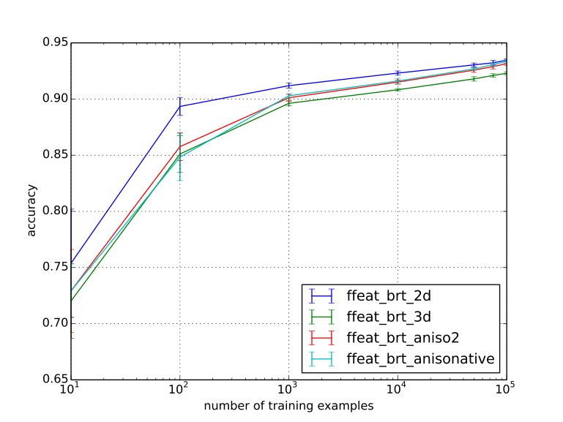
Pedunculus dataset:
Evaluation of aniso pixfeatures.
In the beginning, the 2d features perform significantly better. For bert and ert the native aniso features are slightly better in the end.

Slide 17
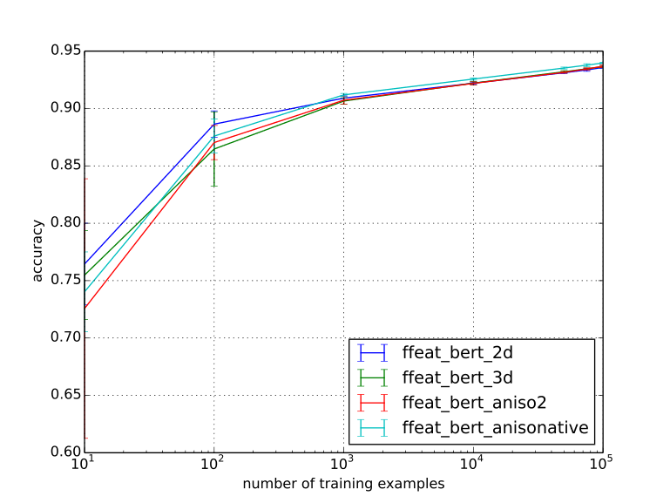
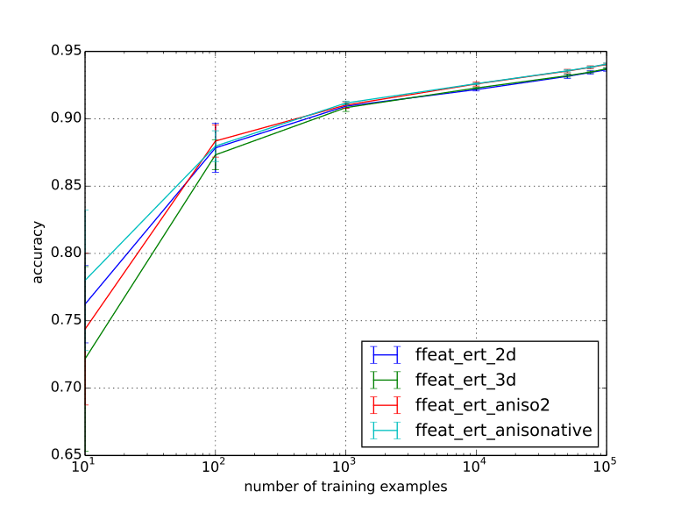
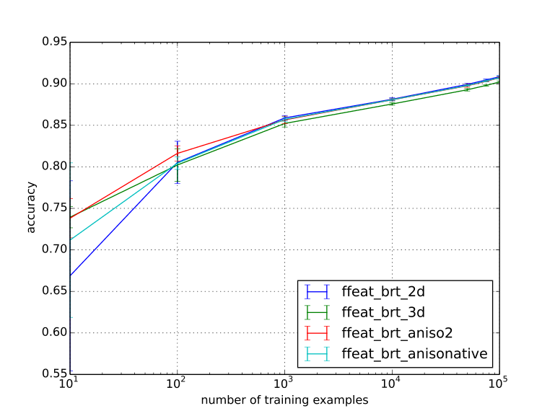
ISBI2013 dataset:
Evaluation of aniso pixfeatures.
For bert and ert the native aniso features perfrom slightly better.

Slide 18
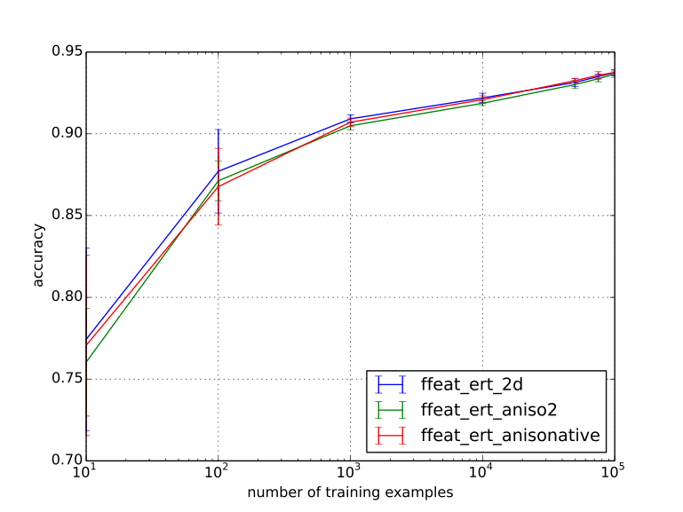
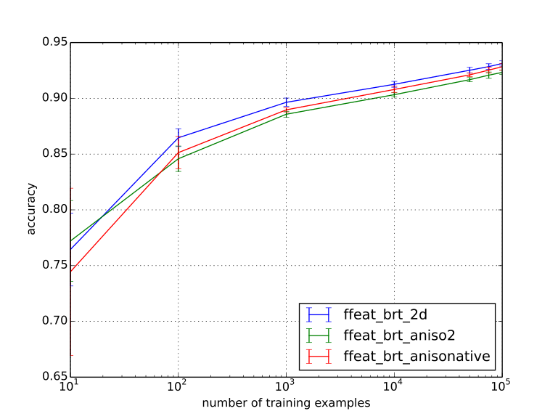
Sopnetcompare dataset:
Evaluation of aniso pixfeatures.
2d feats seem to perform the best for all features (high anisotropy + registration errors)

Slide 19
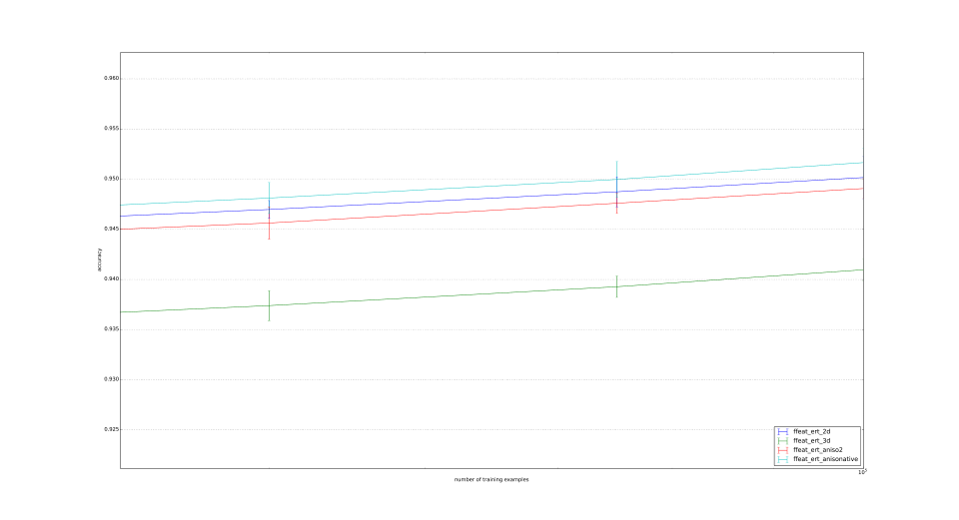
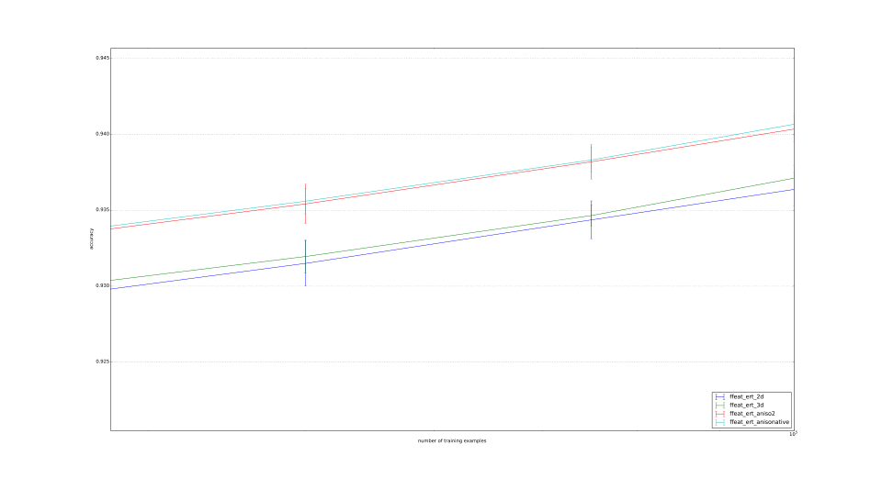
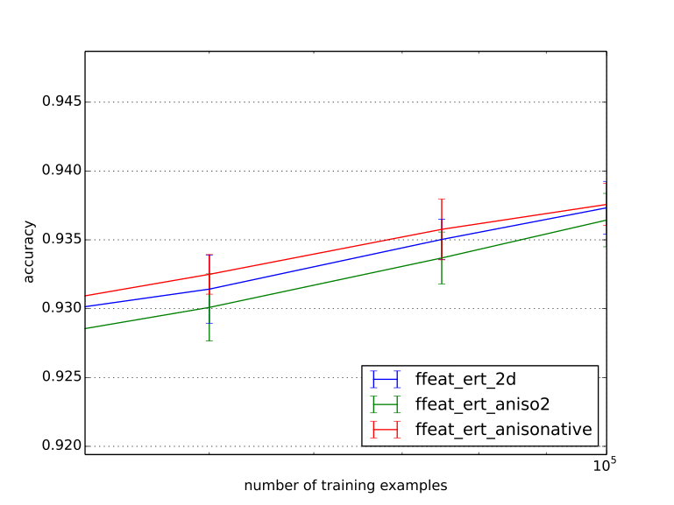
Pedunculus
ISBI2013
Sopnetcompare
Zoom of ert for the 3 datasets:
Pedunculus: Natve performs best, than 2d, than factor 2, all three significantly better than 3d.
ISBI: Native and aniso2 perform significantly better than 2d and 3d.
Sopnetcompare: Performance not significantly different.

