Slide 1











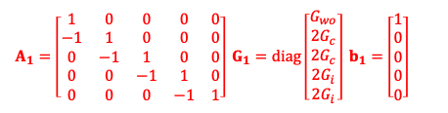





$$\frac{Φ_{i}}{2}$$
$$\frac{Φ_{i}}{2}$$
- +
$$0$$
$$0$$
$$1$$
$$1$$
$$2$$
$$2$$
$$3$$
$$3$$
$$4$$
$$4$$
$$6$$
$$0$$
$$1$$
$$3$$
$$0$$
$$T_{o}$$
$$0$$
$$1$$
$$2$$
$$2$$
$$3$$
$$4$$
$$4$$
$$1$$
$$Φ_{o}$$
$$0$$
$$5$$
$${\dot{Q}}_{aux}/2$$
$$8$$
$$Φ_{a}$$
$$7$$
$$11$$
$$9$$
$$2$$
$$5$$
$$6$$
- +
$$7$$
$$1$$
+ -
$$T_{o}$$
$$0$$
$$0$$
$$1$$
$$1$$
$$2$$
$$0$$
$$0$$
$$T_{i,sp}$$
$$10$$
$${\dot{Q}}_{aux}/2$$
- +
$$0$$
$$T_{o}$$
TCd0
$$\frac{Φ_{i}}{2}$$
$$\frac{Φ_{i}}{2}$$
- +
$$0$$
$$0$$
$$1$$
$$1$$
$$2$$
$$2$$
$$3$$
$$3$$
$$4$$
$$4$$
$$0$$
$$1$$
$$T_{o}$$
$$Φ_{o}$$
TCd1
$$0$$
$${\dot{Q}}_{aux}/2$$
TCd2
$$Φ_{a}$$
- +
$$0$$
$$0$$
$$1$$
$$1$$
$$1$$
$$2$$
$$2$$
$$T_{o}$$
$$0$$
+ -
TCd3
$$1$$
$$T_{i,sp}$$
$${\dot{Q}}_{aux}/2$$
- +
$$0$$
$$T_{o}$$
$$A_{c}=\left[\begin{matrix}0 & 4 & 1 & 0 \\ 1 & 1 & 2 & 1 \\ 1 & 2 & 3 & 0\end{matrix}\right]$$
(a)
$A_{1}=\left[\begin{matrix}1 & 0 & 0 & 0 & 0 \\ −1 & 1 & 0 & 0 & 0 \\ 0 & −1 & 1 & 0 & 0 \\ 0 & 0 & −1 & 1 & 0 \\ 0 & 0 & 0 & −1 & 1\end{matrix}\right] G_{1}=diag\left[\begin{matrix}G_{wo} \\ 2G_{c} \\ 2G_{c} \\ 2G_{i} \\ 2G_{i}\end{matrix}\right] b_{1}=\left[\begin{matrix}1 \\ 0 \\ 0 \\ 0 \\ 0\end{matrix}\right]$
$$A_{2}=\left[\begin{matrix}−1 & 1 & 0 \\ −1 & 0 & 1 \\ 0 & −1 & 1\end{matrix}\right] G_{2}=diag\left[\begin{matrix}G_{LW} \\ G_{wi} \\ G_{gi}\end{matrix}\right] b_{2}=\left[\begin{matrix}0 \\ 0 \\ 0\end{matrix}\right]$$
$C_{2}=diag {\left[\begin{matrix}0 & 0 & C_{a}/2\end{matrix}\right]}^{T}$
$C_{1}=diag {\left[\begin{matrix}0 & { C}_{c} & 0 & { C}_{i} & 0\end{matrix}\right]}^{T}$
$f_{2}={\left[\begin{matrix}1 & 0 & 1\end{matrix}\right]}^{T}$
$f_{1}={\left[\begin{matrix}1 & 0 & 0 & 0 & 1\end{matrix}\right]}^{T}$
$$A_{3}=\left[\begin{matrix}1 & 0 \\ −1 & 1\end{matrix}\right] G_{3}=diag\left[\begin{matrix}G_{g∗} \\ 2G_{g}\end{matrix}\right] b_{3}=\left[\begin{matrix}1 \\ 0\end{matrix}\right]$$
$$A_{4}=1 G_{4}=G_{v} b_{4}=1$$
$C_{3}=diag {\left[\begin{matrix}C_{g} & 0\end{matrix}\right]}^{T}$
$$C_{4}=C_{a}/2$$
$f_{3}={\left[\begin{matrix}1 & 0\end{matrix}\right]}^{T}$
(b)
$f_{4}=1$

Slide 3


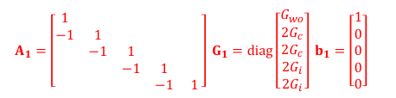



$$\frac{Φ_{i}}{2}$$
$$\frac{Φ_{i}}{2}$$
- +
$$1$$
$$1$$
$$2$$
$$2$$
$$3$$
$$3$$
$$4$$
$$4$$
$$5$$
$$5$$
$$7$$
$$1$$
$$2$$
$$4$$
$$1$$
$$T_{o}$$
$$1$$
$$2$$
$$3$$
$$3$$
$$4$$
$$5$$
$$5$$
$$2$$
$$Φ_{o}$$
$$1$$
$$6$$
$${\dot{Q}}_{aux}/2$$
$$Φ_{a}$$
$$8$$
$$12$$
$$9$$
$$10$$
$$7$$
$$6$$
$$3$$
- +
$$8$$
$$2$$
+ -
$$T_{o}$$
$$1$$
$$1$$
$$2$$
$$2$$
$$3$$
$$1$$
$$2$$
$$T_{i,sp}$$
$$11$$
$${\dot{Q}}_{aux}/2$$
- +
$$1$$
$$T_{o}$$
(a)
TC1
$$\frac{Φ_{i}}{2}$$
$$\frac{Φ_{i}}{2}$$
- +
$$1$$
$$1$$
$$2$$
$$2$$
$$3$$
$$3$$
$$4$$
$$4$$
$$5$$
$$5$$
$$1$$
$$2$$
$$T_{o}$$
$$Φ_{o}$$
TC2
$$1$$
$${\dot{Q}}_{aux}/2$$
TC3
$$Φ_{a}$$
$$3$$
- +
$$1$$
$$1$$
$$2$$
$$2$$
$$2$$
$$3$$
$$T_{o}$$
+ -
TC4
$$1$$
$$2$$
$$T_{i,sp}$$
$$11$$
$${\dot{Q}}_{aux}/2$$
- +
$$1$$
(b)
$$T_{o}$$
Assembly-connectivity matrix
$$A_{c}=\left[\begin{matrix}1 & 5 & 2 & 1 \\ 2 & 2 & 3 & 2 \\ 2 & 3 & 4 & 1\end{matrix}\right]$$
(c)
$A_{1}=\left[\begin{matrix}1 & & & & \\ −1 & 1 & & & \\ & −1 & 1 & & \\ & & −1 & 1 & \\ & & & −1 & 1\end{matrix}\right] G_{1}=diag\left[\begin{matrix}G_{wo} \\ 2G_{c} \\ 2G_{c} \\ 2G_{i} \\ 2G_{i}\end{matrix}\right] b_{1}=\left[\begin{matrix}1 \\ 0 \\ 0 \\ 0 \\ 0\end{matrix}\right]$
$$A_{2}=\left[\begin{matrix}−1 & 1 & \\ −1 & & 1 \\ & −1 & 1\end{matrix}\right] G_{2}=diag\left[\begin{matrix}G_{LW} \\ G_{wi} \\ G_{gi}\end{matrix}\right] b_{2}=\left[\begin{matrix}0 \\ 0 \\ 0\end{matrix}\right]$$
$C_{2}=diag {\left[\begin{matrix}0 & 0 & C_{a}/2\end{matrix}\right]}^{T}$
$C_{1}=diag {\left[\begin{matrix}0 & { C}_{c} & 0 & { C}_{i} & 0\end{matrix}\right]}^{T}$
$f_{2}={\left[\begin{matrix}1 & 0 & 1\end{matrix}\right]}^{T}$
$f_{1}={\left[\begin{matrix}1 & 0 & 0 & 0 & 1\end{matrix}\right]}^{T}$
$$A_{3}=\left[\begin{matrix}1 & \\ −1 & 1\end{matrix}\right] G_{3}=diag\left[\begin{matrix}G_{g∗} \\ 2G_{g}\end{matrix}\right] b_{3}=\left[\begin{matrix}1 \\ 0\end{matrix}\right]$$
$$A_{4}=1 G_{4}=G_{v} b_{4}=1$$
$C_{3}=diag {\left[\begin{matrix}C_{g} & 0\end{matrix}\right]}^{T}$
$$C_{4}=C_{a}/2$$
$f_{3}={\left[\begin{matrix}1 & 0\end{matrix}\right]}^{T}$
(d)
$f_{4}=1$

Slide 4


$$Φ_{i}$$
- +
$$1$$
$$1$$
$$2$$
$$2$$
$$3$$
$$3$$
$$4$$
$$4$$
$$5$$
$$5$$
$$7$$
$$1$$
$$2$$
$$4$$
$$1$$
$$T_{o}$$
$$1$$
$$2$$
$$3$$
$$3$$
$$4$$
$$5$$
$$5$$
$$2$$
$$Φ_{o}$$
$$1$$
$$6$$
$$Φ_{a}$$
$$8$$
$$9$$
$$10$$
$$7$$
$$12$$
$$6$$
$$3$$
- +
$$8$$
$$2$$
+ -
$$T_{o}$$
$$1$$
$$1$$
$$2$$
$$2$$
$$3$$
$$1$$
$$2$$
$$T_{i,sp}$$
$$11$$
$${\dot{Q}}_{aux}$$
- +
$$1$$
$$T_{o}$$
TC1
$$\frac{Φ_{i}}{2}$$
$$\frac{Φ_{i}}{2}$$
- +
$$1$$
$$1$$
$$2$$
$$2$$
$$3$$
$$3$$
$$4$$
$$4$$
$$5$$
$$5$$
$$1$$
$$2$$
$$T_{o}$$
$$Φ_{o}$$
TC2
$$1$$
$${\dot{Q}}_{aux}/2$$
TC3
$$Φ_{a}$$
$$3$$
- +
$$1$$
$$1$$
$$2$$
$$2$$
$$2$$
$$3$$
$$T_{o}$$
+ -
TC4
$$1$$
$$2$$
$$T_{i,sp}$$
$$11$$
$${\dot{Q}}_{aux}/2$$
- +
$$1$$
Assembly-connectivity matrix
$$T_{o}$$
$$A_{c}=\left[\begin{matrix}1 & 5 & 2 & 1 \\ 2 & 2 & 3 & 2 \\ 2 & 3 & 4 & 1\end{matrix}\right]$$
(b)
$A_{1}=\left[\begin{matrix}1 & & & & \\ −1 & 1 & & & \\ & −1 & 1 & & \\ & & −1 & 1 & \\ & & & −1 & 1\end{matrix}\right] G_{1}=diag\left[\begin{matrix}G_{wo} \\ 2G_{c} \\ 2G_{c} \\ 2G_{i} \\ 2G_{i}\end{matrix}\right] b_{1}=\left[\begin{matrix}1 \\ 0 \\ 0 \\ 0 \\ 0\end{matrix}\right]$
$$A_{2}=\left[\begin{matrix}−1 & 1 & \\ −1 & & 1 \\ & −1 & 1\end{matrix}\right] G_{2}=diag\left[\begin{matrix}G_{LW} \\ G_{wi} \\ G_{gi}\end{matrix}\right] b_{2}=\left[\begin{matrix}0 \\ 0 \\ 0\end{matrix}\right]$$
$C_{2}=diag {\left[\begin{matrix}0 & 0 & C_{a}/2\end{matrix}\right]}^{T}$
$C_{1}=diag {\left[\begin{matrix}0 & { C}_{c} & 0 & { C}_{i} & 0\end{matrix}\right]}^{T}$
$f_{2}={\left[\begin{matrix}1 & 0 & 1\end{matrix}\right]}^{T}$
$f_{1}={\left[\begin{matrix}1 & 0 & 0 & 0 & 1\end{matrix}\right]}^{T}$
$$A_{3}=\left[\begin{matrix}1 & \\ −1 & 1\end{matrix}\right] G_{3}=diag\left[\begin{matrix}G_{g∗} \\ 2G_{g}\end{matrix}\right] b_{3}=\left[\begin{matrix}1 \\ 0\end{matrix}\right]$$
$$A_{4}=1 G_{4}=G_{v} b_{4}=1$$
$C_{3}=diag {\left[\begin{matrix}C_{g} & 0\end{matrix}\right]}^{T}$
$$C_{4}=C_{a}/2$$
$f_{3}={\left[\begin{matrix}1 & 0\end{matrix}\right]}^{T}$
$f_{4}=1$
(c)

Slide 5
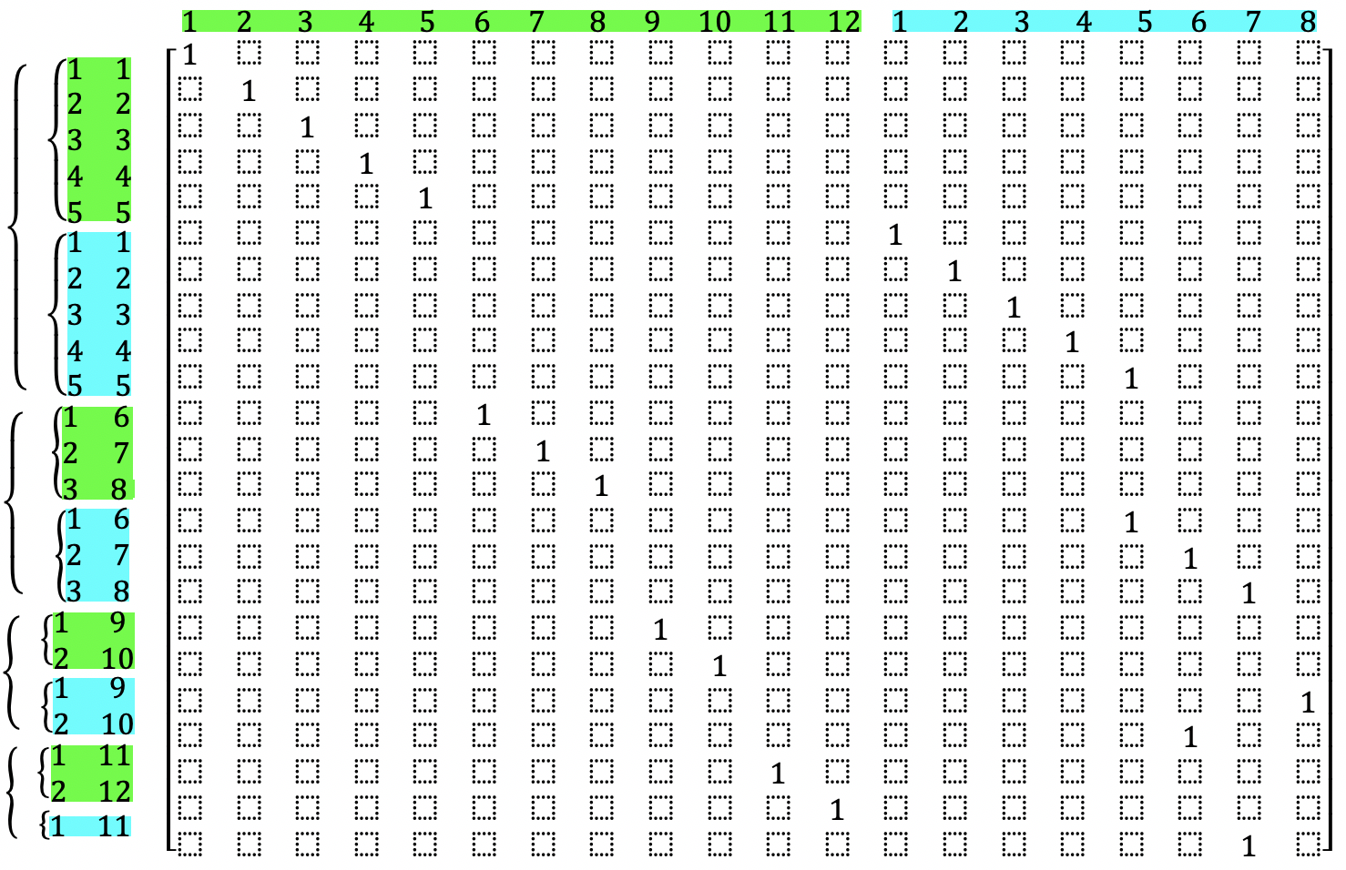
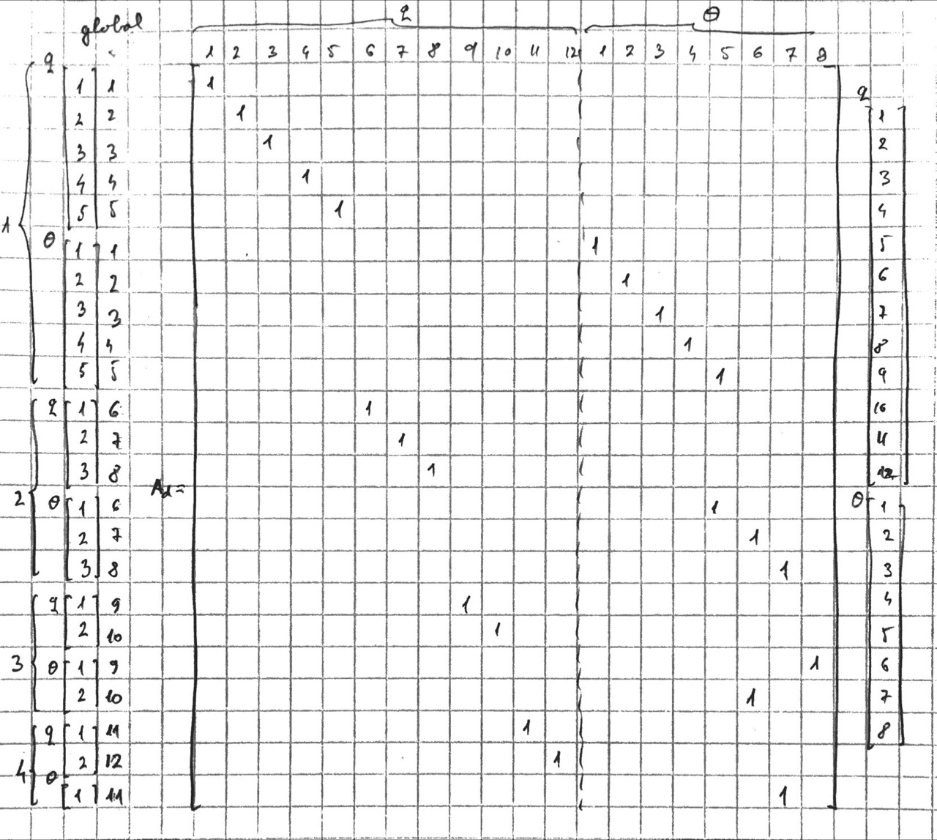
















Disassembled thermal circuit
- local index
- global index
Assembled thermal circuit
- global index
$$q$$
$$θ$$
$$q$$
$$1$$
$$θ$$
$$q$$
$$2$$
$$θ$$
$$3$$
$$q$$
$$θ$$
$$4$$
$$q$$
$$θ$$
$$θ$$
$$q$$
$$θ$$

Slide 6
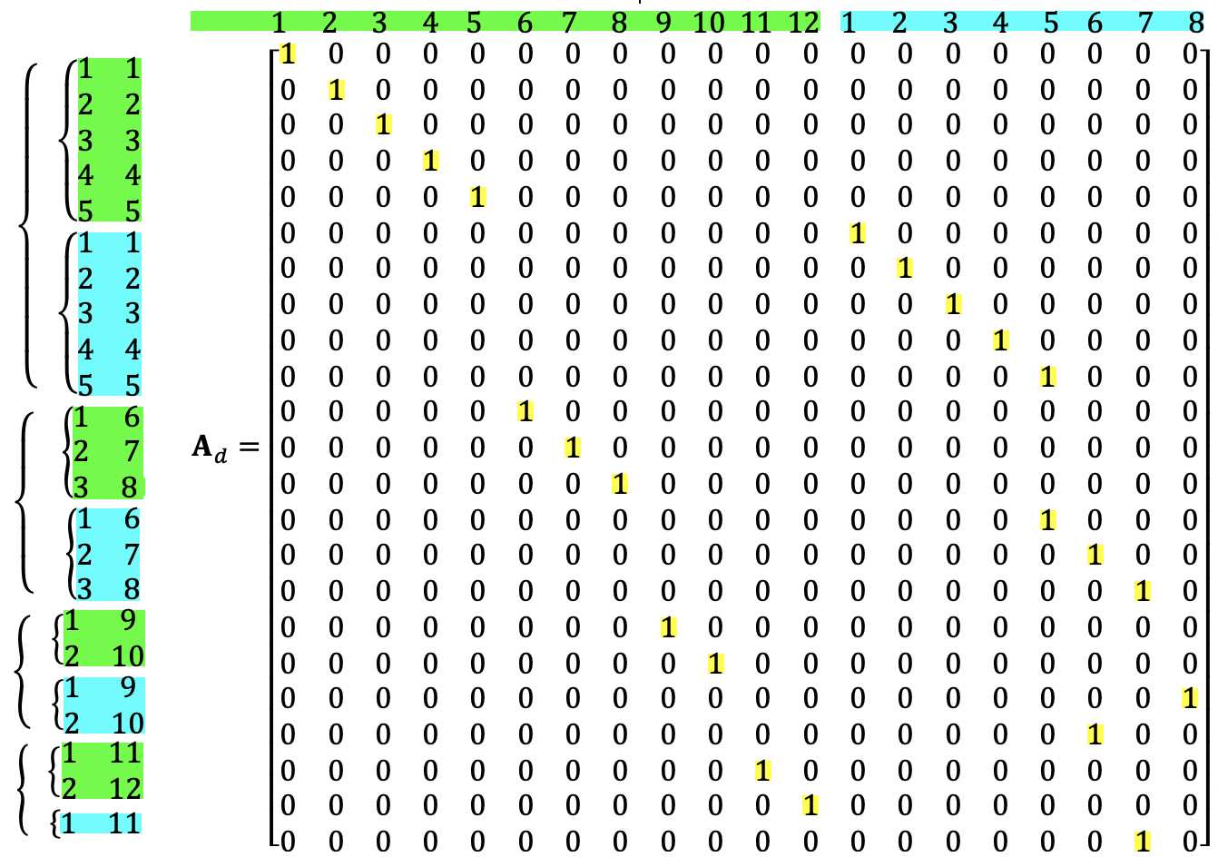






Disassembled thermal circuit
- local index
- global index
Assembled thermal circuit
- global index
$$q$$
$$θ$$
$$q$$
$$1$$
$$θ$$
$$q$$
$$2$$
$$θ$$
$$3$$
$$q$$
$$θ$$
$$4$$
$$q$$
$$θ$$
$$θ$$
$$q$$
$$θ$$

Slide 7
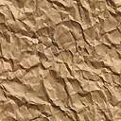

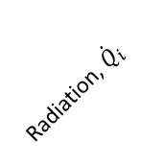








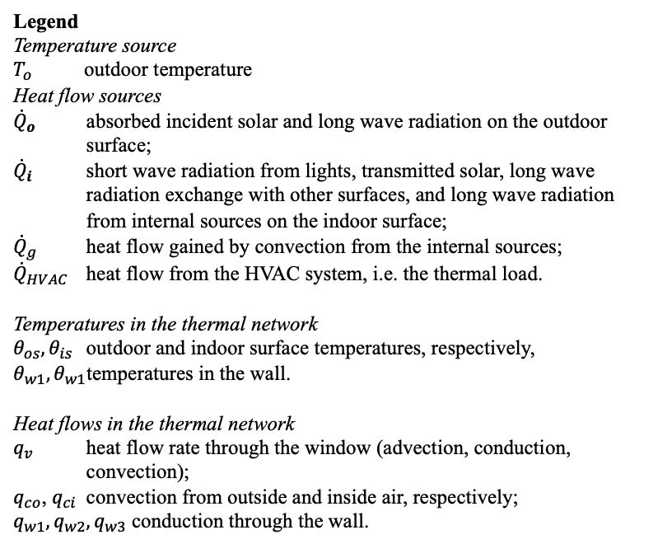





















Window
(fenestration)
Outdoor air, $T_{o}$
Indoor air, $θ_{a}$
Gains, ${\dot{Q}}_{g}$
HVAC, ${\dot{Q}}_{HVAC}$
Radiation, ${\dot{Q}}_{o}$
Radiation, ${\dot{Q}}_{i}$
Wall
$$R_{f}$$
$$R_{co}$$
$$q_{f}$$
$$θ_{so}$$
$$θ_{so}$$
$$R_{w1}$$
$$θ_{so}$$
$$R_{w2}$$
$$R_{w3}$$
$$θ_{si}$$
$$R_{ci}$$
$$θ_{a}$$
+
$$q_{co}$$
$$q_{w1}$$
$$q_{w2}$$
$$q_{w3}$$
$$q_{ci}$$
-
$$T_{o}$$
$${\dot{Q}}_{o}$$
$$C_{w1}$$
$$C_{w2}$$
$${\dot{Q}}_{i}$$
$$C_{a}$$
$${\dot{Q}}_{g}$$
$${\dot{Q}}_{HVAC}$$
Legend
Temperature source
$T_{o}$ outdoor temperature
Heat flow sources
${\dot{Q}}_{o}$ absorbed incident solar and long wave radiation on the outdoor surface;
${\dot{Q}}_{i}$ short wave radiation from lights, transmitted solar, long wave radiation exchange with other surfaces, and long wave radiation from internal sources on the indoor surface;
${\dot{Q}}_{g}$ heat flow gained by convection from the internal sources;
${\dot{Q}}_{HVAC}$ heat flow from the HVAC system, i.e. the thermal load.
Temperatures in the thermal network
$θ_{os}, θ_{is}$ outdoor and indoor surface temperatures, respectively,
$θ_{w1}, θ_{w1}$temperatures in the wall.
Heat flows in the thermal network
$q_{v}$ heat flow rate through the window (advection, conduction, convection);
$q_{co}$, $q_{ci}$ convection from outside and inside air, respectively;
$q_{w1}, q_{w2}, q_{w3}$ conduction through the wall.

Slide 8



















































































$$R_{f}$$
$$R_{co}$$
$$q_{f}$$
$$θ_{so}$$
$$θ_{so}$$
$$R_{w1}$$
$$θ_{so}$$
$$R_{w2}$$
$$R_{w3}$$
$$θ_{si}$$
$$R_{ci}$$
$$θ_{a}$$
+
$$q_{co}$$
$$q_{w1}$$
$$q_{w2}$$
$$q_{w3}$$
$$q_{ci}$$
-
$$T_{o}$$
$${\dot{Q}}_{o}$$
$$C_{w1}$$
$$C_{w2}$$
$${\dot{Q}}_{i}$$
$$C_{a}$$
$${\dot{Q}}_{g}$$
$${\dot{Q}}_{HVAC}$$
$$b_{6}$$
e₆
-
+
$$R_{6}$$
$$T_{of}$$
$$q_{6}$$
$$b_{1}$$
e₁
$$θ_{1}$$
e₂
$$θ_{3}$$
e₃
$$θ_{4}$$
e₄
$$θ_{2}$$
e₅
$$θ_{5}$$
-
+
$$R_{1}$$
$$R_{2}$$
$$R_{3}$$
$$R_{4}$$
$$R_{5}$$
$$T_{ow}$$
$$q_{1}$$
$${\dot{Q}}_{o}$$
$$q_{2}$$
$C_{3}$
$$q_{3}$$
$$C_{4}$$
$$q_{4}$$
$${\dot{Q}}_{i}$$
$$q_{5}$$
$$C_{5}$$
$${\dot{Q}}_{a}$$
$$f_{1}$$
$$f_{2}$$
$$f_{3}$$
$$b_{0}$$
e₆
-
+
$$R_{6}$$
$$T_{of}$$
$$q_{6}$$
$$b_{1}$$
e₁
$$θ_{1}$$
e₂
$$θ_{2}$$
e₃
$$θ_{3}$$
e₄
$$θ_{4}$$
e₅
$$θ_{5}$$
-
+
$$R_{1}$$
$$R_{2}$$
$$R_{3}$$
$$R_{4}$$
$$R_{5}$$
$$T_{ow}$$
$$q_{1}$$
$$q_{2}$$
$$q_{3}$$
$$q_{4}$$
$${\dot{Q}}_{i}$$
$$q_{5}$$
$${\dot{Q}}_{a}$$
$$f_{1}$$
$${\dot{Q}}_{o}$$
$C_{3}$
$$C_{4}$$
$$f_{2}$$
$$C_{5}$$
$$f_{3}$$

Slide 9
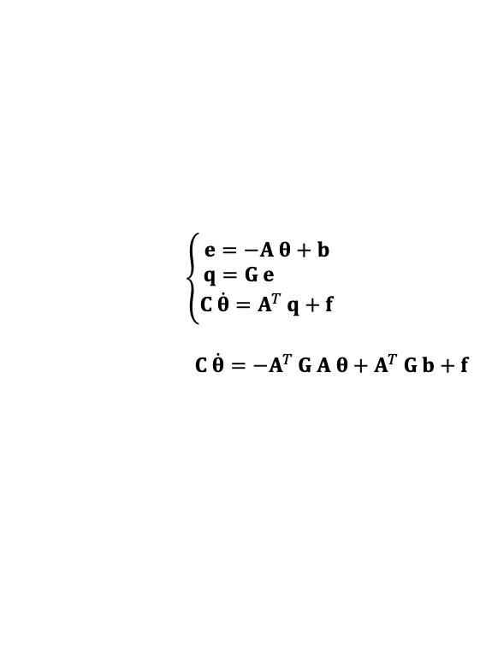



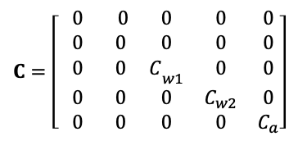

$$θ_{so} θ_{si} { θ}_{w1} { θ}_{w2} θ_{a}$$
$$\begin{matrix}q_{co} \\ q_{w1} \\ q_{w2} \\ q_{w3} \\ q_{ci} \\ q_{f}\end{matrix}$$
$C=\left[ \begin{matrix}0 & 0 & 0 & 0 & 0 \\ 0 & 0 & 0 & 0 & 0 \\ 0 & 0 & C­_{w1} & 0 & 0 \\ 0 & 0 & 0 & C_{w2} & 0 \\ 0 & 0 & 0 & 0 & C_{a}\end{matrix}\right]$
$$\left\{\begin{matrix}e=−A θ+b \\ q=G e \\ C \dot{θ}=A^{T} q+f\end{matrix}\right.$$
$$C \dot{θ}=−A^{T} G A θ+A^{T} G b+f$$
$$f={\left[\begin{matrix}{ \dot{Q}}_{o} & 0 & 0 & { \dot{Q}}_{i} & { \dot{Q}}_{a} \end{matrix}\right]}^{T}$$
$${\dot{Q}}_{a}={\dot{Q}}_{g}+{\dot{Q}}_{HVAC}$$

Slide 10
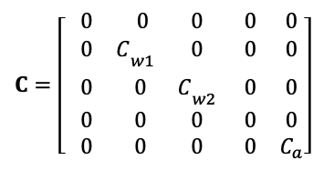
$$θ_{so} θ_{si} { θ}_{w1} { θ}_{w2} θ_{a}$$
$$\begin{matrix}q_{co} \\ q_{w1} \\ q_{w2} \\ q_{w3} \\ q_{ci} \\ q_{f}\end{matrix}$$
$C=\left[ \begin{matrix}0 & 0 & 0 & 0 & 0 \\ 0 & C­_{w1} & 0 & 0 & 0 \\ 0 & 0 & C­_{w2} & 0 & 0 \\ 0 & 0 & 0 & 0 & 0 \\ 0 & 0 & 0 & 0 & C_{a}\end{matrix}\right]$
$$\left\{\begin{matrix}e=−A θ+b \\ q=G e \\ C \dot{θ}=A^{T} q+f\end{matrix}\right.$$
$$C \dot{θ}=−A^{T} G A θ+A^{T} G b+f$$
$$f={\left[\begin{matrix}{ \dot{Q}}_{o} & 0 & 0 & { \dot{Q}}_{i} & { \dot{Q}}_{a} \end{matrix}\right]}^{T}$$
$${\dot{Q}}_{a}={\dot{Q}}_{g}+{\dot{Q}}_{HVAC}$$

Slide 11








































$$θ_{1}, S_{1}$$
$$dV=S ds$$
$$θ_{0}, S_{0}$$
$$q_{1}$$
$$θ_{0}$$
- +
$$R_{0}$$
$$θ_{1}$$
$$q_{s}$$
$$q_{s+ds}$$
$$s_{1}$$
$$q_{0}$$
$$b_{0}$$
$$q_{0}$$
$$q_{1}$$
$$q_{0}$$
$$s$$
$$f_{1}$$
$$s_{0}$$
$$ds$$
$$(a)$$
$$(b)$$
- +
$$θ_{k}$$
$$b_{j}$$
$$q_{j}$$
$$f_{k}$$
$$(a)$$
$$(b)$$
$$θ_{1}$$
$$θ_{1}>θ_{2}$$
$$θ_{2}$$
${θ_{1}=θ}_{S}>{θ_{2}=T}_{∞}$
$v_{∞}$
$$q_{cd}$$
Moving fluid
Convection
$$θ_{S}$$
$$q_{cv}=q_{12}$$
$$q_{cd}$$
Conduction
$$q_{12}=\frac{κ}{w}S\left(θ_{1}−θ_{2}\right)$$
$$q_{12}=hS\left(θ_{1}−θ_{2}\right)$$
$$(a)$$
$$(b)$$

Slide 12
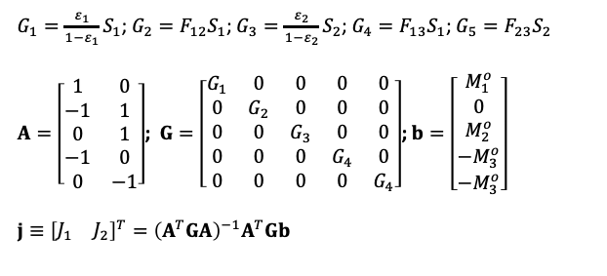
- +
$$M_{3}$$
- +
$$M_{3}$$
- +
$$M_{3}$$
- +
$$T_{3}$$
- +
$$T_{3}$$
- +
$$4$$
$$5$$
+ -
- +
$$4$$
$$5$$
+ -
- +
$$4$$
$$5$$
+ -
$$M_{1}$$
$$1$$
$$1$$
$$2$$
$$2$$
$$3$$
$$M_{2}$$
$$M_{1}$$
$$1$$
$$1$$
$$2$$
$$2$$
$$3$$
$$M_{2}$$
$$T_{1}$$
$$1$$
$$1$$
$$2$$
$$2$$
$$3$$
$$T_{2}$$
(a)
(b)
(c)
$G_{1}=\frac{ε_{1}}{1−ε_{1}}S_{1}$; $G_{2}=F_{12}S_{1}$; $G_{3}=\frac{ε_{2}}{1−ε_{2}}S_{2}$; $G_{4}=F_{13}S_{1}$; $G_{5}=F_{23}S_{2}$
$A=\left[\begin{matrix}1 & 0 \\ −1 & 1 \\ 0 & 1 \\ −1 & 0 \\ 0 & −1\end{matrix}\right]$; $G=\left[\begin{matrix}G_{1} & 0 & 0 & 0 & 0 \\ 0 & G_{2} & 0 & 0 & 0 \\ 0 & 0 & G_{3} & 0 & 0 \\ 0 & 0 & 0 & G_{4} & 0 \\ 0 & 0 & 0 & 0 & G_{4}\end{matrix}\right]$; $b=\left[\begin{matrix}M_{1}^{o} \\ 0 \\ M_{2}^{o} \\ −M_{3}^{o} \\ −M_{3}^{o}\end{matrix}\right]$
$j≡{\left[\begin{matrix}J_{1} & J_{2}\end{matrix}\right]}^{T}={\left(A^{T}GA\right)}^{−1}A^{T}Gb$

