Slide 1











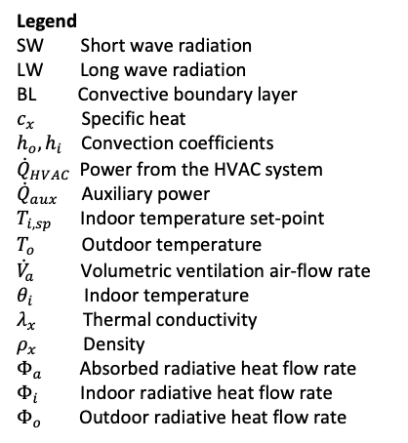








Wall: concrete & insulation
HVAC system
Window: glass
Indoor air
-
$$T_{i,sp}$$
+
Ventilation
$$(a)$$
Wall
Concrete Insulation
Sun
Legend
SW Short wave radiation
LW Long wave radiation
BL Convective boundary layer
$c_{x}$ Specific heat
$h_{o}, h_{i}$ Convection coefficients
${\dot{Q}}_{HVAC }$ Power from the HVAC system
${\dot{Q}}_{aux}$ Auxiliary power
$T_{i,sp}$ Indoor temperature set-point
$T_{o}$ Outdoor temperature
${\dot{V}}_{a}$ Volumetric ventilation air-flow rate
$θ_{i}$ Indoor temperature
$λ_{x}$ Thermal conductivity
$ρ_{x}$ Density
$Φ_{a}$ Absorbed radiative heat flow rate
$Φ_{i}$ Indoor radiative heat flow rate
$Φ_{o}$ Outdoor radiative heat flow rate
BL
SW
$$T_{o}$$
$$1$$
$$2$$
$$3$$
$$4$$
$$5$$
BL
Outdoor
air
$$h_{o}$$
$$λ_{c}, ρ_{c}, c_{c}$$
$$λ_{i}, ρ_{i}, c_{i}$$
$$h_{i}$$
Indoor
air
SW
$$w_{c}$$
$$w_{i}$$
LW
HVAC system
Sun
Window: glass
$$θ_{i}$$
$${\dot{Q}}_{aux}$$
Outdoor
air
$$T_{o}$$
BL
BL
$$8$$
$$6$$
$$7$$
$$h_{o}$$
$$λ_{g}, ρ_{g}, c_{g}$$
$$h_{i}$$
$${\dot{Q}}_{HVAC}$$
-
SW
$$w_{g}$$
+
Outdoor
air
Sun
Ventilation
$$T_{o}$$
$${\dot{V}}_{a}$$
$$(b)$$

Slide 2


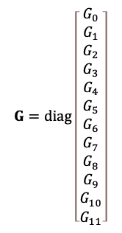



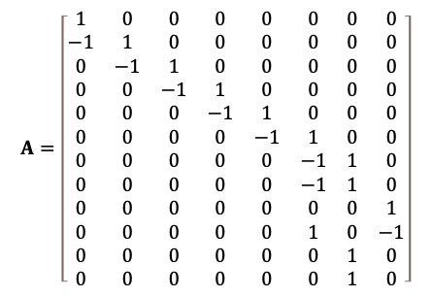





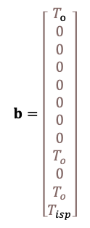




$$0$$
$$1$$
$$2$$
$$3$$
$$Φ_{i}$$
- +
$$0$$
$$1$$
$$2$$
$$3$$
$$4$$
$$4$$
$$6$$
$$T_{o}$$
$$Φ_{o}$$
$$5$$
$${\dot{Q}}_{a}$$
- +
$$7$$
$$Φ_{a}$$
$$5$$
$$6$$
+ -
$$T_{o}$$
$$8$$
$$9$$
$$7$$
$$11$$
$$T_{i,sp}$$
- +
$$10$$
$$T_{o}$$
$$\begin{matrix}θ_{0} & θ_{1} & θ_{2} & θ_{3} & θ_{4} & θ_{5} & θ_{6} & θ_{7}\end{matrix}$$
$$q_{0}$$
$$A=\left[\begin{matrix}1 & 0 & 0 & 0 & 0 & 0 & 0 & 0 \\ −1 & 1 & 0 & 0 & 0 & 0 & 0 & 0 \\ 0 & −1 & 1 & 0 & 0 & 0 & 0 & 0 \\ 0 & 0 & −1 & 1 & 0 & 0 & 0 & 0 \\ 0 & 0 & 0 & −1 & 1 & 0 & 0 & 0 \\ 0 & 0 & 0 & 0 & −1 & 1 & 0 & 0 \\ 0 & 0 & 0 & 0 & 0 & −1 & 1 & 0 \\ 0 & 0 & 0 & 0 & 0 & −1 & 1 & 0 \\ 0 & 0 & 0 & 0 & 0 & 0 & 0 & 1 \\ 0 & 0 & 0 & 0 & 0 & 1 & 0 & −1 \\ 0 & 0 & 0 & 0 & 0 & 0 & 1 & 0 \\ 0 & 0 & 0 & 0 & 0 & 0 & 1 & 0\end{matrix}\right]$$
$$G=diag\left[\begin{matrix}G_{0} \\ G_{1} \\ G_{2} \\ G_{3} \\ G_{4} \\ G_{5} \\ G_{6} \\ G_{7} \\ G_{8} \\ G_{9} \\ G_{10} \\ G_{11}\end{matrix}\right]$$
$$b=\left[\begin{matrix}T_{o} \\ 0 \\ 0 \\ 0 \\ 0 \\ 0 \\ 0 \\ 0 \\ T_{o} \\ 0 \\ T_{o} \\ T_{isp}\end{matrix}\right]$$
$$q_{1}$$
$$q_{2}$$
$$q_{3}$$
$$q_{4}$$
$$q_{5}$$
$$q_{6}$$
$$q_{7}$$
$$q_{8}$$
$$q_{9}$$
$$q_{10}$$
$$q_{11}$$
$$C=diag\left[ \begin{matrix}0 & { C}_{1} & 0 & { C}_{3} & 0 & 0 & C_{6} & { C}_{7}\end{matrix} \right]$$
$$f={\left[\begin{matrix}{ Φ}_{o} & 0 & 0 & 0 & { Φ}_{i} & 0 & {\dot{Q}}_{a} & Φ_{a}\end{matrix}\right]}^{T}$$

