Slide 1

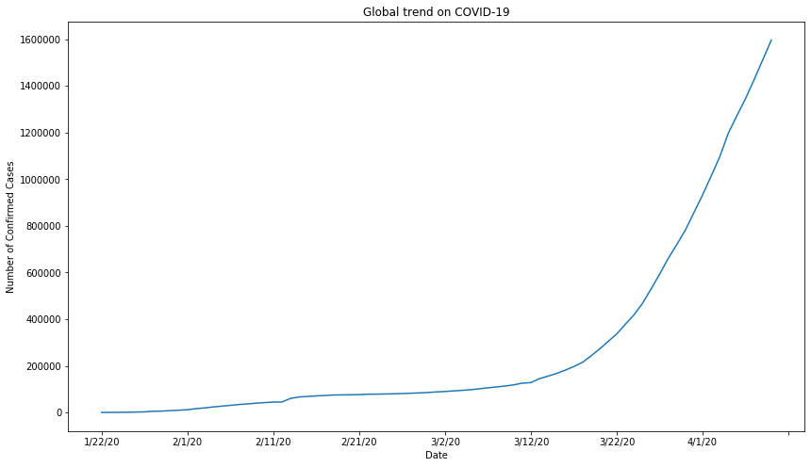
Why do we care?
Exponential Growth
Confirmed:
1,677,286
Deaths:
101,576

Slide 2
A Quick Look on COVID-19 in US and Your Neighborhood
By Vince Pan
GitHub: https://github.com/constiny/COVID19

Slide 3
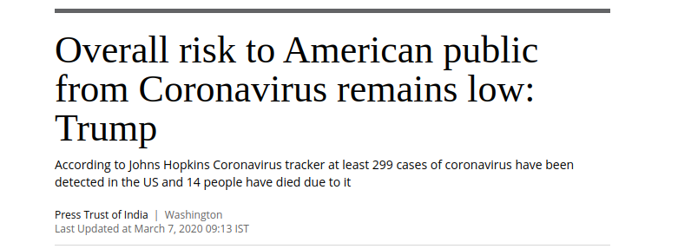
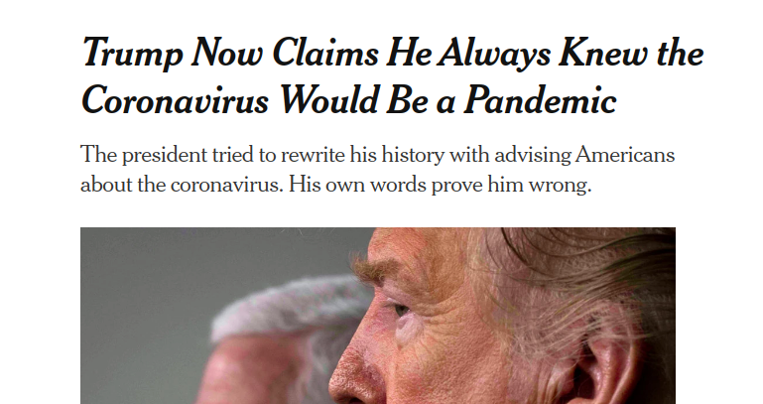
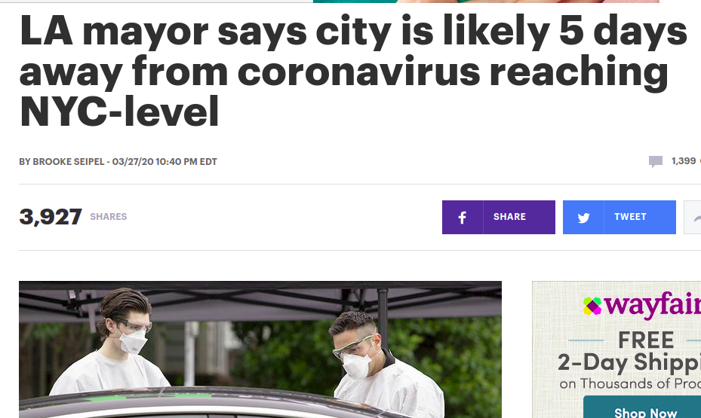
Motivation
"The death of one man is a tragedy. The death of millions is a statistic."
- Original by Kurt Tucholsky as a Joke
The objective of this project is to
Provide relevant and precise information to people.

Slide 4
DATA
Source
RAW
Dataset
Organized by JHU
.csv
CDC/PHD Press Release
.html
Download
Pandas DataFrames
Pandas DataFrames
Case Data
Testing Data
Date, Location,
Long, Lat,
# of Confirm,
# of Death,
# of Recovery
Date, Location,
# of Positive,
# of Negative
Pipeline
Cleaning
Web Scraping

Slide 5
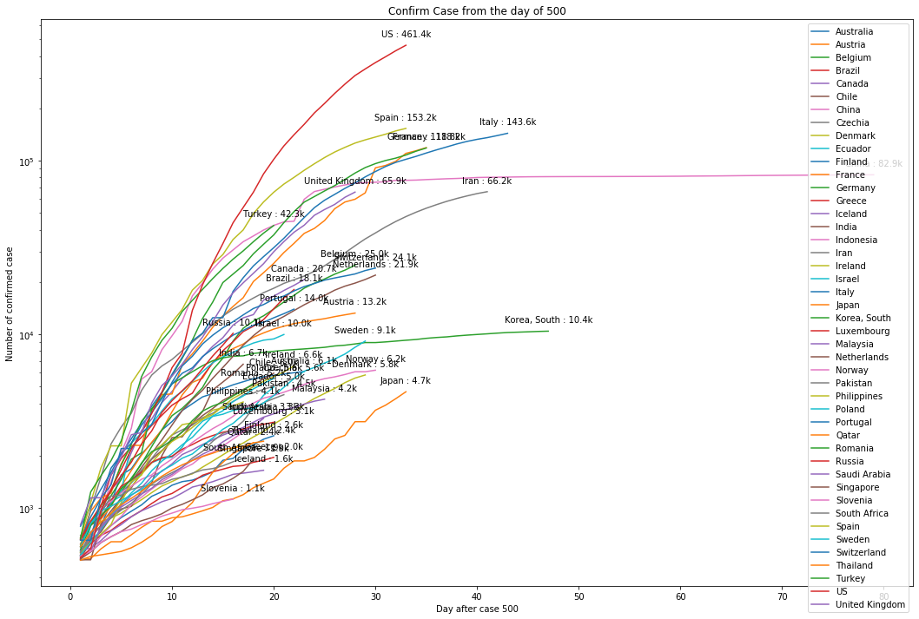

US cases number is still in fast growth.

Slide 6
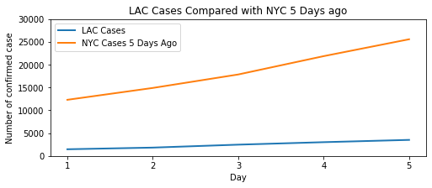
Statistically, we reject Mayor’s statement.
Null hypothesis H0: From Mar 27th till Apr 1st (5 days after) LA county has same case level or even higher than NYC in Mar 23rd to Mar 27th.
Alternative hypothesis H1: From Mar 27th till Apr 1st (5 days after) LA county has less case level than NYC in Mar 23rd to Mar 27th.
P-value of the U-test is 0.006.
We reject the null hypotheses on a significance level 0.05.

Slide 7
Takeaway
US is still currently the epicenter of COVID-19 and cases are still growth fast.
CA is one of epicenter inside US. The situation in LA showing no trend to be the second New York but it is still too early to be optimized.
Be suspicious on the guess or projection from the media or authority. Do your research.

Slide 8
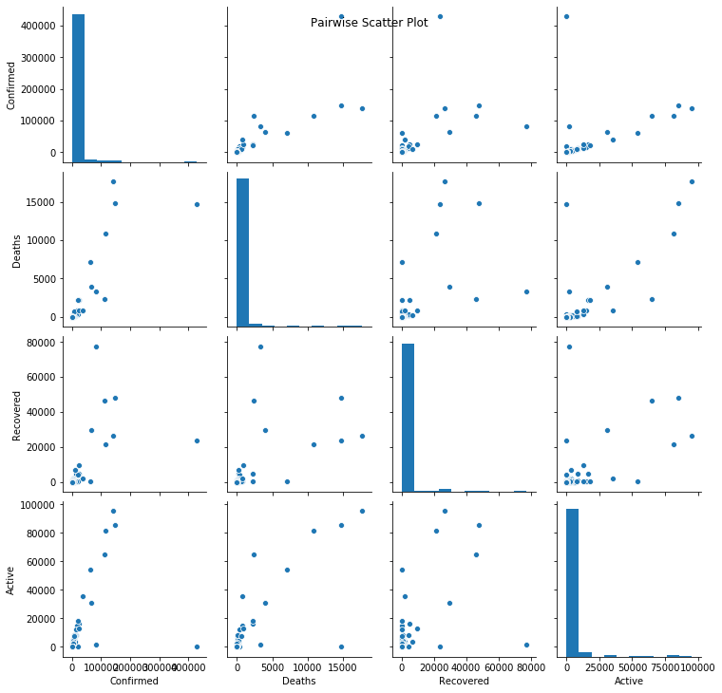
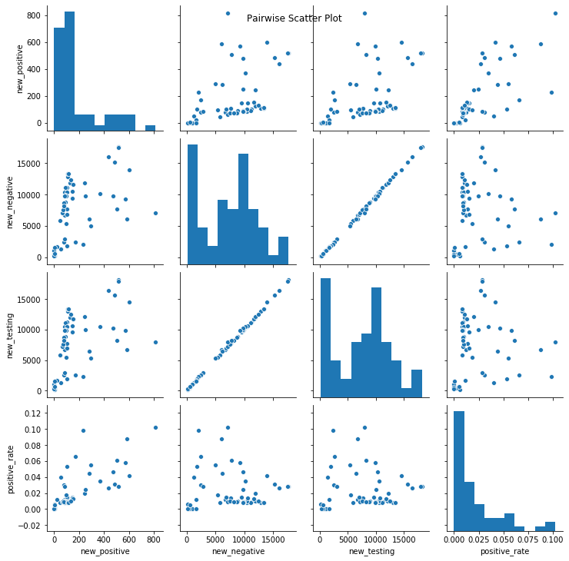
Appendix I - Correlation
Case Data
Testing Data
All other cases indicator show a positive relationship with confirmed.
Unfortunately, we didn’t find strong relationship between testing quantity and case.

Slide 9
Appendix II - What’s next?
The U test has an assumption on the sample from i.i.d. while we did not have time to test it. The Chow's test on time series might be a good try if time allows.
Create an automatic system to update data and update maps.

Slide 10
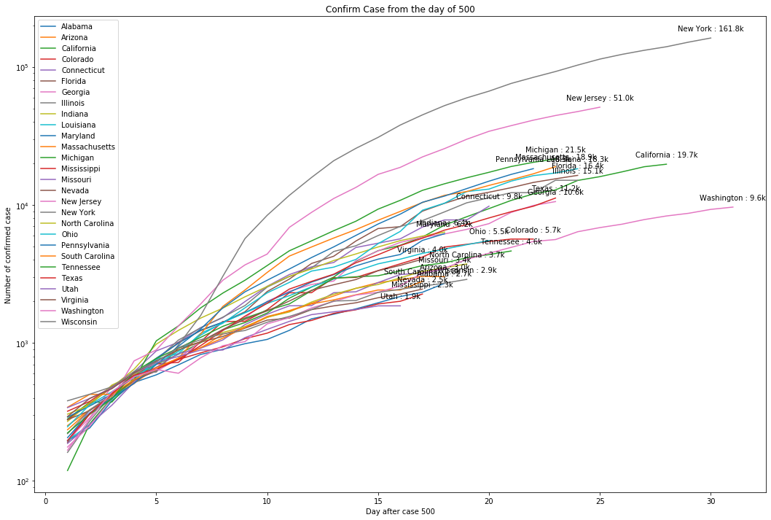
Appendix III - State Curve

Slide 11
Real takeaway
Stay at home as much as you can.
Wear a mask and bring a hand sanitizer if you must go out.
Avoid close contact.
Share information to people you love.

