Slide 1

TIME SERIES AND DATA STREAMS
ConDyGNet: Constraint-Guided Dynamic Graph Networks for Multivariate Time Series Forecasting
A global low-rank basis stabilizes patch-wise dynamic graphs—preserving adaptivity while filtering noise.
Zhenzhou Li¹ Xiang Li²˒³ Zhibin Niu¹*
¹ Tianjin University · ² China Iron and Steel Research Institute Group · ³ UC Berkeley
Bremen · 18 August 2026
Notes:
Good morning. I am Zhenzhou Li, and today I will present ConDyGNet for multivariate time-series forecasting. In this task, we use past values from many channels to predict their future values. These channels are related to each other, but their relations can also change over time. Our method uses a global low-rank basis to keep the graph stable, while patch-wise routing lets the graph change when the local data changes.

Slide 2
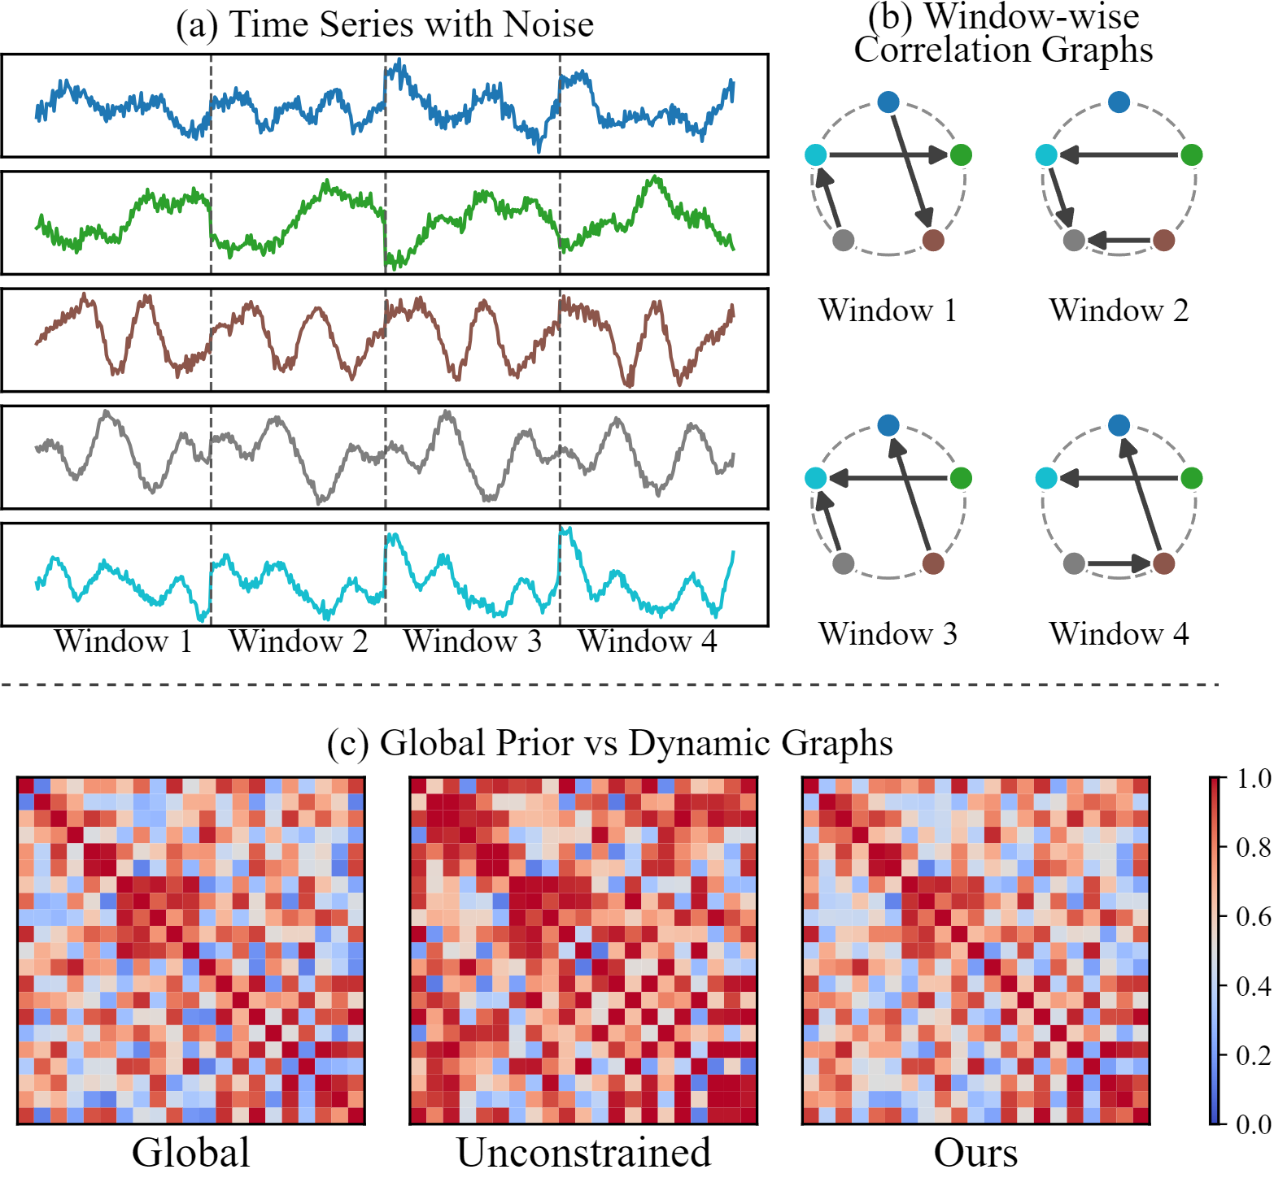
Short windows make fully dynamic graphs drift
01 Static global graph
Stable across time, but blind to window-specific relation changes.
02 Unconstrained dynamic graph
Adaptive, but short-window correlations may mistake noise for structure—and amplify it during message passing.
03 What is needed
Local adaptation inside a globally reliable structural subspace.
Adapt without topological drift.
Figure 1 · Window-wise relations vary; constrained topology stays near the global prior.
02
Notes:
Relations between channels can change over time, so one static graph cannot describe every local pattern. But a fully dynamic graph learned from a short patch also has a problem. A short patch may contain noise, and the model may treat this noise as a real relation. Then graph message passing can make these false relations stronger. Figure one shows this problem. We need a graph that can change with local data, but should still stay close to a reliable global pattern. So our goal is simple: keep local change, but avoid unstable changes in graph structure.

Slide 3
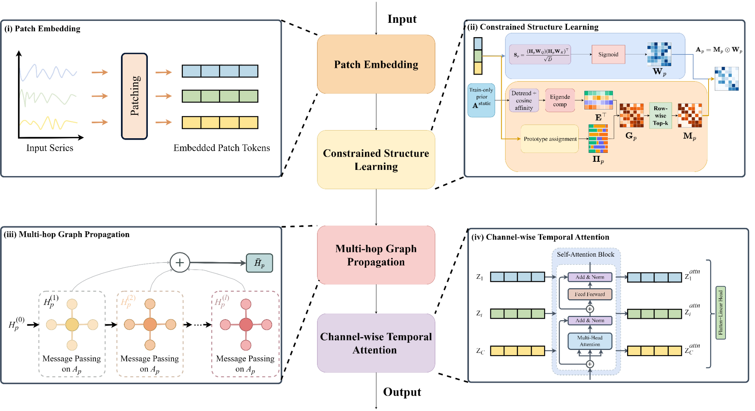
ConDyGNet constrains graphs before propagation
Patch tokens → constrained graph construction → cross-channel propagation → temporal forecasting
1 PATCH
2 CONSTRAIN
3 PROPAGATE
4 ATTEND
03
Notes:
This slide shows the full forecasting process. First, patch embedding turns the input series into local tokens for each channel. Second, constrained structure learning builds a sparse directed graph for each patch. This is the main part of our method. Third, multi-hop graph propagation lets information move between related channels, including direct and indirect relations. Finally, channel-wise temporal attention learns patterns over time, and a linear head gives the final forecast. The key point is that we control the graph before information is passed through it, so noisy edges are less likely to affect later layers.

Slide 4
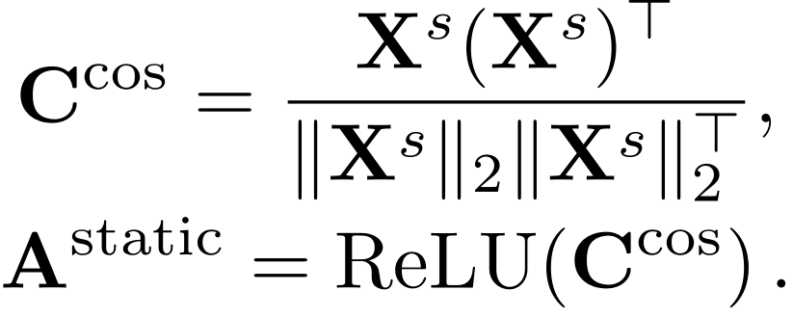
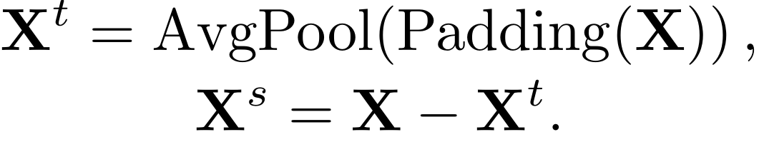
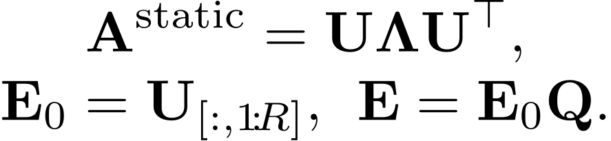
A residual prior constrains the topology search space
01 Remove slow trends
02 Residual affinity
03 Constrain basis modes
Compute residual co-movement from the full training split—once.
Scale-invariant cosine similarity keeps non-negative evidence.
Keep the dominant R eigenvectors; learn only their rotation and mixing.
Trend removal prevents shared level shifts from dominating structural evidence.
The prior captures recurring channel relations before any short patch is observed.
Updates may reweight modes, but cannot drift outside the dominant structural subspace.
Learn inside a data-derived O(CR) search space— rather than rediscovering O(C²) topology per patch.
WHY THIS MATTERS
04
Notes:
Now I will explain how we build the reliable graph space. This part is done once using the training data. First, average pooling removes slow trends, so we focus on changes that show relations between channels. Second, cosine similarity turns these signals into a global graph prior. Third, we keep the main rank-R basis patterns. We then use a learnable matrix Q to adjust them, written as E equals E zero Q. The model can still learn and change the basis, but it stays inside a smaller and more reliable graph space instead of searching all channel pairs for every patch.

Slide 5
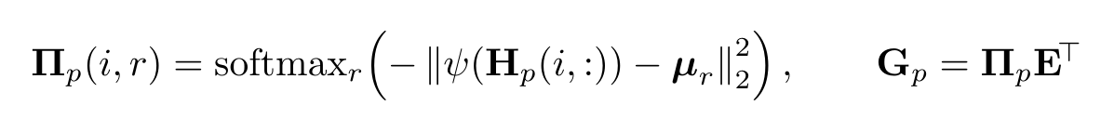
Context-aware mixing yields a patch-specific directed graph
01
02
03
04
05
READ PATCH
CONTEXT
MATCH SHARED
MODES
COMPUTE ROUTING
WEIGHTS
MIX THE
BASIS BANK
SELECT SPARSE
SUPPORT
Encode each channel’s local
temporal pattern within
the current patch.
Compare the patch state with
reusable structural
mode prototypes.
Convert prototype distances
into patch-specific soft
routing weights.
Mix shared basis rows into
low-rank channel
interaction evidence.
Keep the strongest directed
relations through row-wise
Top-k selection.
CONTEXT-AWARE BASIS MIXING · EQUATION 8
TOPOLOGY × INTENSITY
The constrained mixer selects reliable edges;
a separate intensity branch weights only those connections.
05
Notes:
The global basis is shared by all patches, but each patch can use it differently. For each channel, the model first reads the local patch features. It then compares the current patch with shared patterns and turns the scores into soft routing weights. The routing weights decide how much each basis pattern should be used. Equation eight gives this main step. After mixing the basis, row-wise top-k selection keeps only the strongest directed relations. A separate branch gives a strength value to each kept edge. So we separate two questions: which edges should exist, and how strong should they be. This makes the graph flexible and stable.

Slide 6
ConDyGNet leads across model families
10 methods spanning GNN, Transformer, MLP, CNN, and linear designs · mean over 8 datasets × 4 horizons
Method | Architecture family | Mean MSE | Mean MAE
ConDyGNet(IJCAI-ECAI2026) | GNN + Transformer | 0.3057 | 0.3133
TimeFilter(ICML2025) | GNN | 0.3076 | 0.3227
SOFTS(NeurIPS2024) | MLP | 0.3212 | 0.3299
TimeXer(NeurIPS2024) | Transformer | 0.3219 | 0.3351
DUET(KDD2025) | MLP | 0.3244 | 0.3229
iTransformer(ICLR2024) | Transformer | 0.3284 | 0.3358
PatchTST(ICLR2023) | Transformer | 0.3529 | 0.3549
MSGNet(AAAI2024) | GNN | 0.3598 | 0.3557
TimesNet(ICLR2023) | CNN | 0.3669 | 0.3565
DLinear(AAAI2023) | Linear | 0.3998 | 0.3970
LOWER IS BETTER
ConDyGNet ranks first even against baselines built from different modeling families.
06
Notes:
Now let us look at the main forecasting results. We compare ConDyGNet with ten strong baselines from several model types, including GNNs, Transformers, MLPs, CNNs, and linear models. The table gives the average results over eight datasets and four prediction lengths, so it covers many different settings. Since lower MSE and MAE are better, the result is clear: ConDyGNet reaches the best average performance on both measures. This shows that our graph design is useful not only compared with other graph models, but also compared with strong methods from other model types.

Slide 7
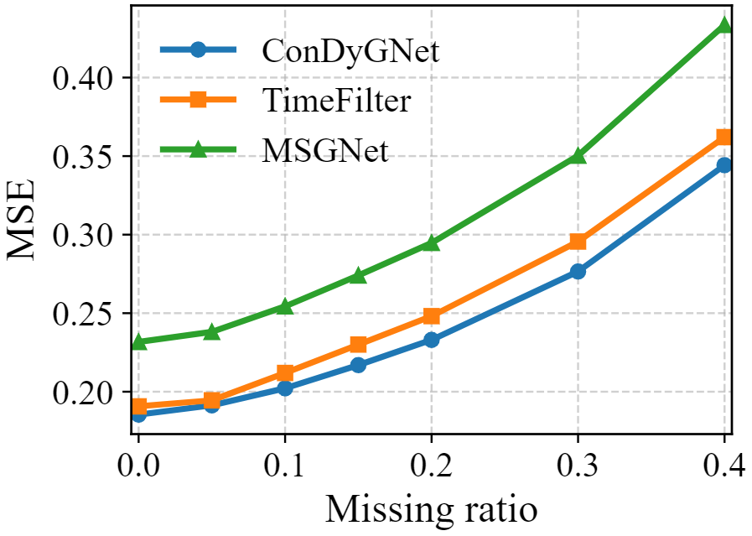
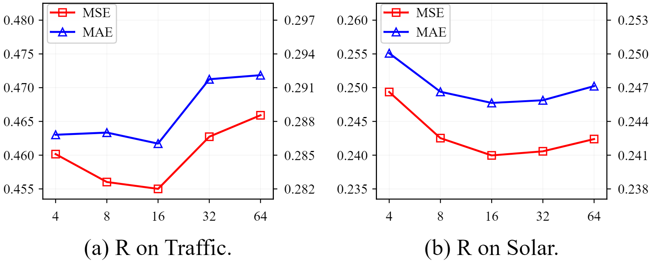
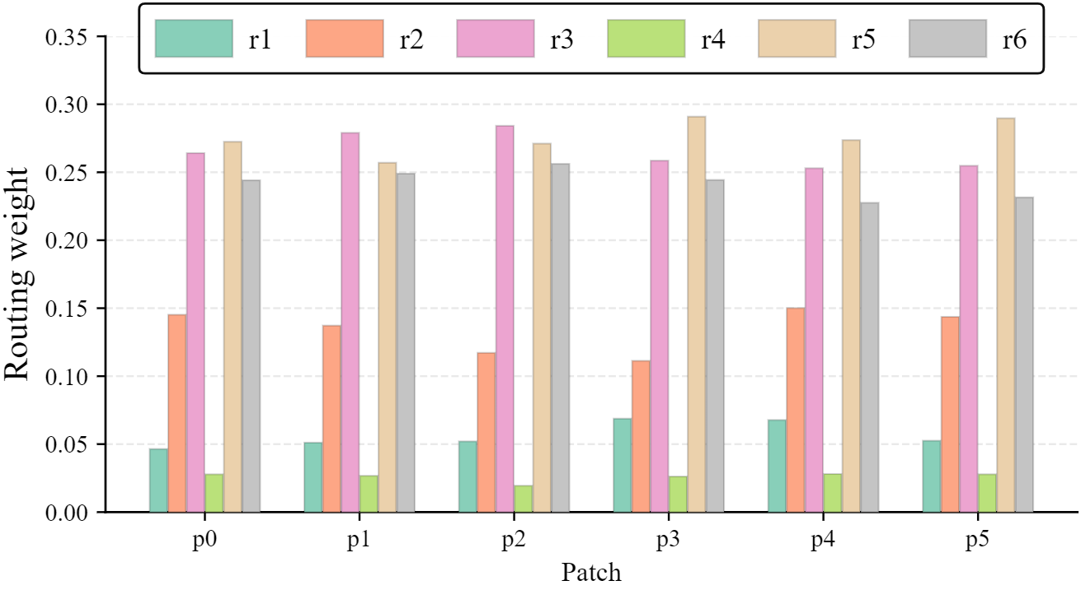
Three experiments support constrained, selective adaptation
01 · MISSING-BLOCK ROBUSTNESS
02 · RANK CONTROLS CAPACITY
R ≈ 16 balances fit and noisy degrees of freedom.
03 · ROUTING REMAINS SELECTIVE
ROBUST UNDER CORRUPTION
ConDyGNet degrades more slowly than TimeFilter and MSGNet.
Together, the three studies support adaptation inside
a compact structural subspace.
07
Notes:
We also perform three extra experiments to better understand the method. First, when some input blocks are missing, ConDyGNet drops more slowly than TimeFilter and MSGNet, so the model is more stable with incomplete input. Second, we study the rank R. A small rank may lose useful graph information, while a very large rank gives too much freedom. A value around sixteen gives a good balance. Third, the routing weights focus on a few basis patterns, and these patterns change across patches. This shows that the graph can adapt to local data without changing in a random way. Together, these results support our idea of flexible but controlled dynamic graphs.

Slide 8
IJCAI–ECAI 2026 · ORAL PRESENTATION
Thank you
Questions & discussion
Zhenzhou Li¹ · Xiang Li²˒³ · Zhibin Niu¹*
¹ Tianjin University · ² China Iron and Steel Research Institute Group
³ UC Berkeley
Bremen · 18 August 2026
Notes:
That concludes my presentation. To summarize, ConDyGNet lets channel relations change with each local patch, but keeps these changes inside a reliable shared graph space. This gives us both flexibility and stability for multivariate time-series forecasting. Thank you very much for listening. I would be happy to take your questions.

