Slide 1

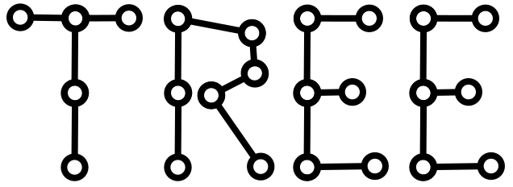

Querying TREE/LDES
Pieter Colpaert and Bryan-Elliott Tam

Slide 2
Why are we doing all of this again?
A couple of examples:
Graph queries
Route planning
Substring autocompletion

Slide 3
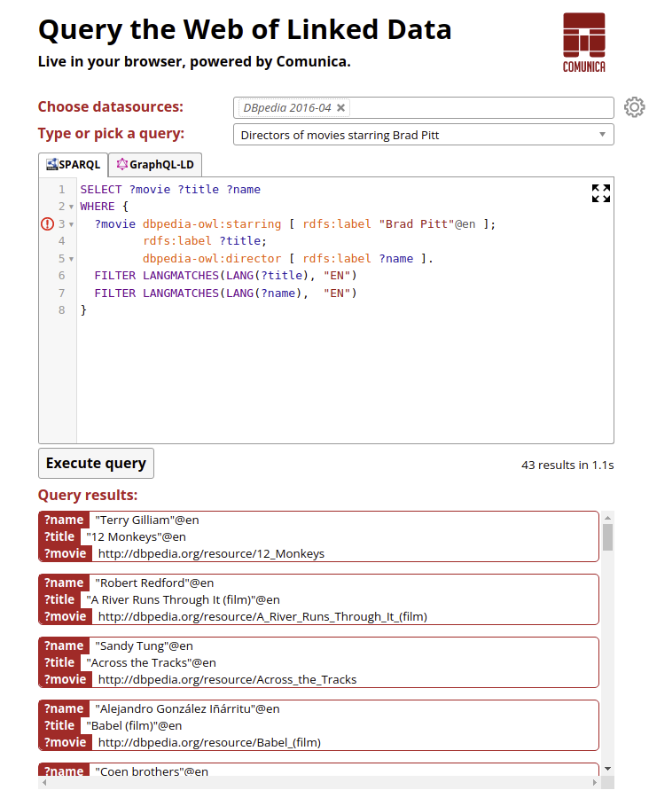
Graph Queries on top of Triple Pattern Fragments
https://query.linkeddatafragments.org/#transientDatasources=%2F%2Ffragments.dbpedia.org%2F2016-04%2Fen
The event stream is fragmented on all triple patterns in the dataset

Slide 4
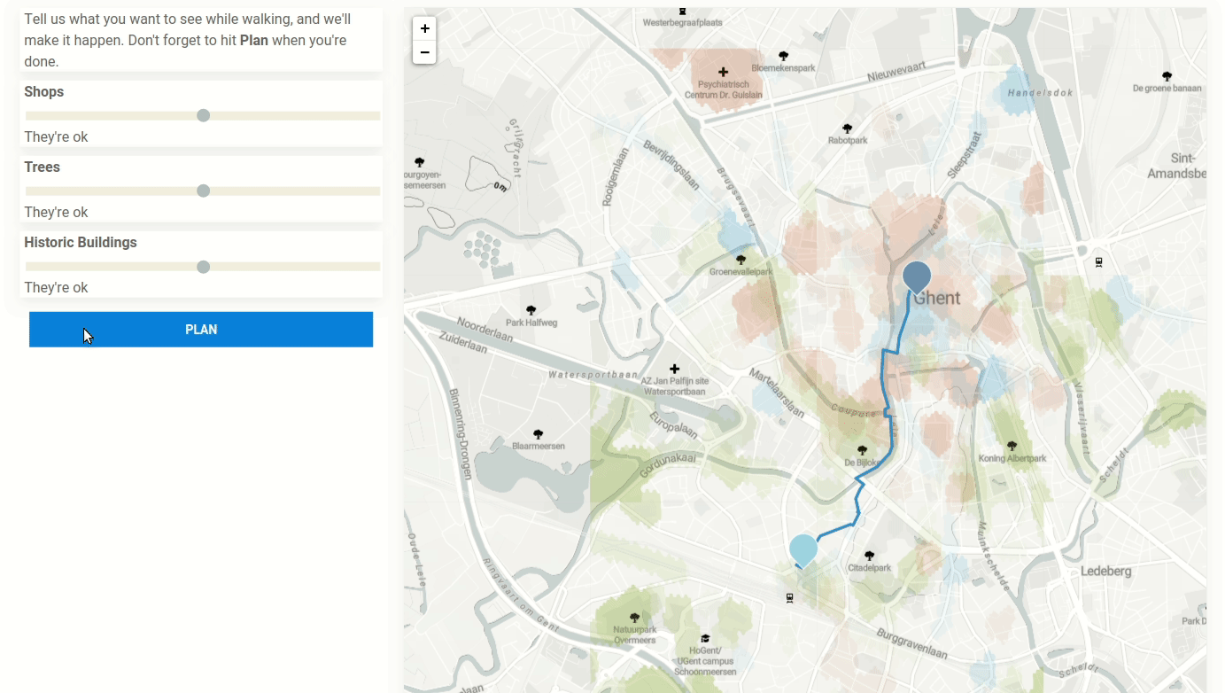
Route Planning on top of geospatial fragments
http://hdelva.be/sem4tra2020/demo.html
Combination of:
Clustering of points of interest in OSM
Routable Tiles (Linked OSM PoC)
Weighted client-side route planning
[1] “Interactive Route Personalization Using Regions of Interest” Harm Delva, Annelien Smets, Pieter Colpaert, Pieter Ballon, Ruben Verborgh Proceedings of the 2nd International Workshop on Semantics for Transport. 2020.
[2] “Client-side route planning: preprocessing the OpenStreetMap road network for routable tiles.” Delva, Harm, et al. Academic Track, State of the Map 2019. 2019.

Slide 5
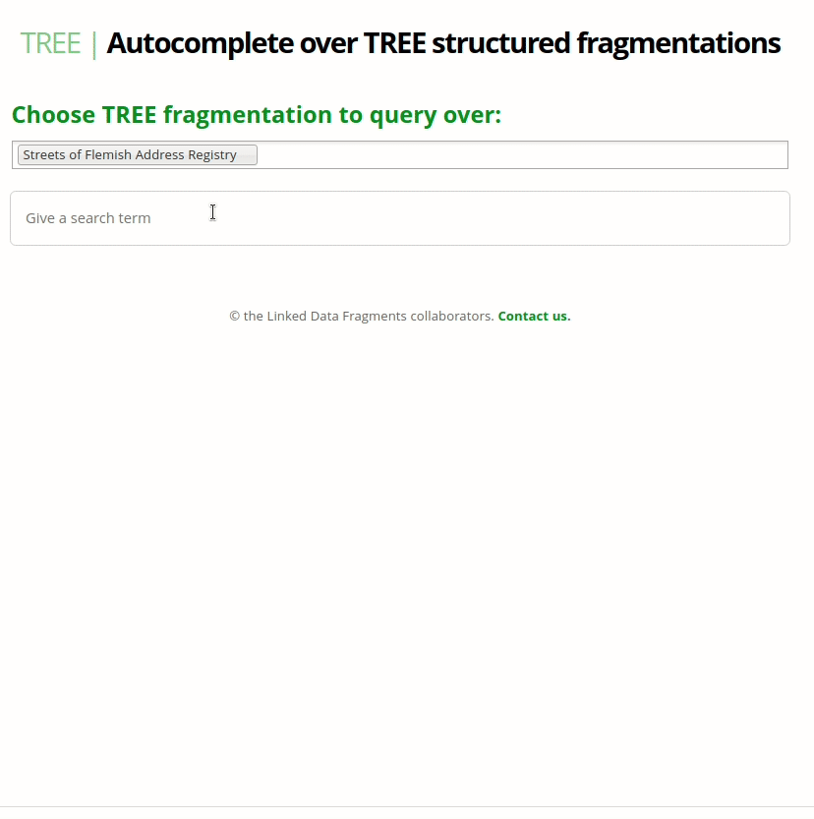
Autocompletion on top of substring fragments
Client is in charge of doing ranking results and descending the source tree
Live demo at tree.linkeddatafragments.org
Ruben, D., Delva, H., Colpaert, P., & Verborgh, R. (2021, May). “A File-Based Linked Data Fragments Approach to Prefix Search”. Proceedings of the 21th International Conference on Web Engineering.

Slide 6
Up next…
Partially joining multiple LDES-es into one via an LDI
LDES to Service workflows where only the data necessary is downloaded instead of full replication of all LDES-es
Forecasting based on a Time Series based fragmentation
…

Slide 7
Discovery when querying
Dataset discovery
Finding a dataset to query
View discovery
Finding a data service that publishes the dataset
Interface discovery
Traversing the HTTP interface
What we’re working on today

Slide 8
Two types of clients
Member based
Those looking to replicate/show the full member representation
E.g., LDES client and the autocompletion agent
Triple based
Those clients that select specific triple patterns
E.g., Comunica SPARQL or GraphQL querying
This presentation

Slide 9
Existing work: Link Traversal in Comunica
Naive approach: just follow any link (“follow-all”)
E.g., search the Web for people who know each other
https://comunica.github.io/comunica-feature-link-traversal-web-clients/builds/follow-all/#datasources=https%3A%2F%2Fpietercolpaert.be%2F%23me&query=PREFIX%20foaf%3A%20%3Chttp%3A%2F%2Fxmlns.com%2Ffoaf%2F0.1%2F%3E%0ASELECT%20DISTINCT%20%3Fname%20%3FotherPersonName%20WHERE%20%7B%0A%20%20%20%20%3Fperson%20foaf%3Aname%20%3Fname%3B%0A%20%20%20%20%20%20%20%20%20%20%20%20foaf%3Aknows%20%3FotherPerson%20.%0A%20%20%20%20%3FotherPerson%20foaf%3Aname%20%3FotherPersonName%20.%0A%7D

Slide 10
LINK TRAVERSAL QUERY PROCESSING
start from the seed URLs
  follow the URLs and get RDF documents
  query those documents
  dereference the URL associated to the named node present in the documents
  follow recursively the dereferenced URLs

Slide 11
TREE hypermedia is an optimization
Instead of following any link,
only follow TREE hypermedia

Slide 12
WEB OF LINKED DATA
The web can be consider as a “global” public forum
  There multiples conversations
  People giving speeches
  Shoping
  ...
To engage in a forum we need
  Body
  Language
  Custom
The forum is situated in space-time
  The internet kills that notion
Create tension because we don’t have a “global” language and custom
Solutions
  Imperialise the web; Have one big platform
  Federate the web; Linked data, decentralized systems
TREE attempt to be a library/journal stand, bring structure in the federated web

Slide 13
HOW TREE HYPERMEDIA CAN SPEED UP LINK TRAVERSAL-BASED QUERY PROCESSING FOR SPARQL QUERIES WITH FILTERS
DEPARTMENT OF ELECTRONICS AND INFORMATION SYSTEMS
KNOWS
Bryan-Elliott TAM

Slide 14
AGENDA
Context or the TREE specification
Link Traversal Query Processing (LTQP)
Formalisation
Benchmark
Future work

Slide 15
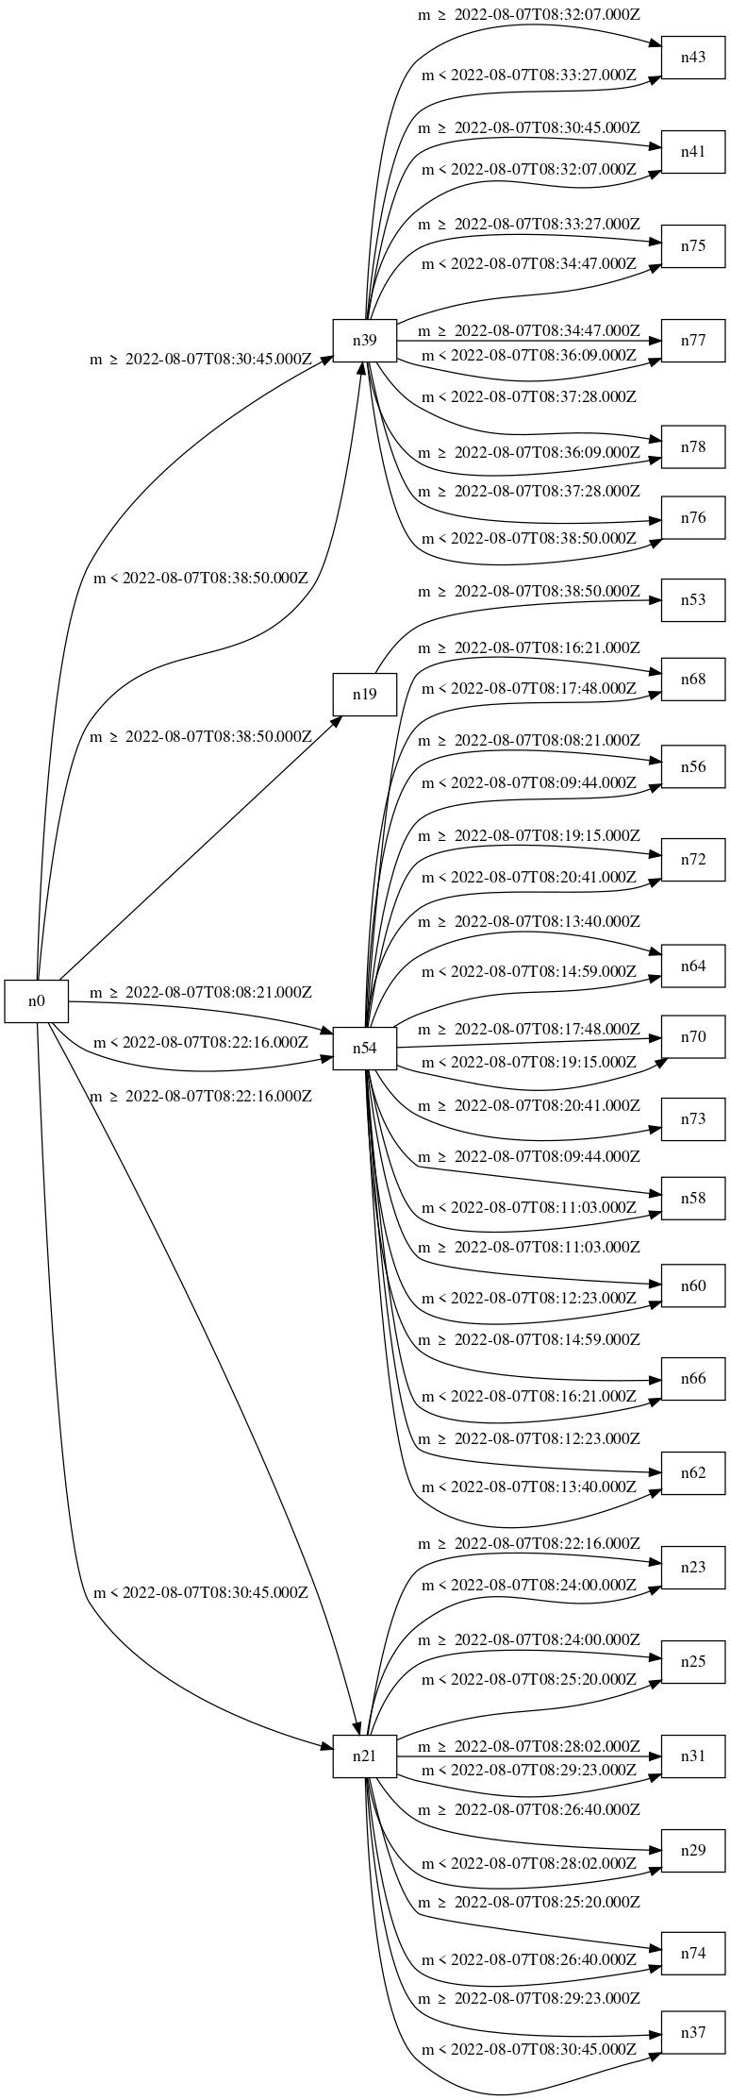
Visualizing a TREE view
Generated by querying a test TREE document with our tool tree-document-topology-visualizer

Slide 16
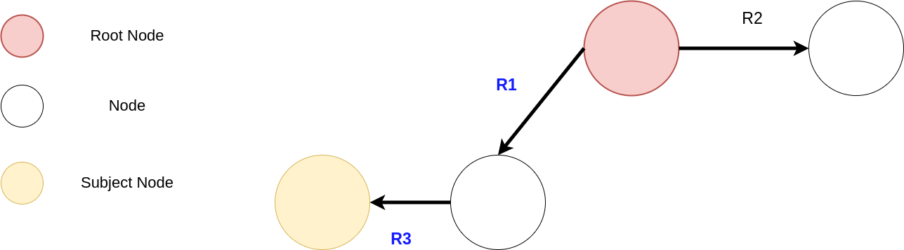
It’s a search tree from the eye of a client
Each node is a set containing members respecting
all the equation from the path starting from the root node
to the subject node

Slide 17
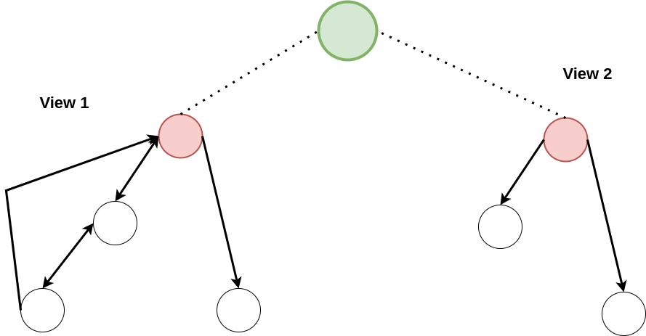
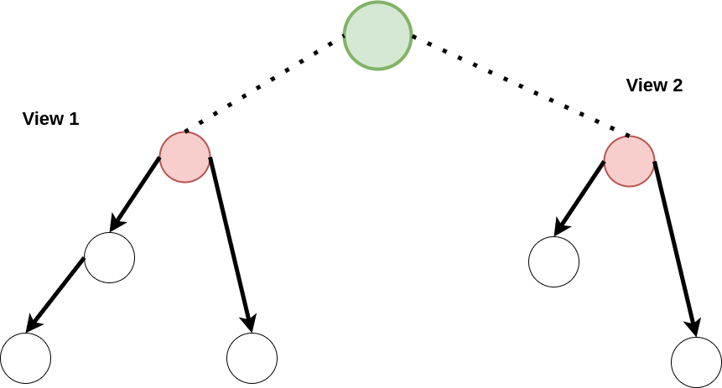
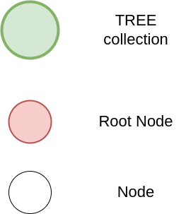
It’s a search tree from the eye of a client
Birds eye view
Query engine view

Slide 18
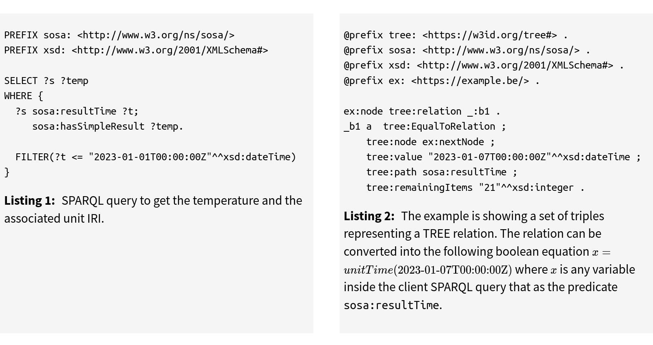
EXAMPLE USE CASE
Querying observations after the first of January
A solver will be needed to match a SPARQL query pattern to tree:Relations

Slide 19
How do we prune or prioritize relations based on a certain client’s input?
Client’s input: in our case this will be a SPARQL query

Slide 20
LINK TRAVERSAL QUERY PROCESSING (LTQP)

Slide 21
GUIDED LINK TRAVERSAL QUERY PROCESSING
We take advantage of a priori knowledge or meta knowledge (understanding) for the choice of links
  Structure of a document
    Eg: We want to query sensors data and we know a priori what kind of triples contains this information, then we follow only links that leads us to other sensors data, knowing what kind of triples contain this information
  Discovery of knowledge
    Eg: We know that set of triples described a condition or state (SHACL shape, shape tree, boolean) pertaining to the data inside the data source and we evaluate that condition before following the link or to choose which link to follow

Slide 22
FORMALISATION

Slide 23
STRATEGY
Give to the engine the knowledge
  The triple pattern that lead to new nodes
Give to the engine the understanding
  How to detect if the SPARQL query is aligned with the TREE fragmentation
  How to solve a boolean equation combining the SPARQL filter and the TREE relation

Slide 24
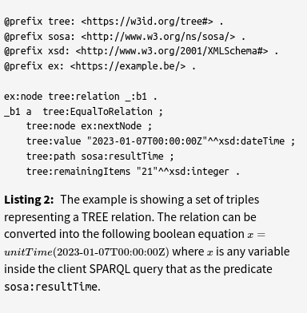
A TREE document
“:_b1” describe a new fragment of the dataset
The fragment is bound by a condition and describes the number of elements remaining following that branch
Next fragment

Slide 25
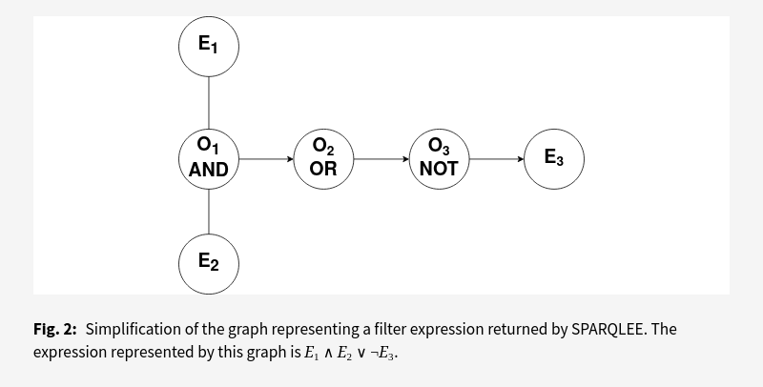
FILTER EXPRESSION

Slide 26
PROBLEM
We have a boolean expression from the TREE Document and a boolean expression from the SPARQL filter
We want to know if the combination of the two expression can be satisfy
  If so we follow the link

Slide 27
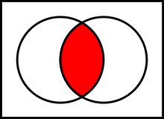
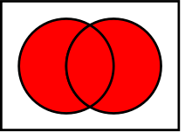
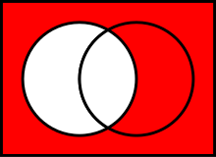

STRATEGY OF RESOLUTION
We calculate the domain of each sub expression and represent it as a set {lower bound, upper bound}
Eg: x>5
{5+dx, infinity}
We concatenate the expression based on the boolean operator
  AND
  OR
  NOT
The domain is a set of set containing the domain (subdomain) of each expression

Slide 28
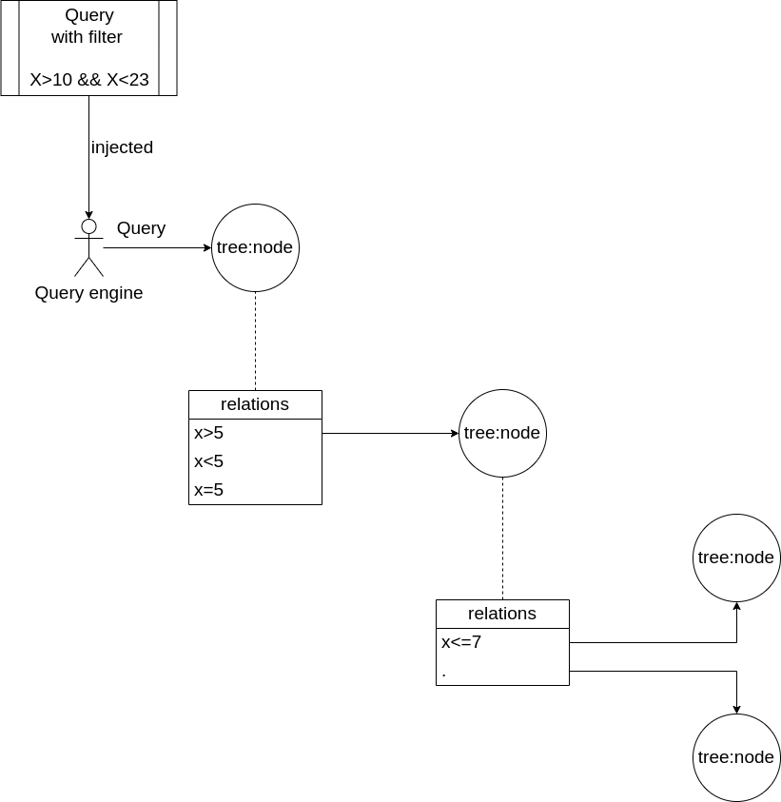

Slide 29
Entry node
Search form: /{substring}/
Node with relation substring containing "a"
Tree:member "Antwerp"
Node with relation substring containing "an"
Tree:member not again antwerp because it occurred earlier already

Slide 30
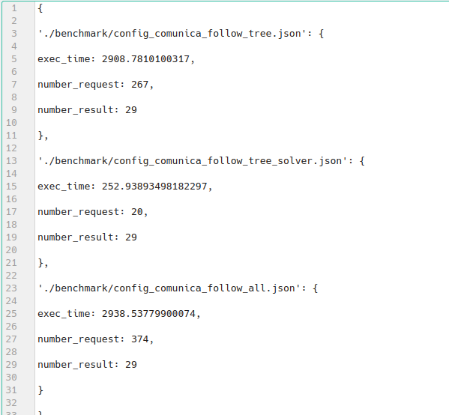
Testing query performance
Data: Time series, public transportation
Different topologies: B-tree, linked list, …
Parameters
  Number of request
  Query execution time
  Number of results

Slide 31
Future work
Benchmarking of query clients
Better visualization tool
  Seeing which node we traversed
Support for string
View selection based on the query
Support of the Hydra search

