Slide 1



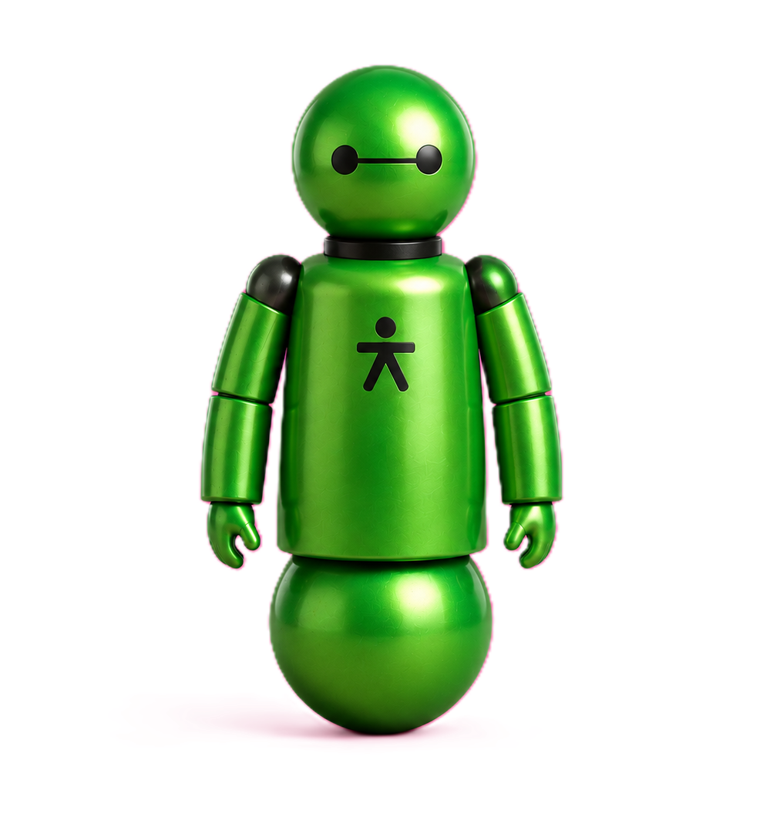

PINK

Slide 2
GREEN

