Slide 1

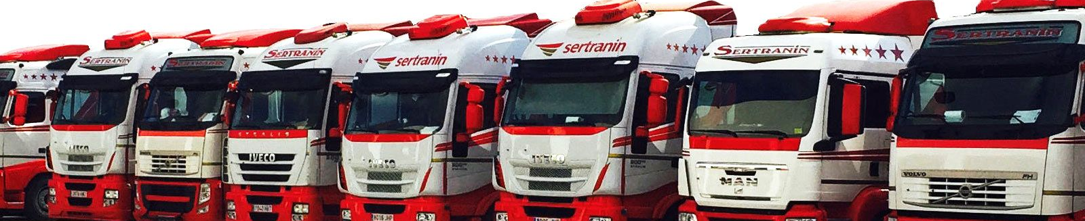
B2B MEETINGS IN PIEDMONT · GRUPO SERTRANIN
Family-run logistics,
ready to cross borders
Road transport and logistics from collection to final delivery.
Spain · Portugal · France · Germany
Italy: occasional services, no established presence
Notes:
Sertranin is a family-run logistics group founded in 1996. Elena places this B2B workshop in Piedmont and adds Portugal to the countries where the group operates. Her text says Sertranin has already carried out occasional transport services in Italy at customers’ request, although it has no established presence there.
Sources: the company PDF and Elena’s document supplied for this presentation. Photograph: Sertranin’s corporate website.
Source images: https://sertranin-transportes.es/

Slide 2
01 / ABOUT US
A family business that grew with its customers
Since 1996, Sertranin has tailored its transport services to each operation. In 2011, Logística Javier Talavera was established to cover the full logistics journey.
1996
2008
2011
Today
Sertranin is founded, initially specialising in bulk transport.
GPS is installed across the fleet, allowing customers to track their goods.
Logística Javier Talavera is established, broadening the group’s specialist services.
Three logistics bases and operations in Spain, Portugal, France and Germany.
01 / ABOUT US
02 / 16
Notes:
Advance to reveal the four milestones. This scene shows the continuity of the family business and how its services grew alongside customers’ needs.
Source: company PDF supplied.
Source images: https://sertranin-transportes.es/

Slide 3
02 / WHAT WE DO
The full
goods journey
From collection to final delivery, with warehousing and order preparation so customers can focus on their core business.
01
02
03
04
05
Collection
Transport
Warehousing
Order preparation
Delivery
Eight specialist services for different operations.
02 / WHAT WE DO
03 / 16
Notes:
This diagram summarises the journey the company says it can cover. Elena adds order preparation and emphasises that the aim is to free customers to focus on their core business. The sequence is not mandatory for every shipment. Advance to reveal the five stages.
Sources: the company PDF and Elena’s document supplied.
Source images: https://sertranin-transportes.es/

Slide 4
02 / WHAT WE DO
Eight specialist services. One group
Each service has its own equipment and operational know-how.
01
Bulk goods
05
Fuel transport
02
Palletised goods and groupage
06
Special transport
03
Steel industry
07
Containers and port services
04
ADR and waste
08
Stock management
02 / WHAT WE DO
04 / 16
Notes:
This scene is interactive. Select any of the eight specialist services, or use the left and right arrow keys when a tab has focus. Details come from the company PDF. Confirm current commercial and technical information with Sertranin.
Photographs: Sertranin’s corporate website. Text source: company PDF supplied.
In PowerPoint, the eight interactive HTML tabs continue as four editable detail slides.
Source images: https://sertranin-transportes.es/

Slide 5
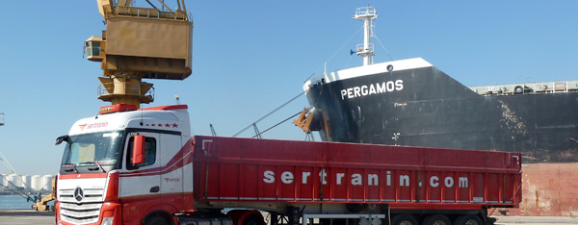
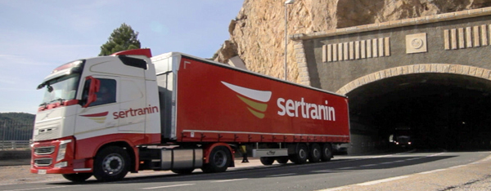
02 / WHAT WE DO
Specialist services in detail
01–02 / 08
01
Bulk goods
02
Palletised goods and groupage
Over 20 years transporting bulk goods with tipper trailers, including the loading and unloading of ships.
Groupage to every Spanish province, with fast delivery throughout the country.
Where the group began
Own fleet and two logistics bases
02 / WHAT WE DO
05 / 16
Notes:
This scene is interactive. Select any of the eight specialist services, or use the left and right arrow keys when a tab has focus. Details come from the company PDF. Confirm current commercial and technical information with Sertranin.
Photographs: Sertranin’s corporate website. Text source: company PDF supplied.
Source images: https://sertranin-transportes.es/

Slide 6
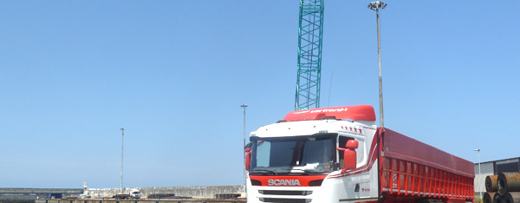
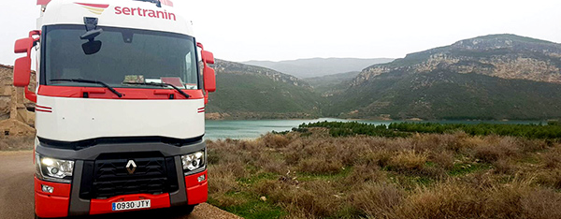
02 / WHAT WE DO
Specialist services in detail
03–04 / 08
03
Steel industry
04
ADR and waste
From collecting scrap metal for steelworks to distributing heavy steel coils, beams and sections.
Dangerous goods and both hazardous and non-hazardous waste, in bulk or on pallets. Sertranin states that it holds the necessary permits and uses ADR-equipped vehicles.
Across the steel supply chain
Specialist operations
02 / WHAT WE DO
06 / 16
Notes:
This scene is interactive. Select any of the eight specialist services, or use the left and right arrow keys when a tab has focus. Details come from the company PDF. Confirm current commercial and technical information with Sertranin.
Photographs: Sertranin’s corporate website. Text source: company PDF supplied.
Source images: https://sertranin-transportes.es/

Slide 7
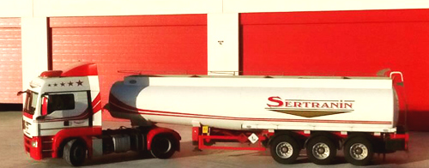
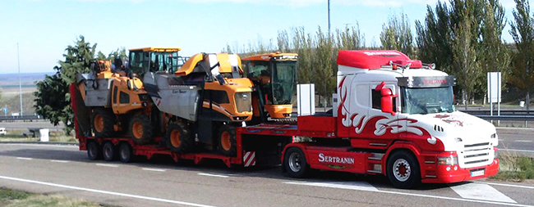
02 / WHAT WE DO
Specialist services in detail
05–06 / 08
05
Fuel transport
06
Special transport
One of the group’s newer divisions, with dedicated equipment and a team focused on operational safety.
Machinery, vehicles and infrastructure. Low loaders carry oversized loads. The company PDF says 80% of vehicles can accommodate loads of up to 15 metres.
Specialist support, 24 hours a day, year-round
Oversized loads
02 / WHAT WE DO
07 / 16
Notes:
This scene is interactive. Select any of the eight specialist services, or use the left and right arrow keys when a tab has focus. Details come from the company PDF. Confirm current commercial and technical information with Sertranin.
Photographs: Sertranin’s corporate website. Text source: company PDF supplied.
Source images: https://sertranin-transportes.es/

Slide 8
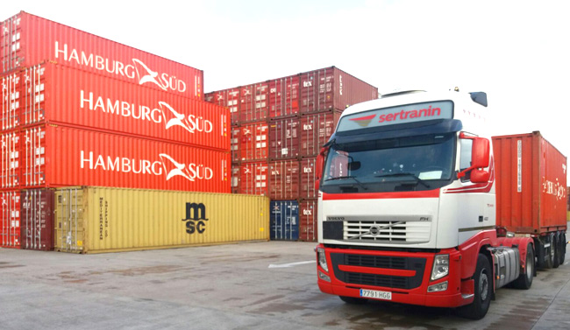
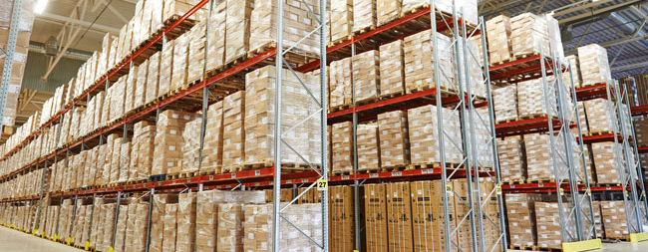
02 / WHAT WE DO
Specialist services in detail
07–08 / 08
07
Containers and port services
08
Stock management
From Picassent, near the Port of Valencia: containers, consolidation, cross-docking, loading and storage for imports and exports.
Sertranin teams work on customers’ premises, handling stock, orders, documentation and labelling.
Own resources near the port
Logistics integrated into customers’ operations
02 / WHAT WE DO
08 / 16
Notes:
This scene is interactive. Select any of the eight specialist services, or use the left and right arrow keys when a tab has focus. Details come from the company PDF. Confirm current commercial and technical information with Sertranin.
Photographs: Sertranin’s corporate website. Text source: company PDF supplied.
Source images: https://sertranin-transportes.es/

Slide 9
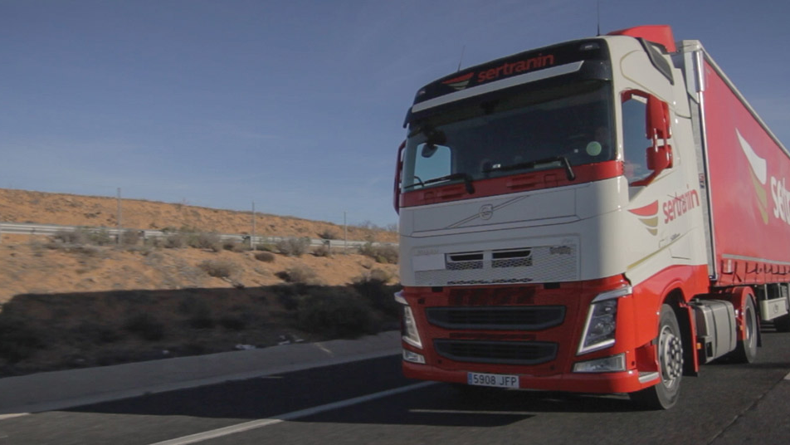
EQUIPMENT FOR DIFFERENT LOADS
A fleet for different types of cargo
01
02
03
Tipper trailers
Curtainsiders
Walking-floor trailers
SECTORS WE WANT TO GROW IN
Automotive, chemicals and retail
EQUIPMENT FOR DIFFERENT LOADS
09 / 16
Notes:
Elena highlights three types of trailer: tippers, curtainsiders and walking-floor trailers. Automotive, chemicals and retail are target sectors, not a list of customers already won. Advance to reveal the three trailer types.
Sources: Elena’s document supplied and Sertranin’s corporate website for fleet terminology.
Source images: https://sertranin-transportes.es/

Slide 10
PICASSENT AND THE VALENCIA AREA
Valencia, close to the port
Container transport for imports and exports. Sertranin can arrange customs clearance when customers need it.
2
bonded warehouses in the Valencia area
Storage
Stock management
Order preparation
National and international distribution
PICASSENT AND THE VALENCIA AREA
10 / 16
Notes:
The company PDF places container operations in Picassent, near the Port of Valencia. Elena adds two bonded warehouses in the Valencia area and says Sertranin can arrange customs clearance on request. The supplied documents do not identify the warehouses’ addresses or authorisations; confirm their status and precise description before using this as a formal credential.
Sources: the company PDF and Elena’s document supplied. Photograph: Sertranin’s corporate website.
Source images: https://sertranin-transportes.es/

Slide 11
03 / HOW WE WORK
Capabilities and credentials you can verify
1996
2008
24/365
3
Year the group was founded
GPS across the fleet
Support throughout the year
Own logistics bases
ISO 9001:2015
ISO 14001:2015
GPS tracking
Quality management
Environmental management
Shipment location visible to customers
03 / HOW WE WORK
11 / 16
Notes:
Advance to reveal the four figures. The company PDF states ISO 9001:2015 and ISO 14001:2015 certification but does not include the certificates. Check their current status before using them as formal credentials.
Source: company PDF supplied.
Source images: https://sertranin-transportes.es/

Slide 12
04 / OUR LOCATIONS
In Cuenca and Valencia, close to the port
Cuenca
Valencia
HEAD OFFICE
Minglanilla
WAREHOUSE AND CONTAINERS
Picassent
Fuente de los Arrieros industrial estate. Fuel station and vehicle wash near the A-3 motorway.
La Coma industrial estate, near the Port of Valencia.
LOGISTICS BASE
Iniesta
OFFICES
Beniparrell
Warehousing, maintenance and operations management.
Av. Camino del Polio, 18.
Three logistics bases and one office location
04 / OUR LOCATIONS
12 / 16
Notes:
The company PDF lists four locations but only three logistics bases. Beniparrell is listed as an office. Elena also mentions two bonded warehouses in the Valencia area, but her document does not say whether either corresponds to a location shown here. Do not add them to the three-base count.
Sources: the company PDF and Elena’s document supplied.
Source images: https://sertranin-transportes.es/

Slide 13
05 / PARTNERSHIPS
Partners for growth in Italy and Europe
We operate in Spain, Portugal, France and Germany. We have already carried out transport services in Italy at customers’ request, but have no established presence there yet.
Portugal
Spain
France
Germany
Current operations
Current operations
Current operations
Current operations
Italy
No established presence
Italy: previous services at customers’ request. Lines do not represent specific routes.
05 / PARTNERSHIPS
13 / 16
Notes:
Elena adds Portugal to the countries where Sertranin operates and says the group has already carried out transport services in Italy at customers’ request. The company has no established presence there. The diagram does not imply a regular route, office or local network in Italy.
Sources: the company PDF and Elena’s document supplied.
Source images: https://sertranin-transportes.es/

Slide 14
05 / PARTNERSHIPS
A partnership that works for both sides
What we offer
What we seek
01
Transport, warehousing and distribution in Spain using our own resources.
01
Transport and logistics companies in Italy and other EU countries.
02
Operations near the Port of Valencia, with delivery in 24–48 hours for eligible services.
02
Services, routes or local knowledge that complement our own.
03
Specialist services for bulk goods, steel, ADR, fuel and oversized loads.
03
Lasting partnerships that create opportunities for both sides to grow.
04
Year-round support and GPS tracking.
05 / PARTNERSHIPS
14 / 16
Notes:
Elena focuses the search on partners in Italy and other EU countries whose services, routes or local knowledge complement Sertranin’s. The company PDF mentions 24–48 hour delivery; confirm the commitment applicable to each route and operation before making an offer.
Sources: the company PDF and Elena’s document supplied, plus the services section of sertranin-transportes.es.
Source images: https://sertranin-transportes.es/

Slide 15
B2B MEETINGS · PIEDMONT
A conversation to find the right fit
In our individual meetings, we want to understand three things:
01
What does each company do particularly well?
02
Where does each of us need support?
03
What practical opportunity could we develop together?
B2B MEETINGS · PIEDMONT
15 / 16
Notes:
This scene reflects the purpose of the individual B2B meetings in Elena’s text. Start with each company’s strengths, identify where support is needed and end with a practical opportunity for collaboration. It does not presume an agreement or commercial commitment. Advance to reveal the three questions.
Source: Elena’s document supplied.
Source images: https://sertranin-transportes.es/

Slide 16
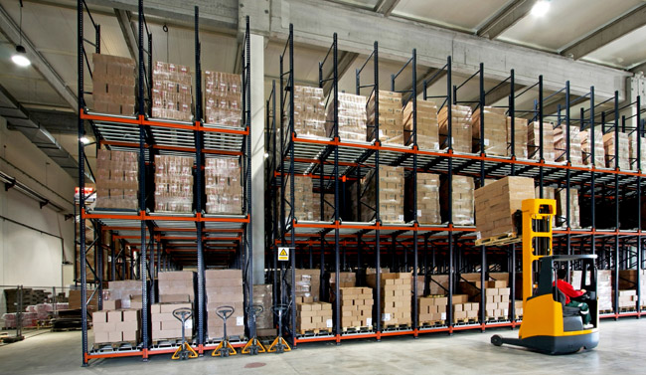
06 / CONTACT
Meet Sertranin
in person
Let’s talk about capabilities, needs and practical ways to work together.
trafico@sertranin.com
+34 962 163 161 · +34 967 490 565
sertranin-transportes.es
06 / CONTACT
16 / 16
Notes:
Elena closes by inviting conversations during the workshop. Contact details come from the company PDF and have been checked against Sertranin’s website. Before wider distribution, confirm the status and scope of the two bonded warehouses.
Source images: https://sertranin-transportes.es/

