Slide 1

TAF SCENARIO introduction workshop
Dmitry Novikov
Notes:
What we are trying to achieve with this workshop is to summarize currently available scenario capabilities, fill blank spaces in knowledge, and get everybody on same page.

Slide 2
Agenda
9:30-10:15 - Intro presentation
What is TAF Scenario
Scenario Building blocks – Flow/Test Step/Operator
Flow of scenario - Data Sources/vUsers/Cleanup
10:15-11:15 - Practical Exercises and Q&A
~11:15-11:30 - Break
11:30-12:00 - Advanced usage
Subflows/Splits
Combining Data Sources
Shared Data Sources
12:00-13:00 - Practical Exercises and Q&A
~13:00-14:00 - Lunch break
14:00-14:30 - Wrap up
Tomorrow 14:00-16:00 - Follow up
Notes:
* We expect Q&A during all practical Exercise time. Don’t hesitate to ask questions during this time!
* Break Times are not fixed. Take Lunch breaks and other breaks whatever time suits you best during Practical Exercises

Slide 3
What is TAF Scenario
Notes:
As always, lets quickly go through scenario basics…

Slide 4
Why TAF Scenario
TAF Scenario is advanced way to define and schedule test execution.
Composing Test Flow from reusable components
Executing tests in parallel
Repeating same test code with different input data (Data Driven testing)
Simulating real-time events combining multiple flows
Notes:
Tests or parts of the test

Slide 5
Scenario Features
Java API
Can be used for:
Acceptance Tests
Integration Tests
End-to-end Tests
Performance Tests
Unit Tests
Visualization of execution
Integrates with Allure Test Reporting tool

Slide 6
Scenario building blocks
Notes:
As always, lets quickly go through scenario basics…

Slide 7
Scenario Building blocks hierarchy
Operator – reusable API to SUT
Test Step is an atomic business action that parametrizes calls to operator(s)
Flow is sequence of Test Steps
Scenario is combination of Flows
Scenario
Flow
Test Step
Operator
SUT
combination of
sequence of
adapts to represent
logical action
calls
Notes:
* For example you have System you need to Test (SUT)…

Slide 8
Scenario Building blocks
scenario("scenario") .addFlow( flow("flow") .addTestStep( annotatedMethod(this, Ids.TEST_STEP_1)) .addTestStep( annotatedMethod(this, Ids.TEST_STEP_2)) ) .build();
Scenario
Flow
Test Step1
Test Step2
Notes:
Here is example of very simple scenario, consisting from one flow and two Test Steps
Scenario is constructed using builders

Slide 9
Operators
@com.ericsson.cifwk.taf.annotations.Operator
Provides Java API to SUT (System Under Test). Usually accessing system by HttpTool, TAF UI or CliTool
Reusable by different Test Steps
@Inject Provider<Operator> in Test Steps
There are multiple operators created for shared usage:
Login/Logout
Working with Nodes
More…
! Operators should not contain state
i.e. static variables, class variables etc.
Because can be accessed by multiple vUsers at same time
Notes:
Operators should not contain state

Slide 10
Test Step 1
Is basic building block of Test
Test Step is an atomic test action, which encapsulates a single business function
i.e. Login, Send Email, Add node
Might be reused in different Flows

Slide 11
Test Step 2
To increase re usability Test Step can be parametrized
Example parameter may be username or password.
To access SUT Test Steps are using operators
Among interaction with SUT Test Step may contain assertions to verify state or response of SUT
This is where Scenarios become Test Scenario.

Slide 12
Test Step vs Operator
Test Step
Represents Business action
May call multiple operators
May contain assertion @com.ericsson.cifwk.taf.annotations.Output
Reusable or test specific logic
Work with Context/Data Sources
Operator
API to SUT
More generic
Always Reusable
Notes:
Operator is just API to SUT
Test Steps represent logical business action

Slide 13
Test Step Example
Java method annotated with @com.ericsson.cifwk.taf.annotations.TestStep with uniq ID
Arguments are annotated with @com.ericsson.cifwk.taf.annotations.Input to allow parametrization
@TestStep(id = Ids.LOGIN) public void login( @Input(Params.USERNAME) String username, @Input(Params.PASSWORD) String password) { SUToperator.login(username, password); }
Notes:
Test Step is basically method
Method arguments are parameters

Slide 14
Test Step Example
Test may have parametrized assertions annotated with @com.ericsson.cifwk.taf.annotations.Output
If Test Step creates object (i.e. node, tool) it can be returned from method
@TestStep(id = Ids.LOGIN) public HttpTool login( @Input(Params.USERNAME) String username, @Input(Params.PASSWORD) String password, @Output(Params.EXPECTED_STATUS) int expectedStatus) { Response response = SUToperator.login(username, password); assertThat(response.getStatus()).equalTo(expectedStatus); return response.getTool(); }

Slide 15
Test Flow
Combination of Test Steps
Represents logical sequence of business actions
Example Flow may perform sending of email. It may consist of following actions (3 Test Steps):
Flow is created using static builder method TestScenarios#flow
Flow “sendEmail”
Login
Send Email
Logout

Slide 16
TEST flow example
Execute Test Step. I.e. method from current class (this) annotated with `@TestStep(id = "Ids.LOGIN")`.
TestStepFlow sendEmail = flow("send email") .addTestStep(annotatedMethod(this, Ids.LOGIN) .withParameter(Params.USERNAME, "root") .withParameter(Params.PASSWORD, "shroot")) .addTestStep(annotatedMethod(this, Ids.SEND_EMAIL)) .addTestStep(annotatedMethod(this, Ids.LOGOUT)) .build();
Passing parameters to Test Step defined in previous slide
Flow “sendEmail”
Login
Send Email
Logout

Slide 17
Flow of scenario
Notes:
As always, lets quickly go through scenario basics…

Slide 18
Defining & Running Scenario
Lets look at definition of very simple Scenario that sequentially runs 3 flows:
To run scenario build TestScenarios#runner
TestScenario scenario = scenario("email SUT test") .addFlow(createUsers) .addFlow(sendEmail) .addFlow(cleanupUsers).alwaysRun() .build();
Definition
Execution
TestScenarioRunner scenarioRunner = runner().build(); scenarioRunner.start(scenario);
Flow “createUsers”
Flow “sendEmail”
Flow “cleanupUsers”

Slide 19
Data sources (Data driven)
Notes:
As always, lets quickly go through scenario basics…

Slide 20
Data Records
Data Record is Java Bean with named fields
Interface not Class (implementation resides inside Data Source engine)
public interface User extends DataRecord { String getUsername(); String getPassword(); }

Slide 21
Data Record and test step
Data Record is Input to Test Step
Fields from Data Record
Data Record Bean
@TestStep(id = Ids.LOGIN) public void login( @Input(Params.USERNAME) String username, @Input(Params.PASSWORD) String password) {
@TestStep(id = Ids.LOGIN) public void multipleRecords(
@Input(DataSource.USERS) User user) { logger.debug(user.getPassword()); //...

Slide 22
Data Sources
Data Source is collection of Data Records
When defined on Flow, repeats all Test Steps of Flow with each Data Record
There are different ways to create Data Source.
CSV files
Data from database/netsim
Java class
Java collection
e.t.c.

Slide 23
Data source example
For example Flow need to send email with 2 different users
! users != vUsers
Simplest way to create Data Source is from csv file. Each row will represent one Data Record:
Before start of scenario Data Source should be loaded
TafTestContext.getContext().addDataSource("DS1", fromCsv("fileName.csv")); using name "DS1"
Via datadriven.properties
username , password user1 , password1 user2 , password2
1
2

Slide 24
Data source example
In prev. example Test Steps were parametrized by constants
scenario("scenario") .addFlow( flow("send email") .addTestStep( annotatedMethod(this, Ids.LOGIN) .withParameter(Params.USERNAME, "root") .withParameter(Params.PASSWORD, "shroot")) .addTestStep(annotatedMethod(this, Ids.SEND_EMAIL)) .addTestStep( annotatedMethod(this, Ids.LOGOUT) .withParameter(Params.USERNAME, "root")) );

Slide 25
Data source example 2
Data Source DS1 provide parameters for Test Steps
scenario("scenario") .addFlow( flow("send email") .addTestStep( annotatedMethod(this, Ids.LOGIN)) .addTestStep(annotatedMethod(this, Ids.SEND_EMAIL)) .addTestStep( annotatedMethod(this, Ids.LOGOUT)) .withDataSources(dataSource(DS1)) );
Notes:
* Step send Email is not parametrized, but will be executed anyway

Slide 26
Data SOURCE
scenario("scenario") .addFlow( flow("flow") .addTestStep(annotatedMethod(this, "TS1"))
.addTestStep(annotatedMethod(this, "sen")) .addTestStep(annotatedMethod(this, "TS2")) .withDataSources(dataSource(DS1)) ) .build();
login
send
logout
Data Source DS1:
1
2
“flow”
login
send
logout
login
send
logout
1
1
2
2
time
Notes:
Data Source contains from Data Records

Slide 27
vusers
Notes:
As always, lets quickly go through scenario basics…

Slide 28
Vusers
Runs flow in parallel (copy)
Represent users accessing SUT simultaniosly
Have same Context
For specifics refer to TAF Scenario Guidelines

Slide 29
vusers
scenario("scenario") .addFlow( flow("flow") .addTestStep(annotatedMethod(this, "TS1")) .addTestStep(annotatedMethod(this, "TS2"))
.addTestStep(annotatedMethod(this, "TS3")) .withVusers(2)
) .build();
login
send
logout
vUser1
login
send
logout
“flow”
vUser2
login
send
logout
time
Notes:
If DS allows you to repeat copy of flow seq, vUsers lets you do thi

Slide 30
vUsers & datasources
scenario("scenario") .addFlow( flow("flow") .addTestStep(annotatedMethod(this, "TS1")) .addTestStep(annotatedMethod(this, "TS2")) ) .build();
TS1
TS2
.withVusers(3)
.withDataSources(dataSource(DS))

Slide 31
regular (COPIED) Data SOURCE
Data Source
1
2
vUser1
TS1
TS2
TS3
TS1
TS2
TS3
1
1
1
2
2
2
vUser2
“flow”
TS1
TS2
TS3
TS1
TS2
TS3
1
1
1
2
2
2
vUser3
TS1
TS2
TS3
TS1
TS2
TS3
1
1
1
2
2
2
time
Each Test Step will repeat [vUser] * [Data Record count]

Slide 32
Always run
flow("flow1") .addTestStep(annotatedMethod(this, "TS1")) .addTestStep(annotatedMethod(this, "TS2")) //Exception! .addTestStep(annotatedMethod(this, "TS3").alwaysRun())
TS1
TS2
TS3
vUser1
TS1
TS2
TS3
Regular Test Step
Gets Data Record
Cleanup for vUser
Recommended way to do cleanup
“flow1”
vUser2
TS1
TS2
TS3
time

Slide 33
Before/after flow
flow("flow1") .addTestStep(annotatedMethod(this, "TS1")) .addTestStep(annotatedMethod(this, "TS2")) .afterFlow(new Runnable() {/*...*/})
TS1
TS2
After
vUser1
TS1
TS2
java.lang.Runnable
Will run once regardless vUser count
Not aware about Data Sources
“flow1”
After
vUser2
TS1
TS2
time

Slide 34
Passing values between Test Steps
Test Context
Contains objects specific to current vUser
Example: HttpTool with authorisation cookies
Data Source
Objects shared between all vUsers
Example: Created Node
Deprecated
Between vUser
Between all vUsers
@Inject private TestContext testContext;
testContext.setAttribute("userSpecific", tool);
testContext.dataSource(“nodes") .addRecord() .setField(“id", “123") .setField(“type", “abc");

Slide 35
Passing values between Test Steps
Recommended
As Java method Test Step can return value
Test Step result could be passed as parameter to sequential Test Step in same flow by same vUser
Test Step result could be collected to Data Source and shared in scope of all scenario
More Info

Slide 36
Passing values example
Create Data Source and collect all results from Test Steps
scenario("scenario")​ .addFlow(​ flow("flow1") .addTestStep(annotatedMethod(this, Ids.THE_TEST_STEP) .collectResultToDatasource(DS)) .addTestStep(annotatedMethod(this, Ids.NEXT_TEST_STEP) .withParameter("input", TestScenarios.fromTestStepResult(Ids.THE_TEST_STEP))) ) .addFlow(​ flow("flow2") .addTestStep(annotatedMethod(this, Ids.NEW_TEST_STEP)) .withDataSources(dataSource(DS)) );
Result
passed
User Data Source Created in previous flow

Slide 37
workshop format

Slide 38
Meet excerise
Koan = @Test + placeholders + AssertJ
Objective is to make all tests pass
Fill in the placeholder
TIP Recommended way is to run Test from IDE (using mvn will slow down process)
TIP Read all code in class is recommended
TIP Looking in assertions first is recommended
TIP Look in JavaDocs & Comments

Slide 39
Meet PLACEHOLDER
___.<Class>___() or //.___()
Replace it with code to pass the test
Can be replaced by:
Method call
Argument
Multiple arguments
! You don’t need do any other changes in code to make test pass
Notes:
Placeholder = statement or comment

Slide 40
Meet stack
Allows you to see how your modifications affect Test Step execution order
SUTSimulation.getExecutionOrder()
[“PERFORM_ACTION_ON_NODE (SGSN-14B)”, “PERFORM_ACTION_ON_NODE (LTE01ERB)”, “PERFORM_ACTION_ON_NODE (LTE08dg2)”]
TIP stack gives immediate feedback, so experiment with scenario and run it to get results as much as possible.
Notes:
Best way how to get familiar with scenarios is experimenting. Stack gives you immediate feedback

Slide 41
Getting Started
Search for Scenario Workshop in Confluence
git clone ssh://<user>@gerrit.ericsson.se:29418/OSS/com.ericsson.cifwk/ERICtaf_koans
Import taf-scenario-workshop/pom.xml into IDE
! There are multiples projects in ERICtaf_koans. For this workshop you only need taf-scenario-workshop

Slide 42
Agenda
9:30-10:15 - Intro presentation
What is TAF Scenario
Scenario Building blocks
Flow of scenario - Data Sources/vUsers/cleanup
10:15-11:15 (or earlier) - Practical Exercises and Q&A
11:15-11:30 - Break
11:30-12:00 - Advanced usage
Subflows/Splits
Combining Data Sources
Shared Data Sources
212:00-13:00 - Practical Exercises and Q&A
13:00-14:00 - Lunch break
14:00-14:30 - Wrap up
Thursday 10 Nov 14:00-16:00 - Follow up

Slide 43
Practical exercises
_Introduction.java

Slide 44
Part 2: Advanced usage

Slide 45
subflow
scenario("scenario") .addFlow( flow("flow")
.addTestStep(annotatedMethod(this, "TS1")) .addSubFlow(flows.getSubFlow1()) .addSubFlow(flows.getSubFlow2()) ) .build();
TS0
TS1
TS2
TS3
TS4
Mechanism to execute Flow inside another Flow
Runs with same vUser as main flow
Reusability
Flexibility
vUser1
TS0
TS1
TS2
flow subFlow1 subFlow2
time
Notes:
Flows might be reused too
So theres mechanism to put flow inside other flow
Execution graph

Slide 46
SPLIT
flow("flow")
.addTestStep(annotatedMethod(this, "TS1")) .split( flow("flow1") .addTestStep(annotatedMethod(this, "TS1")) .addTestStep(annotatedMethod(this, "TS2")), flow("flow2") .addTestStep(annotatedMethod(this, "TS3")) .addTestStep(annotatedMethod(this, "TS4")) )
TS0
TS1
TS2
TS3
TS4
Split – run different SubFlows in parallel
! SubFlows will run with different vUser
Can be done on scenario or flow
vUser2
TS1
TS2
subFlow1
vUser1
TS0
flow
vUser3
TS3
TS4
subFlow2
time

Slide 47
More on DAtasources

Slide 48
Multiple datasources
flow("flow1") .addTestStep(annotatedMethod(this, "TS1")) .addTestStep(annotatedMethod(this, "TS2")) .withDataSources(dataSource(DS1), dataSource(DS2))
TS1
TS2
Data Source DS1
1
2
3
4
Data Source DS2
A
B
TS1
TS2
TS1
TS2
1
1
2
2
A
A
B
B
time
Each Test Step will repeat [Smallest Data Record count]

Slide 49
NESTED data sources
scenario("scenario") .addFlow( flow("flow") .addSubFlow( flow("subFlow") .addTestStep(annotatedMethod(this, "TS")) .withDataSources(dataSource(DS2)) ) ) .withDataSources(dataSource(DS1)) ) .build();
TS1
Notes:
Thre are difference when using multiple Data Sources on one of different flow levels. Take note to don’t miss it
For simplicity Only one test step

Slide 50
NESTED data sources
Data Source DS1
1
2
3
4
Data Source DS2
A
B
TS1
TS1
TS1
TS1
TS1
TS1
TS1
TS1
1
1
2
2
3
3
4
4
A
B
A
B
A
B
A
B
time
Nested Sub Flow will repeat multiplication
[DS1 Record count] * [DS2 Record count]
Notes:
Two Data Sources, one contains numbers, second – letters

Slide 51

Filtering Data Sources
flow("flow") .addTestStep(annotatedMethod(this, "TS1")) .addTestStep(annotatedMethod(this, "TS2"))
TS1
TS2
.withDataSources(dataSource(DS1).withFilter(“value < 3"))
Data Source DS1:
1
2
3
Its possible to filter Data Source using
Predicate or MVEL expression.
flow
TS1
TS2
TS1
TS2
1
1
2
2
time

Slide 52
Shared Data source

Slide 53
When to use Shared Data Source
Shared Data Source might be used:
When Data Records represent resources which could not be accessed by multiple users at same time (for example nodes)
To speed up Data Source processing by adding vUsers to Flow

Slide 54
Shared Data Source
In regular Data Source each vUser iterate through all Data Source records.
As opposed in Shared Data Source, each record will be processed only by one of vUsers
Shared Data Source can be represented as bucket of Data Records.
Each vUser might take one Data Record
If all Data Records are taken, Data Source will become "depleted" or "empty"
Data Source is shared in scope of scenario. If multiple flows use same Data Source they all "deplete" it
For specifics refer to TAF Scenario Guidelines
Notes:
* As you may seen on example in Part 1

Slide 55
Shared Data Source
vUsers share same Data Source
scenario("scenario") .addFlow( flow("flow") .beforeFlow(shareDataSource(DS)) .addTestStep(annotatedMethod(this, "TS1")) .addTestStep(annotatedMethod(this, "TS2")) .withDataSources(dataSource(DS)) .withVusers(3) ) .build();
Notes:
Another concept…

Slide 56
Shared Data Source
Data Source
1
2
3
4
vUser1
TS1
TS2
TS1
TS2
1
1
4
4
vUser2
TS1
TS2
2
2
vUser3
TS1
TS2
3
3
time
Each Test Step will repeat [Data Record count]

Slide 57
Making Data Source Shared
By taking existing Data Source (from example loaded as csv) and wrapping it into Shared:
By using TafDataSources#shareDataSource in Before/After flow:
By defining usage=shared in datadriven.properties
TestDataSource<DataRecord> mailContent = fromCsv("data/mailContent.csv"); TestDataSource sentEmails = TafDataSources.shared(mailContent); context.addDataSource(DS, sentEmails);
flow("flow") .beforeFlow(shareDataSource(DS)) //...

Slide 58
Be careful when using Shared Data Sources!
Might be depleted
When number of vUsers > size of Data Source some vUser may not get Data Record, i.e. not execute
When size of Data Source > than the number of vUsers, vUser that will finish processing first will take next available Data Record from bucket. I.e. some vUser may process more Data Records that others.
There more specific cases. Please refer Scenario Guidelines video starting from 16:45.

Slide 59
Debugging scenario

Slide 60
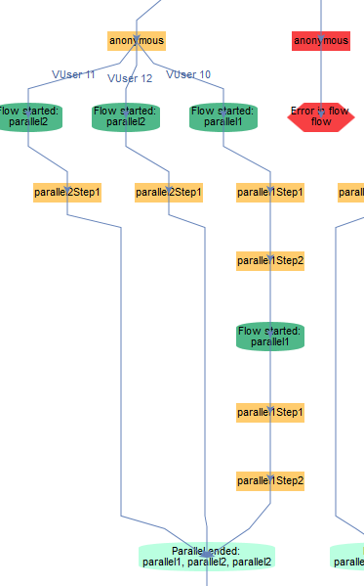
DEBUG: SHOW FLOW
← Branching
← End of flow because of exception
← Flow repetition (DataSource)
← Join Points

Slide 61
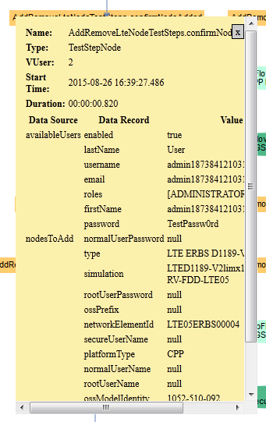
DEBUG: TEST STEP INFO
Full info on by clicking TestSteps/Flows:
vUser
Start time
Duration
Data Sources
Data Records
Notes:
By clicking on Test Step

Slide 62
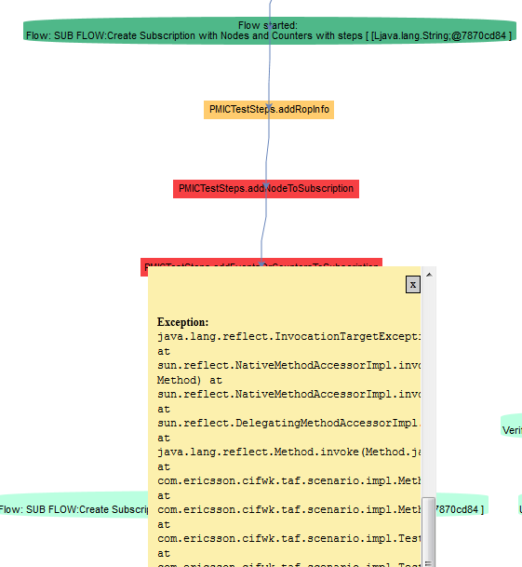
DEBUG: see root exception cause

Slide 63
Debug: highlights
After scenario finished (written to svg file):
enable: -Dtaf.scenario.debug.enabled=true
logs: Scenario graph was written to file … .svg
Runtime (visible in browser):
enable: -Dtaf.scenario.debug.enabled=true -Dtaf.scenario.debug.port=8787
logs: Scenario debug is available on … .svg

Slide 64
Debug: MISC
TIP Use Chrome browser as Firefox may hang on large Scenarios
Square represents failing test step
Stop Sign represents flow that stopped because of test step
More info

Slide 65
Agenda
9:30-10:15 - Intro presentation
What is TAF Scenario
Scenario Building blocks
Flow of scenario - Data Sources/vUsers/cleanup
10:15-11:15 (or earlier) - Practical Exercises and Q&A
11:15-11:30 - Break
11:30-12:00 - Advanced usage
Subflows/Splits
Combining Data Sources
Shared Data Sources
12:00-13:00 - Practical Exercises and Q&A
13:00-14:00 - Lunch break
14:00-14:30 - Wrap up
Tomorrow 14:00-16:00 - Follow up

Slide 66
Practical exercises
A_DataSources
B_ScenarioFlow
C_Debugging

Slide 67
Next steps
taf-stackoverflow.lmera.ericsson.se
Documentation
Advanced Scenario Concepts explanation
TAF Training & Sample Projects
Testware Design Rules

Slide 68
Notes:
2013-02-20
68

