Slide 1
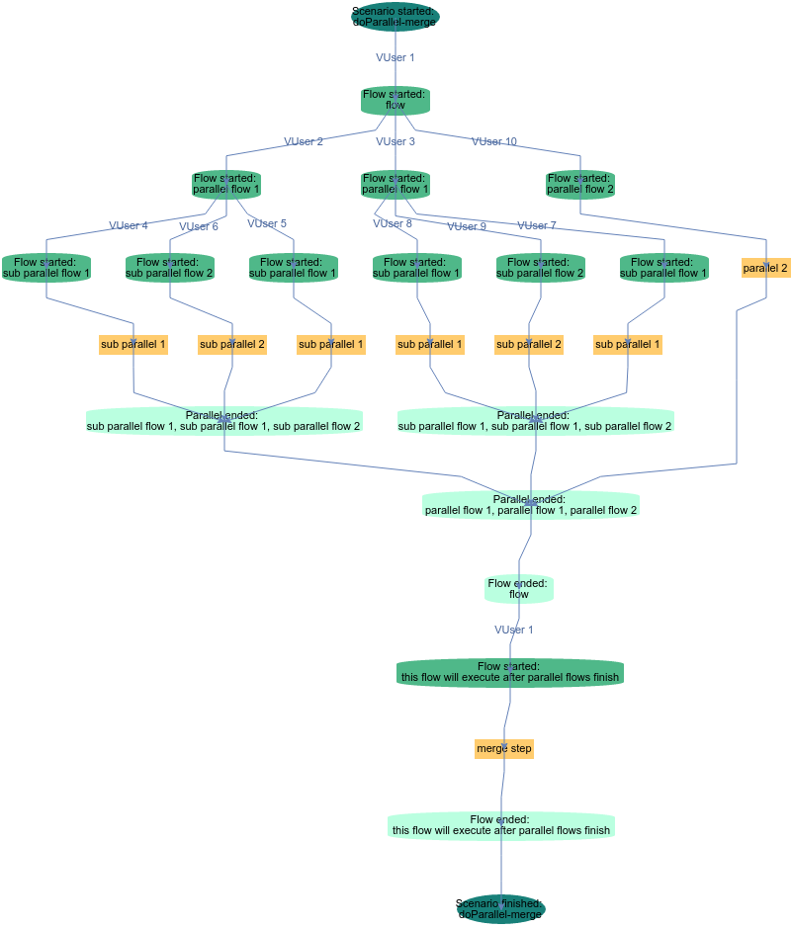
Scenarios. Main concepts
DataSource
Flow
Step
DataRecord
Operator
Context
VUser
TestScenario sendEmailScenario = scenario("Send email")
.addFlow(sendEmail)
.addFlow(sendReplyEmail)
.addFlow(receiveEmail)
.build();

Slide 2
Scenario Building blocks hierarchy
Operator – reusable API to SUT
Test Step is an atomic business action that parametrizes calls to operator(s)
Flow is sequence of Test Steps
Scenario is combination of Flows
Scenario
Flow
Test Step
Operator
SUT
combination of
sequence of
adapts to represent
logical action
calls
Notes:
* For example you have System you need to Test (SUT)…

Slide 3
Scenario Building blocks
scenario("scenario")
.addFlow(
flow("flow")
.addTestStep(
annotatedMethod(this, Ids.TEST_STEP_1))
.addTestStep(
annotatedMethod(this, Ids.TEST_STEP_2))
)
.build();
Scenario
Flow
Test Step1
Test Step2
Notes:
Here is example of very simple scenario, consisting from one flow and two Test Steps
Scenario is constructed using builders

Slide 4
Test Step Example
Java method annotated with @com.ericsson.cifwk.taf.annotations.TestStep with uniq ID
Arguments are annotated with @com.ericsson.cifwk.taf.annotations.Input to allow parametrization
@TestStep(id = Ids.LOGIN)
public void login(
@Input(Params.USERNAME) String username,
@Input(Params.PASSWORD) String password) {
SUToperator.login(username, password);
}
Notes:
Test Step is basically method
Method arguments are parameters

Slide 5
TEST flow example
Execute Test Step. I.e. method from current class (this) annotated with `@TestStep(id = "Ids.LOGIN")`.
TestStepFlow sendEmail = flow("send email")
.addTestStep(annotatedMethod(this, Ids.LOGIN)
.withParameter(Params.USERNAME, "root")
.withParameter(Params.PASSWORD, "shroot"))
.addTestStep(annotatedMethod(this, Ids.SEND_EMAIL))
.addTestStep(annotatedMethod(this, Ids.LOGOUT))
.build();
Passing parameters to Test Step defined in previous slide
Flow “sendEmail”
Login
Send Email
Logout

Slide 6
Data Record and test step
Data Record is Input to Test Step
  Fields from Data Record
  Data Record Bean
@TestStep(id = Ids.LOGIN)
public void login(
@Input(Params.USERNAME) String username,
@Input(Params.PASSWORD) String password) {
@TestStep(id = Ids.LOGIN)
public void multipleRecords(
@Input(DataSource.USERS) User user) {
logger.debug(user.getPassword());
//...

Slide 7
Data SOURCE
scenario("scenario")
.addFlow(
flow("flow")
.addTestStep(annotatedMethod(this, "TS1"))
.addTestStep(annotatedMethod(this, "sen"))
.addTestStep(annotatedMethod(this, "TS2"))
.withDataSources(dataSource(DS1))
)
.build();
login
send
logout
Data Source DS1:
1
2
“flow”
login
send
logout
login
send
logout
1
1
2
2
time
Notes:
Data Source contains from Data Records

Slide 8
Scenario Runner
Runner is the engine to execute the scenario in a controlled way. It takes care of threading mechanism in JVM. It also allows to specify logging and exception handling mechanism.
TestScenarioRunner runner;
runner().withListener(new LoggingScenarioListener())

Slide 9
Test Context
TestContext allows you to share data between test steps and create your own data sources Context is a way to implement business logic and interact with the system under test
@Inject
TestContext context;
context.setAttribute("username", "user");
context.getAttribute("username")

Slide 10
vusers
scenario("scenario")
.addFlow(
flow("flow")
.addTestStep(annotatedMethod(this, "TS1"))
.addTestStep(annotatedMethod(this, "TS2"))
.addTestStep(annotatedMethod(this, "TS3"))
.withVusers(2)
)
.build();
login
send
logout
vUser1
login
send
logout
“flow”
vUser2
login
send
logout
time
Notes:
If DS allows you to repeat copy of flow seq, vUsers lets you do thi

Slide 11
Exception Handling
In case an exception is thrown during flow execution it is caught and provided to exception handler.
ScenarioExceptionHandler.PROPAGATE
ScenarioExceptionHandler.IGNORE
ScenarioExceptionHandler.LOGONLY
scenario("scenario").withExceptionHandler(scenarioHandler)
Exception Handler in Scenario Runner will set Exception Handler for all Scenarios which will be started with this Runner:
runner().withDefaultExceptionHandler(runnerHandler).build().start(scenario);

Slide 12
Before/after flow
flow("flow1")
.addTestStep(annotatedMethod(this, "TS1"))
.addTestStep(annotatedMethod(this, "TS2"))
.afterFlow(new Runnable() {/*...*/})
TS1
TS2
After
vUser1
TS1
TS2
java.lang.Runnable
Will run once regardless vUser count
Not aware about Data Sources
“flow1”
After
vUser2
TS1
TS2
time

