Slide 1
SIM U2
AXE based traffic load generator
Petar.Simundza@ericsson.com

Slide 2
Message path
User Part
User Part
C7DR2
HLR
C7DR2
Signaling Terminal
Signaling Terminal
line
Signaling Terminal
Signaling Terminal
C7DR2
VLR
Routing/Discr.
MGTS
User part
State Machine

Slide 3
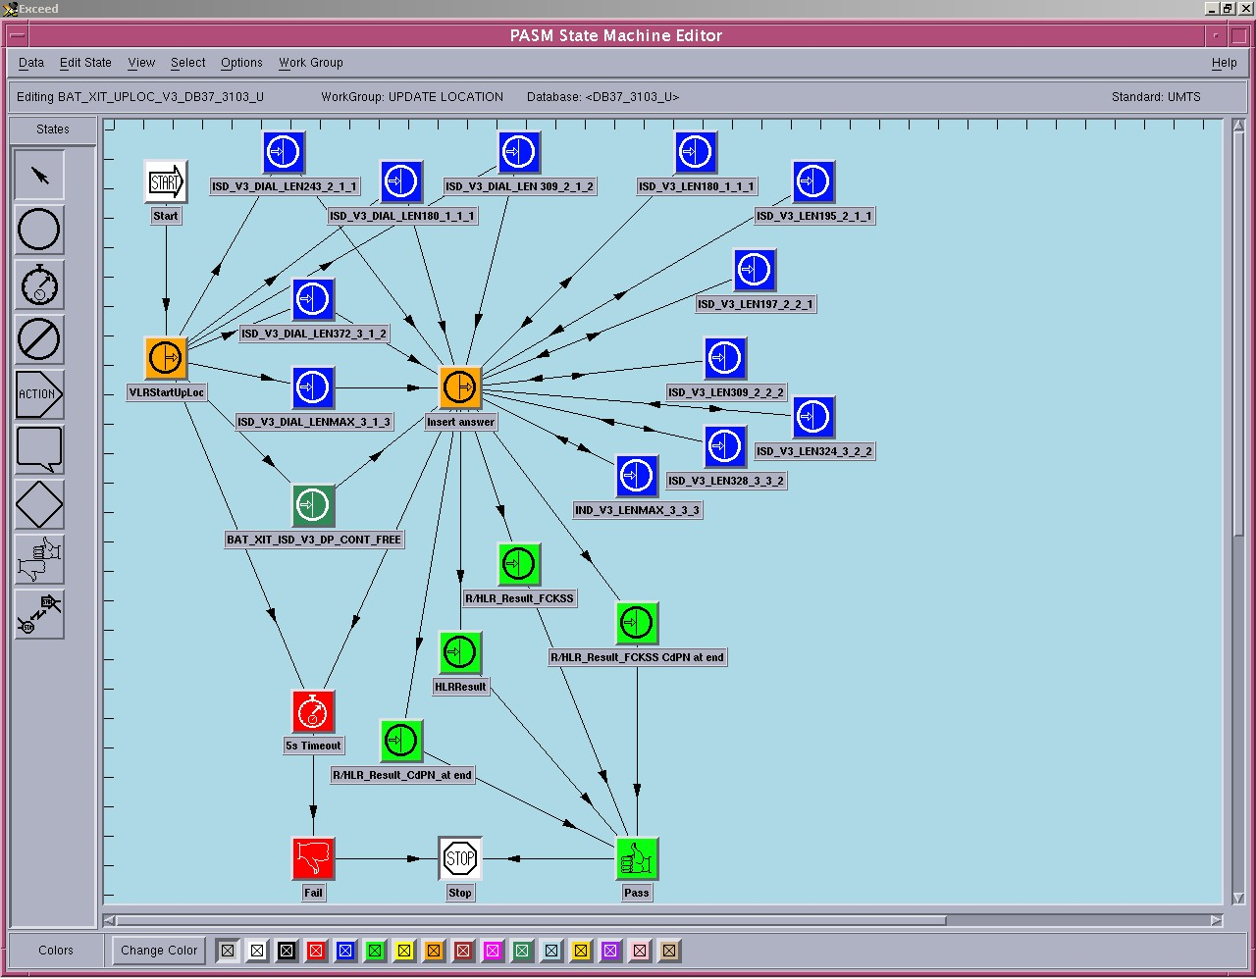
MGTS state machine

Slide 4
MGTS
Expensive ~ 200 000 EUR each shelf
License costs
Complex
How it works internally?
Special competences needed
Naming conventions, ClearCase administration
Support is far away

Slide 5
MGTS vs. VLR
User Part
User Part
C7DR2
MSC
C7DR2
Signaling Terminal
Signaling Terminal
line
Signaling Terminal
Signaling Terminal
C7DR2
VLR
Routing/Discr.
MGTS
State Machine
SIMU
State Machine
User part

Slide 6
VLR vs. HLR
User Part
User Part
C7DR2
HLR1
C7DR2
HLR2
Signaling Terminal
Signaling Terminal
line
Signaling Terminal
SIMU can be loaded
in any AXE node
(BSC, MSC, HLR, STP, …)
C7DR2
VLR
SIMU
SIMU

Slide 7
One HLR
SIMU
User Part1
User Part2
User Part3
HLR
C7DR2
ST1
ST2
ST3
ST4
ST5
loop
SIMU can be loaded in HLR under test

Slide 8


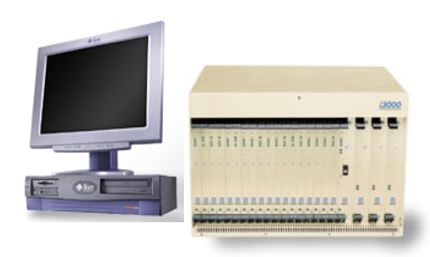
Possible scenarios
Any AXE node
HLR under test
SEA
SIMU
SIMU
via loop
MGTS

Slide 9
Benefits
1 MGTS costs ~ 200 000 EUR
Estimated block design costs ~ 200 000–300 000 EUR
MGTS script is flowchart input for block design
Command based user interface – similar to TLS
No license costs
Easy to see what is going on inside simulator block
Every tester is familiar with PLEX and ASA
No special competences needed
Ericsson internal support
Load limits are APZ dependent

Slide 10
Implementation approach
Prototype
  Update location
  Send routing info
  Provide roaming number
  Send authentication info
  Cancel location
Estimated technical cost: 500 mh
Estimated ready date: week 28
Decision for full implementation
Early estimation: 3-5 kmh

Slide 11
SIMU in VLR
HLR 300
VLR 102
User Part
S I M U
TAKEMSU
OPC=102
DPC=300
ROUTEMSU
OPC=102
DPC=300
ROUTEMSU
OPC=300
DPC=102
TAKEMSU
OPC=300
DPC=102
OPC(102):UPBLOCKREF(SCCP)=C7SRMH
OPC(300):UPBLOCKREF(SCCP)=SIMU
C7DR2
C7DR2
C7EMITMSU
OPC=300
DPC=102
C7EMITMSU
OPC=102
DPC=300
C7DISCRMSU
OPC=300
DPC=102
C7DISCRMSU
OPC=102
DPC=300
ST1
ST2
SIMDI:DEST=2-300;

Slide 12
SIMU in HLR with loop
SIMDI:DEST=2-103;
User Part
S I M U
TAKEMSU
OPC=102
DPC=300
ROUTEMSU
OPC=300
DPC=103
ROUTEMSU
OPC=300
DPC=102
TAKEMSU
DPC=300
OPC=103
OPC(102):UPBLOCKREF(SCCP)=C7SRMH
OPC(103):UPBLOCKREF(SCCP)=SIMU
C7DR2
DPC(102):SPSTATE=LOOP
DPC=300
OPC=103
C7EMITMSU
OPC=300
DPC=102
DPC(103):SPSTATE=LOOP
DPC=300
OPC=102
C7EMITMSU
OPC=300
DPC=103
C7DISCRMSU
OPC=300
DPC=102
C7DISCRMSU
OPC=300
DPC=103
ST1
ST2
SET VAR C7DR2 DPC103 : 2 = 7;
SET VAR C7DR2 DPC102 : 2 = 7;

Slide 13
SIMU features
4 destinations (SAE 504, commands SIMDI / E / P)
20 call programs (SAE 501, commands SIMCL / R / P)
1000 internal SIMU devices (SAE 500)
BHCA from 6 up to 65535 (90000) per call program
Subscribers ranges: up to 9999
Event sequence array: messages, states, fail point
Run single call, burst of calls (max 30), one CP in load, all CPs in load (command SIMTI)
Reporting of started, pass and fail (command SIMTP)
Stop the traffic (command SIMTE)

Slide 14
Supported call program types (prototype)
H’0002 – Update Location
H’0003 – Cancel Location (terminating)
H’0004 – Provide Roaming Number (terminating)
H’0016 – Send routing info
H’0017 – Update Location GPRS
H’0038 – Send Authentication Info
H’0039 – Send Authentication Info GPRS

Slide 15
SIMU in external node preparation
Load SIMU plex block: LASUL/FCSUL (large restart needed)
Connect SIMU as user for DPC and SCCP:
SIMDI:DEST=2-300;
Verify that SP and SSN are available
Define your call programs (SIMCR / SIMCL / SIMCP)
Run your traffic (SIMTI / SIMTE / SIMTP)

Slide 16
SIMU in HLR (loop) preparation
Load SIMU: LASUL / FCSUL (large restart needed)
Connect SIMU as user for DPC and SCCP:
SIMDI:DEST=2-103;
Make a loop
Set var c7dr2 dpc102:2=7;
Set var c7dr2 dpc103:2=7;
Verify that SP and SSN are available
  SIMU seized node (103) will have wrong C7NCP printout

Slide 17
Call program defaults - SIMCR[:CP=x];
<simcp:cp=0;
SIMU CALL PROGRAM DATA
CP 0
NAME
TYPE H'0000
NI 2
OPC 0
DPC 0
HLR 0
VLR 0
IMSI 000000000000000
RANGE 99
CPN 0
BRANGE 99
STATUS 0
BHCA 3600
END

Slide 18
Loading call program - SIMCL:CP=x[,…];
SIMCL:CP=0, TYPE=2, NAME="UPDATE LOCATION 3103";
SIMCL:CP=0, OPC=3103, DPC=300;
SIMCL:CP=0, HLR=49172401111, VLR=49101923103;
SIMCL:CP=0, IMSI=262002000000000, RANGE=99;
SIMCL:CP=0, CPN=49170200000, BRANGE=99;
SIMCL:CP=0, STATUS=1, BHCA=7000;

Slide 19
Printing call program data - SIMCP:CP=x;
<SIMCP:CP=0;
SIMU CALL PROGRAM DATA
CP 0
NAME UPDATE LOCATION 3103
TYPE H’0002
NI 2
OPC 3103
DPC 300
HLR 49172401111
VLR 49101923103
IMSI 262002000000000
RANGE 99
CPN 49170200000
BRANGE 99
STATUS 1
BHCA 7200
END

Slide 20
Starting traffic
Single call: SIMTI:CP=0,N=1;
Burst: SIMTI:CP=0,N=5;
One CP in load: SIMTI:CP=0;
All loaded CPs: SIMTI;
Stop one CP: SIMTE:CP=0;
Stop all CPs: SIMTE;
Statistic counters are reset at first SIMTI

Slide 21
Statistic and reporting
<SIMTP;
SIMU STATISTIC
CP STARTED PASS FAIL
0 UPDATE LOCATION 3103 3908 3905 0
1 0 0 0
2 SEND ROUTING INFO 3102 3893 3890 0
3 PROVIDE ROAMING NUMBER 3890 3890 0
4 0 0 0
5 SEND AUTHENTICATION INFO 3102 3886 3883 0
6 0 0 0
7 UPDATE LOCATION 3101 3881 3878 0
8 CANCEL LOCATION 12957 12957 0
9 0 0 0
10 0 0 0
11 UPDATE LOCATION GPRS 3103 2690 2688 0
12 0 0 0
13 UPDATE LOCATION GPRS 3101 2688 2686 0
14 0 0 0
15 SEND AUTH INFO GPRS 3102 3867 3863 0
16 0 0 0
17 0 0 0
18 0 0 0
19 0 0 0
TOTAL 41661 41640 0
END

Slide 22
Troubleshooting
All common trace measures available
Event sequence array: BAN 2
H’FFFF = failing point
H’FFxx = changing state
H’xxyy = sent / received message
  xx = message type
  yy = MAP operation

Slide 23
Beyond classical tool
Real time tool control:
  BHCA (different load during the day)
  CPTYPE (one subscriber doing different call types)
  IMSI (UpLoc from different subscribers)
  MSISDN (SRI for different subscribers)
  VLR (changing location)
Fault reproduction and troubleshooting
“Load” in SEA environment
CVE measurements
… your imagination…

Slide 24
Support needed?
SIMU web page:
https://quickplace.ericsson.se/SIMU
Mail:
Petar.Simundza@ericsson.com

Slide 25


