Slide 1
SIMU
AXE based mobile traffic load generator
Petar.Simundza@ericsson.com

Slide 2



Mobile network
Internet
GSM
Intranets
WCDMA
Network Control Layer
ISDN/PSTN
Media
POTS/ISDN
Gateway
Transport Network
PLMN
Connectivity Layer

Slide 3
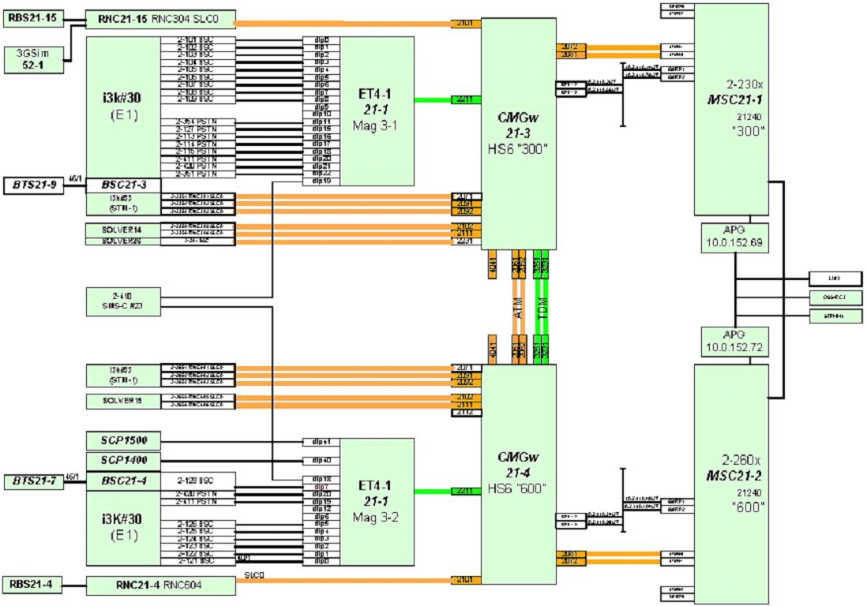
I&V Test Network

Slide 4
Message path
User Part
User Part
C7DR2
MSC
C7DR2
Signaling Terminal
Signaling Terminal
line
Signaling Terminal
Signaling Terminal
C7DR2
BSC
Routing/Discr.
MGTS
User part
State Machine

Slide 5
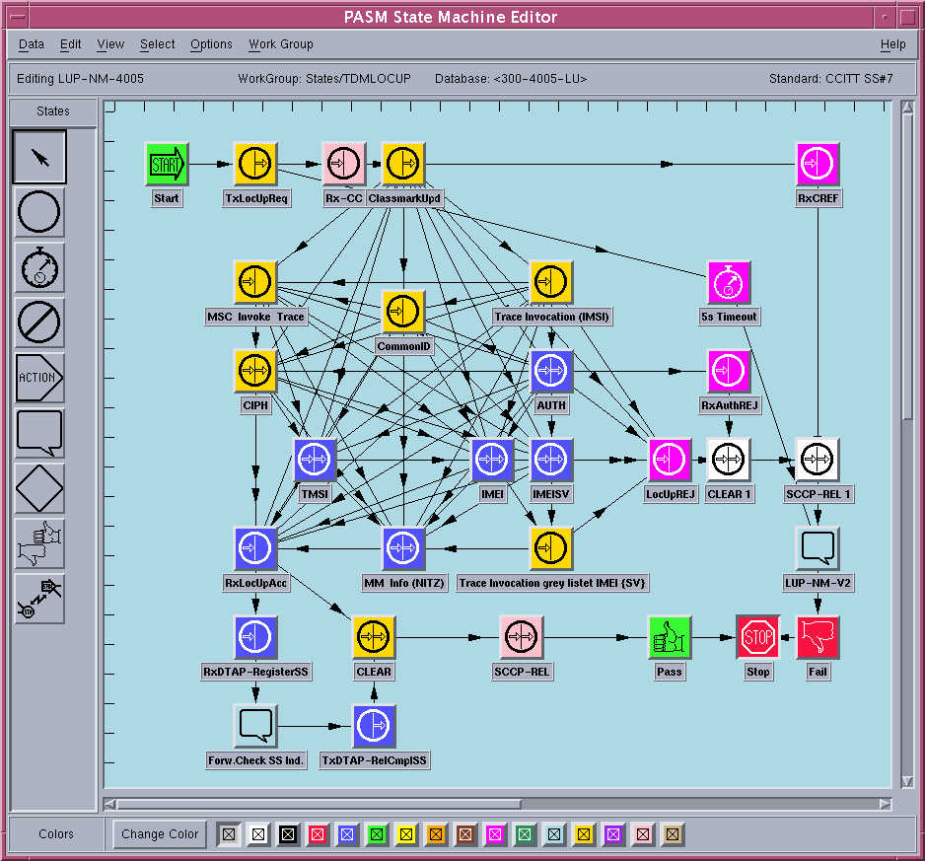
MGTS state machine

Slide 6
MGTS / Solver
Expensive ~ 200 000 EUR each shelf
License costs
Complex
How it works internally?
Special competences needed
Naming conventions, ClearCase administration
Support is far away

Slide 7
MGTS vs. BSC
User Part
User Part
C7DR2
MSC
C7DR2
Signaling Terminal
Signaling Terminal
line
Signaling Terminal
Signaling Terminal
C7DR2
BSC
Routing/Discr.
MGTS
State Machine
SIMU
State Machine
User part

Slide 8
BSC vs. MSC
User Part
User Part
C7DR2
MSC1
C7DR2
MSC2
Signaling Terminal
Signaling Terminal
line
Signaling Terminal
SIMU can be loaded
in any AXE node
(BSC, MSC, HLR, STP, …)
C7DR2
BSC
SIMU
SIMU

Slide 9
One MSC
SIMU
User Part1
User Part2
User Part3
MSC
C7DR2
ST1
ST2
ST3
ST4
ST5
loop
SIMU can be loaded in MSC under test

Slide 10


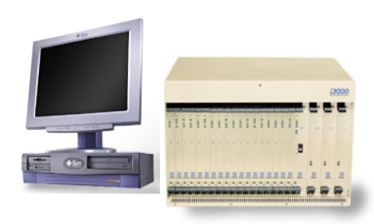
Possible scenarios
Any AXE node
MSC under test
SEA
SIMU
SIMU
via loop
MGTS / UPLOAD

Slide 11
Benefits
1 MGTS costs ~ 200 000 EUR
1 Solver costs ~ 100 000 EUR
Estimated block design costs ~ 200 000–300 000 EUR
MGTS script is flowchart input for block design
Command based user interface – similar to TLS
No license costs
Easy to see what is going on inside simulator block
Every tester is familiar with PLEX and ASA
No special competences needed
Ericsson internal support
Load limits are APZ dependent

Slide 12
Implementation approach
GSM Solver call scenarios (LUP, MOC, MTC)
WCDMA Solver call scenarios (LUP, MOC, MTC)
Interwork with UPload
Implement as much as possible MGTS scripts
Implement TTRMix as plug and play

Slide 13
SIMU in BSC
MSC 300
BSC 102
User Part
S I M U
TAKEMSU
OPC=102
DPC=300
ROUTEMSU
OPC=102
DPC=300
ROUTEMSU
OPC=300
DPC=102
TAKEMSU
OPC=300
DPC=102
OPC(102):UPBLOCKREF(SCCP)=C7SRMH
OPC(300):UPBLOCKREF(SCCP)=SIMU
C7DR2
C7DR2
C7EMITMSU
OPC=300
DPC=102
C7EMITMSU
OPC=102
DPC=300
C7DISCRMSU
OPC=300
DPC=102
C7DISCRMSU
OPC=102
DPC=300
ST1
ST2
SIMDI:DEST=2-300;

Slide 14
SIMU in MSC with loop
SIMDI:DEST=2-103;
User Part
S I M U
TAKEMSU
OPC=102
DPC=300
ROUTEMSU
OPC=300
DPC=103
ROUTEMSU
OPC=300
DPC=102
TAKEMSU
DPC=300
OPC=103
OPC(102):UPBLOCKREF(SCCP)=C7SRMH
OPC(103):UPBLOCKREF(SCCP)=SIMU
C7DR2
DPC(102):SPSTATE=LOOP
DPC=300
OPC=103
C7EMITMSU
OPC=300
DPC=102
DPC(103):SPSTATE=LOOP
DPC=300
OPC=102
C7EMITMSU
OPC=300
DPC=103
C7DISCRMSU
OPC=300
DPC=102
C7DISCRMSU
OPC=300
DPC=103
ST1
ST2
SET VAR C7DR2 DPC103 : 2 = 7;
SET VAR C7DR2 DPC102 : 2 = 7;

Slide 15
Signaling terminal load
S I M U
ROUTEMSU
OPC=300
DPC=102
TAKEMSU
DPC=300
OPC=103
OPC(103):UPBLOCKREF(SCCP)=SIMU
C7DR2
DPC(102):SPSTATE=LOOP
DPC=300
OPC=103
C7EMITMSU
OPC=300
DPC=102
C7DISCRMSU
OPC=300
DPC=102
ST1
ST2

Slide 16
SIMU features
4 destinations (commands SIMDI / E / P)
20 call programs (commands SIMCL / R / P)
1000 internal SIMU devices
Number of destinations, call programs and devices adjustable (current theoretical maximum = 65535)
BHCA from 6 up to 65535 (90000) per call program
Subscribers ranges: up to 9999
Speech duration: 0 - 655 seconds
Event sequence array: messages, states, fail point
Run single call, burst of calls (max 30), one CP in load, all CPs in load (command SIMTI)
Reporting of started, pass and fail (command SIMTP)
Stop the traffic (command SIMTE)

Slide 17
Supported call program types (GSM)
H’0000 - GSM Normal Location Update
H’0001 - GSM Periodic Location Update
H’0002 - GSM IMSI Attach
H’0003 - GSM IMSI Attach / Detach
H’0100 - GSM Basic Originating Speech Call
H'0200 - GSM Originating data MANT call
H'0201 - GSM Originating data UANT call
H'0202 - GSM Originating data NT-FTM call
H’1100 - GSM Basic Terminating Speech Call
H'1200 - GSM Terminating data MANT call
H'1201 - GSM Terminating data UANT call
H'1202 - GSM Terminating data NT-FTM call

Slide 18
Supported call program types (WCDMA)
H’4000 - WCDMA Normal Location Update
H’4001 - WCDMA Periodic Location Update
H’4002 - WCDMA IMSI Attach
H’4003 - WCDMA IMSI Attach / Detach
H’4100 - WCDMA Basic Originating Speech Call
H'4200 - WCDMA Originating data MANT call
H'4201 - WCDMA Originating data UANT call
H'4202 - WCDMA Originating data NT-FTM call
H’5100 - WCDMA Basic Terminating Speech Call
H'5200 - WCDMA Terminating data MANT call
H'5201 - WCDMA Terminating data UANT call
H'5202 - WCDMA Terminating data NT-FTM call

Slide 19
Supported call program types (SMS)
H’0300 - GSM Originating Single SMS
H’0301 - GSM Originating Multiple SMS
H’1300 - GSM Terminating SMS (Single/Multiple)
H’1301 - GSM Terminating SMS - Memory Exceeded
H’4300 - WCDMA Originating Single SMS
H’4301 - WCDMA Originating Multiple SMS
H’5300 - WCDMA Terminating SMS (Single/Multiple)
H’5301 - WCDMA Terminating SMS-Memory Exceeded
SMS-SC address hardcoded in SIMU var 4(0-9).
You can change it (set var), must be 10 digits long

Slide 20
Supported call program types (SMS - SC)
H’030A – SC delivering normal SMS
H’030B – SC delivering SMS - Memory Exceeded
H’030C – SC delivering SMS–No Paging Response
H’030D – SC delivering SMS - Detached
H’030E – SC delivering Multiple SMS
H’130F – SMS SC reception

Slide 21
Supported call program types (special)
H’C000 - MTP dummy messages routing (SI = 11 – spare)
H’C100 - SCCP dummy messages routing (SI = 3 – SCCP)
H’CF00 – Transfer allowed
H’CF01 – BSC reset
H’CF02 – RNC reset

Slide 22
SIMU in BSC preparation
Load SIMU plex block: LASUL/FCSUL (large restart needed)
Connect SIMU as user for DPC and SCCP:
SIMDI:DEST=2-300;
Wait and verify devices are idle:
STRSP:R=MA102O&MA102I;
If needed, send Transfer allowed and BSC/RNC reset with corresponding call programs
Define your call programs (SIMCR / SIMCL / SIMCP)
Run your traffic (SIMTI / SIMTE / SIMTP)

Slide 23
SIMU in MSC (loop) preparation
Load SIMU: LASUL / FCSUL (large restart needed)
Connect SIMU as user for DPC and SCCP:
SIMDI:DEST=2-103;
Make a loop
Set var c7dr2 dpc102:2=7;
Set var c7dr2 dpc103:2=7;
Wait and verify linksets and destinations are up
C7LTP:LS=2-102&-103;
C7RSP:DEST=2-102&2-103;
Wait and verify devices are idle:
STRSP:R=MA102O&MA102I;

Slide 24
Call program defaults - SIMCR[:CP=x];
SIMCP:CP=x;
NAME
TYPE H'0000
NI 2
OPC 0
DPC 0
CGPASPC 0
CDPASPC 0
IMSI 000000000000000
RANGE 99
IMEI 6543210987654321
REVLEV 1
LAI 0-0-0-0
KEY 7
CLASSM3 H'0018 0058
RCR 1
SVI 2-0-1-0-0
CHANNEL 8
CPN 0000000000
BRANGE 99
DURATION 1-2
STATUS 0
BHCA 3600
CINTRA 0

Slide 25
Loading call program - SIMCL:CP=x[,…];
SIMCL:CP=3,TYPE=H'0000,NAME="GSM LUP NORMAL";
SIMCL:CP=3,OPC=101,DPC=300,CGPASPC=101, CDPASPC=300;
SIMCL:CP=3,IMSI=262553000012000,RANGE=99;
SIMCL:CP=3,LAI=262-55-1-2;
SIMCL:CP=3,CPN=491723002000,BRANGE=99;
SIMCL:CP=3,DURATION=1-2,STATUS=1,BHCA=7000;

Slide 26
Printing call program data - SIMCP:CP=x;
<SIMCP:CP=3;
SIMU CALL PROGRAM DATA
CP 3
NAME GSM LUP NORMAL
TYPE H'0000
NI 2
OPC 101
DPC 300
CGPASPC 101
CDPASPC 300
IMSI 262553000012000
RANGE 99
IMEI 6543210987654321
REVLEV 1
LAI 262-55-1-2
KEY 7
CLASSM3 H'0018 0058
RCR 1
SVI 2-0-1-0-0
CHANNEL 8
CPN 491723002000
BRANGE 99
DURATION 1-2
STATUS 1
BHCA 7000
CINTRA 0
END
= CPN IMSI for SMS SC delivering
= msg length - no of repet – tt – np – na (for SCCP dummy routing)
= MSC address for SMS SC delivering

Slide 27
Starting traffic
Single call: SIMTI:CP=0,N=1;
Burst: SIMTI:CP=0,N=5;
One CP in load: SIMTI:CP=0;
All loaded CPs: SIMTI;
Stop one CP: SIMTE:CP=0;
Stop all CPs: SIMTE;
Statistic counters are reset at first SIMTI

Slide 28
Statistic and reporting
<SIMTP;
SIMU STATISTIC
CP STARTED PASS FAIL
0 GSM NORMAL LOCATION UPDATE 41674 41669 0
1 GSM PERIODIC LOCATION UPDATE 46883 46881 0
2 GSM IMSI ATTACH 50009 50005 0
3 GSM IMSI ATTACH / DETACH 5436 5434 0
4 WCDMA NORMAL LOCATION UPDATE 62511 62511 0
5 WCDMA PERIODIC LOCATION UPDATE 62511 62511 0
6 WCDMA IMSI ATTACH 68194 68194 0
7 WCDMA IMSI ATTACH / DETACH 7145 7142 0
8 CVE SCCP ROUTING OVER TDM 75013 75013 0
9 CVE SCCP ROUTING OVER ATM 83348 83348 0
10 G2G ORIG SPEECH CALL 41674 40184 1478
11 G2G TERM SPEECH CALL 40229 40213 5
12 U2U ORIG SPEECH CALL 50009 48421 1583
13 U2U TERM SPEECH CALL 48426 48421 0
14 G2U ORIG SPEECH CALL 371077 329197 41803
15 G2U TERM SPEECH CALL 329872 329838 0
16 U2G ORIG SPEECH CALL 68194 65650 2529
17 U2G TERM SPEECH CALL 65669 65647 6
18 0 0 0
19 0 0 0
TOTAL 1517874 1470279 47404
END

Slide 29
Troubleshooting
Event sequence array: BAN 2
H’FFFF = failing point
H’FFxx = changing state
H’xyzz = sent / received message
  x = SCCP message type
  y = discriminator (BSSAP or DTAP)
  zz = BSSAP or DTAP message type

Slide 30
Verified status
> 1 000 000 (one milion) BHCA (MOC-MTC)
> 100 000 subscibers
> 1000 simultaneous calls
> 60% standalone MSC processor load (212 40)
Calls over TDM loop
Calls over ATM loop
Calls over IP loop
SIMU in MSC under test
SIMU in BSC
SIMU in SEA simulated BSC connected with target MSC via ADAX card

Slide 31
Beyond classical tool
Real time tool control:
  BHCA (different load during the day)
  CPTYPE (one subscriber doing different call types)
  A number (call from different subscribers)
  B number (call to different subscribers/routes)
  Location (moving from one BSC to another)
  Mean holding time (different erlangs during the day)
Fault reproduction and troubleshooting
Signalling terminal stressing with dummy traffic
“Load” in SEA environment
CVE measurements
… your imagination…

Slide 32
Support needed?
SIMU web page:
https://quickplace.ericsson.se/SIMU
Mail:
Petar.Simundza@ericsson.com

Slide 33


