Slide 1
Flow Automation SDK
Concepts diagrams

Slide 2
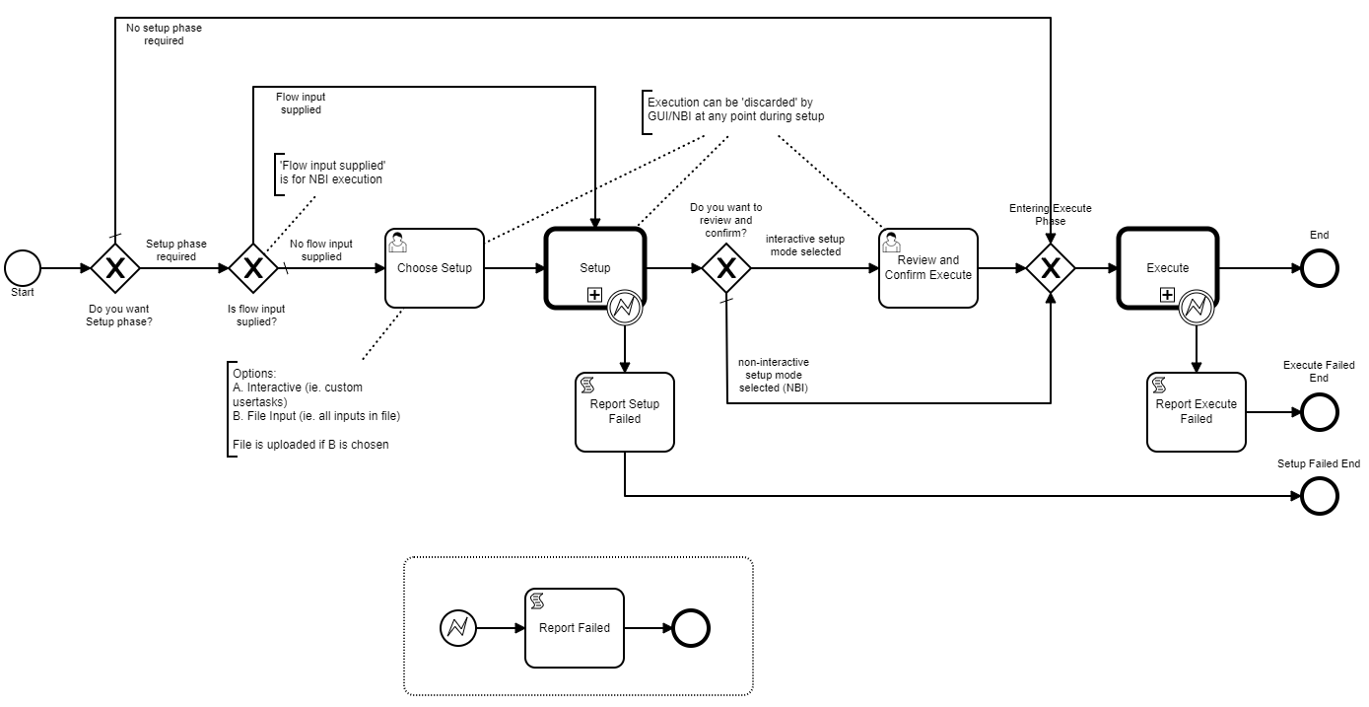
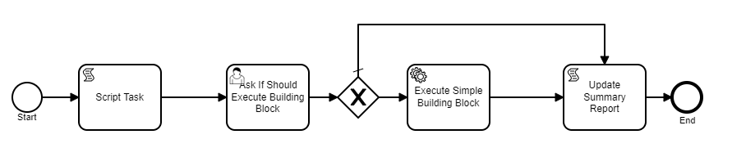
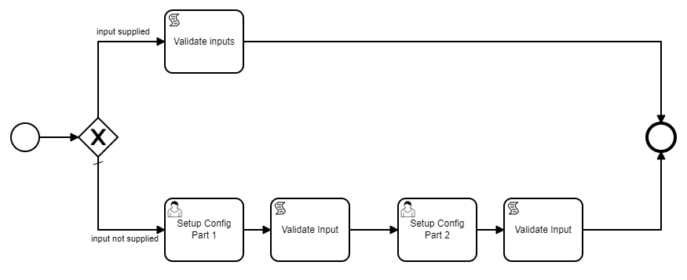
FA NBI Client Application
FA GUI
FA NBI
Flow Data Modeling
Flow
Flow Instance
Standard Flow Process Model
Flow input model
Flow usertask models
Flow report model
Create instance
Flow Execution Report
Flow Execute Phase process model
Flow Scripting
Flow User Interaction
Flow Building Block
Flow Setup Phase process model
Flow API
Flow Automation Service
<sync>
<async>
External application/service
External application/service

