Slide 1
Flow Automation SDK
Data Modeling diagrams

Slide 2
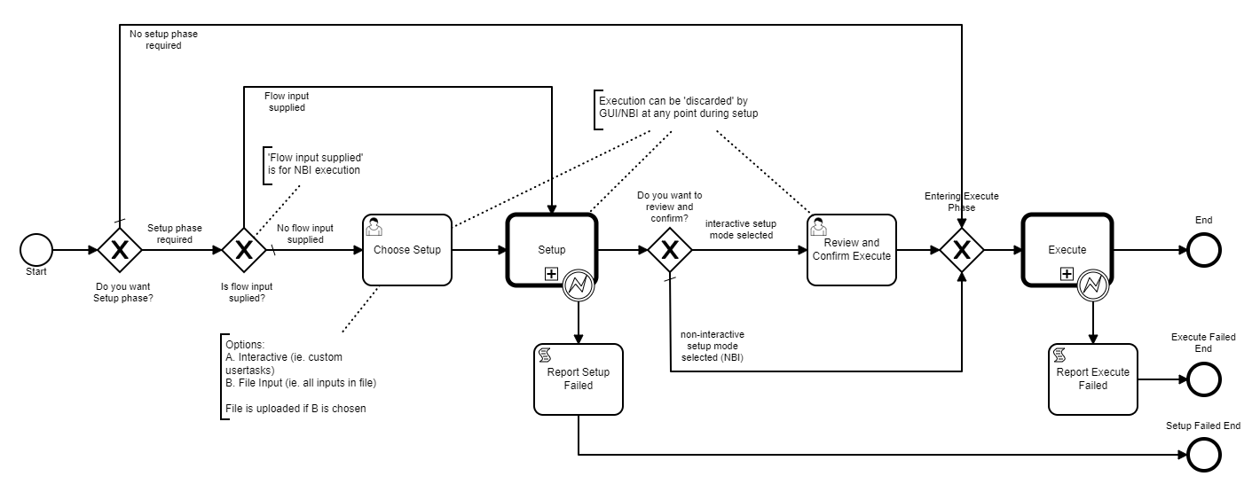
FA NBI, FA UI
Get Flow input schema
Execute Flow
Get Usertask schema
Complete Usertask
Get Report schema
Get Report
Flow input schema
Flow input
Usertask schema
Usertask input
Report schema
Report
complies with
complies with
complies with
FA: Syntactic & Structural Validation
FA: Syntactic & Structural Validation
Flow input schema
Flow: Semantic Validation
Usertask schemas
Report schema
Flow
FA Service
FA: Syntactic & Structural Validation
Register BB
BB request
BB response
BB input&output schemas
BB inputs
BB output
complies with
Building Blocks
Building Blocks

Slide 3
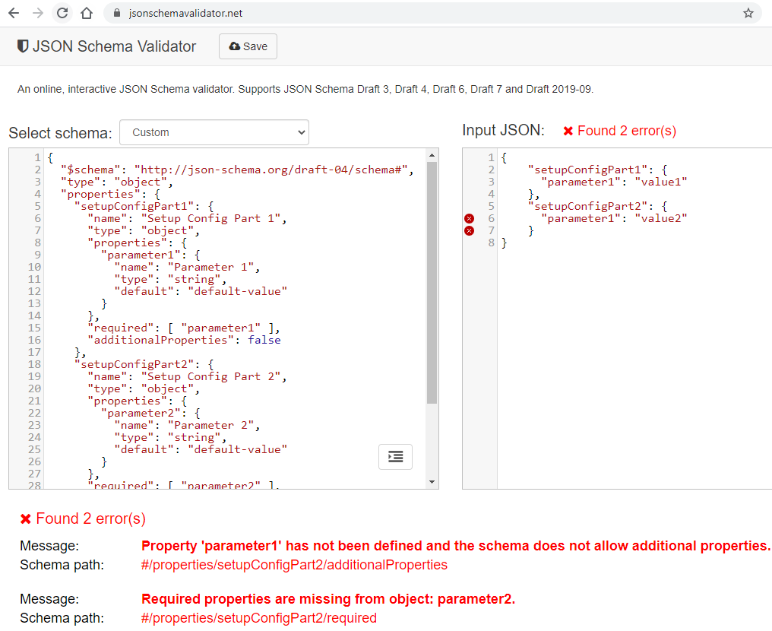

Slide 4
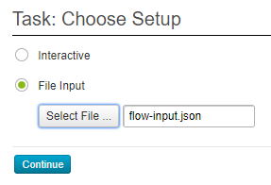
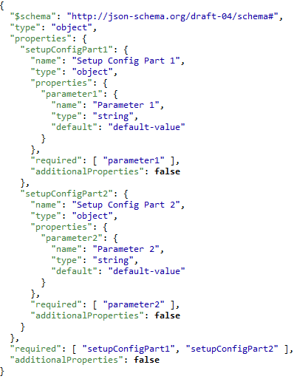
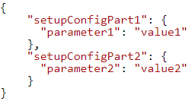

Slide 5
