Slide 1
Flow Automation SDK
Standard Flow Process Model diagrams

Slide 2
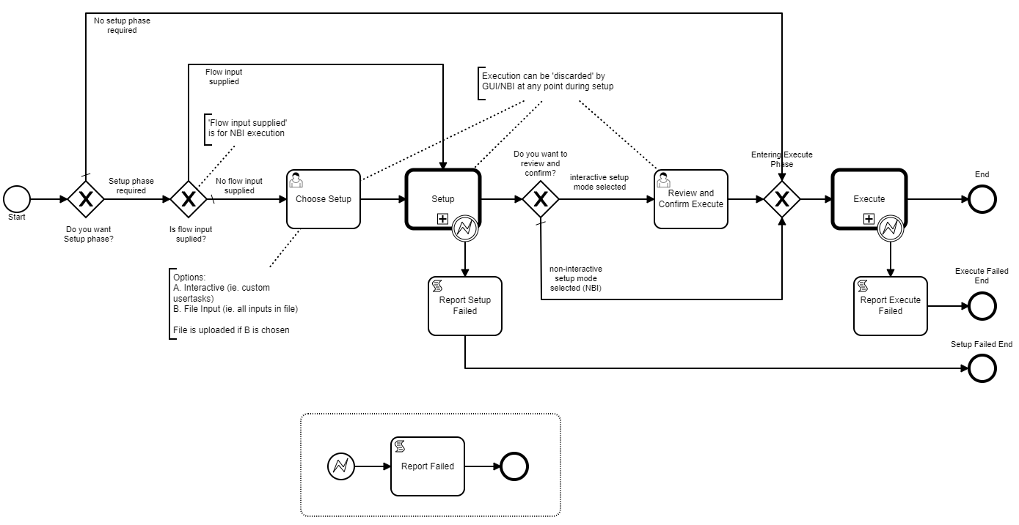

Slide 3
Setup Phase
Execute Phase
flowInput variable

Slide 4


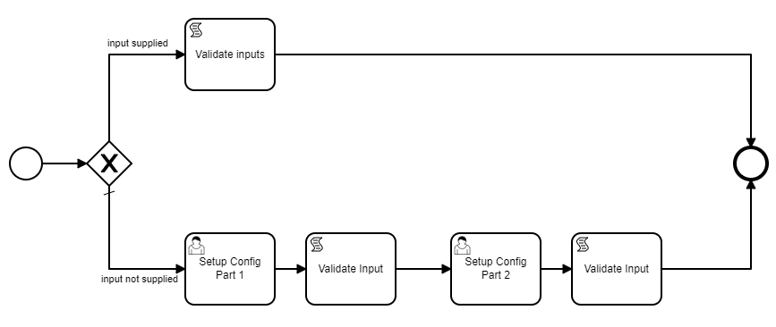

Setup Phase
Execute Phase
Execute Phase subprocess
Setup Phase subprocess

Slide 5
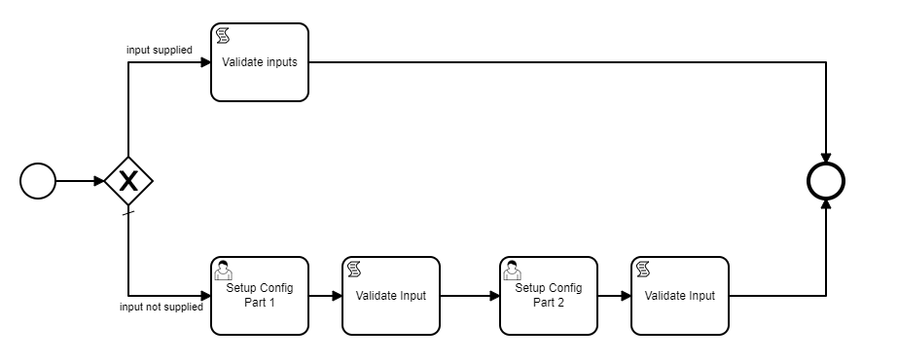

Slide 8
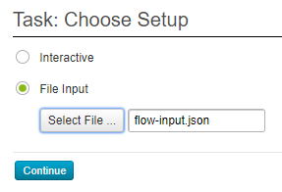
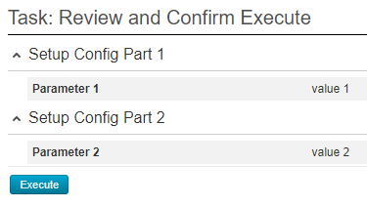

Slide 9
