Slide 1


Leveraging Genoa PIEDE
using Ubuntu through Vagrant
Notes:
2015-10-21
11/08/262011-10-19
2011-10-19

Slide 2
What
The ENM IDE is a set of pre-configured packages that make
up a standard environment for developing products in PDU NAM
The main goal is to simplify and speed up the process of
installing software for designing and testing our products
The packages are maintained as Ubuntu (.deb) packages which
are hosted in a PPA repository
The IDE can be installed natively on ELX or through Vagrant / VirtualBox on Windows®
Notes:
2015-10-21

Slide 3
Why
Using a pre-configured IDE makes it quick and easy
for new designers to get started.
The IDE ensures consistent configuration between
environment by distributing the same set of packages.
The IDE is intended to replace the many Confluence pages
used to install and configure the necessary tools for developing
ENM components.
Using a common environment also ensures consistent tool
versions for team members and simplifies troubleshooting.
Notes:
2015-10-21

Slide 4


Who
Existing ENM developers
  Recent survey conducted
    Yes 68%
    No 26%
    Maybe 5%
New team onboarding to ENM
New hires
  Experienced
  MSC
  Graduates
Notes:
2015-10-21

Slide 5
How
The IDE is distributed as Ubuntu packages to facilitate
both Windows® and ELX users.
A minimal default set of packages are provided to simplify
manual installations.
Extra packages can be included to suit the developers needs
Performing an installation through Vagrant also populates the
VM with the current users login ID, SSH keys and shares the
local git repositories with the guest OS.
Notes:
2015-10-21

Slide 6
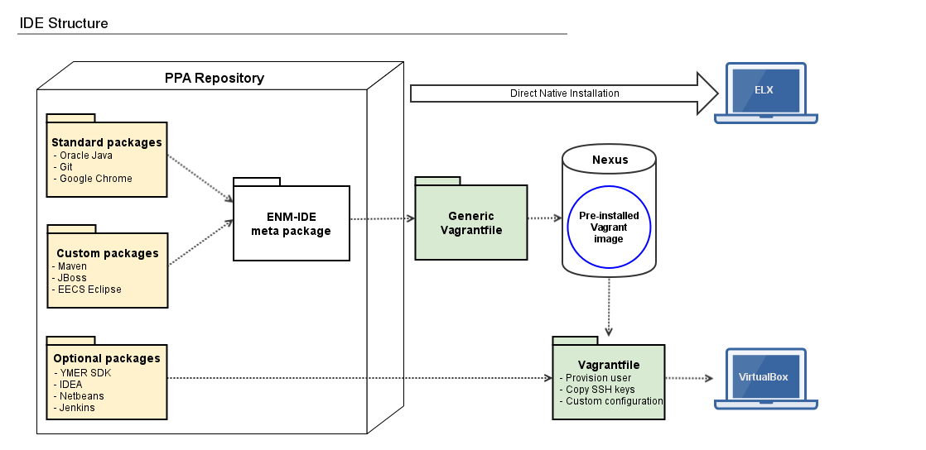
How Cont.
Notes:
2015-10-21

Slide 7
What’s incl.
Standard Packages
  GIT
  Java
  Rpm
  Docker
Custom Packages
  Maven
  EECS Eclipse
  Eclipse LMI-TOR Feature Group
  Jboss EAP
Optional Packages
  Versant
  PostgreSQL
  YMER SDK
  Netbeans
  IntelliJ IDEA Community Edition
  Jenkins
Notes:
2015-10-21

Slide 8
What’s next
Vertical slice testing by connecting the
IDE VM to Docker in the Cloud or on the laptop.
Provision the IDE environment on terminal
servers in the Linköping HUB.
Please visit the
ENM IDE documentation portal
for more information.
Notes:
2015-10-21

Slide 9
Notes:
2015-10-21

