Slide 1

How to pythonize the data from Cisco WLC
Roman Podoynitsyn

Slide 2
The goal
To introduce the Python parser for WLC config (aka wlc-pythonizer)
To discuss the use cases available and gather ideas for future
To demonstrate how it works
To invite for collaboration

Slide 3
How it all started

Slide 4
The relationships between engineer and WLC config
We often work with WLC config files
These files contain a lot of semi-structured data in text format
The information is really useful but hard to grasp in text editor
Love it or hate it?

Slide 5
Project goals
Solve the problems asked by my Customers
Save all historical configuration and operational data in easy-to-use format (export as pickle, json, yaml etc.)
Get quick answer on my fingertips (easy to use filters)
Be able to visualize data to find hidden patterns
Improve Python skills and have fun!!!
Try AI capabilities on collected dataset (*future releases)

Slide 6
Some disclaimers
Work in progress, not a complete product or service to use
Many undiscovered bugs may exist
Some scalability tests were done (45 Mb config with ~2500 AP)
Not a python guru, sometimes the code is awkward
Tested with Python 3.7
No fancy GUI, but some nice visualizations

Slide 7
Why use customized objects?
Clear representation
Context help to quickly find attribute
Human-readable syntax
Customized methods (like compare whole config or its special part, filter by attribute or value)
Fast customization (if needed)

Slide 8
Winning combination for any config analysis task
Your wireless network skills
Basic knowledge of Python

Slide 9
Examples of use cases

Slide 10
Some examples that are easy to solve with tool
What exactly changed in the config since the last (day, week, month)?
Best practice rules – update, adjust and customize for your Cu
Do we have the same SSID settings in every branch?
How diverse is network configuration for 100 WLCs installed in Customer network?
Which rogue APs have the most impact on our network?
Etc.

Slide 11
And eventually… It’s time for DEMO

Slide 12
Demo scenarios
Parse config file
Explore data with context help (refer to object tree)
Define best practice rules and check WLC config against them
Compare SSID config for different WLCs
Compare SSID configs of the same WLC collected in different time
Config diversity
Explore rogue APs
Explore channel utilization and its impact factors

Slide 13
Parse config

Slide 14
The ways to import config
From file
wlcs = parse_file('wlc_config_example.txt’)
Following WLCs were parsed from file: ['tac-test’, ‘wlc2’]

Slide 15
The ways to import config – via SSH
Via SSH
wlcs = ssh_collect()
Collecting config from WLC via SSH
WLC IP address, please: >? 10.11.12.13
Your username, please: >? admin
Your password, please: >? *******
sending username...
sending pwd...
Please, hold on, getting config, it can take some time...
Collection is completed
Please, hold on, parsing configs, it can take some time...
Configs are written to file with name: WLC_config-IP 10.11.12.13-Tue Aug 7 111500 2021.txt
Configs are sent to parser….
Following WLCs were parsed…

Slide 16
The ways to import config – via Cisco DNA Center
Via DNAC API
wlcs = dnac_get_wlc_configs()
Enter the IP address of DNAC, please: >? 192.168.44.44
Your username, please: >? user
Your password, please: >? ****
Contacting Cisco DNA Center with IP address: 192.168.44.44
for username: user
Following WLC devices are found and reachable:
sdc1wlc001
Starting config collection...
Waiting for collection results ...
DNA Center collected configs, grabbing config files from it...
WLC config files are successfully collected
Configs are written to file with name: all_WLC_config-DNAC-
Configs are sent to parser
...
Following WLCs were parsed from file: ['sdc1wlc001']

Slide 17
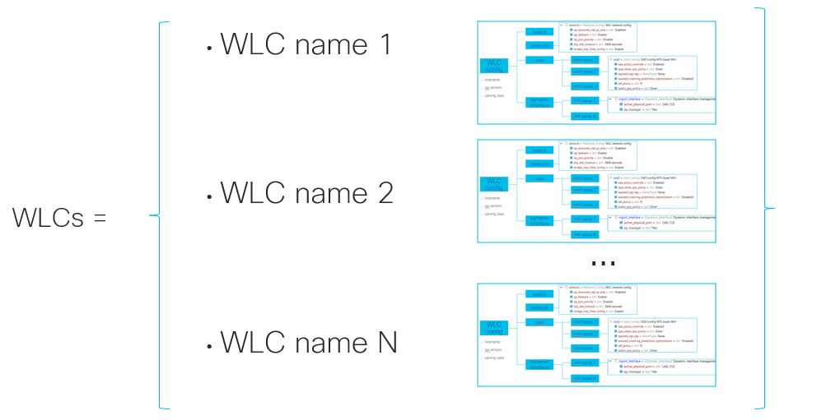
To access the WLC config – refer by hostname
Files may contain the config from many WLCs
All the functions above return the Python dictionary, keys are hostnames
To access the WLC config objects:
wlc1 = wlcs[<wlc1 hostname>]
wlc2 = wlcs[<wlc2 hostname>]

Slide 18
Explore the data

Slide 19
The ways to explore parsed data
Just print the object name in console
wlc
WLC config for host: WC-Cisco-CX-020, version is 8.10.142.0, collection time is Sun Jul 7 00:00:07 2021,
parsing date is Mon Aug 12 152115 2021

Slide 20
The ways to explore parsed data
Add attributes after point (config section type 1)
wlc.network
WLC network config
wlc.switch
WLC switch config

Slide 21
The ways to explore parsed data
Add attributes after point (config section type 2)
wlc.dynamic_interfaces
Named List of length 7 with items Dynamic_Interface: management, redundancy-management, redundancy-port, service-port, virtual, wifi_guest, wifi_guest_bras, wifi_guest_old, wifi_cisco, wifi_users, wifi_users_vip, wifi_voice
wlc.ssid
Named List of length 7 with items Ssid_Config: Cisco_WLC, 9800_best, AireOS, BEST-WIFI, Provision, Corporate, Guest WiFi

Slide 22
The ways to explore parsed data
Add [name] to get the item from list (config section type 2)
wlc.dynamic_interfaces['management’]
Dynamic interface management
wlc.ssid[‘Guest’]
SSID config Guest

Slide 23
The ways to explore parsed data
Add point and the attribute name to get the value
Hint: Don’t remember the name of attribute? Stay calm and start printing!
(Tab button is your friend for context help)
wlc.dynamic_interfaces['management'].ip_address
'192.168.176.129’
wlc.dynamic_interfaces['management'].active_physical_port
'LAG (13)'

Slide 24
List is too long? - Use “filter” method
SYNTAX:
Object.filter(<ATTRIBUTE NAME>,<VALUE>)
wlc.ap_rf
Named List of length 651 with items Ap_Rf_Config: WA-KUR-KRCH-001-1100_slot0, …
#Find all radios with failed noise profile
wlc.ap_rf.filter('noise_profile','FAILED’)
Named List of length 2 with items Ap_Rf_Config:
WA-MSK-CWK_slot0, WA-MSK-SBC-002_slot0
#Double filtering is allowed too ;)
wlc.rogue_aps.filter('channel','11').filter('state','Alert')

Slide 25
Display all values? – Use “show” command
SYNTAX:
show(object)
object.show()
#Display all attributes of network config section
wlc.network.show()
...
rf_network_name wifimsk
dns_server_ip 192.168.0.41
web_mode Disable
secure_web_mode Enable
secure_web_mode_cipher_option_high Enable
secure_web_mode_ssl_protocol Disable
web_csrf_check Enable
ocsp Disabled
...

Slide 26
Find attribute or value? – Use “grep” command
SYNTAX:
grep(object,’value’)
object.grep(‘value’)
#Find all IPv6 MLD parameters
wlc.grep('mld’)
WLC network config mld_snooping Disabled
WLC network config mld_timeout 60 seconds
WLC network config mld_query_interval 20 seconds
#Find all timeouts for SSID
wlc.ssid[‘Guest'].grep('second’)
SSID config Guest exclusionlist_timeout 60 seconds
SSID config Guest session_timeout 1800 seconds
SSID config Guest scan_defer_time 100 milliseconds
#Find all radios with FAILED profiles
wlc.ap_rf.grep('FAIL’)
AP RF config WA-MSK-SSH-001_slot0 interference_profile FAILED
AP RF config WA-MSK-TEL-003_slot0 noise_profile FAILED

Slide 27
Using list comprehension - 1
[x for x in range(6)]
[0, 1, 2, 3, 4, 5]
[ssid.name for ssid in wlc.ssid] # get all names of SSIDs configured
['Guest_WiFi’,
'Users',
‘9800-1x',
‘9800-EOGRE',
'Provision',
'Corporate’,
‘Cisco Guest WiFi']

Slide 28
Using list comprehension - 2
[(x,x*2) for x in range(6)] # get pairs of number, doubled number
[(0, 0), (1, 2), (2, 4), (3, 6), (4, 8), (5, 10)]
# get name and status of SSIDs configured
[(ssid.name, ssid.status) for ssid in wlc.ssid]
[('Guest_WiFi', 'Disabled'),
(‘9800-1X', 'Enabled'),
('Users', 'Enabled'),
('Provision', 'Enabled'),
('Corporate', 'Enabled'),
('Guest WiFi', 'Enabled')]

Slide 29
Using list comprehension - 3
[(x,x*2) for x in range(10) if x%2 ==0] # get pairs for odd numbers
[(0, 0), (2, 4), (4, 8)]
# get the names of SSIDs in Disabled status
[ssid.name for ssid in wlc.ssid if ssid.status == 'Disabled’]
['Guest_WiFi’]
# get the names of SSIDs with AAA override
[ssid.name for ssid in wlc.ssid
if ssid.aaa_policy_override == 'Enabled’]
# get the names of SSIDs with CWA
[ssid.name for ssid in wlc.ssid
if ssid.aaa_policy_override == 'Enabled’ and
'Guest' in ssid.name]

Slide 30
Best practice check

Slide 31
To check the BP rule – use tools available
Translate the BP rule into Python code
Usually one string is enough
Example: ‘Telnet service should be disabled on AP’
#Get all AP names with telnet enabled
[ap.name for ap in wlc.ap_configs if 'Enable’ in ap.telnet_state]

Slide 32
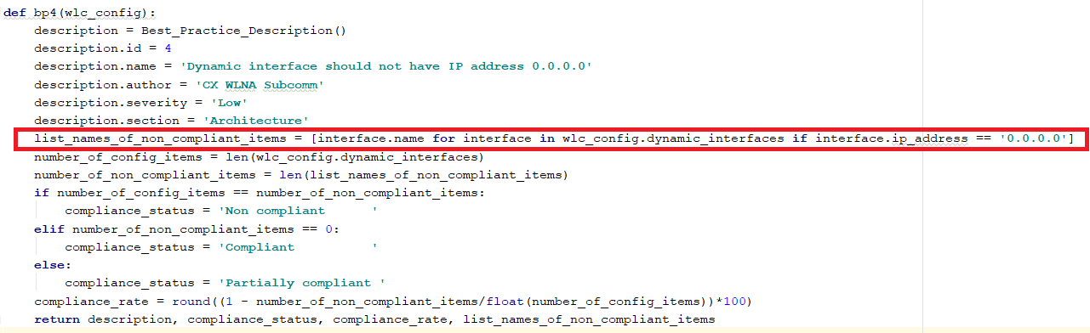
Example of function to check BP rule

Slide 33
To apply the set of BP rules – use “bp_check”
SYNTAX:
bp_check(wlc_config)
#Check WLC config against the set of rules
bp_check(wlc)
Best practices compliance report
ID Status Rate Name
1 Compliant 100 Telnet should be disabled in all APs
2 Compliant 100 Each SSID is mapped with unique interface in controller if no AAA override is enabled
3 Compliant 100 Local Client profiling using HTTP and DHCP is enabled unless RADIUS profiling is in use
4 Compliant 100 Dynamic interface should not have IP address 0.0.0.0
5 Compliant 100 Primary and secondary DHCP server IP addresses are configured for WLC dynamic interfaces

Slide 34
Some advantages
Relatively easy translation of business requirements into code
Customize and implement if needed
Fast automated checking
Double-check values in the same tool if in doubt

Slide 35
Compare config files or its sections

Slide 36
Compare config? – Use “compare” function
SYNTAX:
compare(object1, object2)
#Get the same SSID config from the same device during last 3 weeks
ssid1 = archive['Week 31']['WC-MSK-CX'].ssid['Corporate']
ssid2 = archive['Week 32']['WC-MSK-CX'].ssid['Corporate']
ssid3 = archive['Week 33']['WC-MSK-CX'].ssid['Corporate’]
#Call compare function
a = compare(ssid1,ssid2)
Compare called for SSID config Corporate
SSID config:
Subdiffs:
- 0 #Zero changes between Week 31 and 32
- 196 #196 parameters were compared

Slide 37
Compare config? – Use “compare” function
SYNTAX:
compare(object1, object2)
#Call compare function
a = compare(ssid2,ssid3)
Compare called for SSID config Corporate
SSID config:
Subdiffs:
- 3 #3 parameters were changed between Week 32 and 33
- 196 #196 parameters were compared
d_802_11k_neighbor_list: # <-The name of parameter
- Disabled # <-The value for Week 32
- Enabled # <-The value for Week 32
d_802_11v_bss_transition_service:
- Disabled
- Enabled
security_ft_support:
- Disabled
- Adaptive

Slide 38
“Compare” function
Works with any config section
Recursively calls every branch in config tree
If called for list, compares only items with the same name, for example SSID ‘Corporate’ with SSID “Corporate’
Calculates the number of parameters compared
Calculates the number of differences in values

Slide 39
Know the diversity of configs

Slide 40
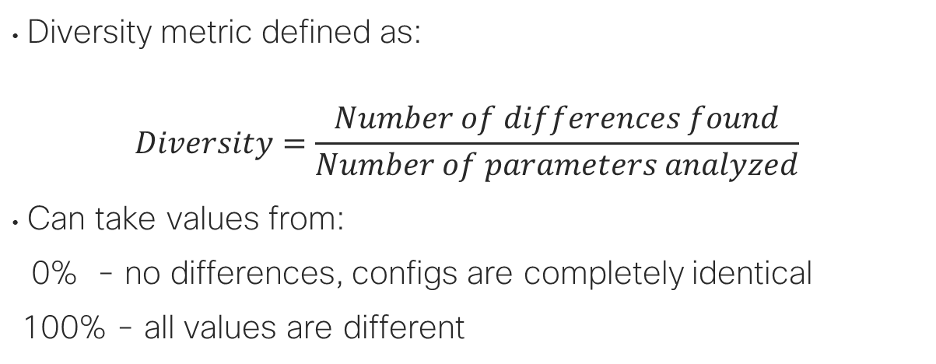
Compare without details – get the “big picture”
Diversity metric defined as:
$$Diversity=\frac{Number of differences found}{Number of parameters analyzed}$$
Can take values from:
0% - no differences, configs are completely identical
100% - all values are different

Slide 41
Measure the diversity– Use “config_diversity”
SYNTAX:
config_diversity([object 1, object 2,…,object N]) # list as input!!!
#Compare SSID configs
config_diversity([ssid1,ssid2])
Diversity metric is equal 0 %
This metric is calculated for 2 config items of type SSID config
#Compare SSID configs
Diversity metric is equal 1 %
This metric is calculated for 2 config items of type SSID config
Hint: Get the big picture first, then dig deeper into details

Slide 42
Analyze rogue APs

Slide 43
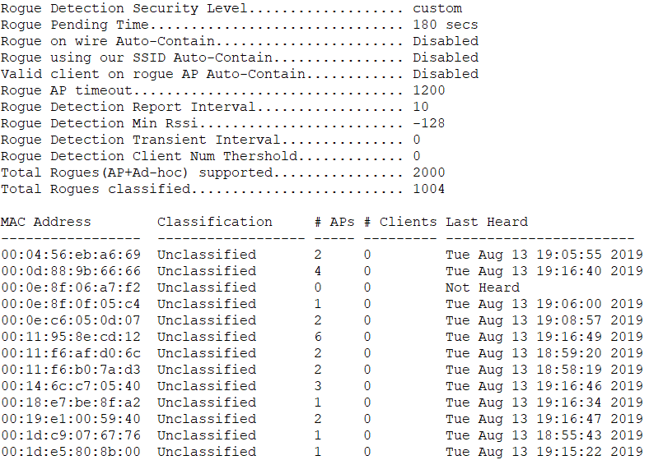
Can we do something useful with this list?

Slide 44
Get the nice summary for all rogue APs - 1
SYNTAX:
Rogue_ap_summary(wlc_config)
#See how many rogue APs are dangerous ones (close to our APs)
Rogue AP summary for WC-MSK-CISCO-CX:
The overall number of rogue APs : 1998
The number of rogue AP with highest RSSI -10 dBm = 0
The number of rogue AP with highest RSSI -20 dBm = 5
The number of rogue AP with highest RSSI -30 dBm = 19
The number of rogue AP with highest RSSI -40 dBm = 51
The number of rogue AP with highest RSSI -50 dBm = 125
The number of rogue AP with highest RSSI -60 dBm = 236
The number of rogue AP with highest RSSI -70 dBm = 432
The number of rogue AP with highest RSSI -80 dBm = 853
The number of rogue AP with highest RSSI -90 dBm = 1989
<..output continues next page..>

Slide 45
Get the nice summary for all rogue APs - 2
SYNTAX:
Rogue_ap_summary(wlc_config)
#See which rogue APs has the most impact
The most impacting rogue APs in this environment:
Currently hardcoded values for impact are:
* RSSI > -50 dBm
* number of detecting APs > 3
54:4a:00:d1:fd:00 #Check these rogues first – they MIGHT have high impact
a0:93:51:38:a8:60
f0:9e:63:70:ef:b0
00:fc:ba:0b:b9:e0
<..output continues next page..>

Slide 46
Get the nice summary for all rogue APs - 3
SYNTAX:
Rogue_ap_summary(wlc_config)
#See which APs from our network are impacted
The impacted APs in this environment:
WA-MSK-CX-001 60 %
WA-MSK-CX-006 30 %
WA-MSK-CX-215 20 %
WA-MSK-CX-007 53 %
WA-MSK-CX-330 28 %
WA-MSK-CX-003 16 %
<..output omitted..>
#Know manufacturers of rogue APs
Most common manufacturers of rogue APs are:
[('Cisco', 199), ('Sercomm', 168), ('RuckusWi', 158), ('ZyxelCom', 127), ('Routerboard', 115)]

Slide 47
Visualize the channel utilization

Slide 48
Why not to turn text data into graph?
One picture worth a thousands of text words
Find some patterns based on data
Examples:
Periodically collected WLC config -> channel utilization changes in time
Which factors define channel utilization? -> scatterplot data for every AP in network

Slide 49
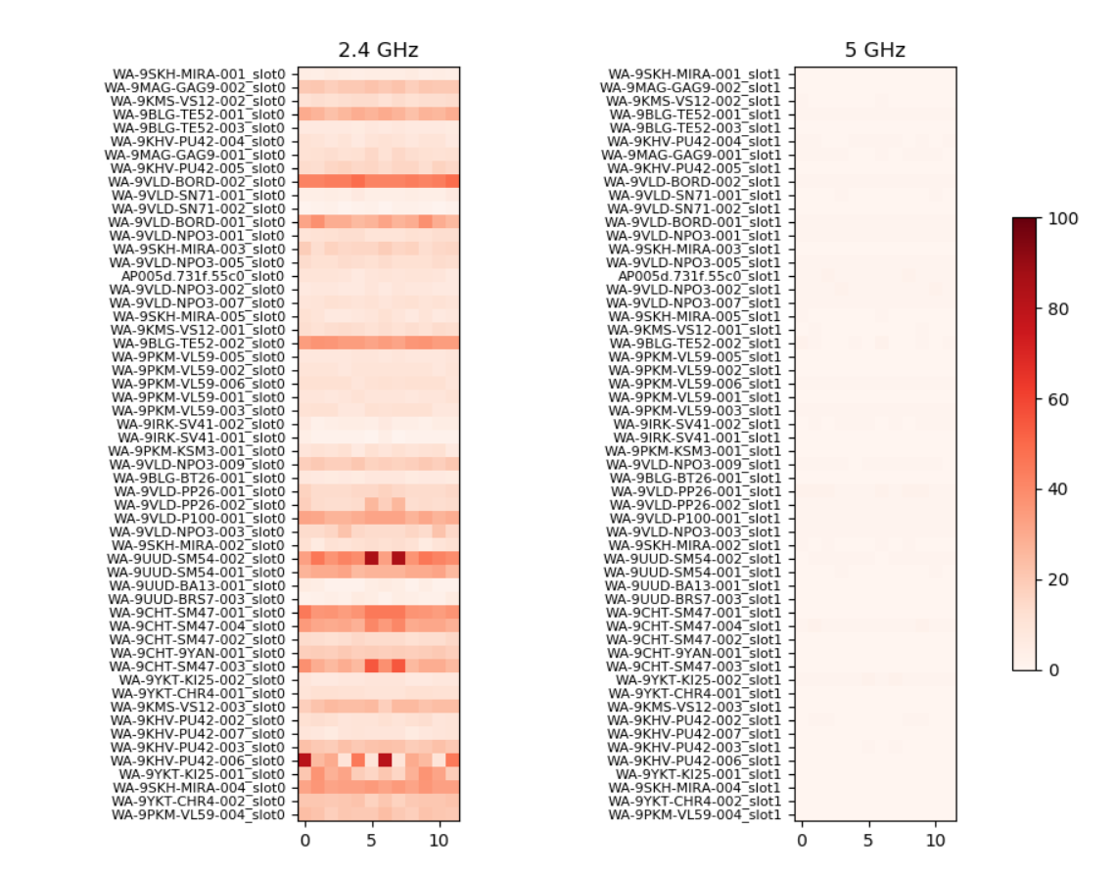
Heatmap of channel utilization in time
SYNTAX:
channel_utilization_visual(archive)

Slide 50
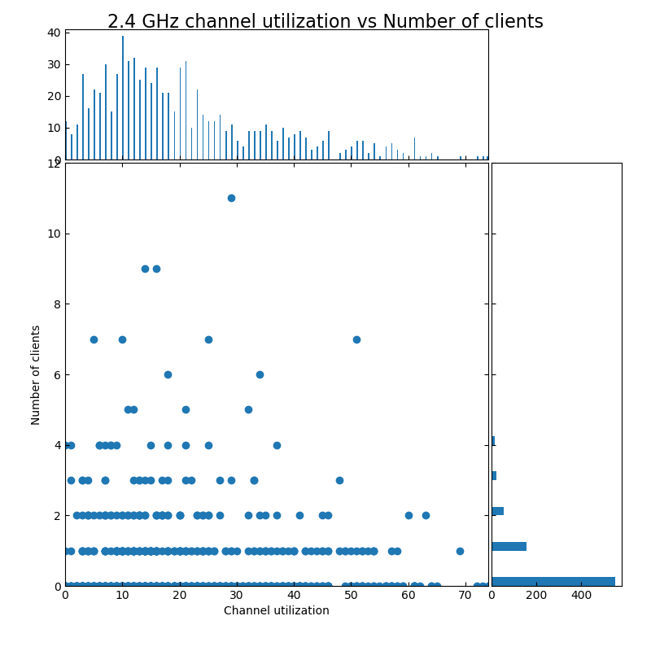
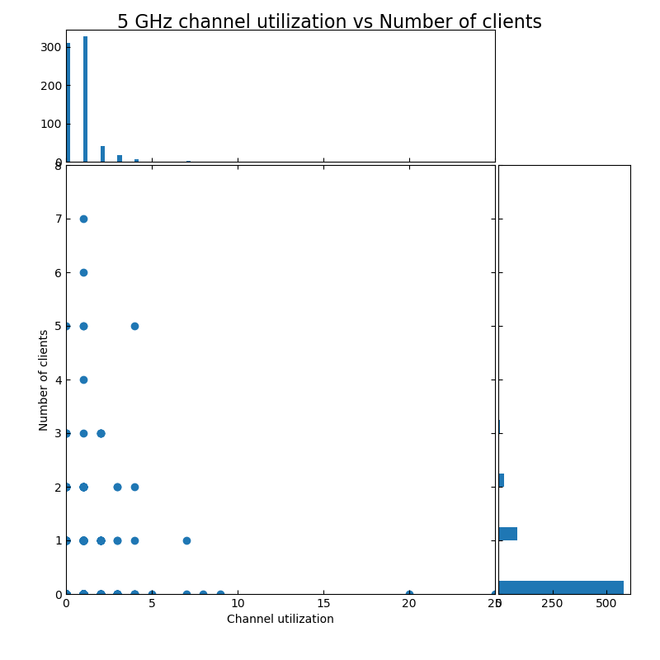
Does channel utilization depends on # of clients?
SYNTAX:
utilization_clients_scatterplot(archive)

Slide 51
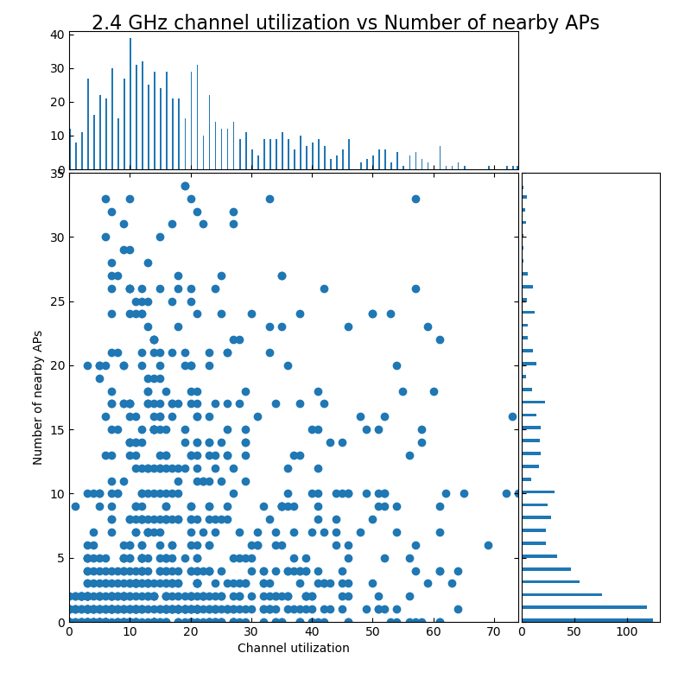
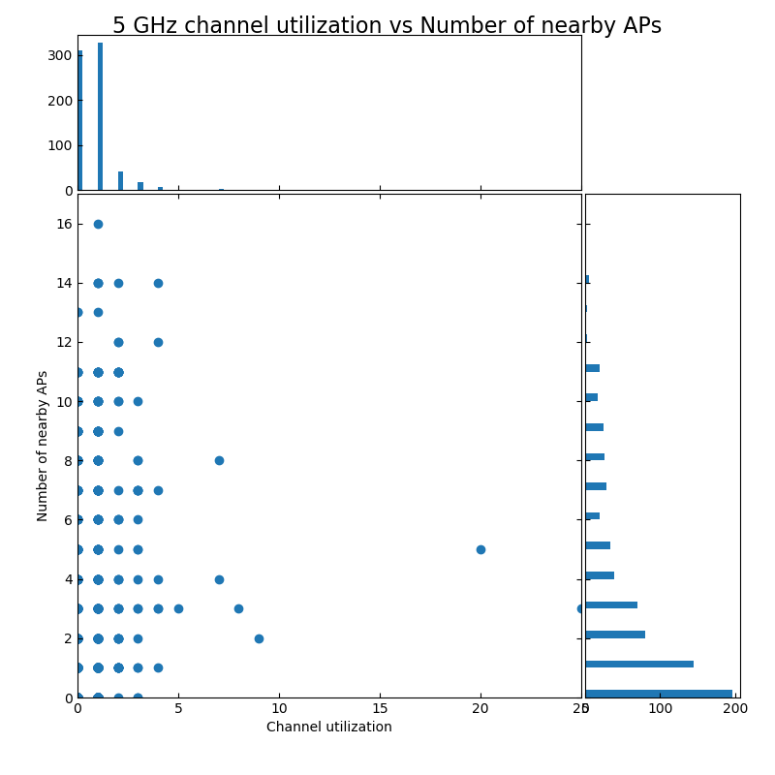
Does channel utilization depends on nearby APs?
SYNTAX:
utilization_nearby_aps_scatterplot(archive)

Slide 52
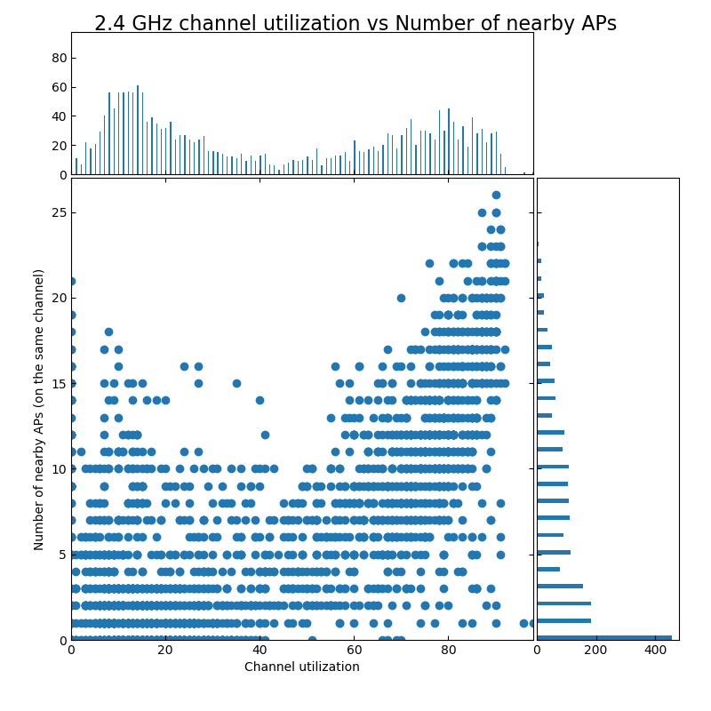
Does channel utilization depends on nearby APs?
SYNTAX:
utilization_same_channel_nearby_aps_scatterplot(archive)

Slide 53
What is next?

Slide 54
Next steps and call to action
First and foremost - Test and give feedback
Share ideas for the problems and tasks you face in everyday job
Join the development

Slide 55
How to join?
HERE IS THE link to DevNet github repo!

Slide 56
The approach to parsing (if you would like to co-develop)

Slide 57
WLC config file
Quite large for text file (up to 50 Mbytes)
Mix of configuration and operational data
Structured to some extent

Slide 58
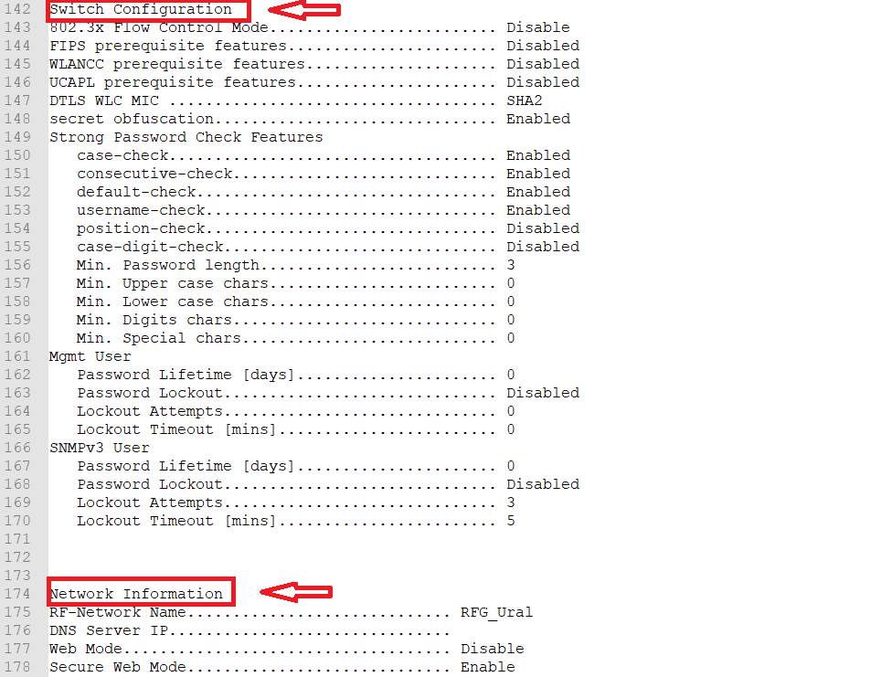
WLC config sections
Start with easy distinguishable word sequence
First step to parsing
About 80 sections

Slide 59
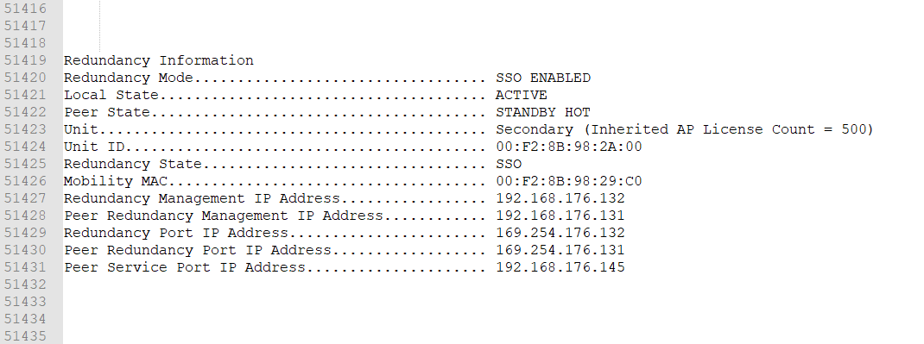
Two types of config sections – type 1
Every parameter is unique and not repeated
Usually it is WLC (whole system) config
The number of parameters is usually the same (may differ with sw version)

Slide 60
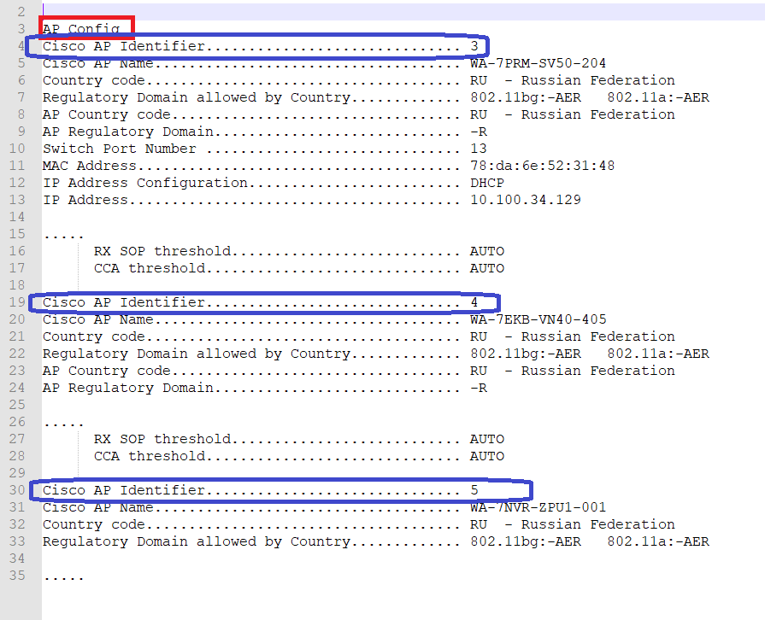
Two types of config sections – type 2
Contains the list of objects
Objects have identifier of some sort
The same repetitive set of parameters for every object
The number of objects in list may differ (WLANs configured, AP associated etc.)

Slide 61
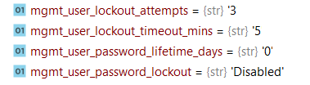
Key element of data model
Attribute (key) = name of parameter
Value = configuration applied
Dictionary-like: quickly access value by name of attribute

Slide 62
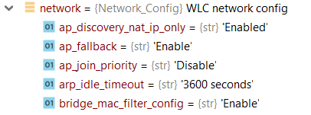
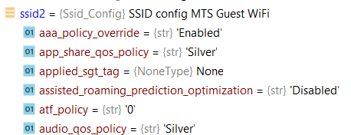

The object tree for WLC config
switch
config section
type 1
network
WLC config
ssid
ssid name 1
…
…
ssid name 2
hostname
sw version
collection date
parsing date
ssid name n
dynamic interface
Intf name 1
…
Intf name N
config section type 2

Slide 63
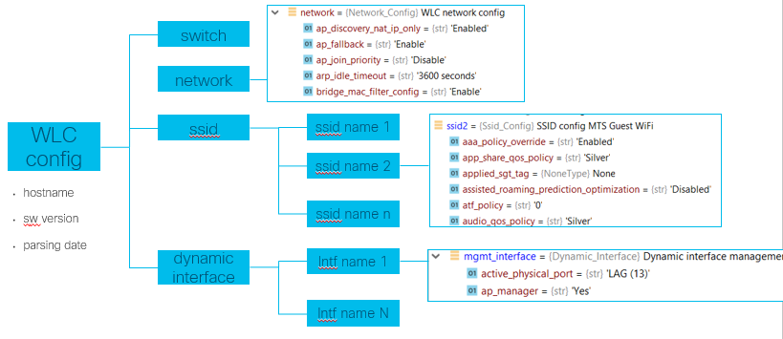
Multiple WLCs can be combined into one element
WLC name 1
WLC name 2
WLC name N
WLCs =
…

Slide 64
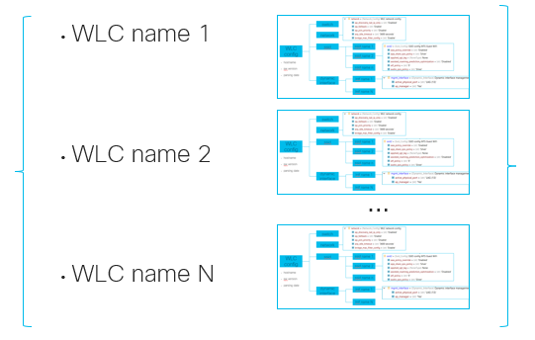
Multiple WLCs, multiple periodic config collection
…
archive =
Week 1
Week N

Slide 65
Overview of parsing procedure
Separate config sections by start words
Parse every section into Python object – two types of objects to represent two section types
Attach the section object to WLC config object
Repeat for every WLC in file

