Slide 1
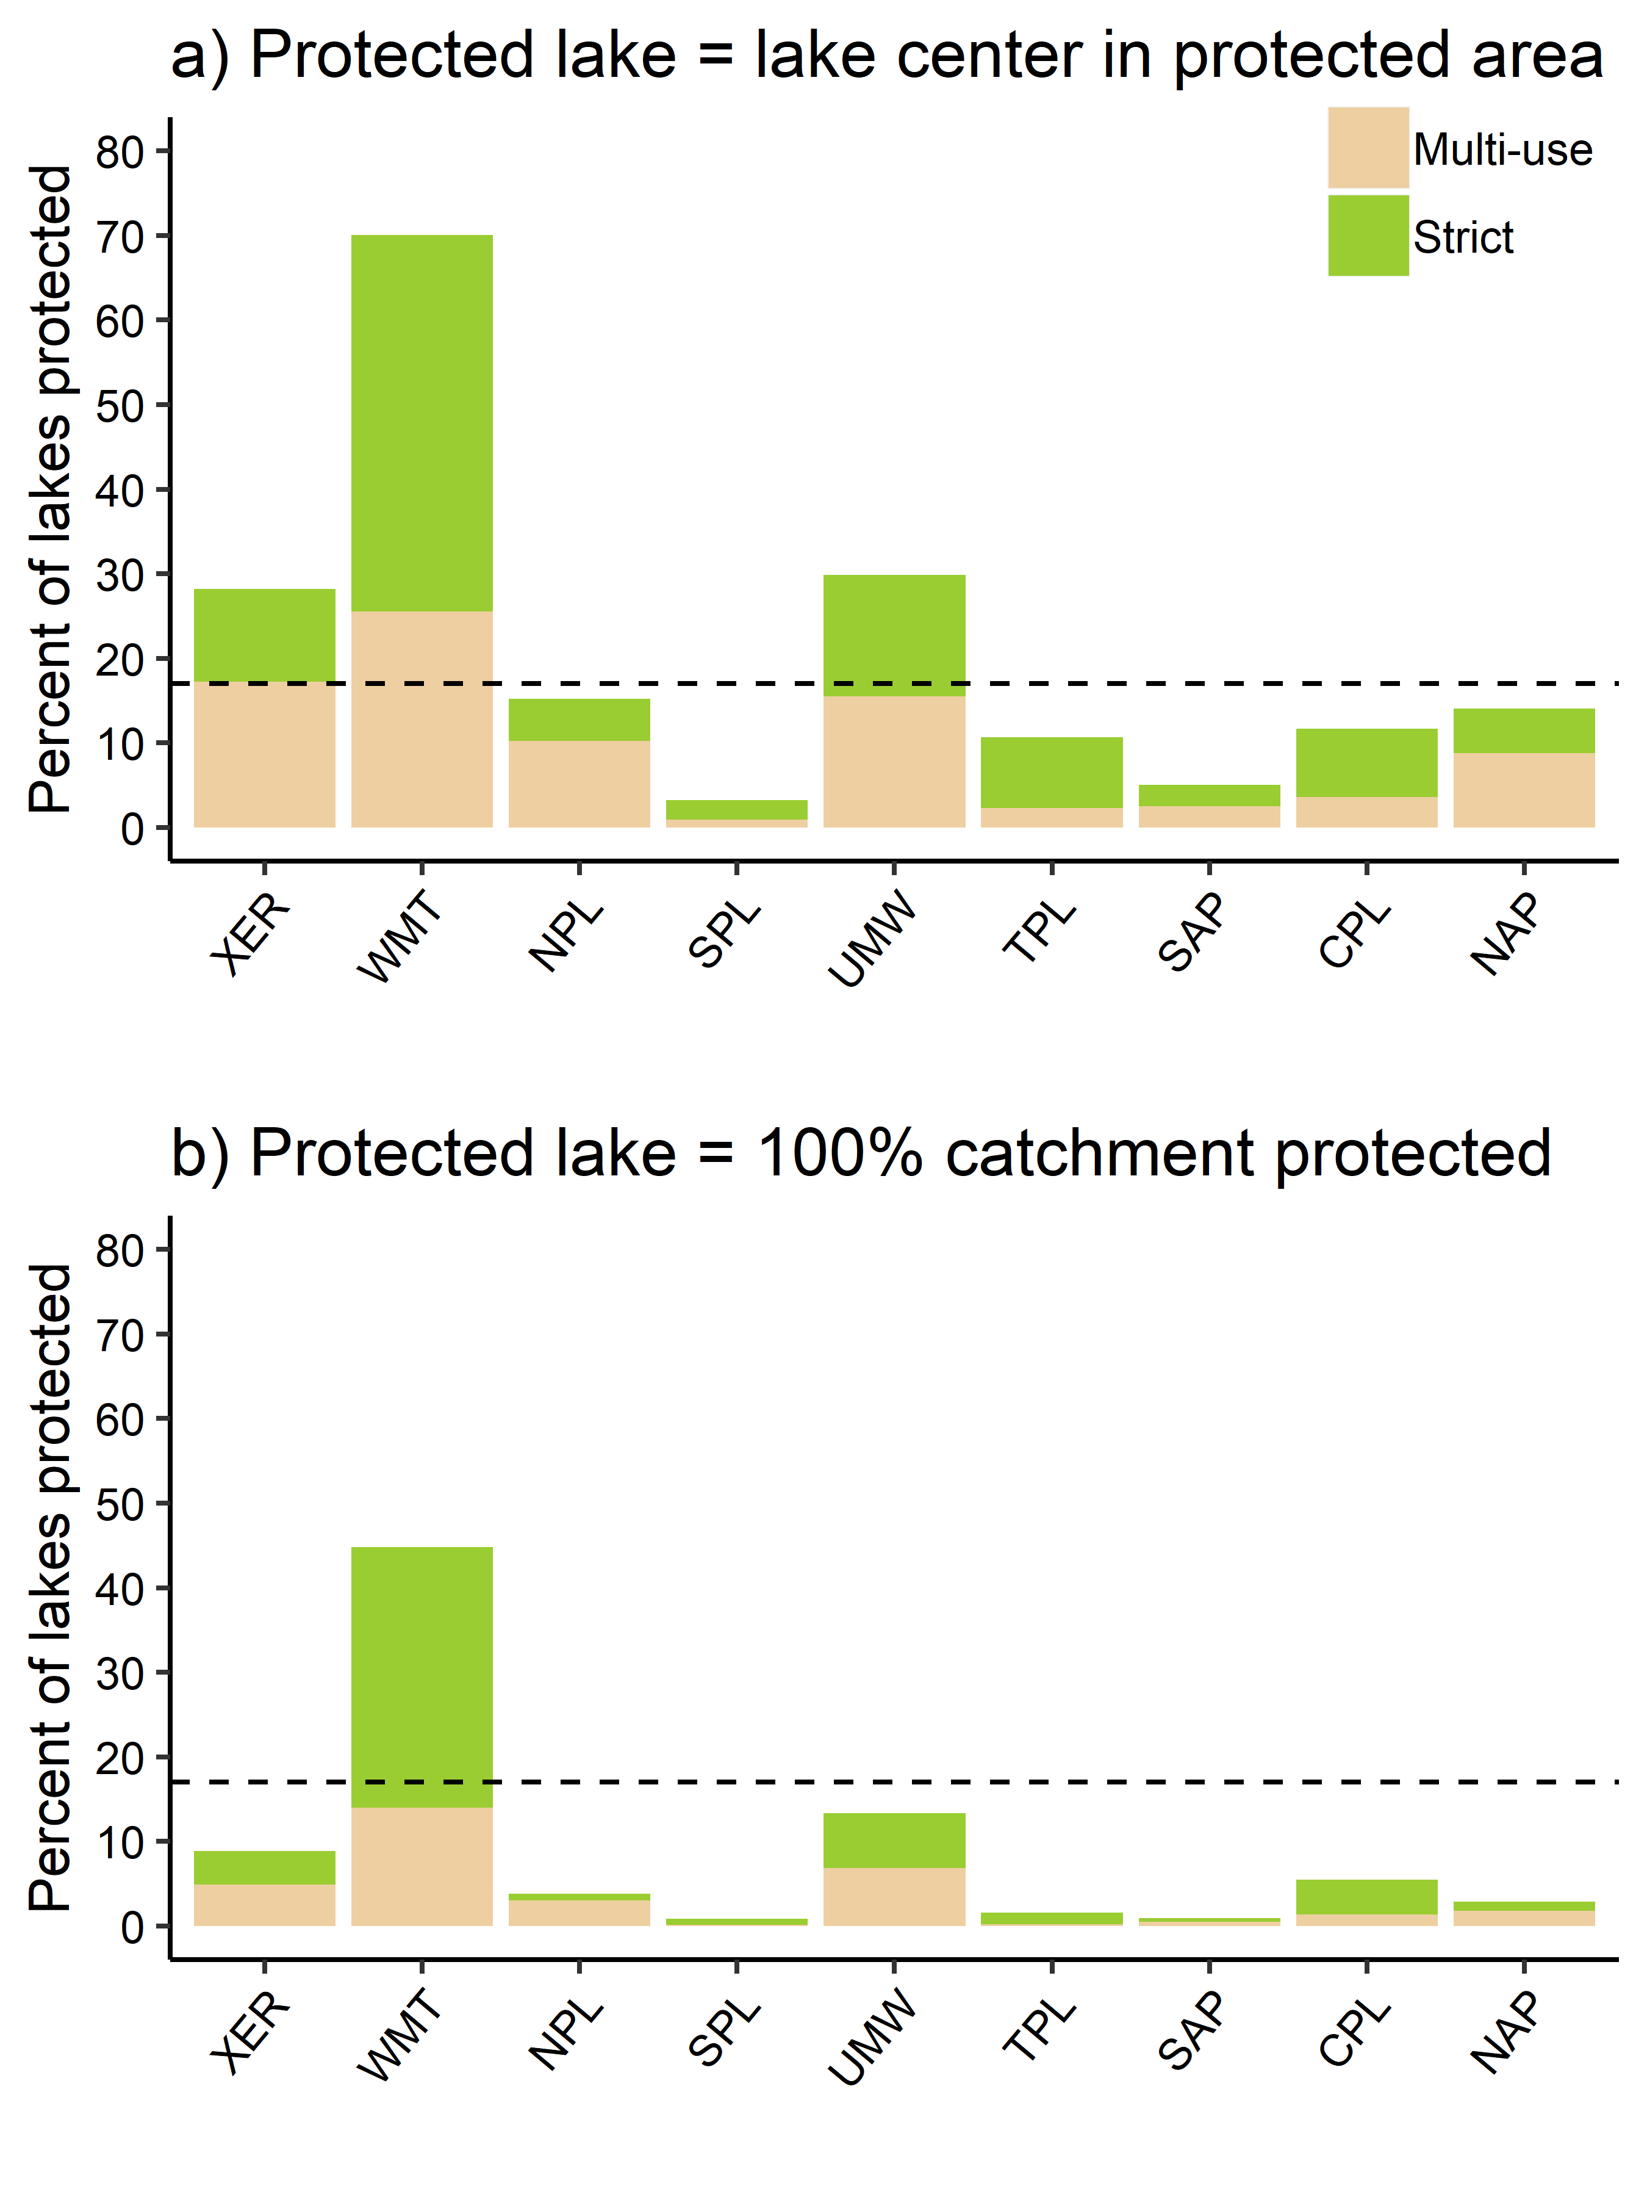
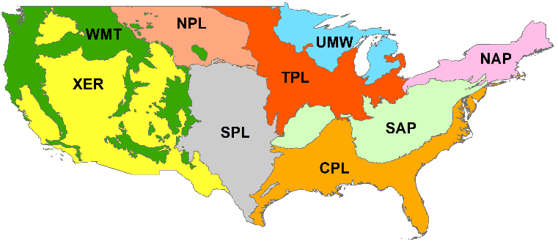

Slide 2
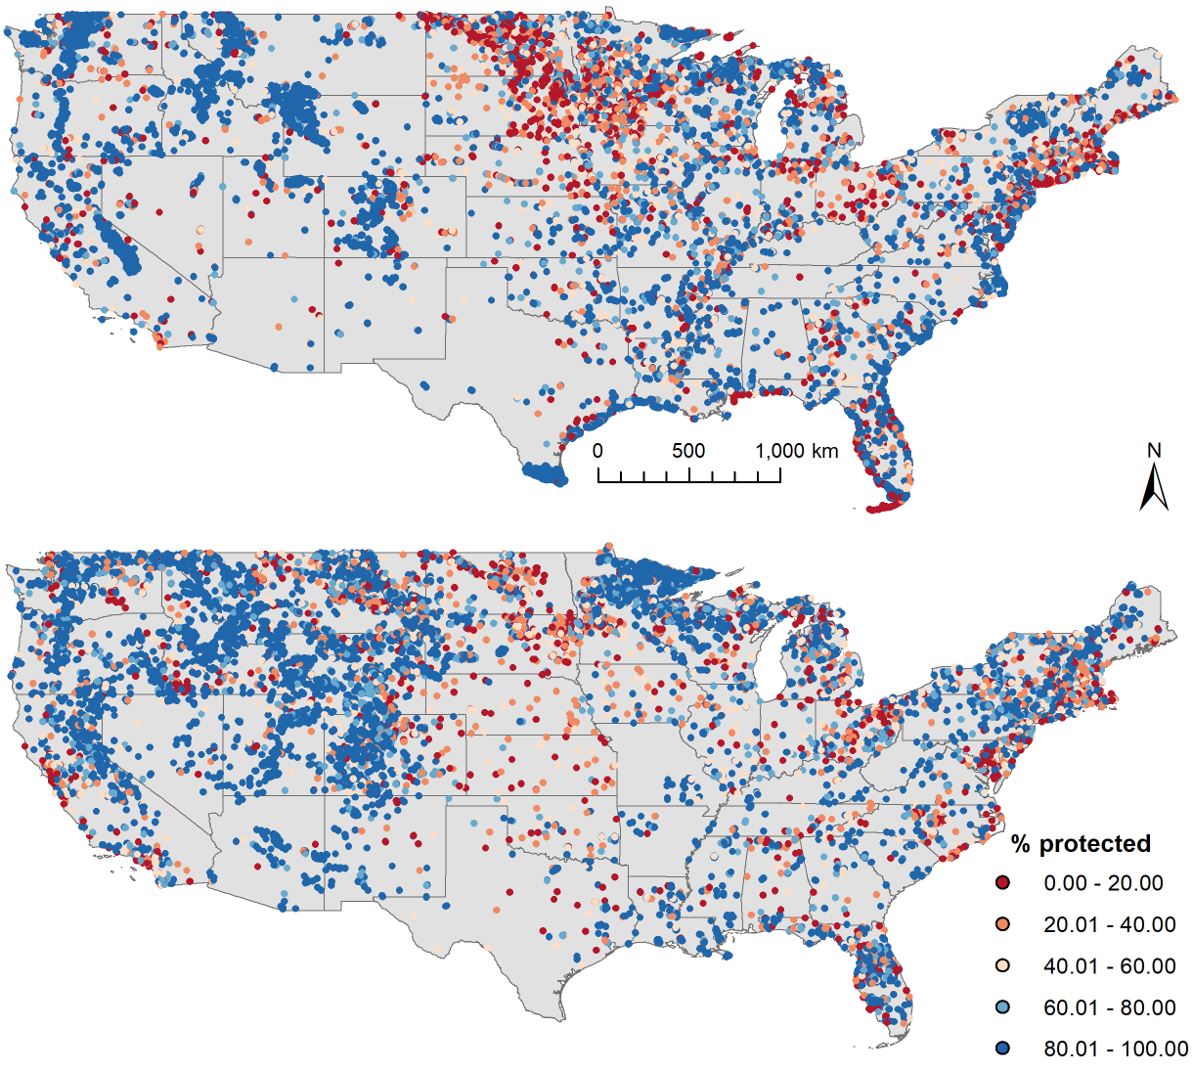
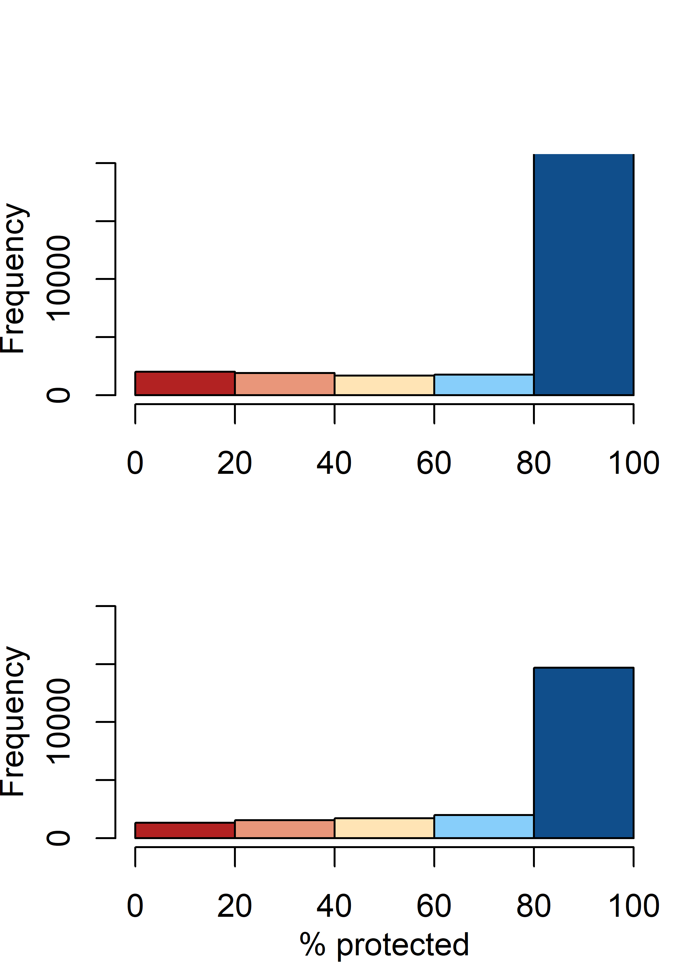
a) Strict (28704 lakes)
b)
c) Multi-use (21280 lakes)
d)

Slide 3
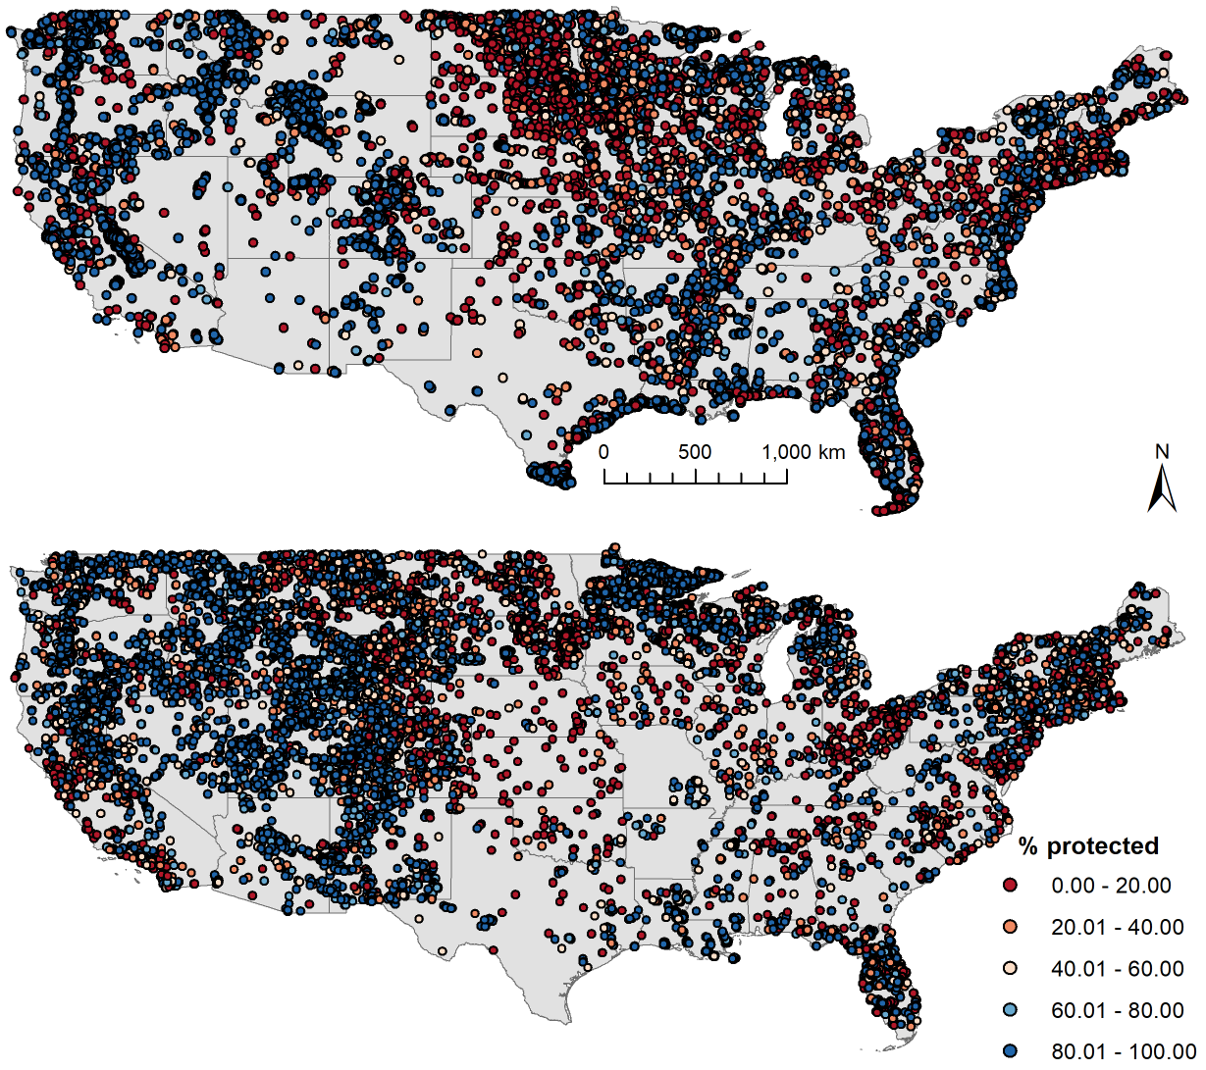
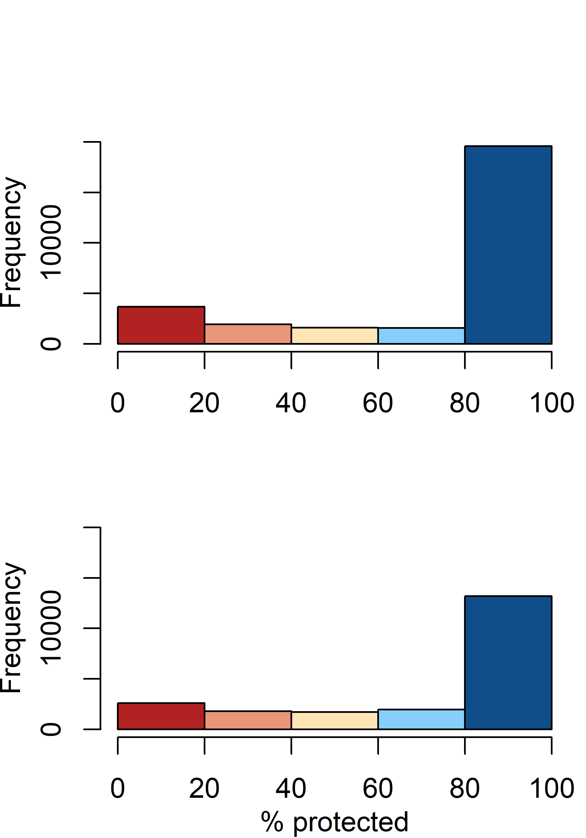
a) Strict (28704 lakes)
b)
c) Multi-use (21280 lakes)
d)

