Slide 1
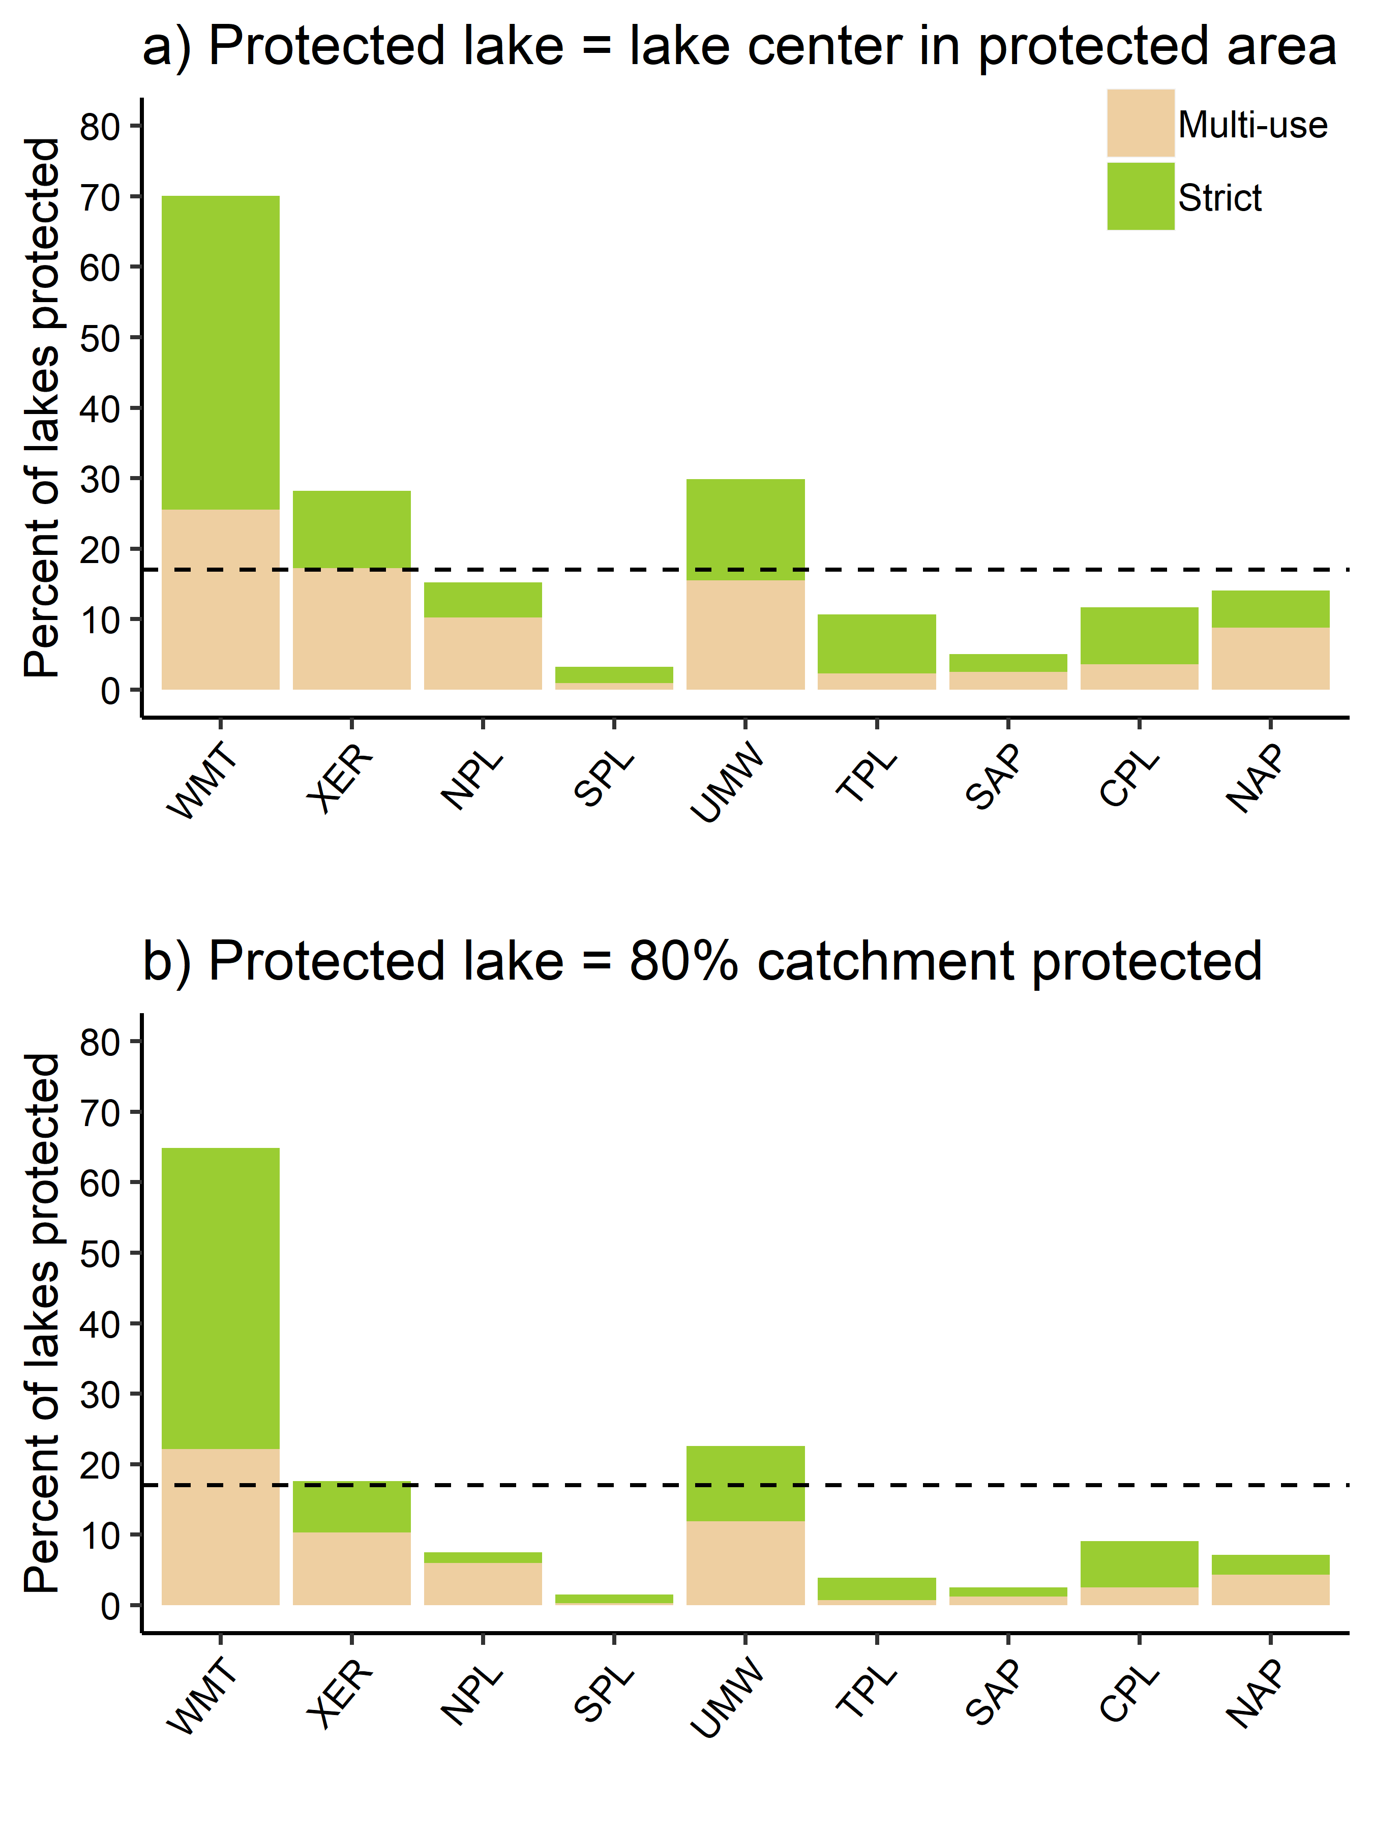
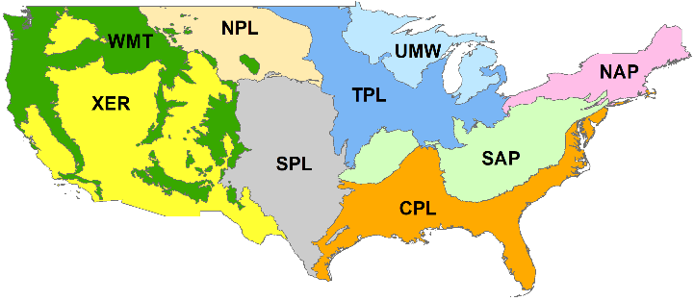

Slide 2
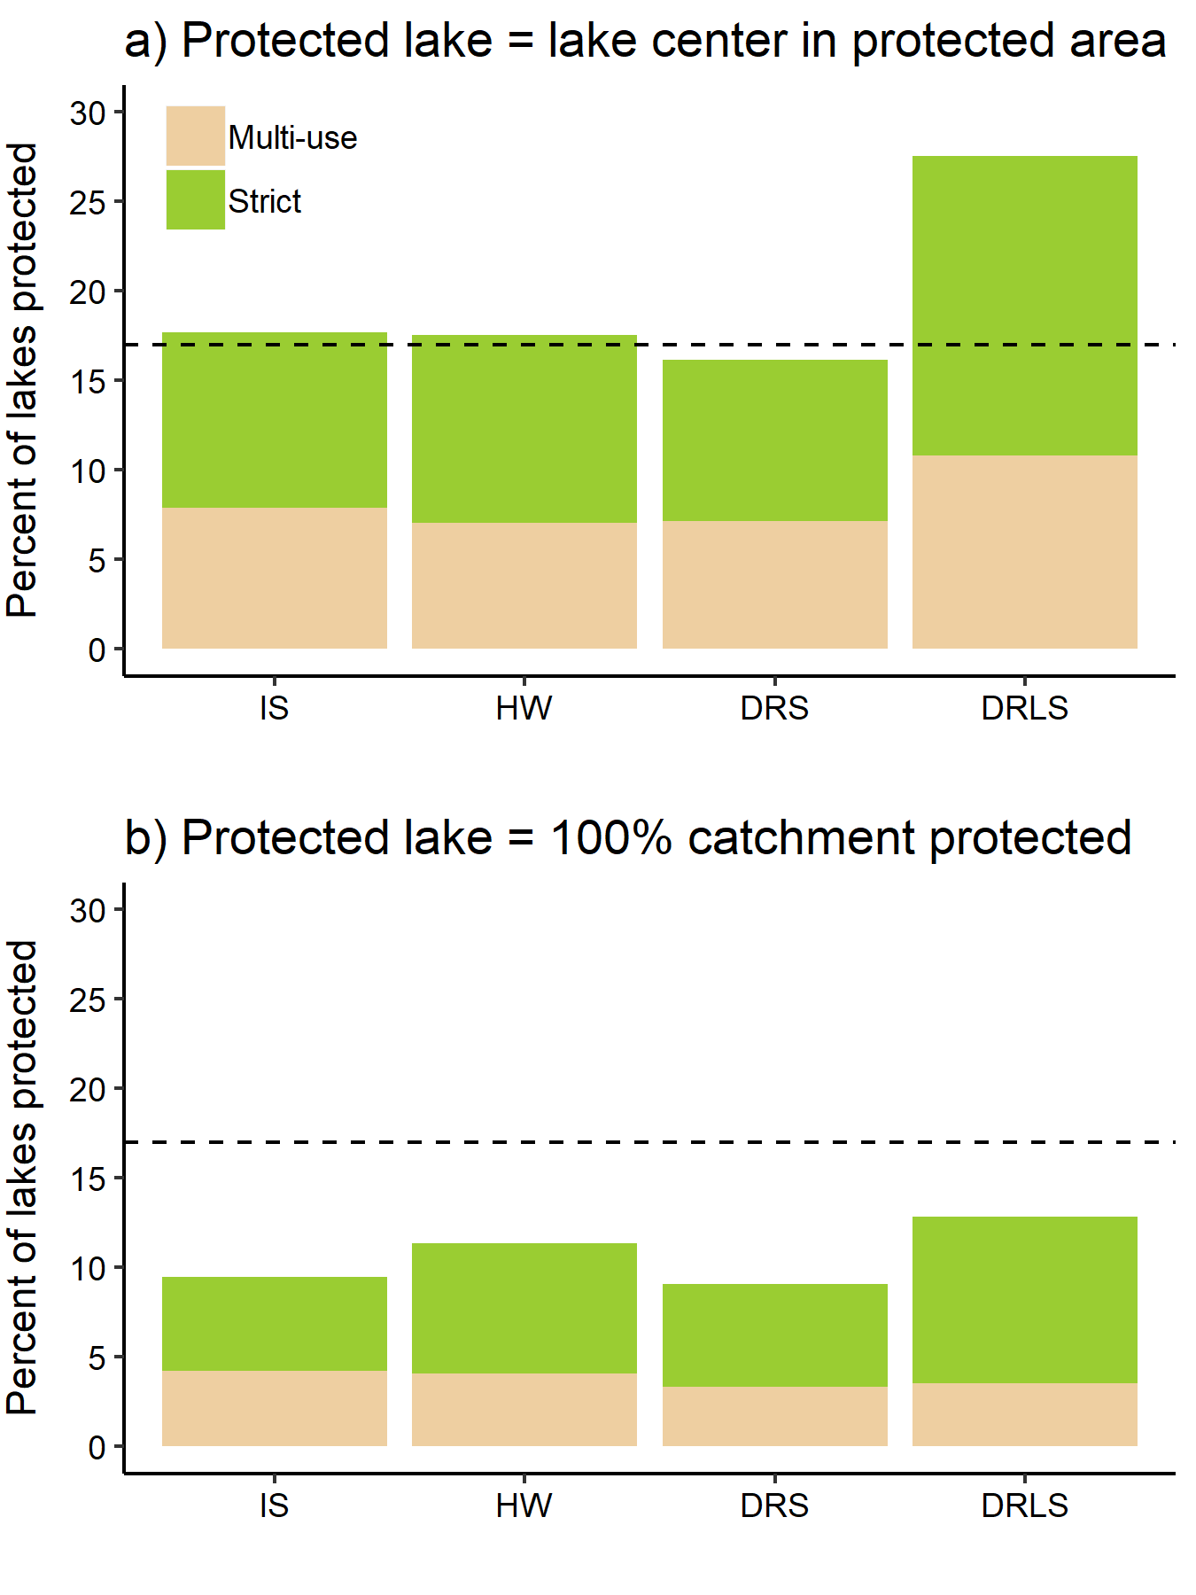
33.50%
14.51%
44.08%
7.90%

Slide 3
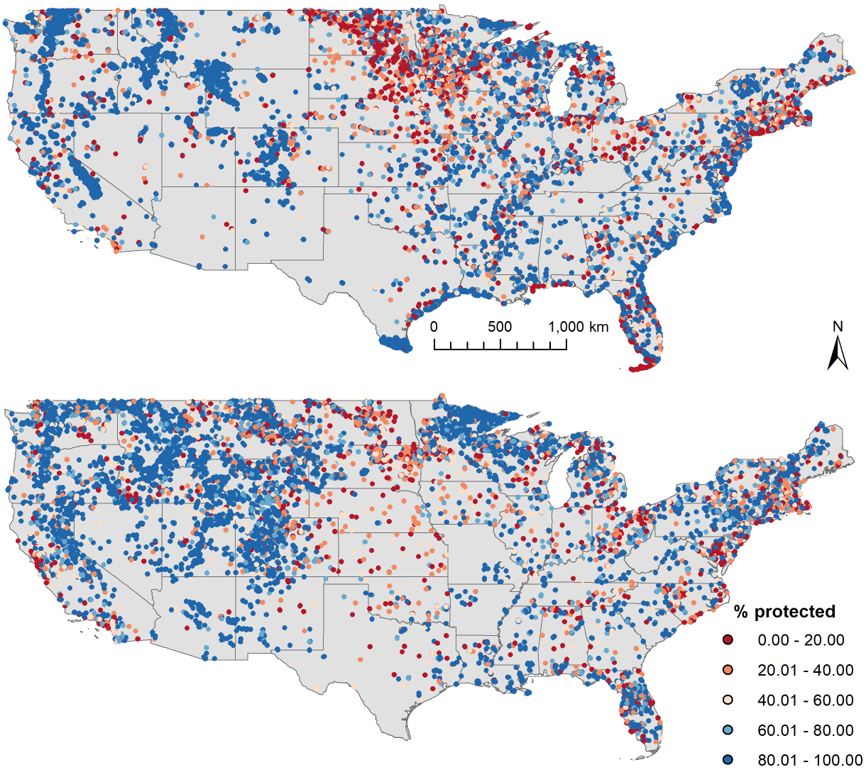
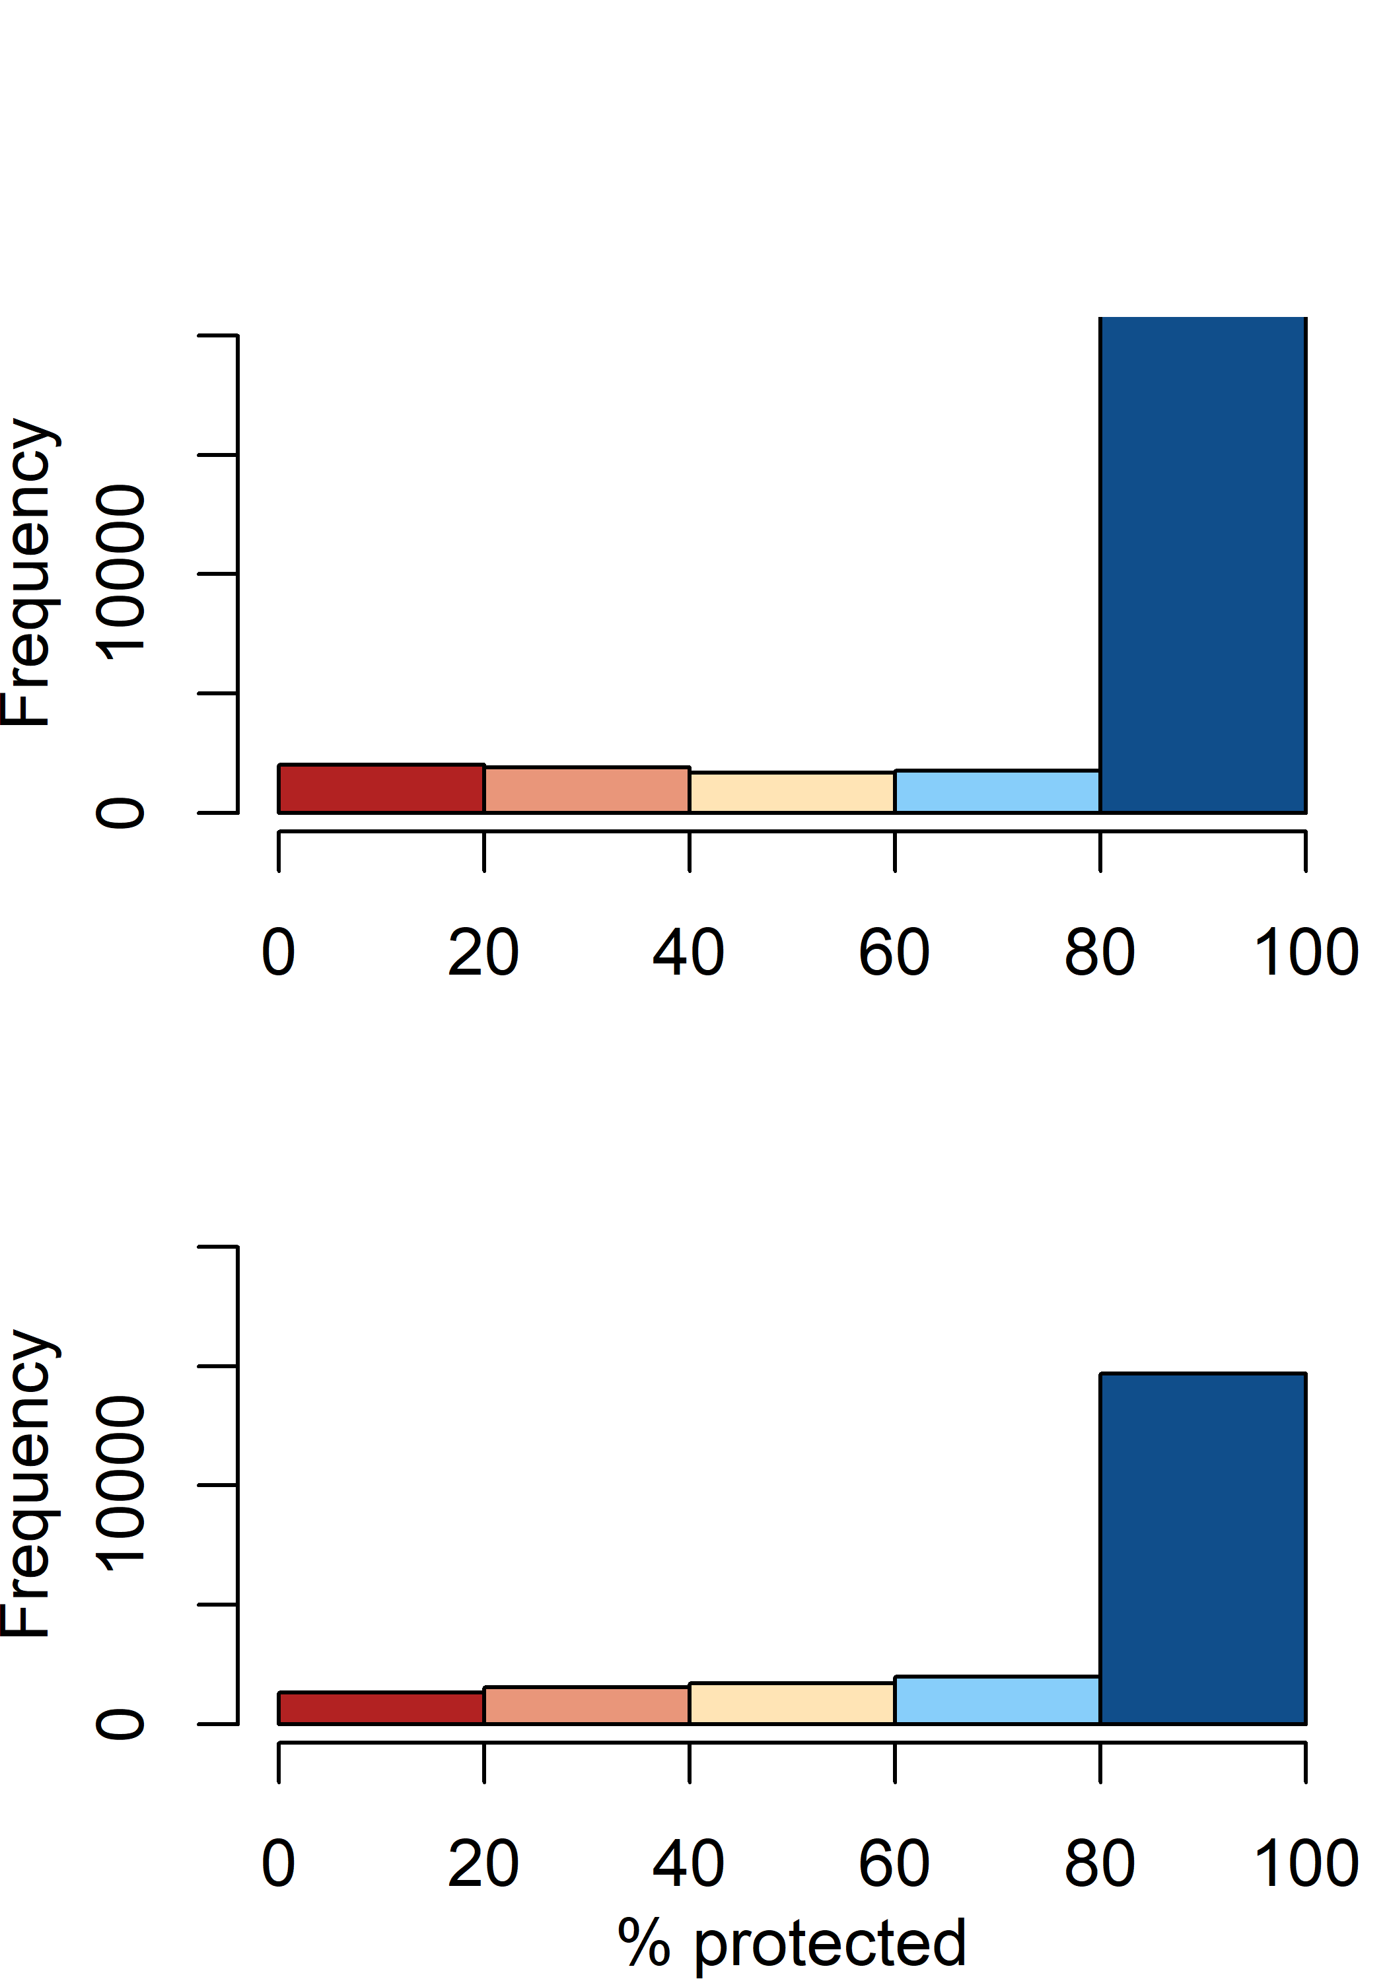
a) Strict (28704 lakes)
b)
c) Multi-use (21280 lakes)
d)

Slide 4
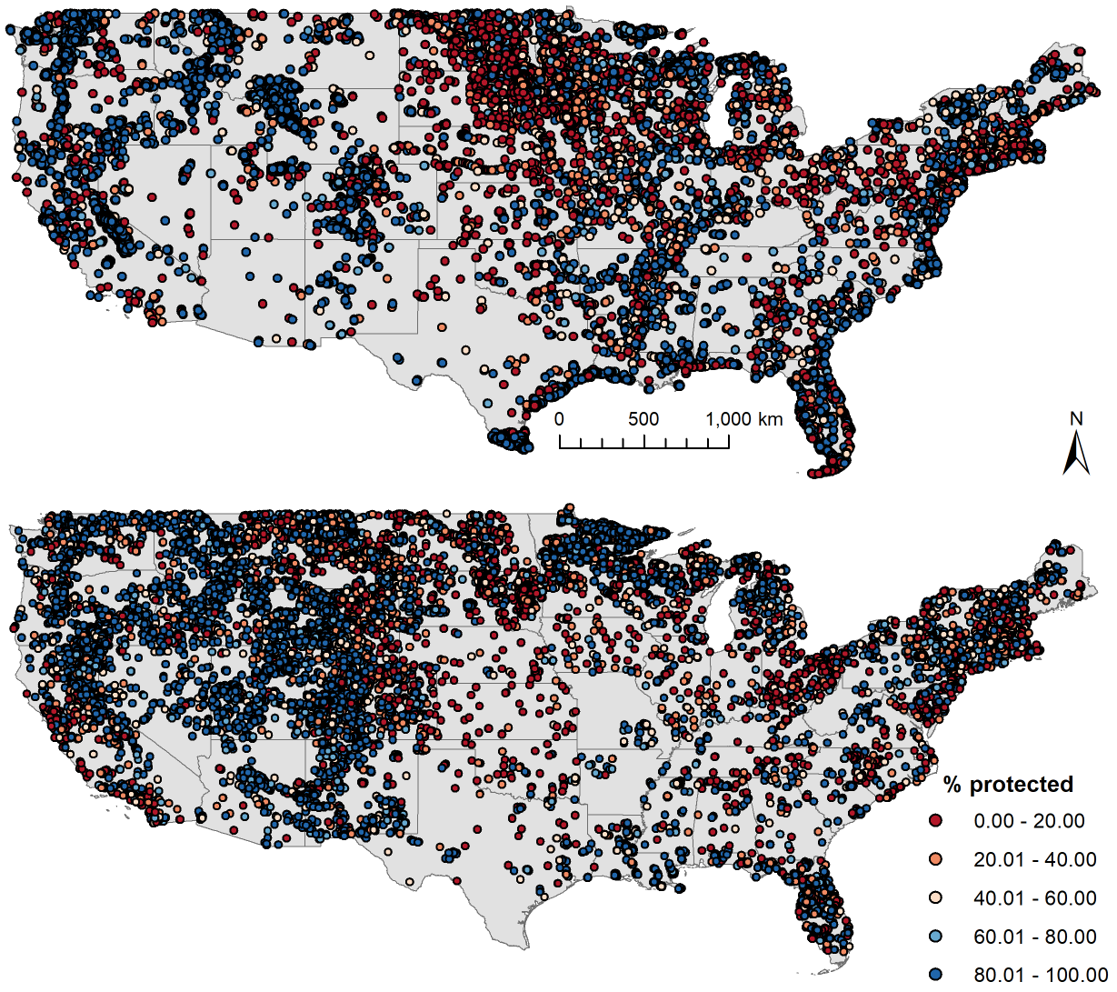
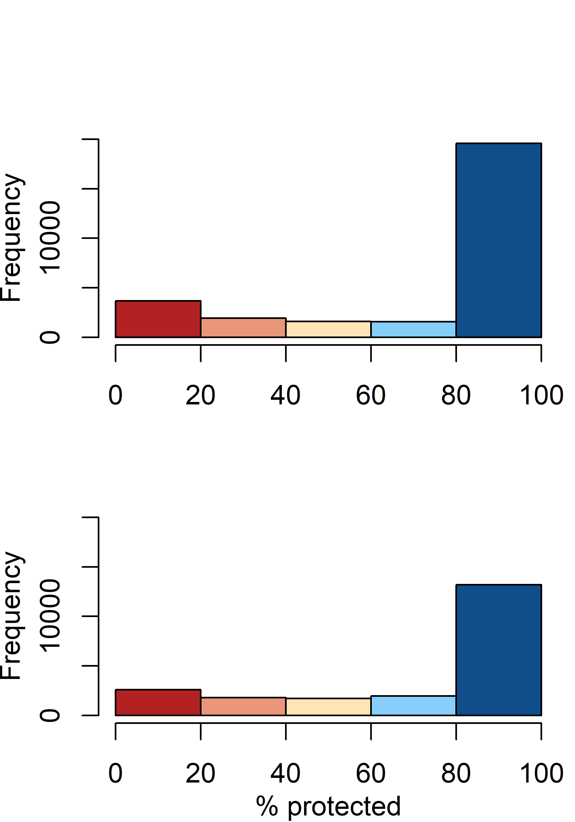
a) Strict (28704 lakes)
b)
c) Multi-use (21280 lakes)
d)

