Slide 1
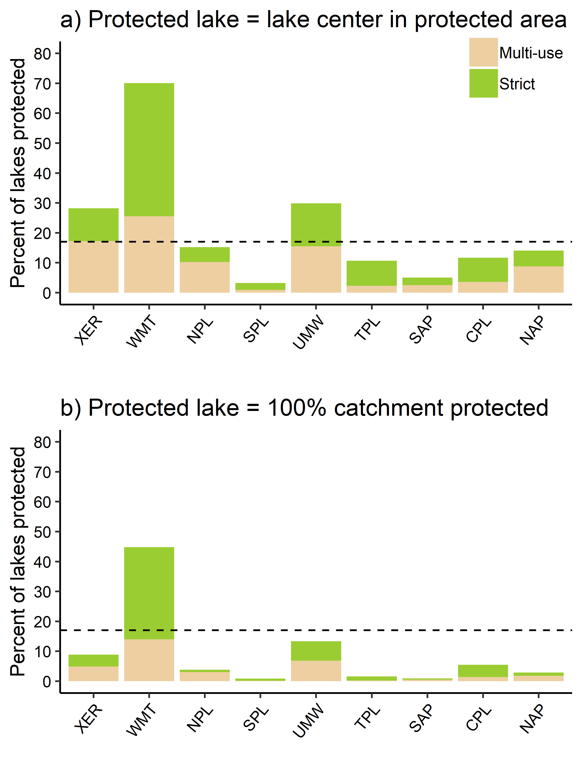
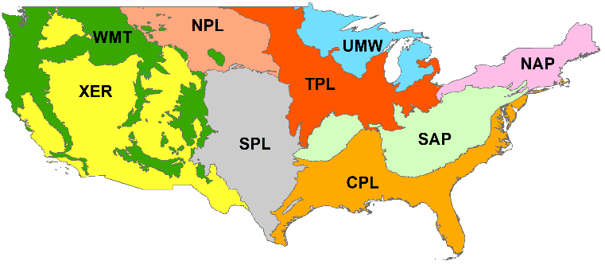

Slide 2
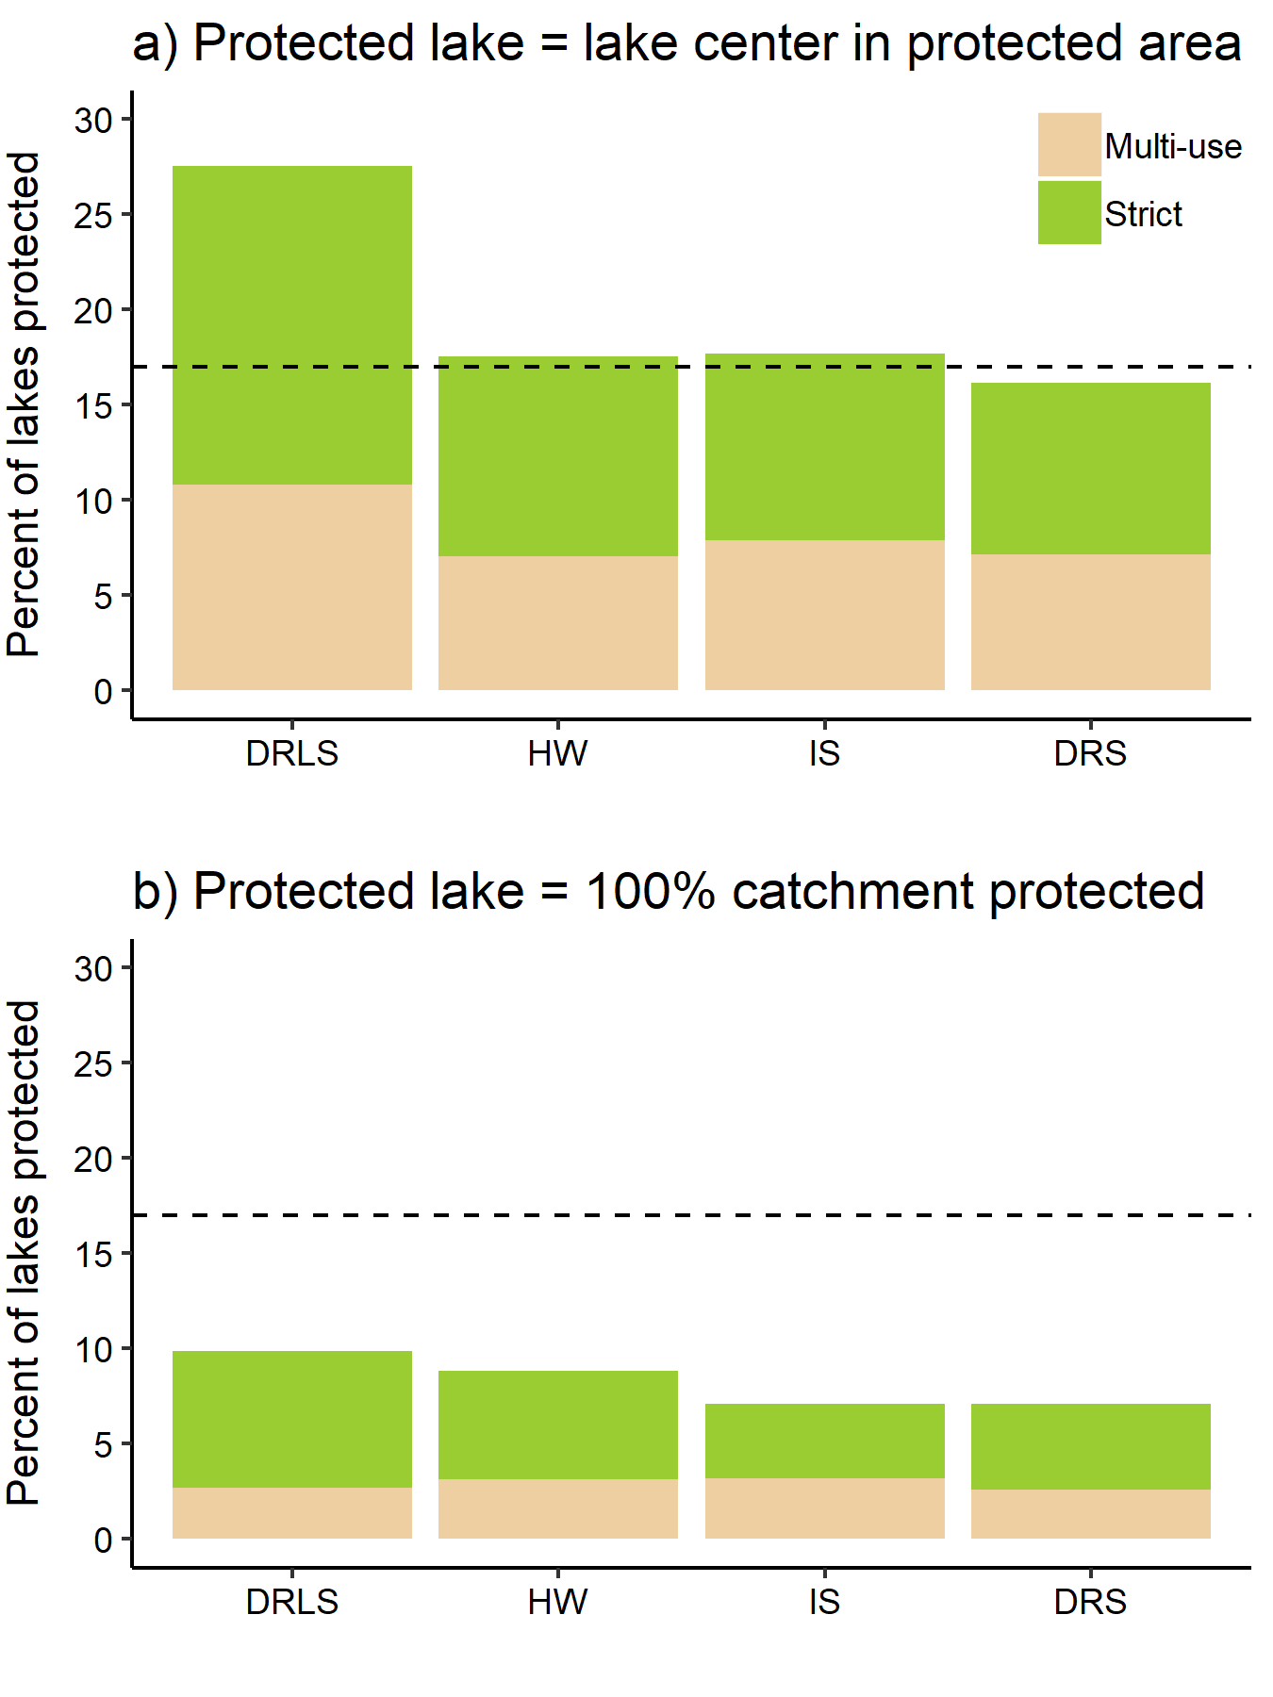
7.90%
44.08%
14.51%
33.50%

Slide 3
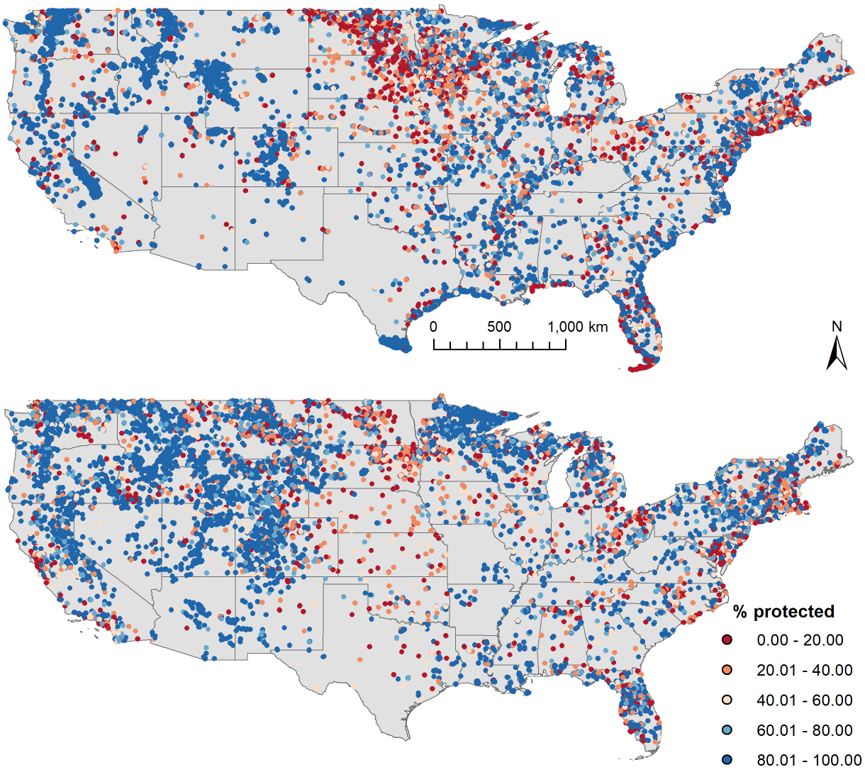
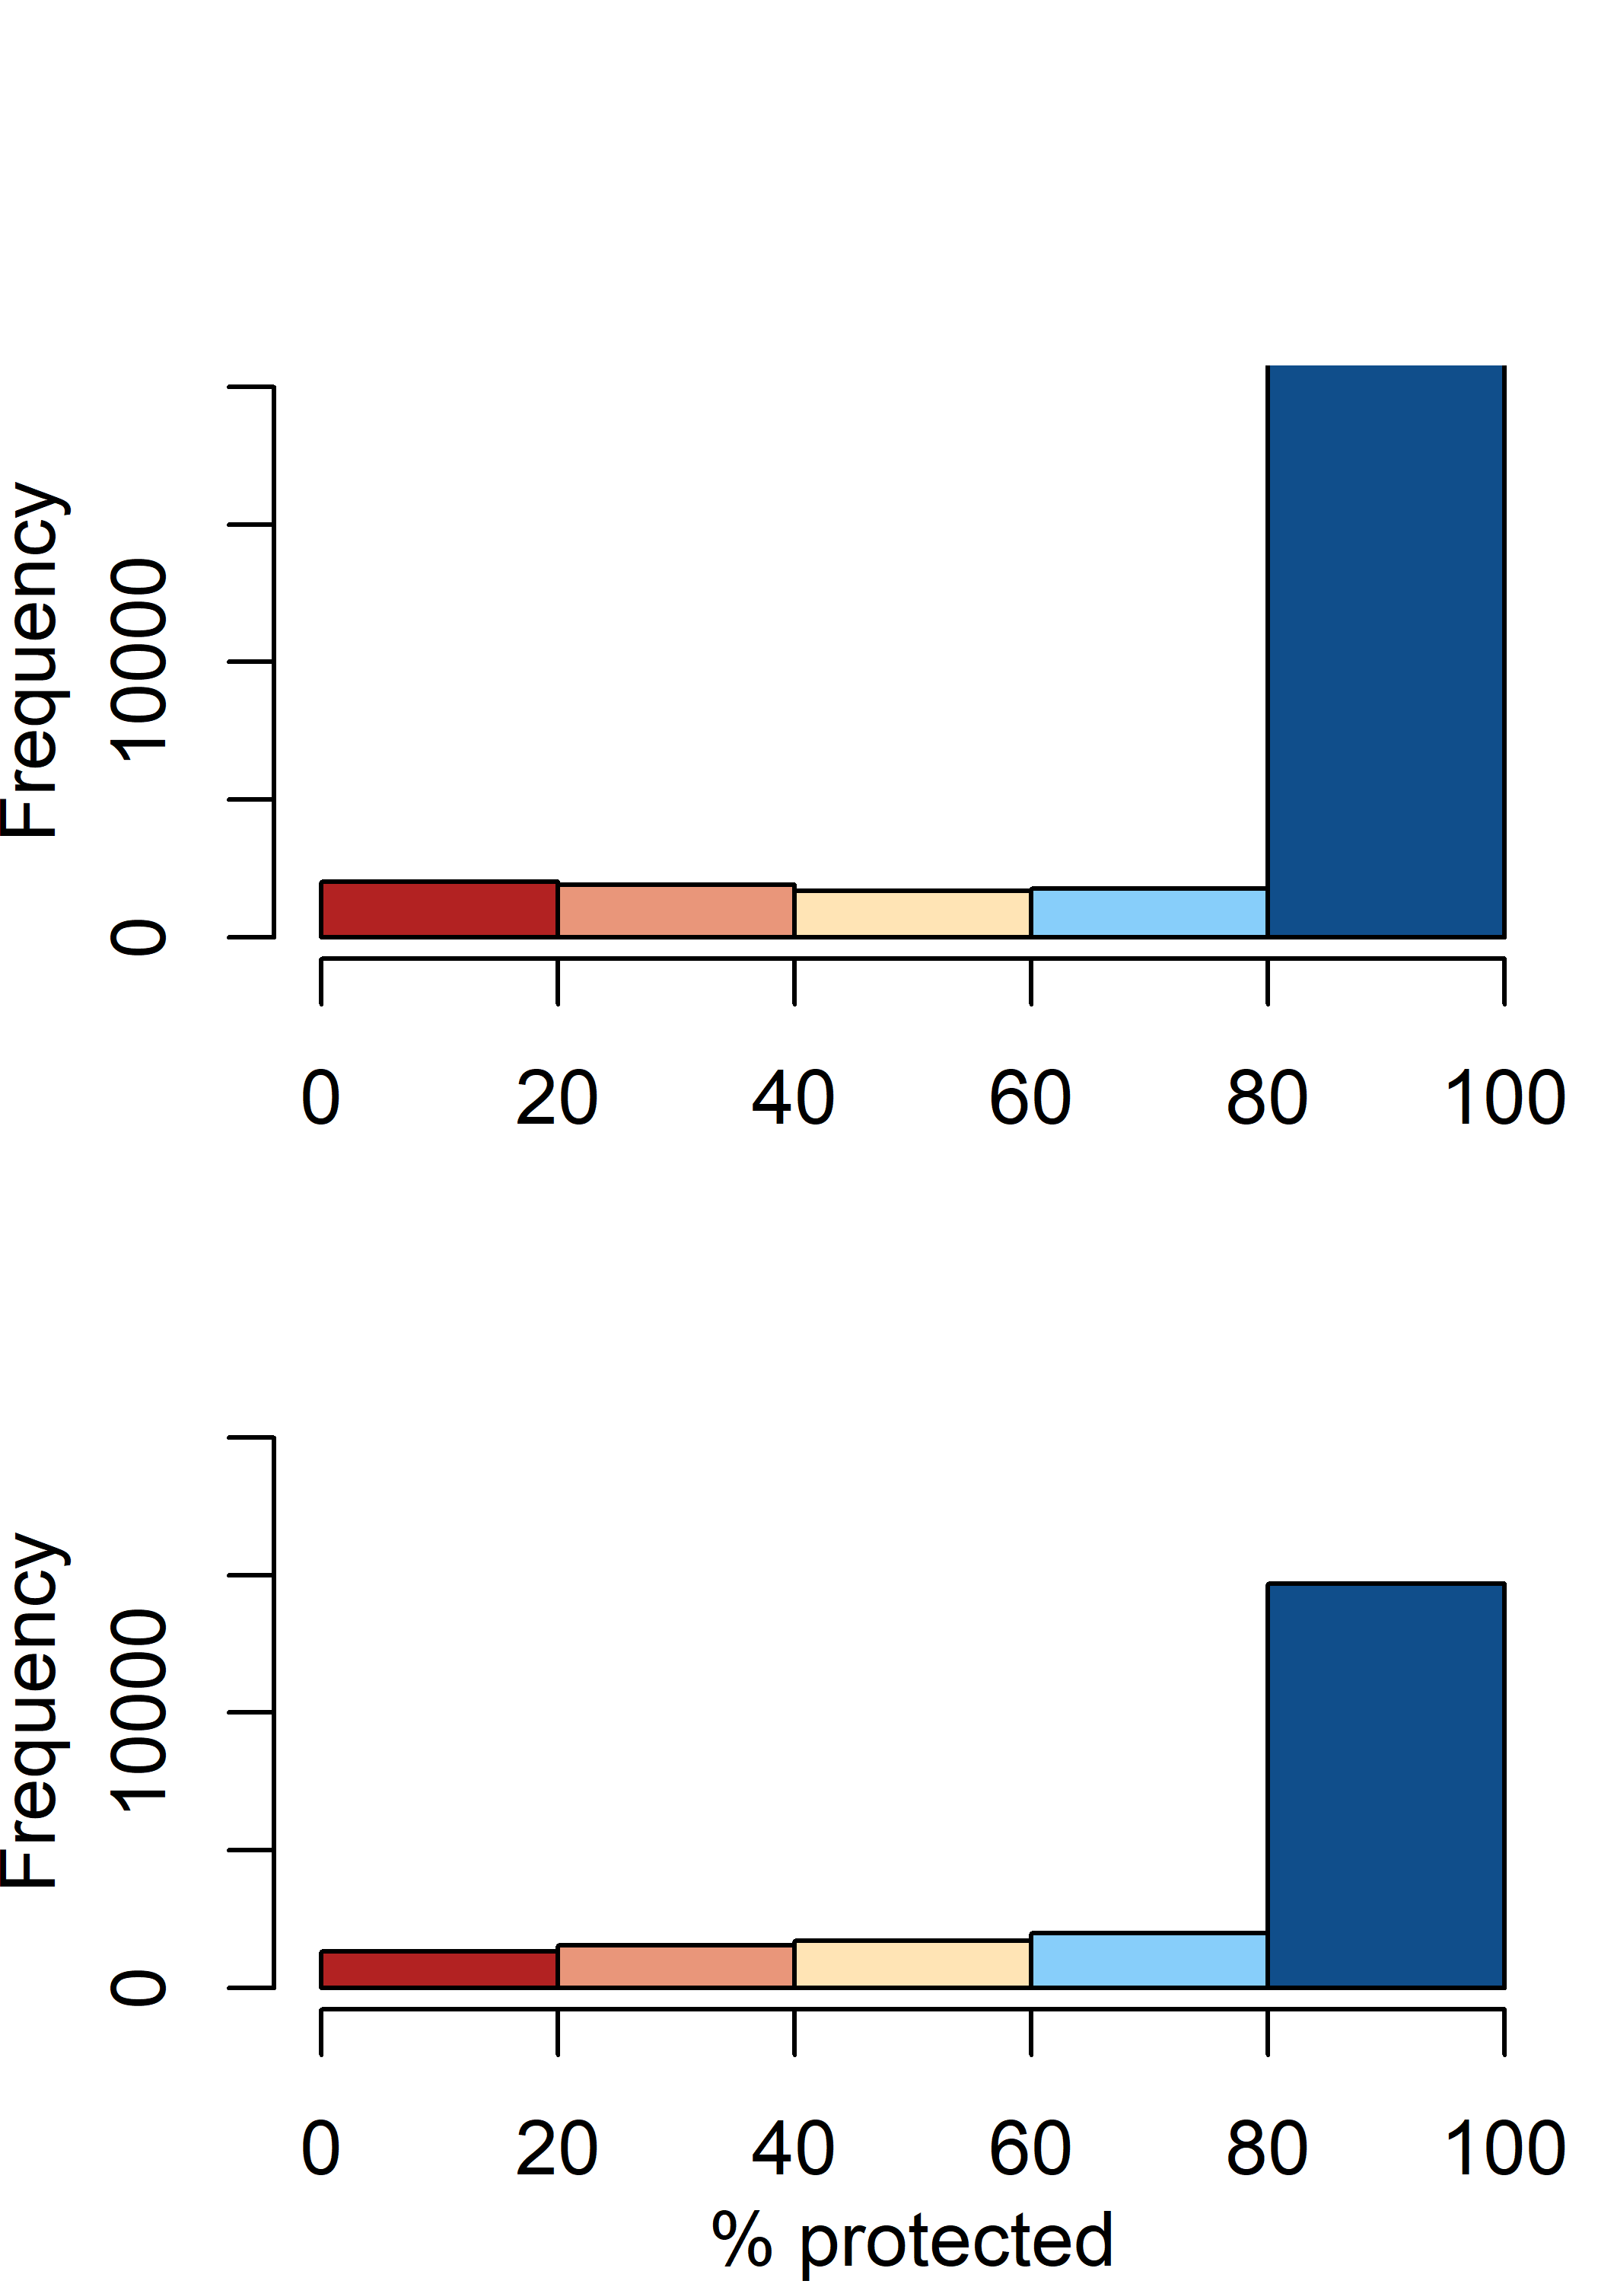
a) Strict (28704 lakes)
b)
c) Multi-use (21280 lakes)
d)

Slide 4
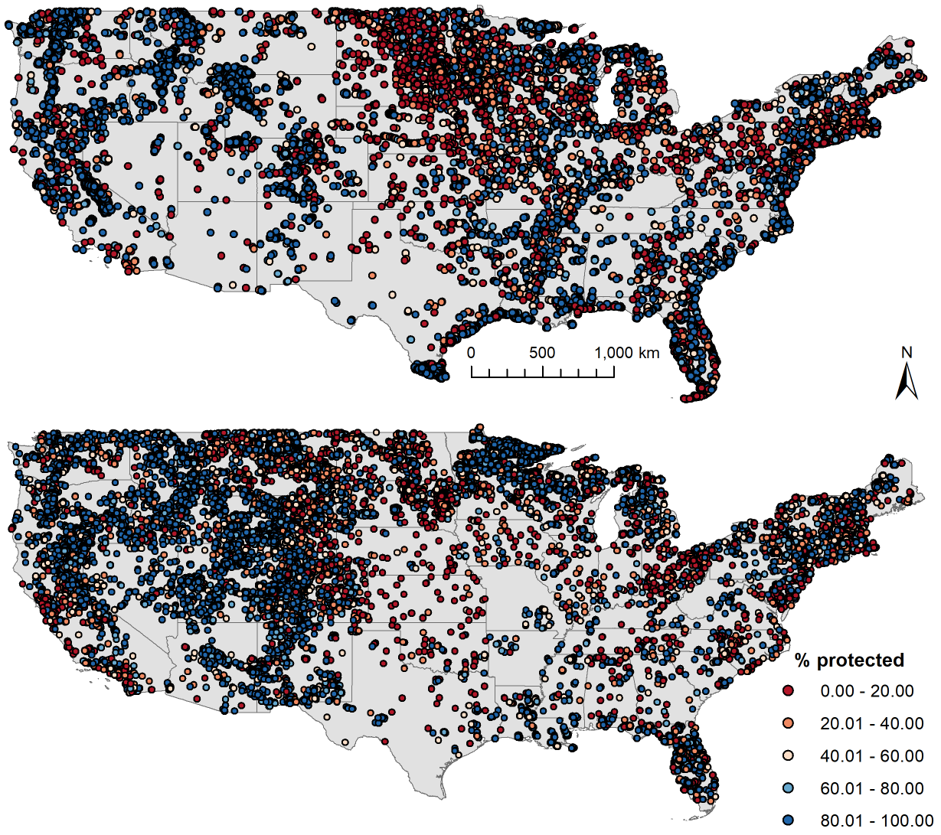
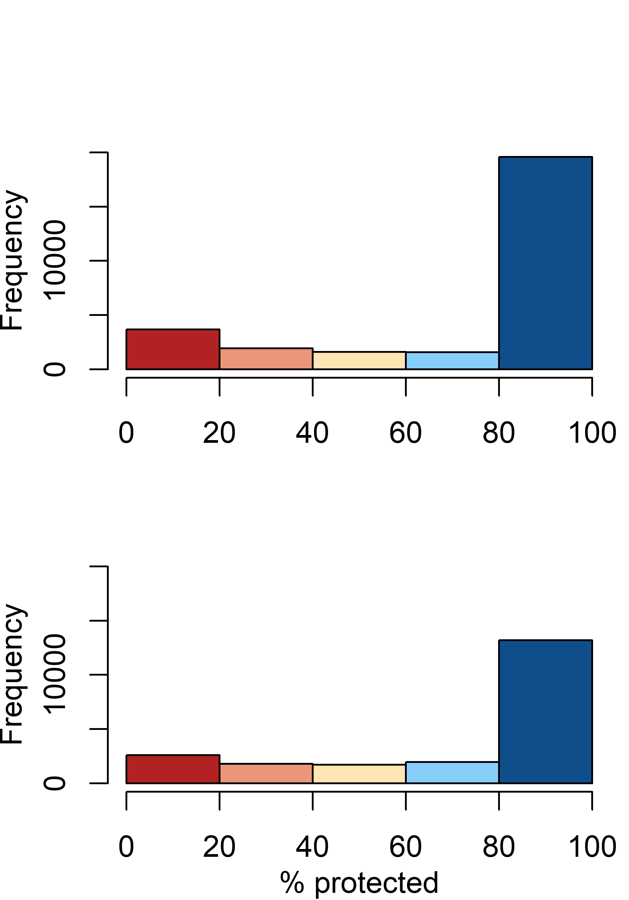
a) Strict (28704 lakes)
b)
c) Multi-use (21280 lakes)
d)

