Slide 1
Movement cost
Hydrologically connected, terrestrially isolated
Hydrologically and terrestrially connected
Low | High
Hydrologic connectivity
Hydrologically and terrestrially isolated
Hydrologically isolated, terrestrially connected
Terrestrial connectivity

Slide 2
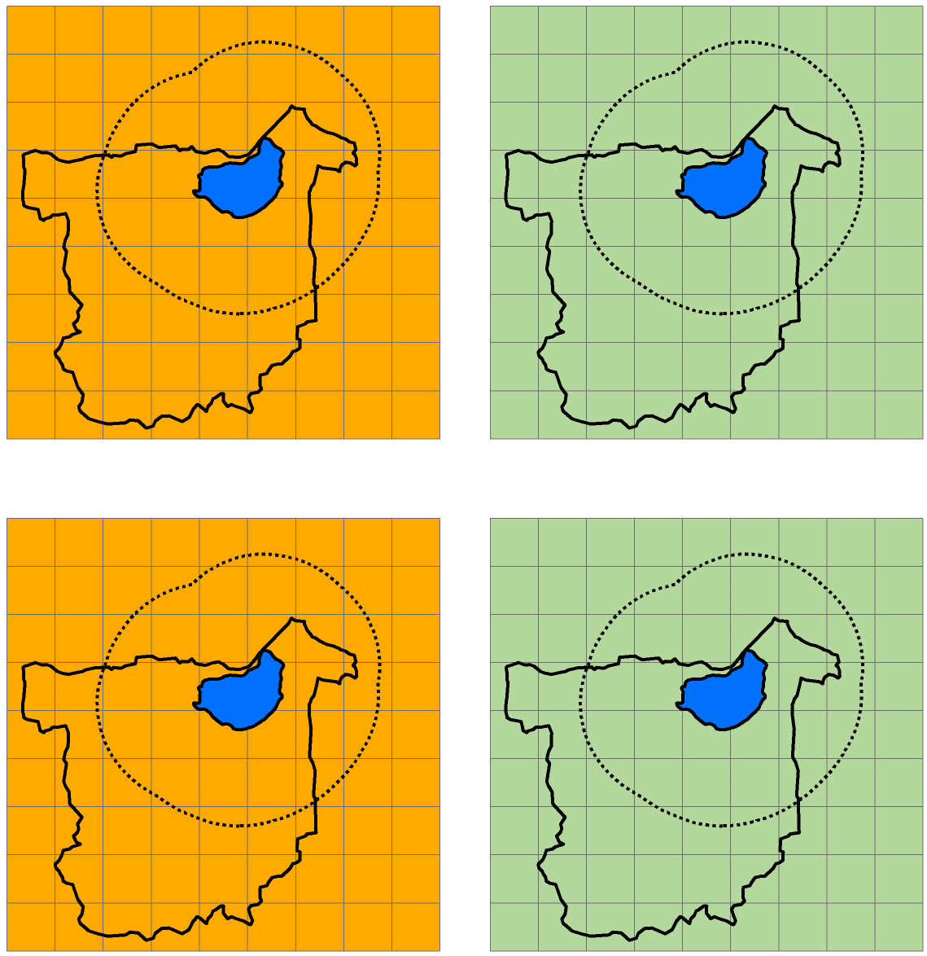
Hydrologically connected, terrestrially isolated lake
Hydrologically and terrestrially connected lake
A)
B)
High movement cost
Low movement cost
Stream direction
Wildlife dispersal buffer
Lake watershed
Wetland
Non-focal lake
Hydrologic connectivity
Hydrologically isolated, terrestrially connected lake
Hydrologically and terrestrially isolated lake
C)
D)
Terrestrial connectivity

Slide 3
Highly connected for aquatic species, poorly connected for semi-aquatic species
Highly connected for aquatic and semi-aquatic species
a)
b)
High movement cost
Low movement cost
Stream direction
Wildlife dispersal buffer
Lake watershed
Focal lake
Non-focal lake
Wetland
Aquatic connectivity
Poorly connected for aquatic and semi-aquatic species
Poorly connected for aquatic species, highly connected for semi-aquatic species
c)
d)
Semi-aquatic connectivity

