Slide 1
A) Post-fire water chemistry
B) Post-fire algal biomass
Nutrients
Sediments
DOC
Algal biomass
Sample event
Drainage
Isolated
Burned
Control
Spring
snowmelt
Spring precipitation
Summer precipitation
Spring
snowmelt
Spring precipitation
Summer precipitation
Fig. X. Hypothesized post-fire water quality temporal trajectories across drainage, headwater and isolated lakes. Drainage/headwater lakes
Notes:
New 12-2

Slide 2
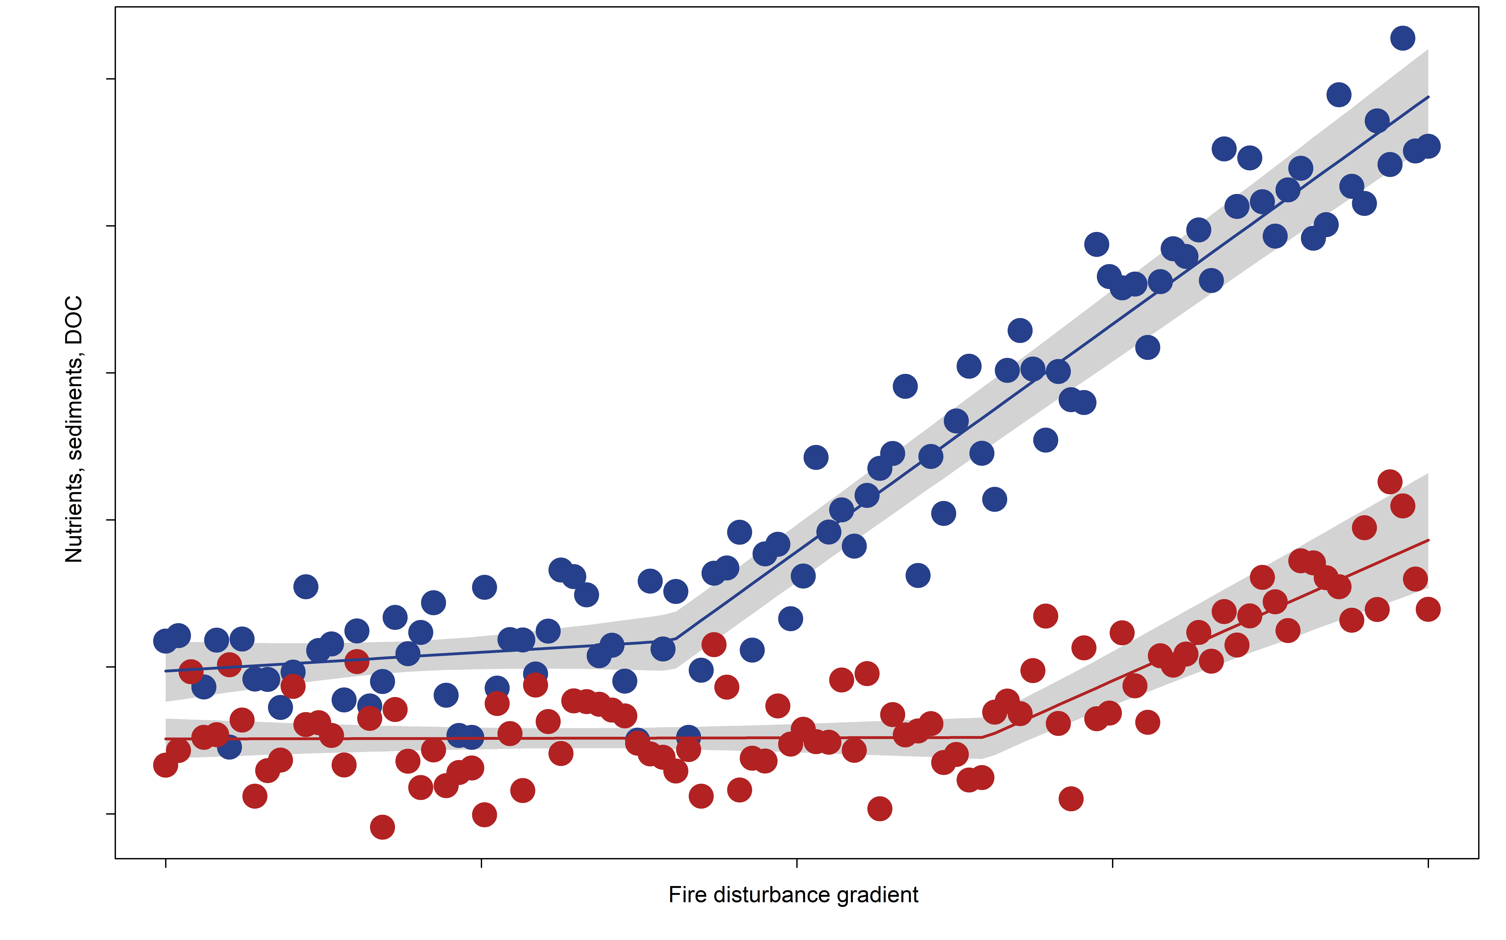
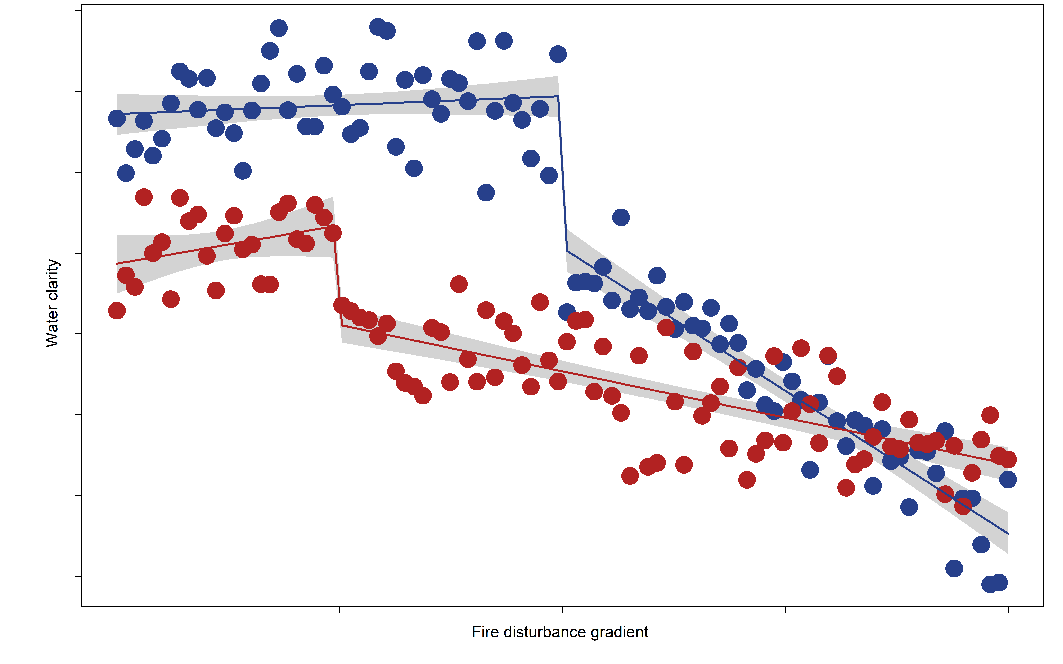
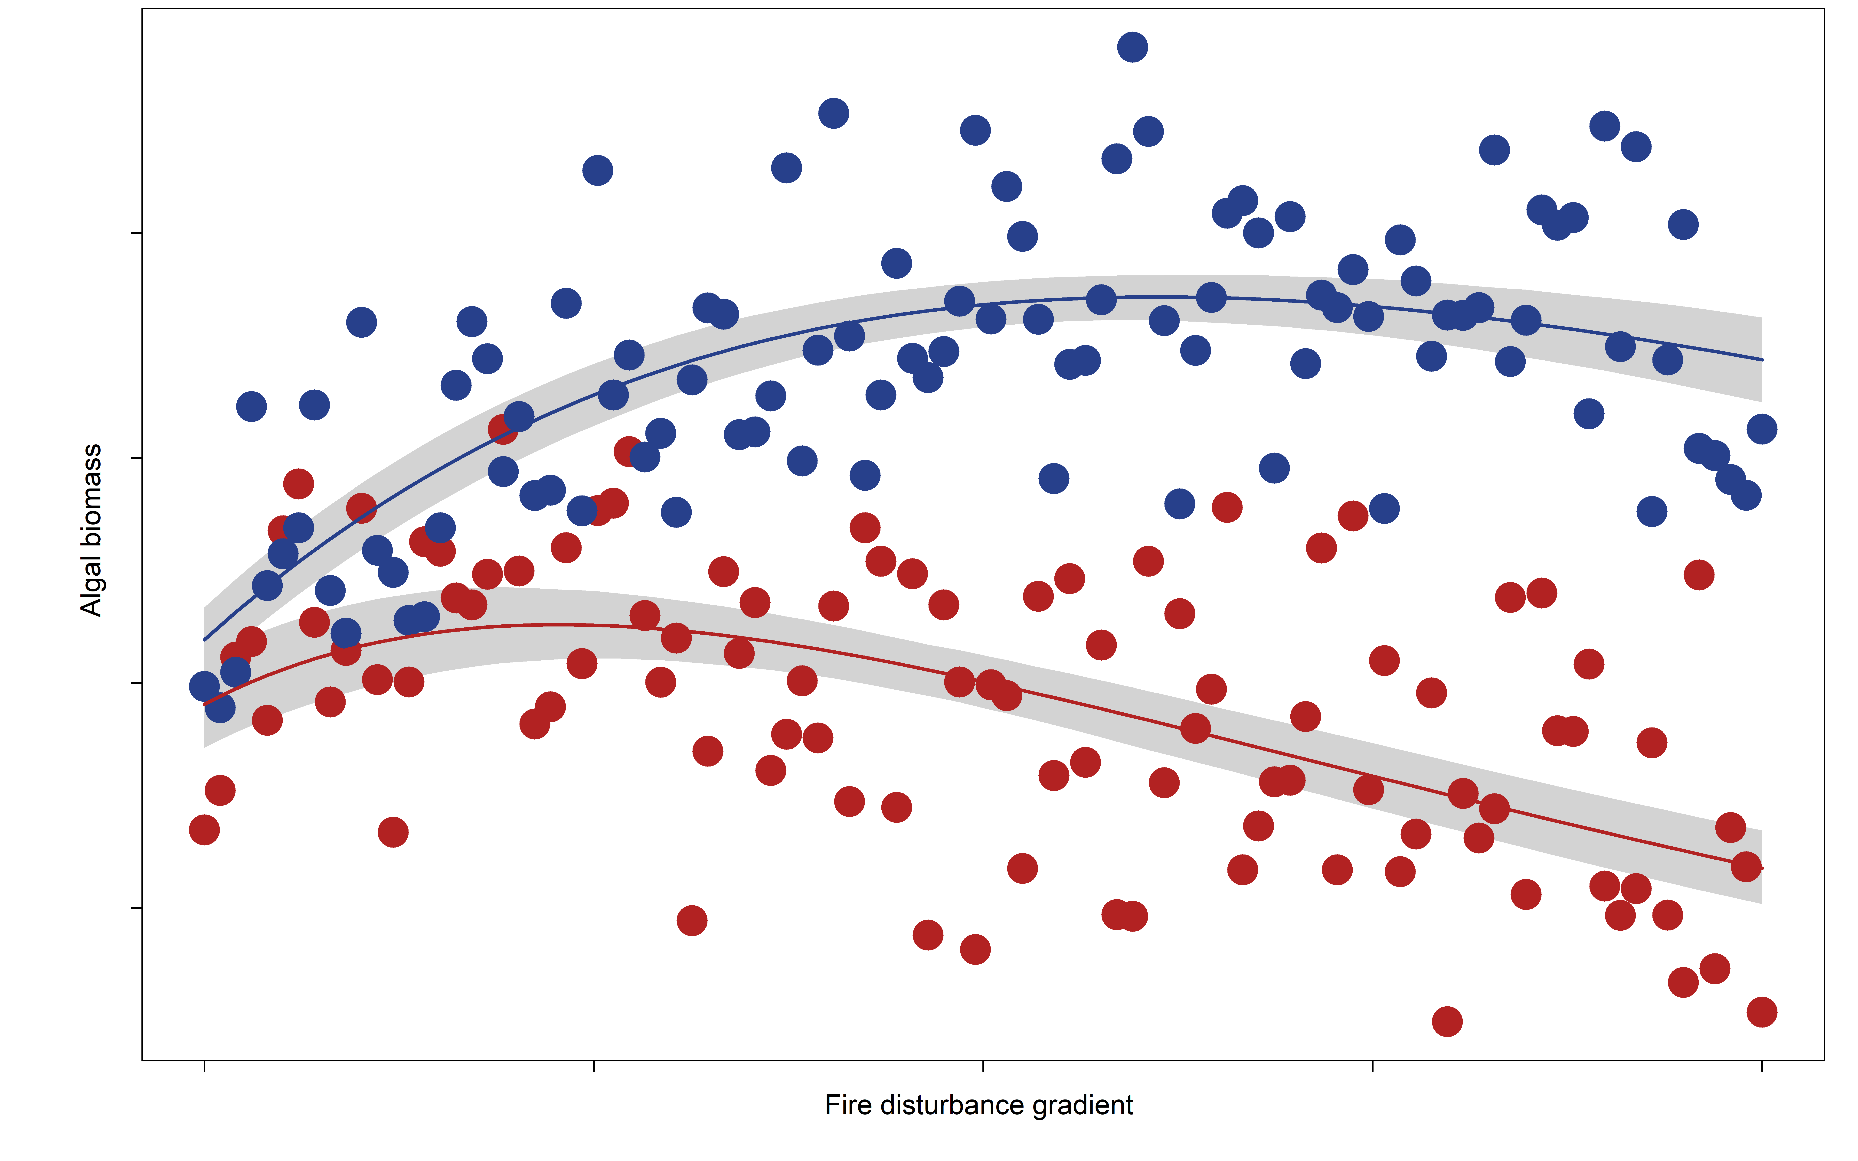
A) Water chemistry
B) Water clarity
C) Algal biomass
Drainage
Isolated
Nutrients, sediments, DOC
Water clarity
Algal biomass
Fire disturbance gradient
Fire disturbance gradient
Fire disturbance gradient

Slide 3
Outtakes

Slide 4
A) Water chemistry
B) Water clarity
C) Primary productivity
Response threshold
Nutrients
Sediments
DOC
Water
clarity
PP
Light limitation
(DOC, sediments)
Disturbance gradient
Disturbance gradient
Disturbance gradient
Fig. 2. Hypothesized relationships between watershed disturbance (proportion watershed burned or burned at high severity (> 70% canopy mortality)) and A) water chemistry, B) water clarity and C) primary productivity (PP; measured as chlorophyll-a). Orange dashed lines represent disturbance response thresholds, below which lake responses to disturbance are negligible. In C, the black dashed line represents a disturbance threshold beyond which PP no longer increases due to higher concentrations of DOC or sediments.
Notes:
New 12-1

Slide 5
Peak smoke
Snowmelt/
precipitation
Precipitation
Sampling events
Burned watershed
Smoke-exposed
Control
Nutrients
Turbidity
DOC
Summer 21
Fall 21
Winter 22
Spring 22
Summer 22
Time since ignition
Fig. X. Hypothesized post-fire water quality temporal trajectories across burned watershed, smoke-exposed/unburned watershed and control lakes from ignition date to one year later. These curves depict explanations for differences in lake responses across the three groups.

Slide 6
A) Water chemistry
B) Primary productivity
Drainage
Headwater
Isolated
Drainage
Headwater
Isolated
Nutrients
Turbidity
DOC
PP
Spring snowmelt/ precipitation
Summer precipitation
Spring snowmelt/ precipitation
Summer precipitation
Fall precipitation
Fall precipitation
Time since ignition
Time since ignition
Fig. X. Hypothesized post-fire water quality temporal trajectories across drainage, headwater and isolated lakes. Drainage/headwater lakes
Notes:
New 12-2

Slide 7
A) Water chemistry
B) Primary productivity
Sample events
Sample events
Drainage
Headwater
Isolated
Drainage
Headwater
Isolated
Nutrients
Turbidity
DOC
PP
Spring snowmelt/ precipitation
Summer precipitation
Spring snowmelt/ precipitation
Summer precipitation
Fall precipitation
Fall precipitation
Time since ignition
Time since ignition
Fig. X. Hypothesized post-fire water quality temporal trajectories across drainage, headwater and isolated lakes. Drainage/headwater lakes
Notes:
New 12-2

Slide 8
Snowmelt/precipitation
Precipitation
Peak smoke
Winter
Nutrients
Turbidity
DOC
Summer 21
Fall 21
Winter 22
Spring 22
Summer 22
Time since ignition

Slide 9
A) Minnesota lakes: 1 year post-fire
B) Québec lakes: 3 years post-fire
Control
Burned watershed
Frequency
Nutrient concentration
Nutrient concentration

Slide 10
A) Disturbance gradient
B) Clear lakes
C) Brown lakes
D) Green lakes
Burned watershed
Smoke-exposed
Control
Burned watershed
Nutrients
Nutrients
Nutrients
Nutrients
Smoke-exposed,
unburned watershed
Proportion burned
Proportion high severity
Smoke exposure
Primary productivity
Primary productivity
Primary productivity
Fig. X. Hypothesized nutrient-productivity relationships across A) clear (unproductive), B) brown (unproductive) and C) green (productive) lakes across lakes with burned watersheds, smoke-exposed, unburned watersheds and the control group. In less productive lakes (A-B), differences in nutrient concentrations among groups are greater. In more productive lakes, slopes are gentler due to high pre-fire nutrient concentrations.

Slide 11
A) Isolated/HW
B) Drainage
Burned watershed
Smoke-exposed
Control
TP, DOC
TN, TSS
Disturbance gradient
Disturbance gradient
Fig. X. Hypothesized water quality-disturbance relationships across A) isolated/headwater (HW) lakes and B) drainage lakes across lakes with burned watersheds, smoke-exposed, unburned watersheds and the control group.

Slide 12
New ideas Aug 2022
Nutrient limitation vs. light limitation
Variation along fire disturbance gradient (% watershed burned, severity)
Isolated vs. drainage lakes
In general, we expect nutrient concentrations to increase in burned lakes and that these increases will increase along fire disturbance gradients (i.e., higher % watershed burned and at higher burn severity). However, we do not expect commensurate increases in primary productivity due to light limitation, which we expect to be greater at higher levels of disturbance.

Slide 13
Both nutrient concentrations and light have the potential to co-limit primary productivity in lakes, but the relative magnitudes of these limiting mechanisms vary according to pre-fire water clarity and presence of fire disturbance. Brown, unburned lakes are most co-limited due to low nutrients and high sediments and DOC in runoff, whereas clear, burned lakes are least co-limited due to relatively pristine pre-fire conditions and post-fire influxes of nutrients, sediments and DOC.
I like how this one incorporates the role of water clarity (and how that can change following fire), but the figure lacks a disturbance gradient and says nothing about isolated vs. drainage lakes
Clear, unburned
Brown, unburned
Nutrient limitation
Clear, burned
Brown, burned
Light limitation

Slide 14
Both nutrient concentrations and light have the potential to co-limit primary productivity in lakes, but the relative magnitudes of these limiting mechanisms vary along fire disturbance gradients (i.e., % watershed burned, burn severity). At low levels of disturbance, nutrient limitation prevails over light limitation, but as disturbance increases, nutrient limitation decreases (i.e., more nutrients in runoff) and co-limitation shifts toward light limitation (i.e., more sediments, DOC). At intermediate levels of disturbance, nutrient concentrations and light are equally co-limiting, whereas at high levels of disturbance, light limitation prevails over nutrient limitation despite higher nutrient concentrations.
Should the curves look different for isolated vs. drainage lakes? Not sure that they would or if we need to go there.
Nutrient limitation
Light limitation
Equal co-limitation at intermediate fire disturbance
Fire disturbance

Slide 15
Under what circumstances can disturbance override background lake ecosystem drivers and trigger conversion to a new ecosystem state?
A) Critical thresholds above which fire influence overrides background driver influence
B) Critical thresholds of fire disturbance are lower for more fire-sensitive ecosystems
C) Multi-scale drivers that influence the sensitivity of lake ecosystems to fire
Ecosystem fire sensitivity
Critical threshold
Lake depth
Others?
Lake scale: Sediment properties, food web dynamics,
Landscape/watershed scale: LULC, soils, topography,
Regional/macroscale: climate, hydrology
Deep
Shallow
Nutrient concentration
Relative influence
Critical threshold
High
Fire
Low
Water clarity
Green/brown
Clear
Background drivers
Drainage ratio
Low
High
Fire disturbance gradient
Ecosystem fire sensitivity
Regional hydrology/runoff
Low
High
A) The relative influence of fire vs. background drivers on lake ecosystems rapidly increases along a watershed disturbance gradient beyond a critical threshold of watershed disturbance. B) Critical thresholds of watershed disturbance are not the same across all lakes and watersheds; fire-sensitive ecosystems have lower critical thresholds. C) Ecosystem fire sensitivity is influenced by several local lake and watershed variables, including depth, drainage ratio, water clarity, nutrient concentration and hydrologic connectivity. These variables influence the physical/chemical lake environment and therefore may override fire-derived inputs of nutrients, sediments and organic carbon.
Notes:
Local drivers, landscape drivers, regional/macroscale drivers (which are basically all the same in our study)
Background drivers
Local: lake morphometry, water chemistry, food web dynamics, sediment properties
Landscape: watershed morphometry, hydrology, LULC, soils, topography
Regional/macroscale: climate, hydrology
Low threshold: clear/unproductive, shallow, connected lake with high watershed/lake area ratio
High threshold: green/productive, deep, isolated with low watershed/lake area ratio
Brown lakes: post-fire nutrient inputs cannot override light limitation

