Slide 1
A)
B)
Connected lake
Inaccessible lake
Hub lake
Fig. X. Connectivity within a lake network based on A) all available within-network connections and B) loss of a key network component (“hub” lake). All blue lakes are hypothetically accessible to each other based on stream connections, illustrating the potentially large effect of network disruptions on gene flow, migrations and species range shifts. Under A, many gray lakes are hydrologically isolated naturally, whereas network disruptions can artificially isolate lakes.

Slide 2
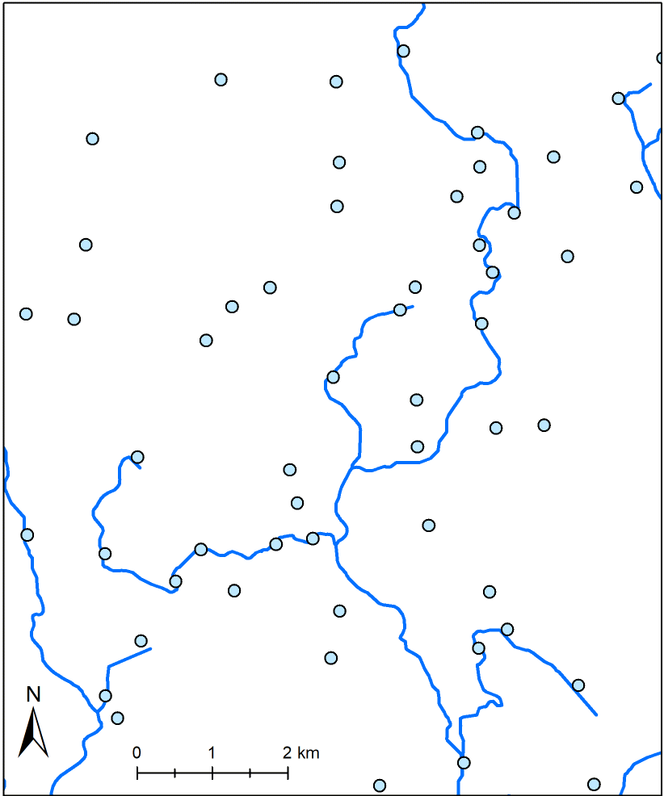
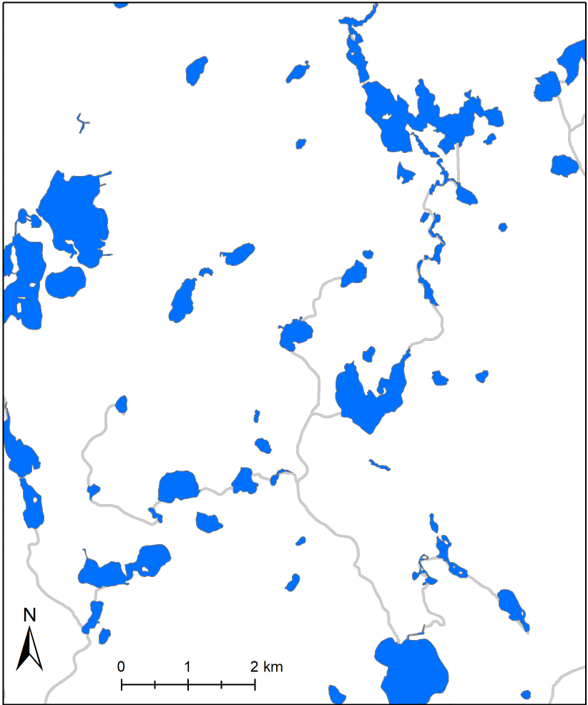
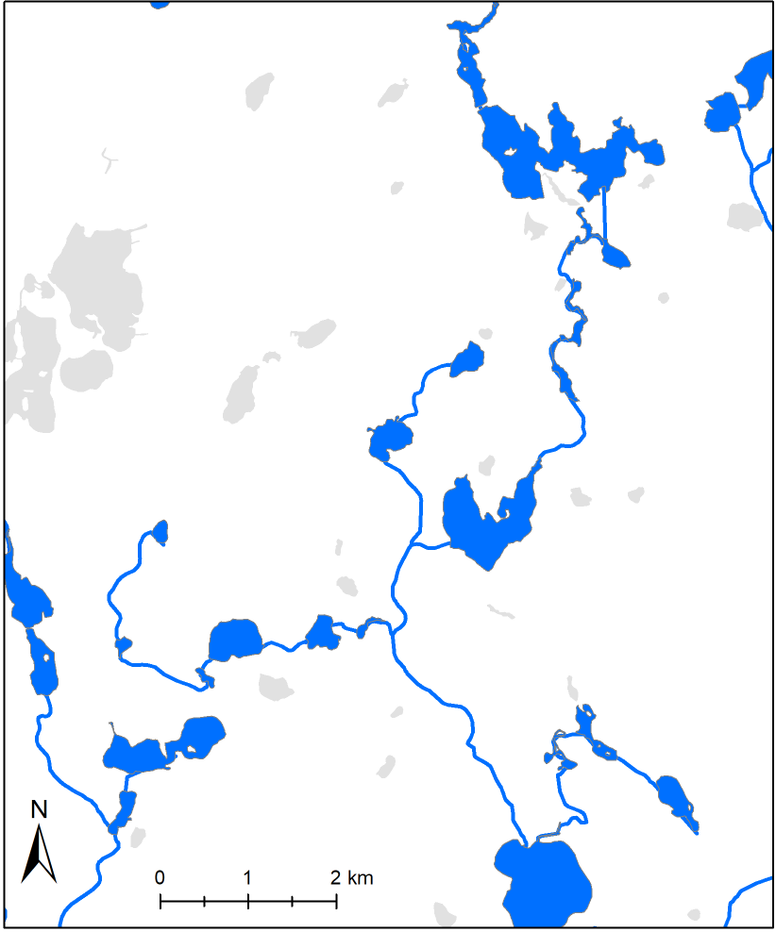
A)
B)
C)
Fig. X. Contrasting views of the freshwater landscape. A) Stream network with lakes as simple nodes, B) Lakes as aquatic habitat patches without regard for stream connections and C) Lake and stream network with network-connected lakes as accessible aquatic habitat patches and hydrologically isolated lakes inaccessible (gray).

Slide 3
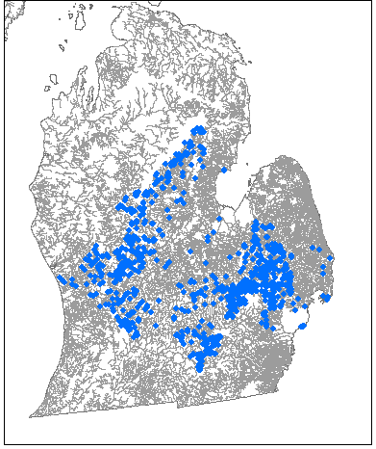
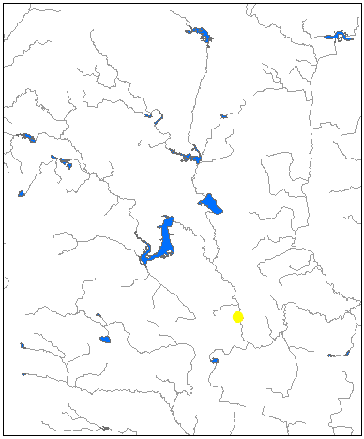
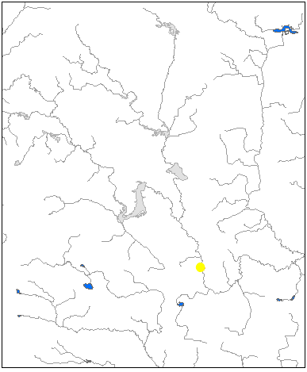
A)
B)
Connected lake
Inaccessible lake
Hub lake
Habitat complexity
Edge density
Lake order
Articulation points
Habitat availability
Number of lakes
Lake distance
Betweenness
centrality
Maximum network connectivity
Fig. X. Conceptual, multi-scale view of freshwater network connectivity. A) Maximum network connectivity is achieved when habitat complexity, habitat availability and climatic connectivity are high. B) Example of a freshwater network, consisting of the largest network lakes in Michigan’s Lower Peninsula (blue dots) connected by streams (gray). The large geographic footprint of this network facilitates large-scale biotic movements along wide ecological gradients. C) A closer view of this same network (red box extent) showing availability of stream-connected lake habitat and the hub lake, which is disproportionately important for whole-network connectivity. D) Illustration of habitat loss when connectivity is lost through the hub lake. More complex networks are more resistant to habitat loss following a single network disruption.
Climatic connectivity
Latitudinal breadth
Ecological gradients
C)
D)

Slide 4
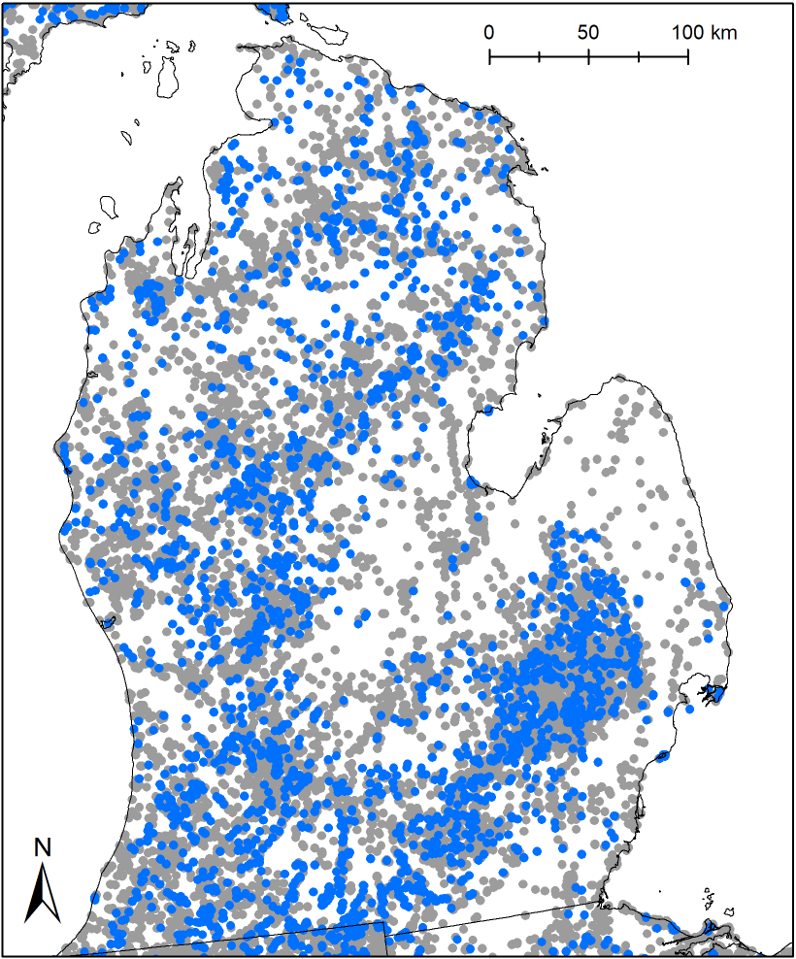
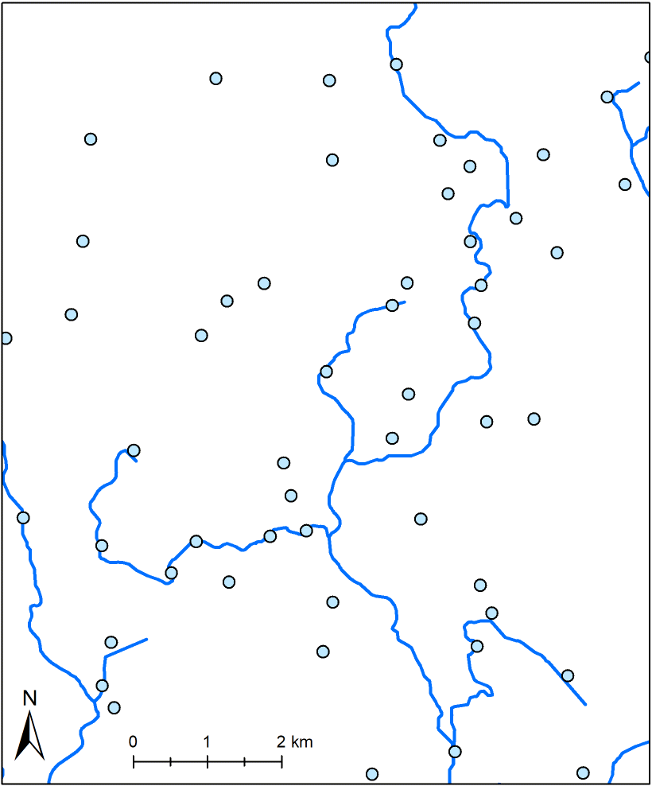

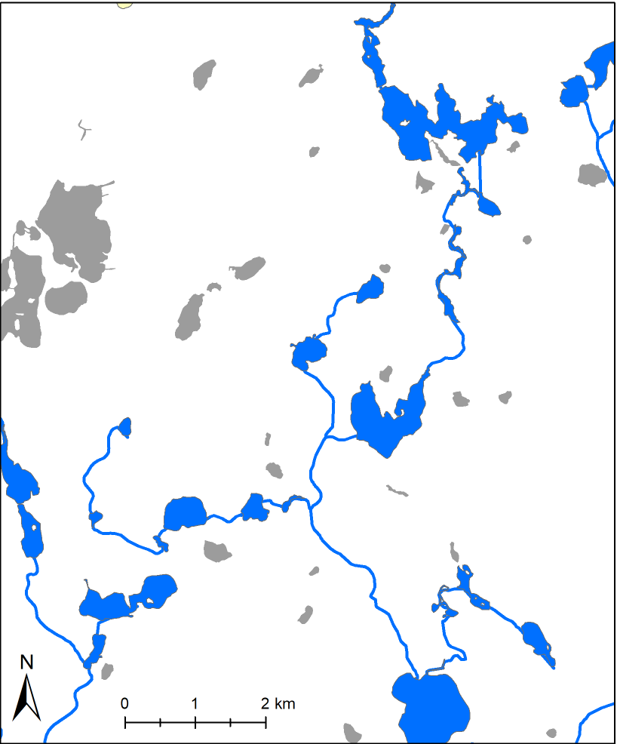
A)
B)
Fig. X. Contrasting views of the freshwater landscape. A) Regional view of stream network-connected and hydrologically isolated (off-network) lakes in Michigan, USA, B) Stream network with lakes as simple nodes, C) Lakes as aquatic habitat patches without regard for stream connections (gray) and D) Lake and stream network with network-connected lakes as accessible aquatic habitat patches and hydrologically isolated lakes inaccessible (gray). B-D occur within red box.
Network
Isolated
C)
D)

Slide 5
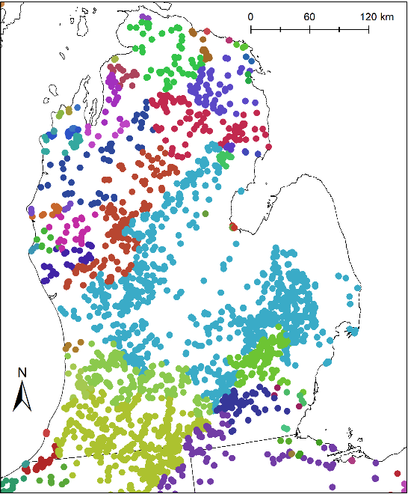
A)
B)
C)
D)

Slide 6
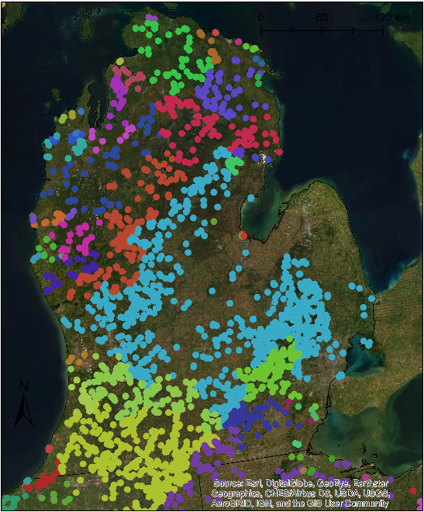
A)
B)
C)
D)

