Slide 1
Mapping hierarchical clusters from Ty’s original output
2-2-21

Slide 2
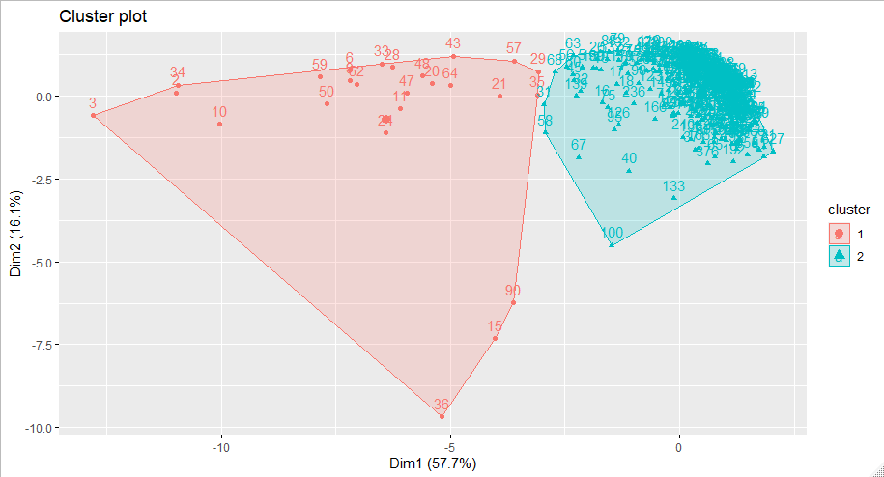
1: 36050 lakes in 25 networks
2: 16369 lakes in 360 networks

Slide 3
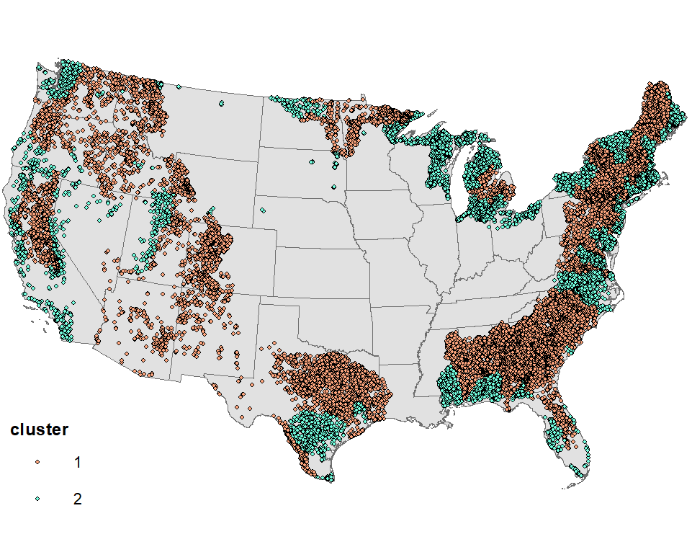
1: 36050 lakes in 25 networks
2: 16369 lakes in 360 networks

Slide 4
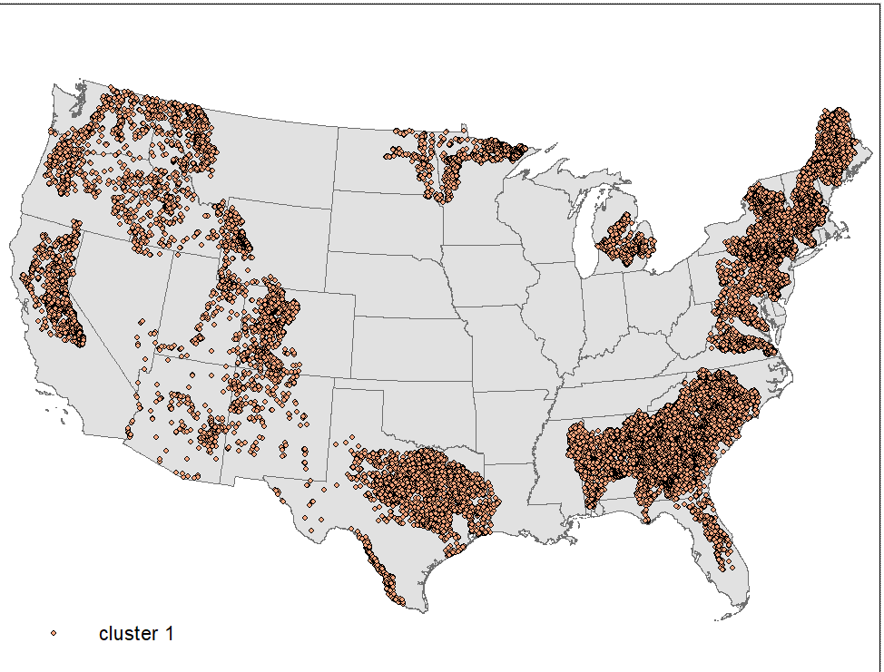
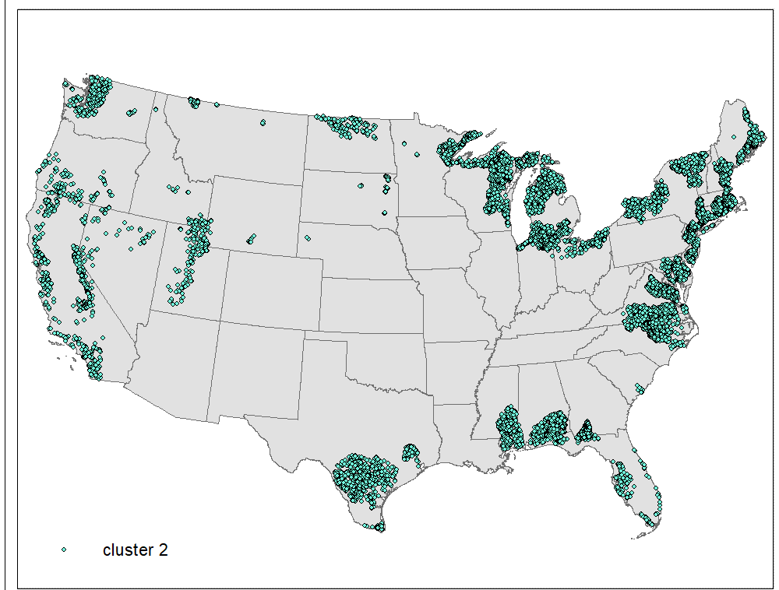
1: 36050 lakes in 25 networks
2: 16369 lakes in 360 networks

Slide 5
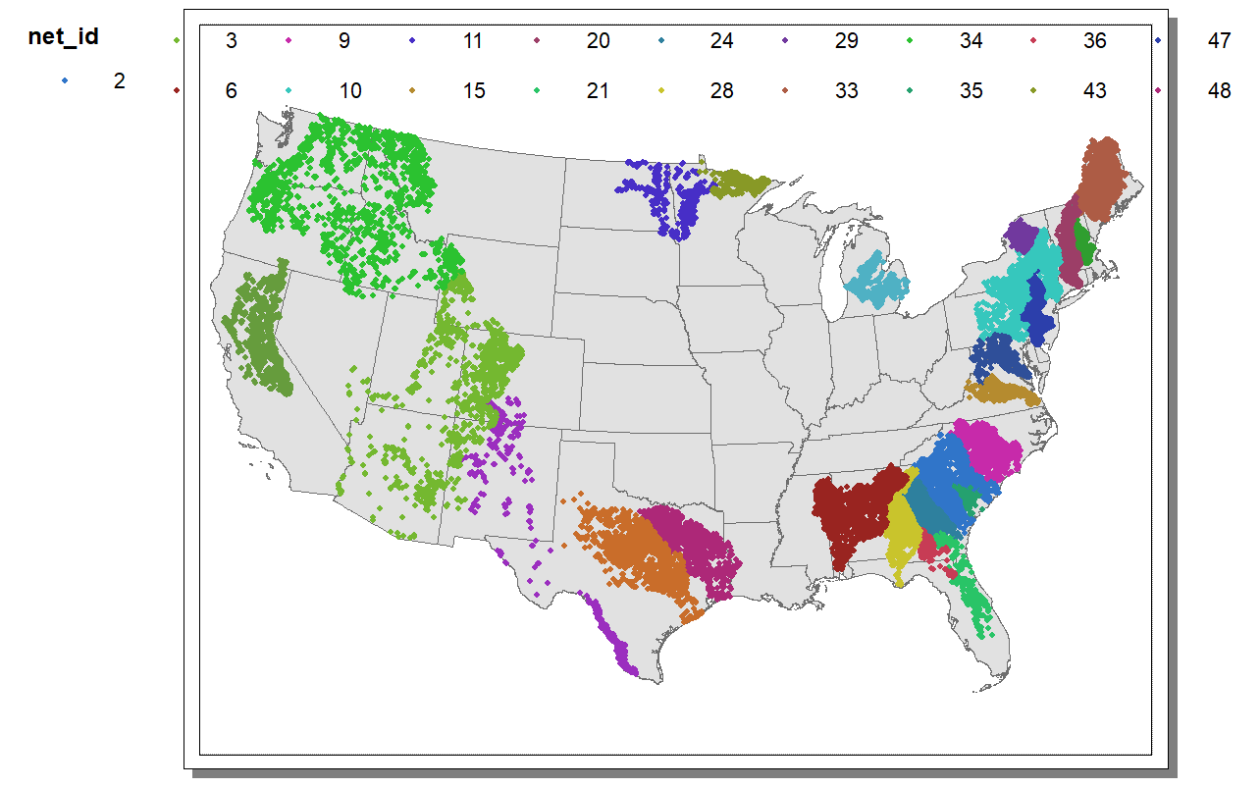
Cluster 1
36050 lakes in 25 networks

Slide 6
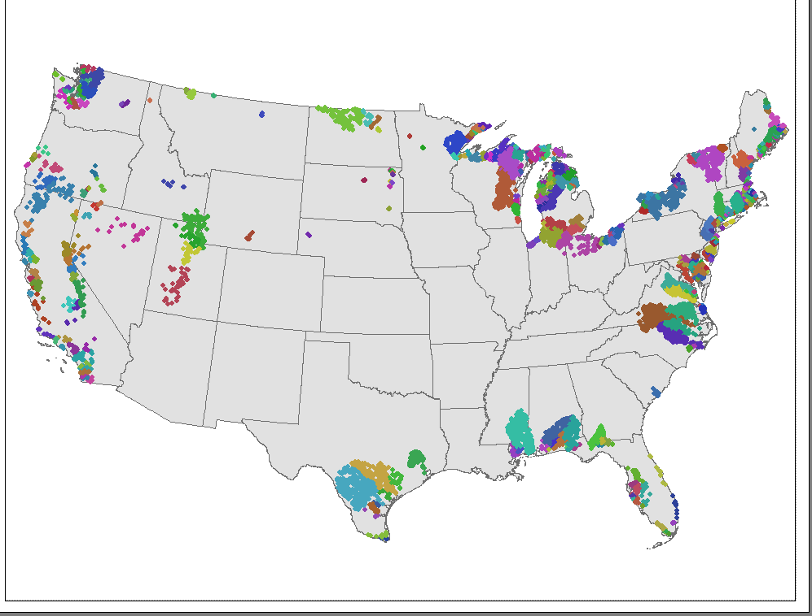
Cluster 2
16369 lakes in 360 networks

Slide 7
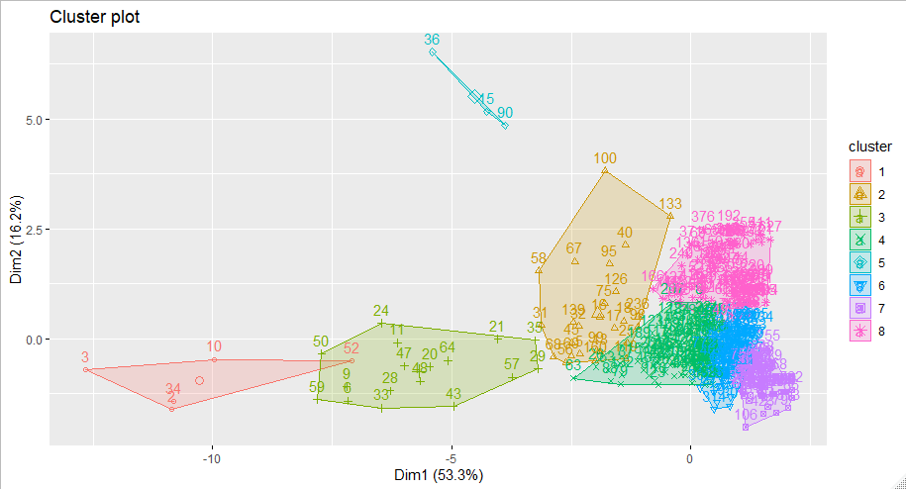
Adding in betweenness centrality variable
Number of networks by cluster:
1: 5
2: 26
3: 17
4: 96
5: 3
6: 78
7: 67
8: 93

Slide 8
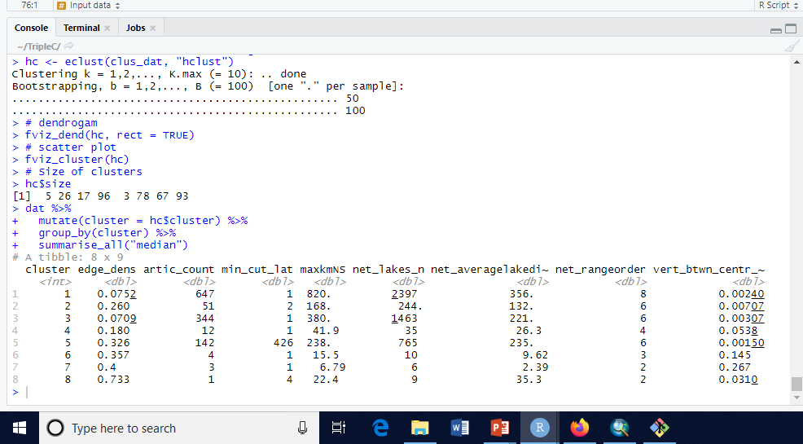

Slide 9
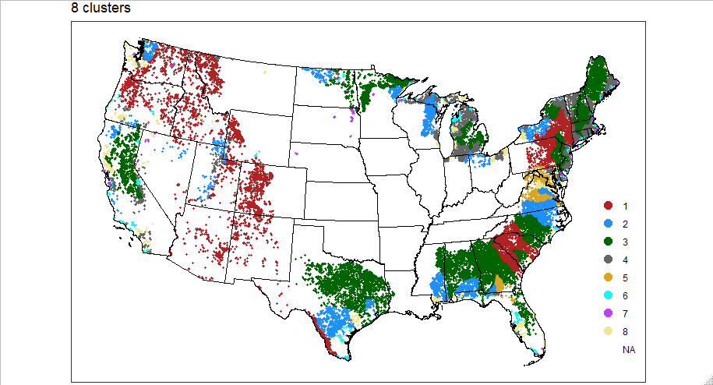

Slide 10
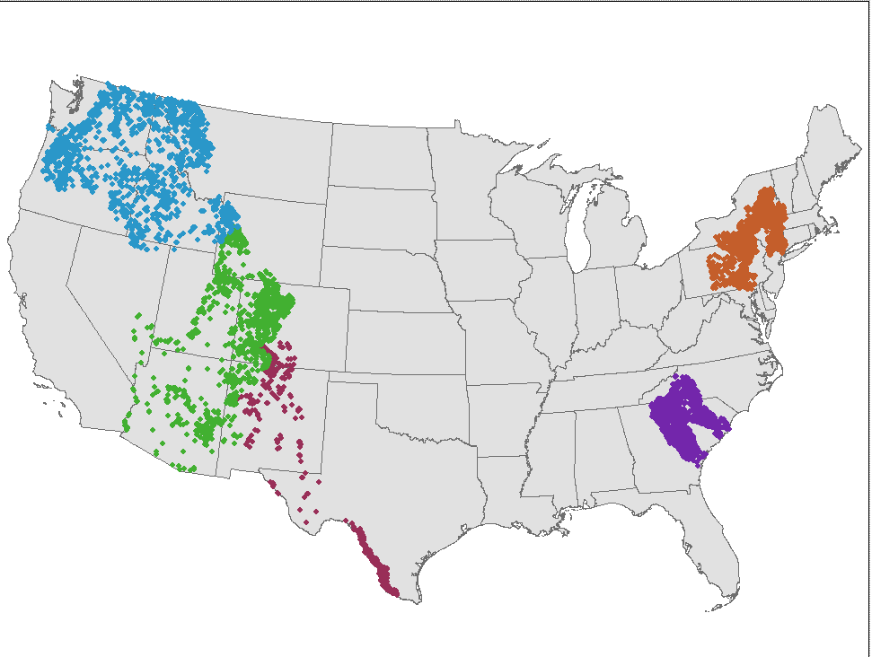
Cluster 1
5 networks

Slide 11
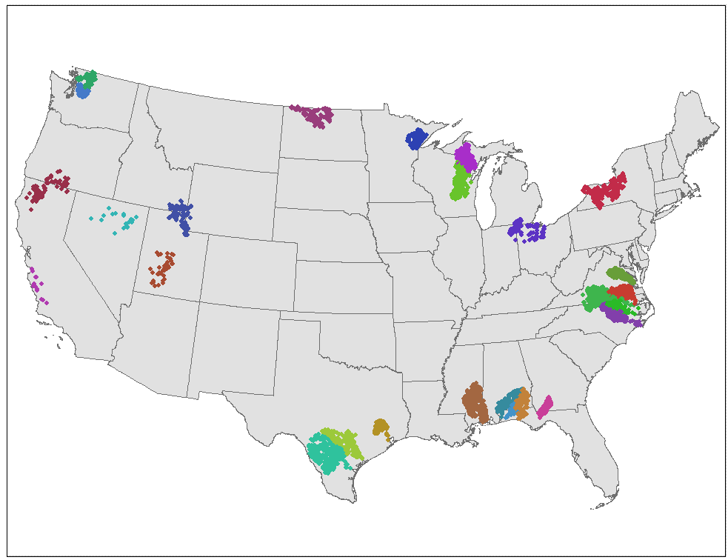
Cluster 2
26 networks

Slide 12
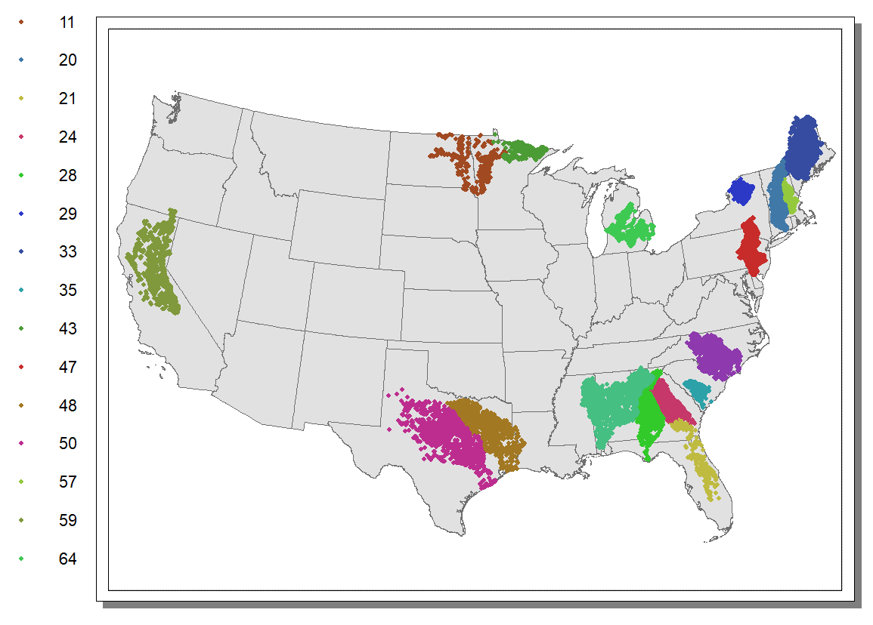
Cluster 2
17 networks

Slide 13
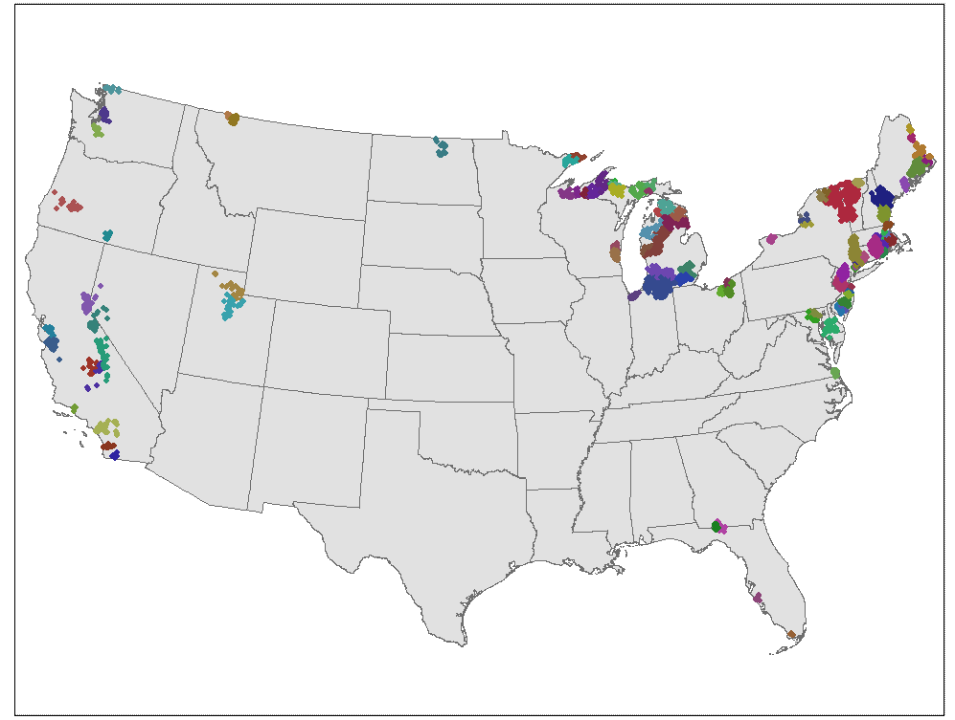
Cluster 4
96 networks

Slide 14
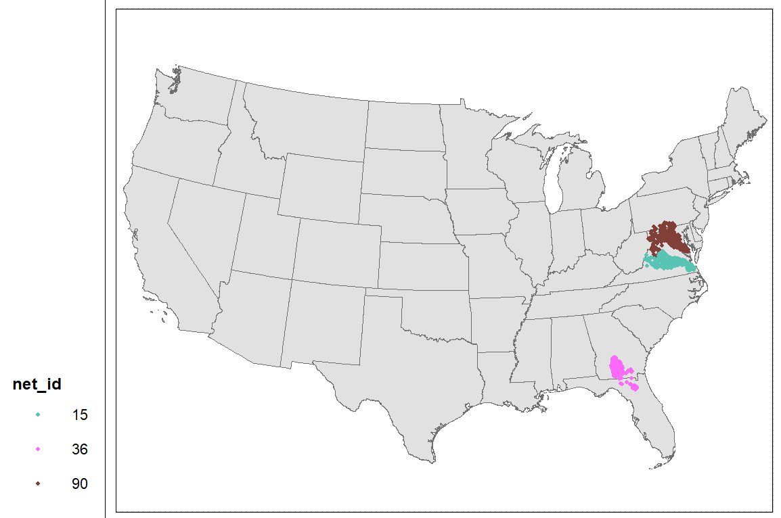
Cluster 5
3 networks

Slide 15
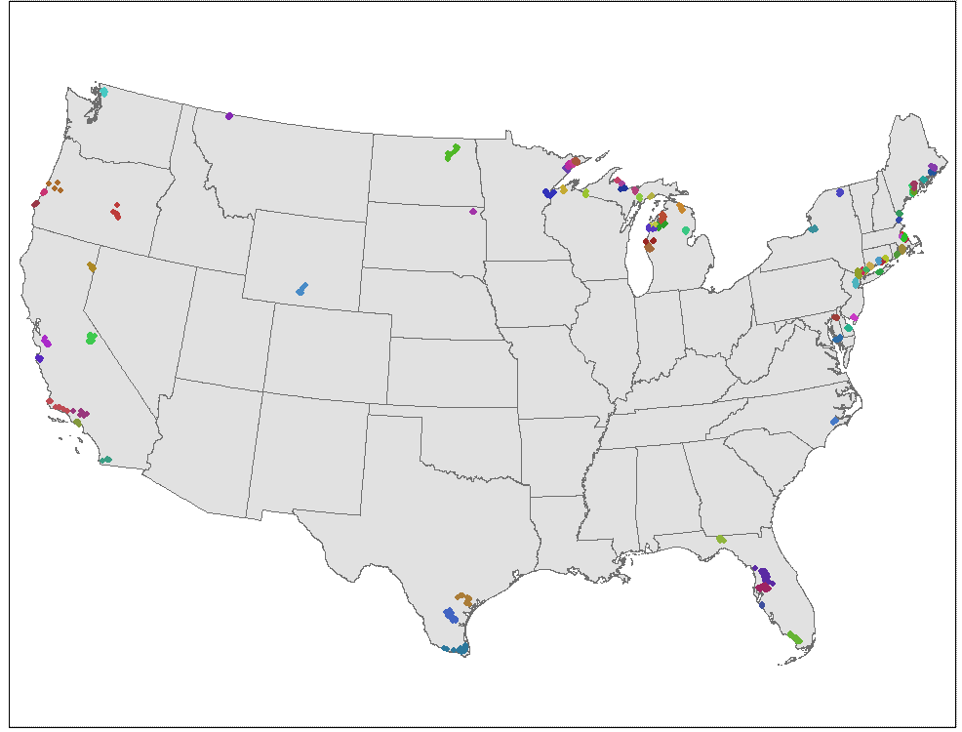
Cluster 6
78 networks

Slide 16
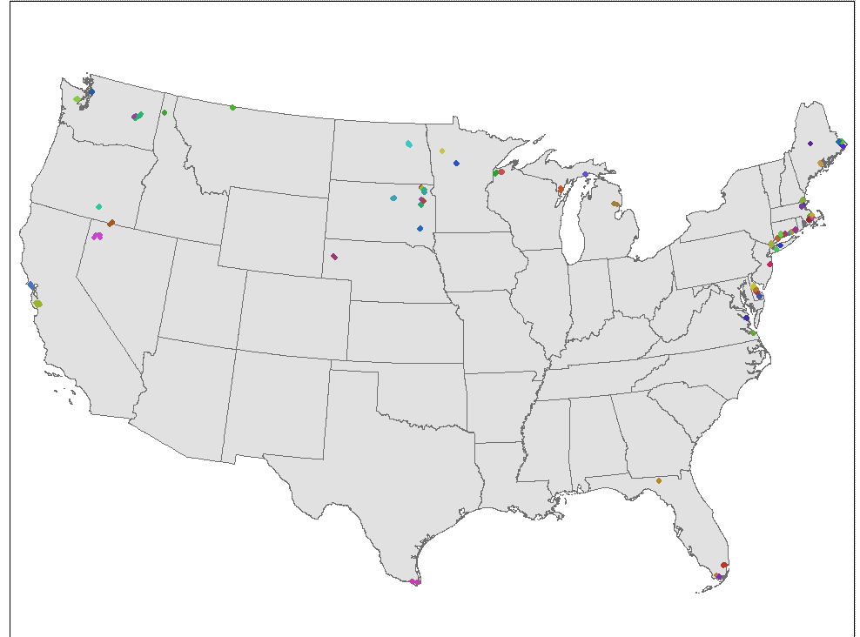
Cluster 7
67 networks

Slide 17
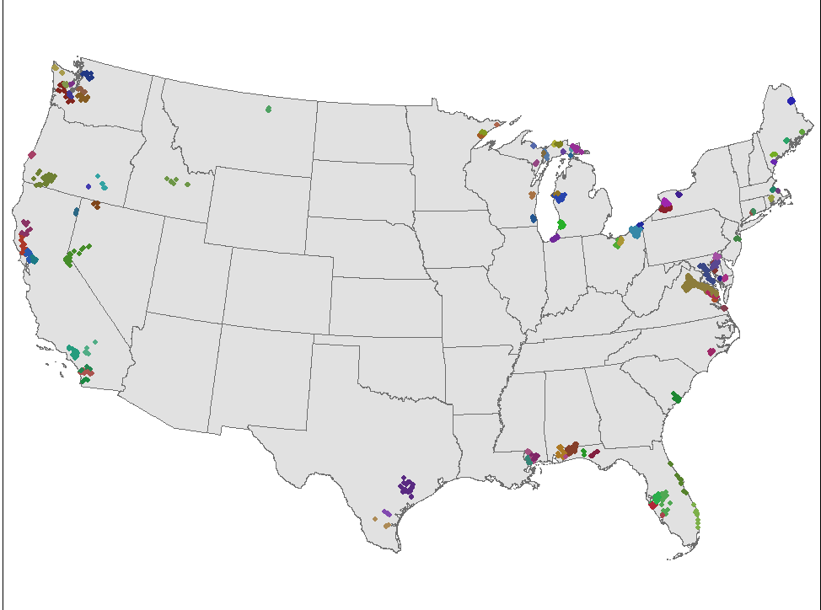
Cluster 8
93 networks

