Slide 1
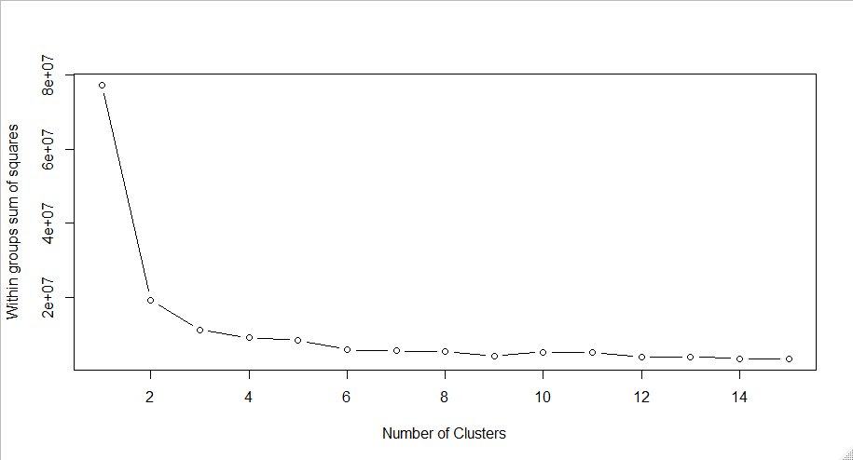
How many clusters?

Slide 2
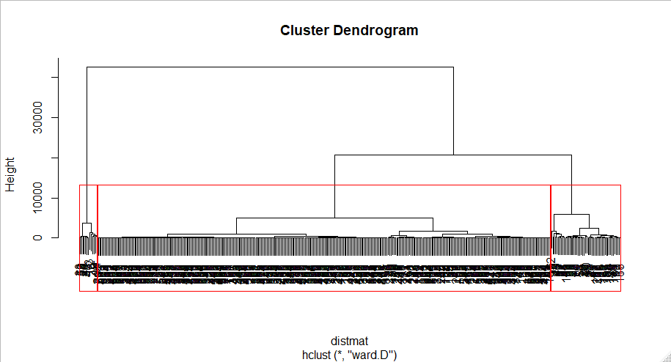
3 cluster dendrogram

Slide 3
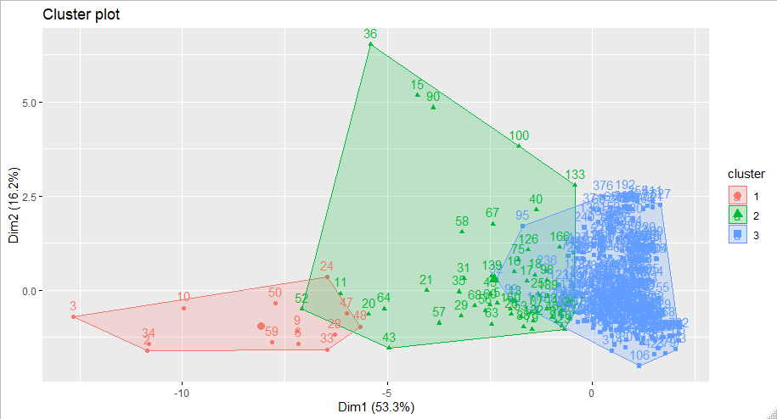
1 2 3
13 50 322

Slide 4
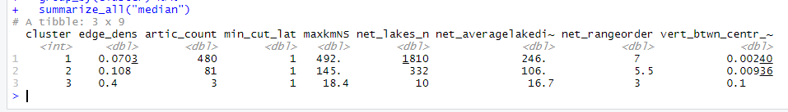
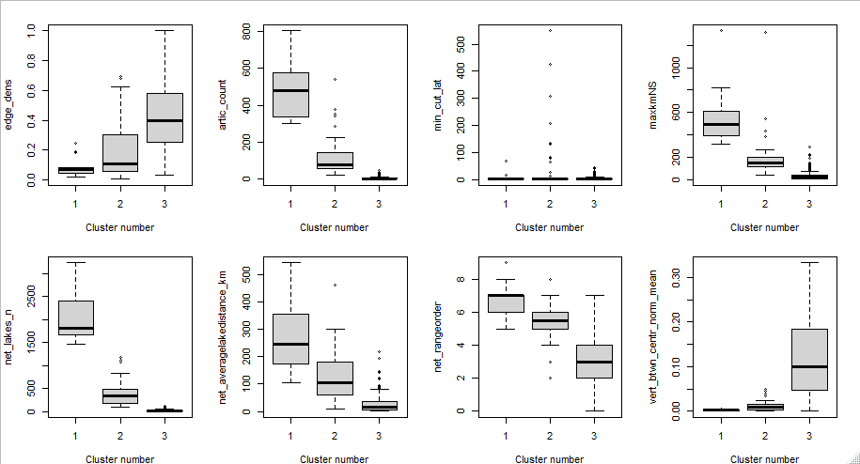

Slide 5
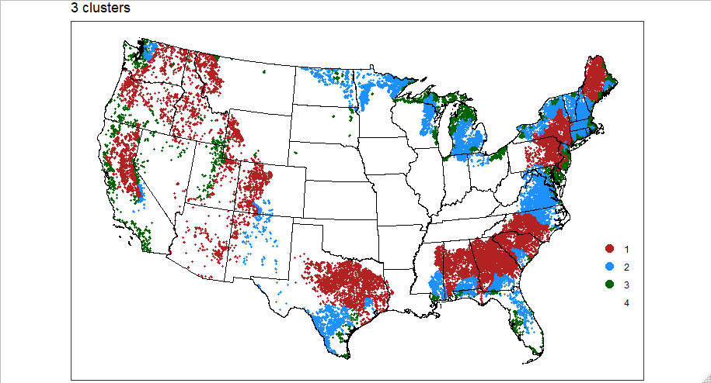

Slide 6
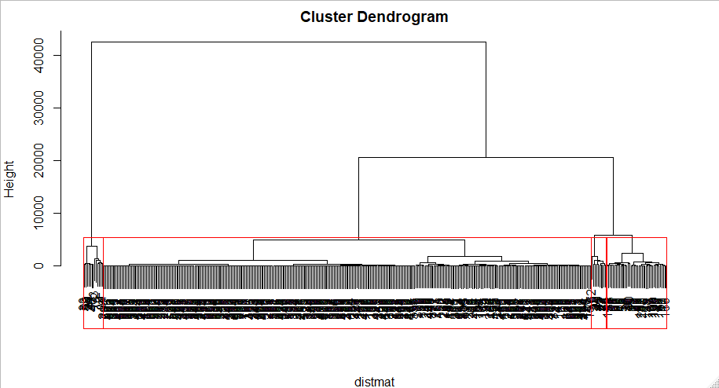
4 cluster dendrogram
Broken up into 2 clusters

Slide 7
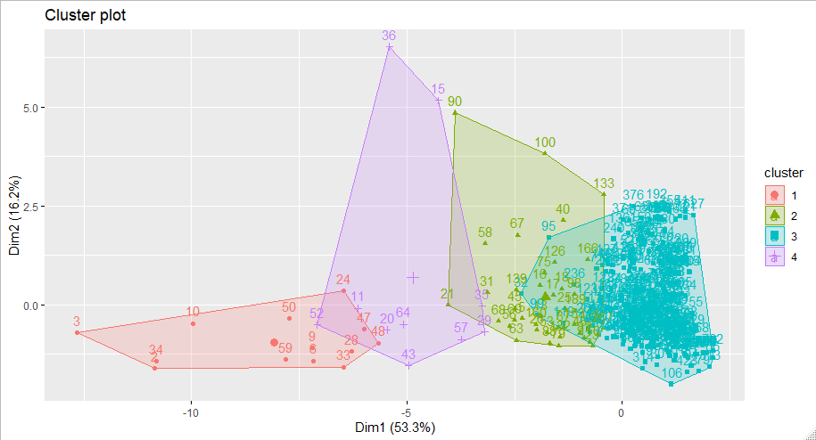
1 2 3 4
13 40 322 10

Slide 8
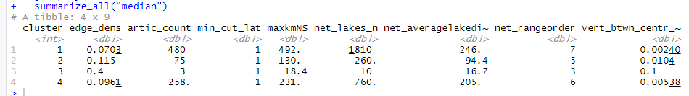
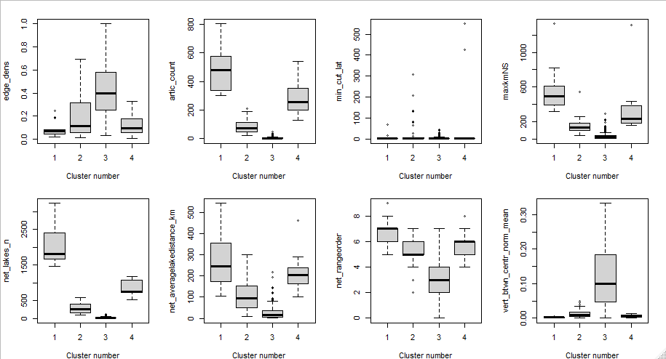

Slide 9
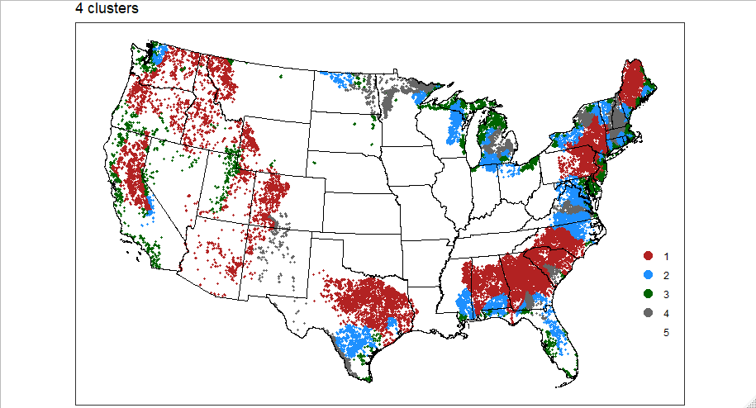

Slide 10
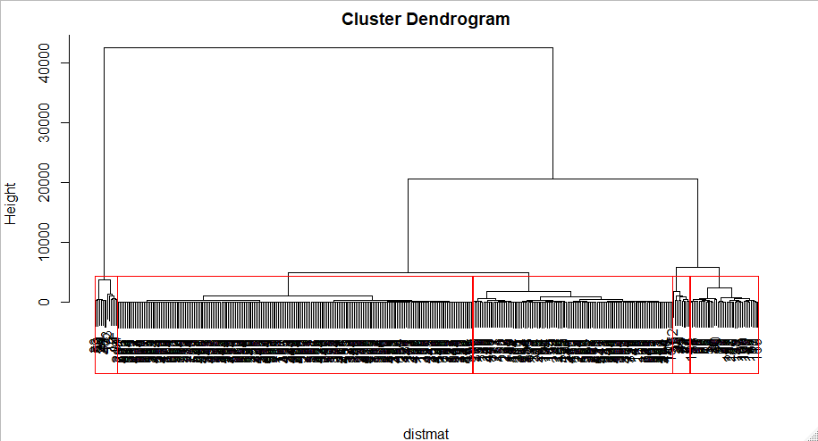
5 cluster dendrogram
Broken up this round
Broken up last round

Slide 11
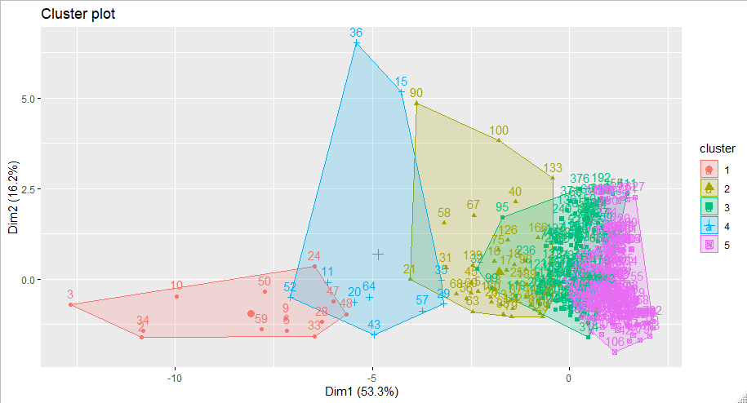
1 2 3 4 5
13 40 116 10 206

Slide 12
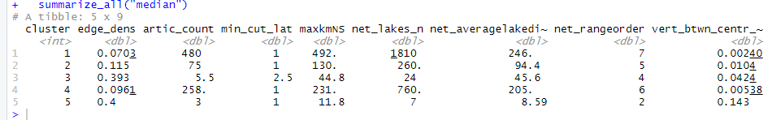
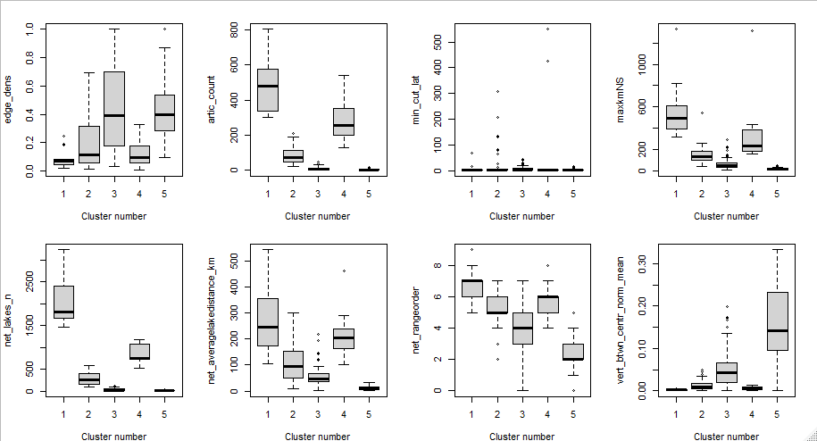

Slide 13
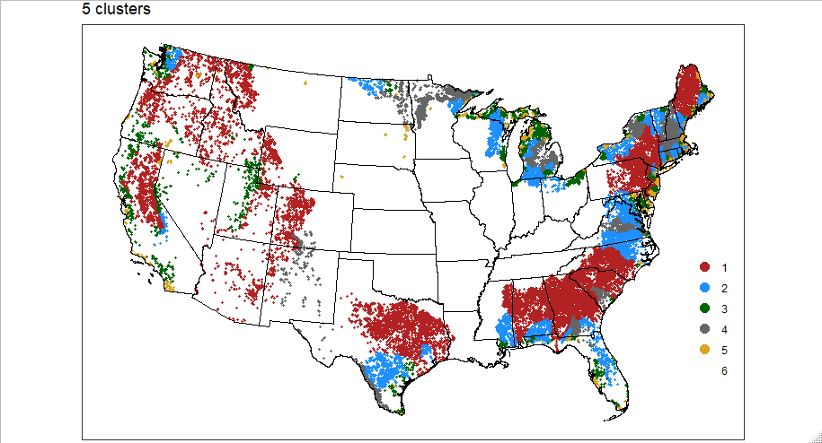

Slide 14
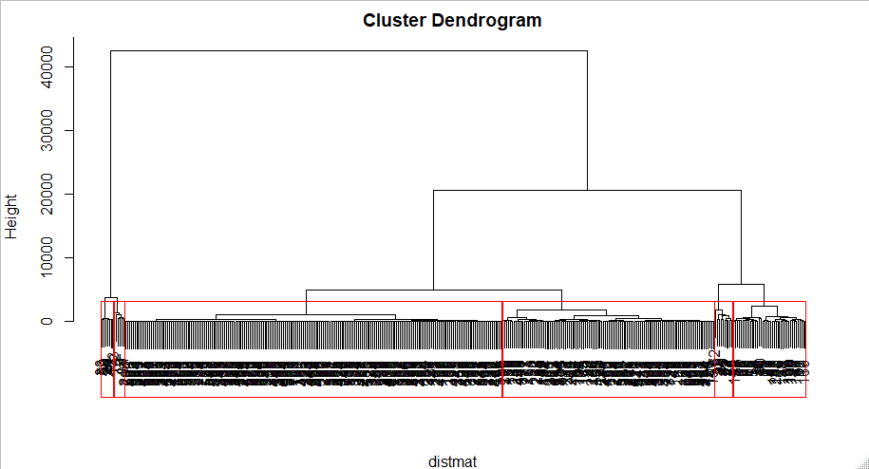
6 cluster dendrogram
Broken up this round
Broken up last round
Broken up 2 rounds ago

Slide 15
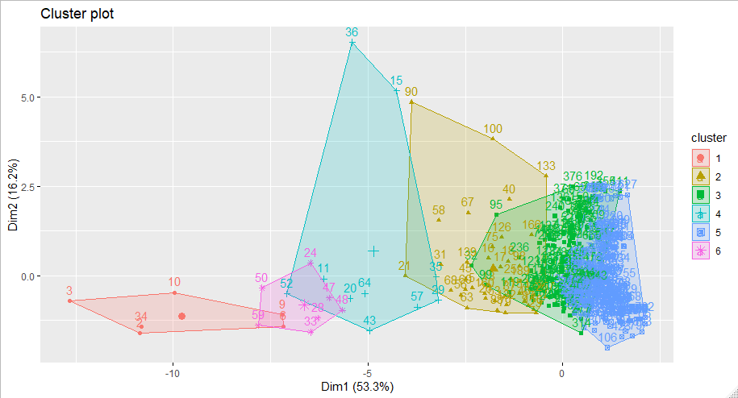
1 2 3 4 5 6
6 40 116 10 206 7

Slide 16
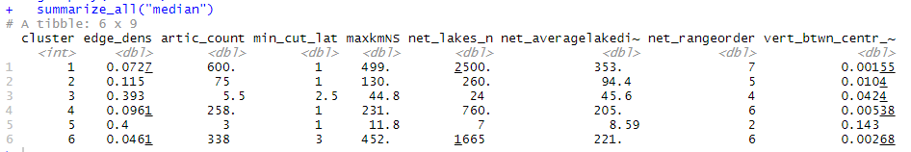
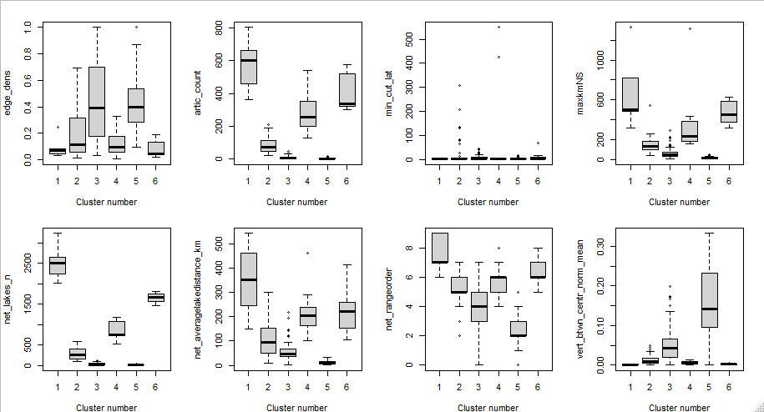

Slide 17
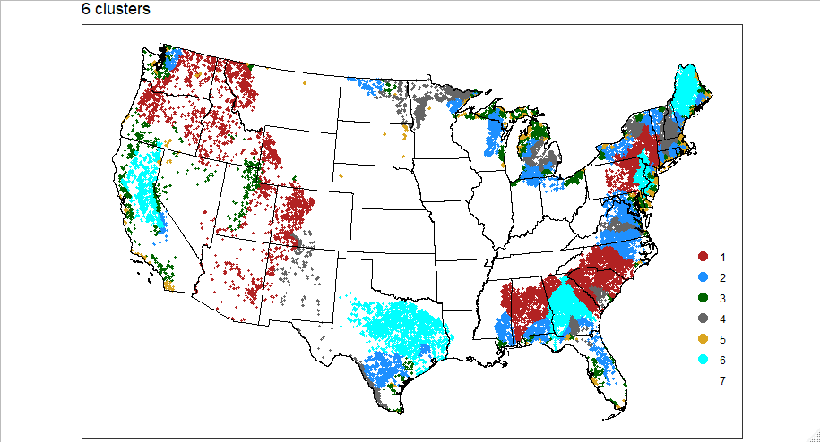

Slide 18
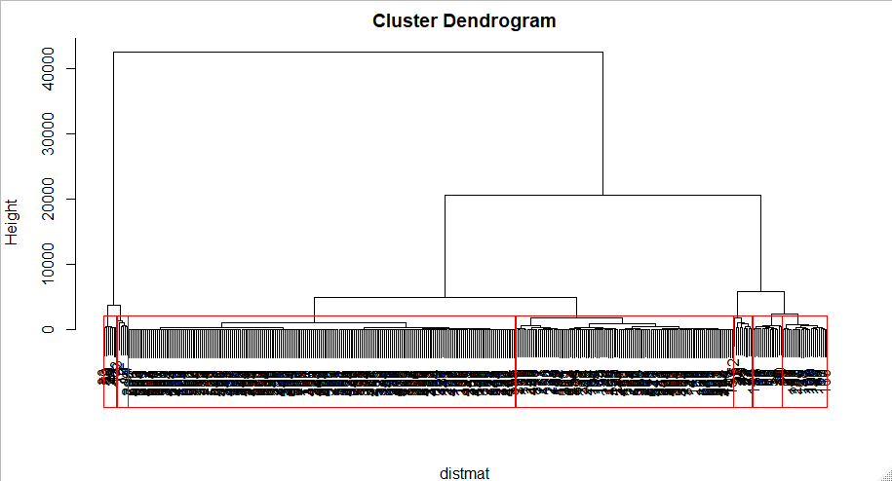
7 cluster dendrogram
Latest break

Slide 19

1 2 3 4 5 6 7
6 16 24 116 10 206 7

Slide 20

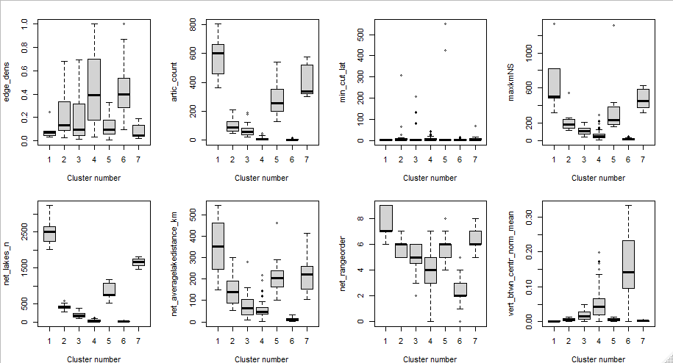

Slide 21
