Slide 1
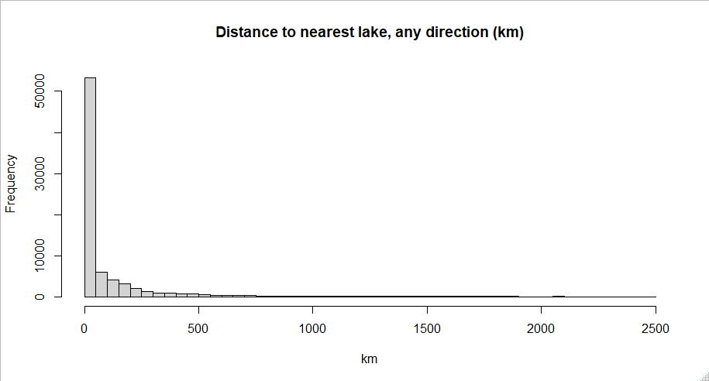

Slide 2


Slide 3
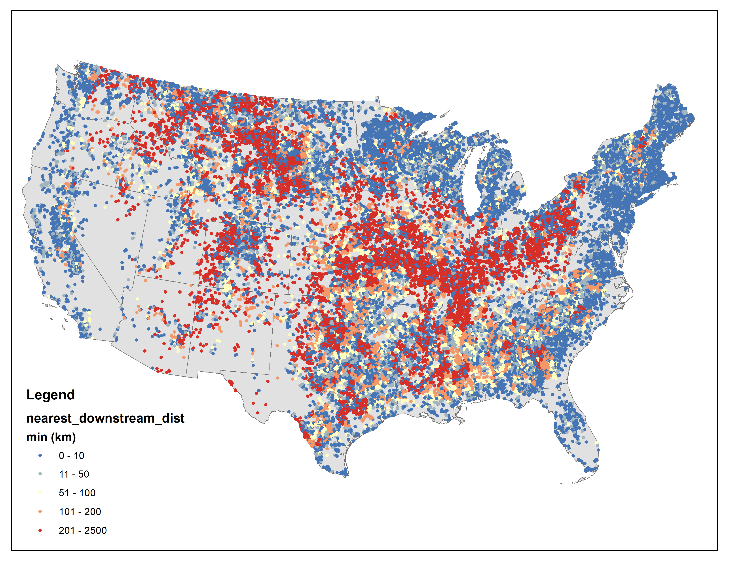

Slide 4
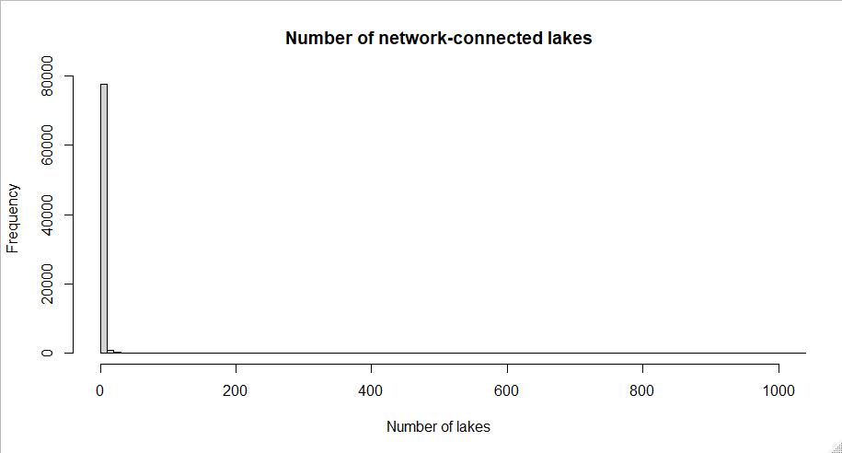
98% of connected lakes are in networks of fewer than 10 lakes

Slide 5
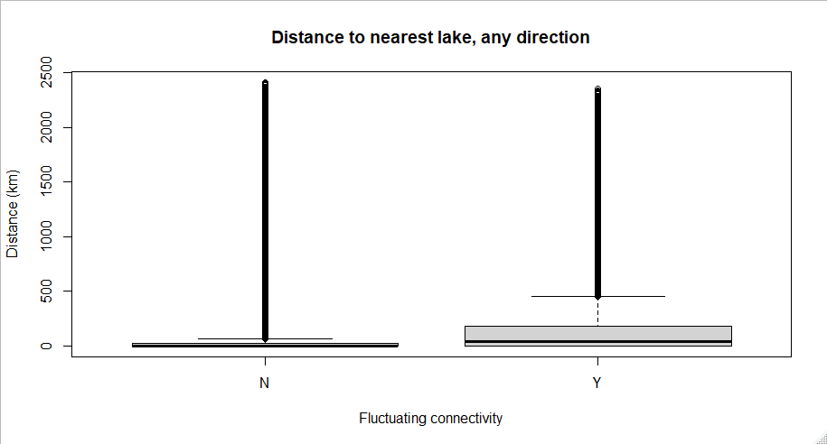

Slide 6
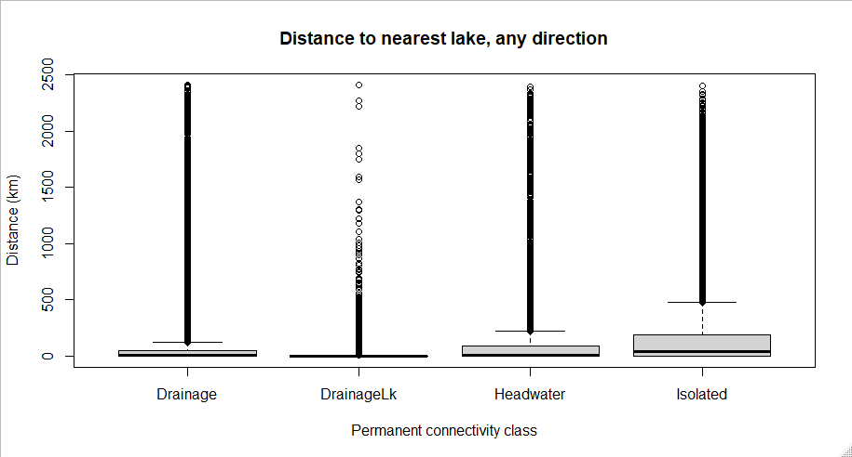
What’s going on with the isolated lakes? Shouldn’t those not even be here? Is this a med/high res thing?

