Slide 1
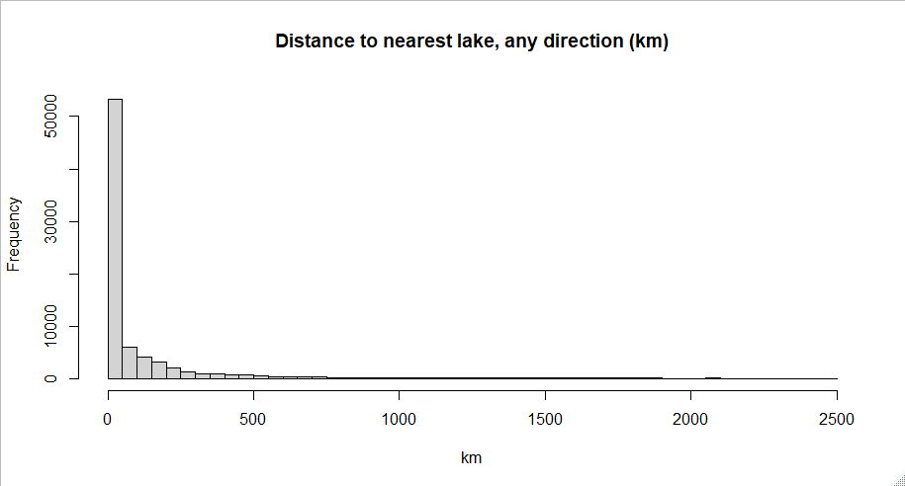

Slide 2


Slide 3
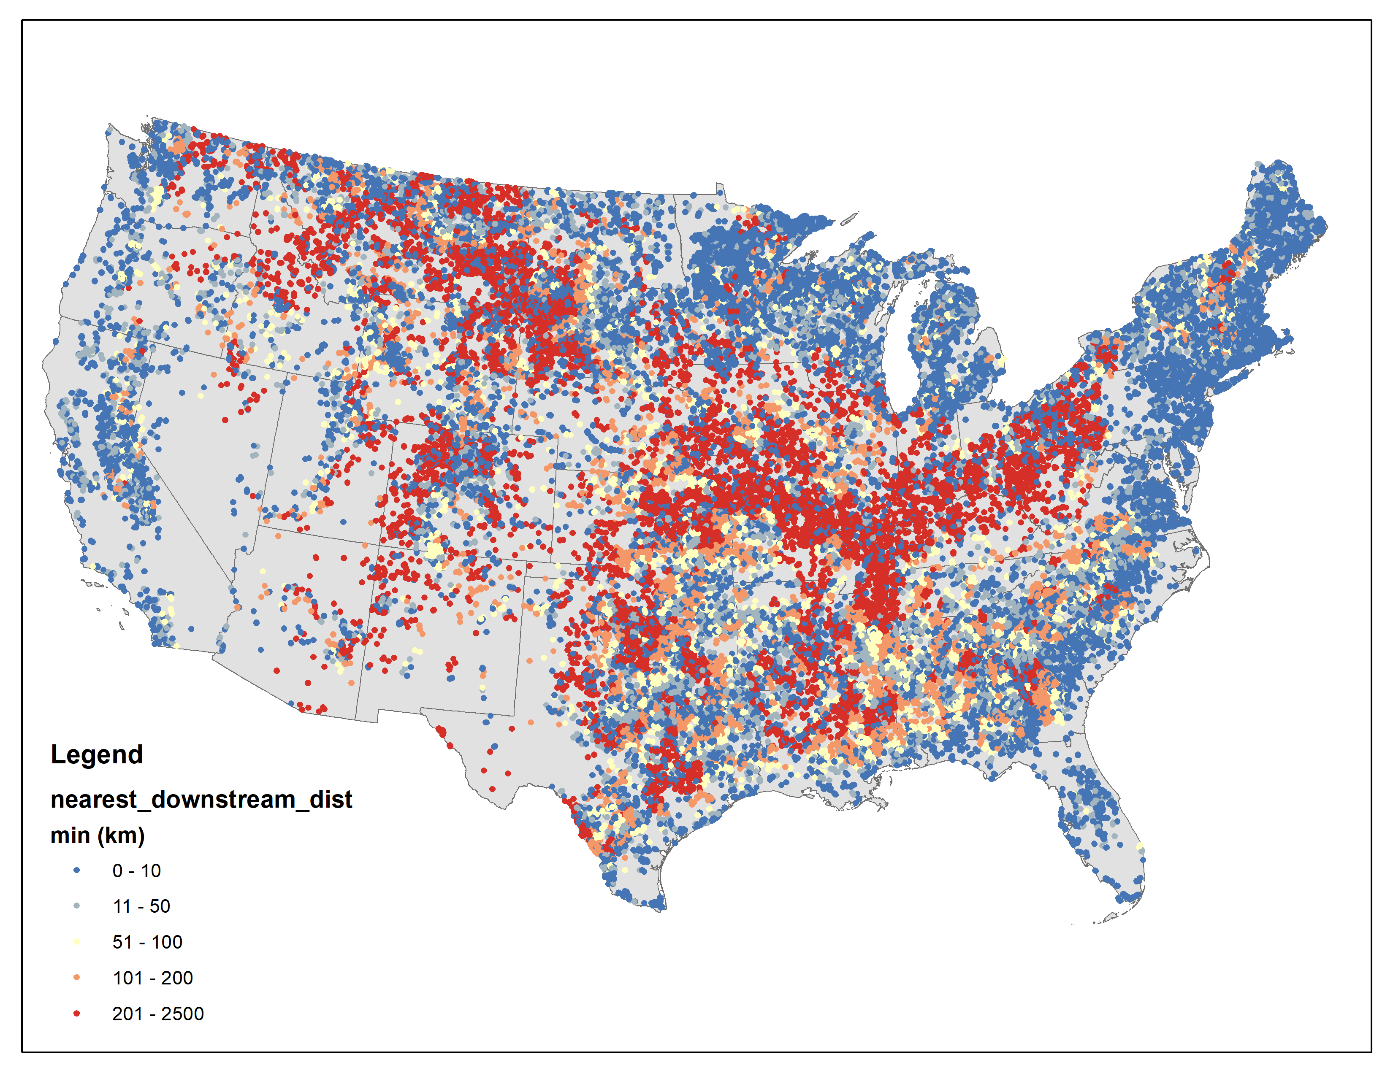

Slide 4
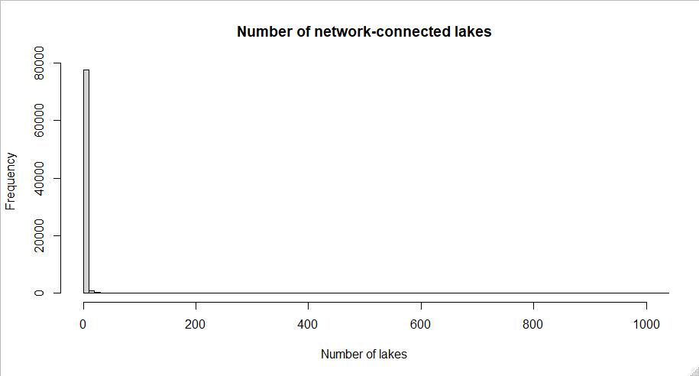
98% of connected lakes are in networks of fewer than 10 lakes

Slide 5
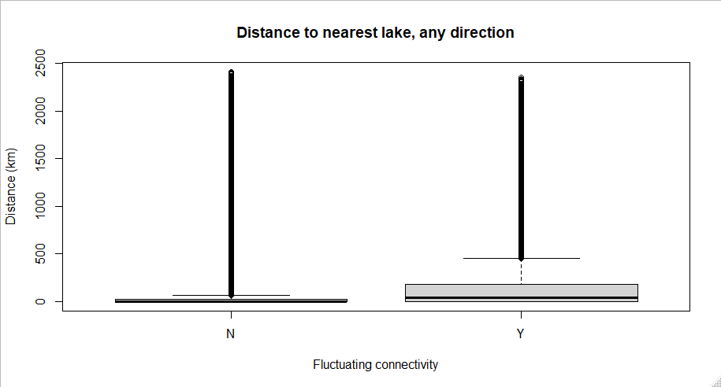

Slide 6
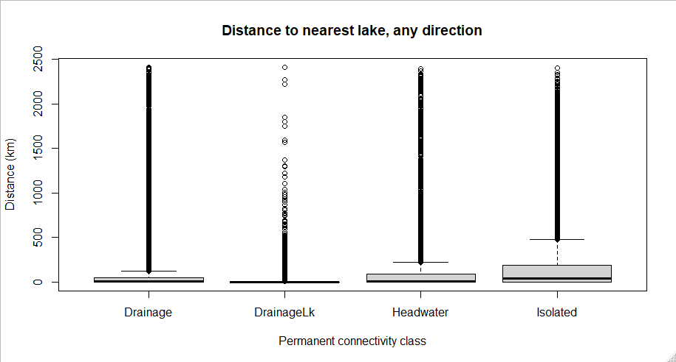
What’s going on with the isolated lakes? Shouldn’t those not even be here? Is this a med/high res thing?

Slide 7
PCA

Slide 8
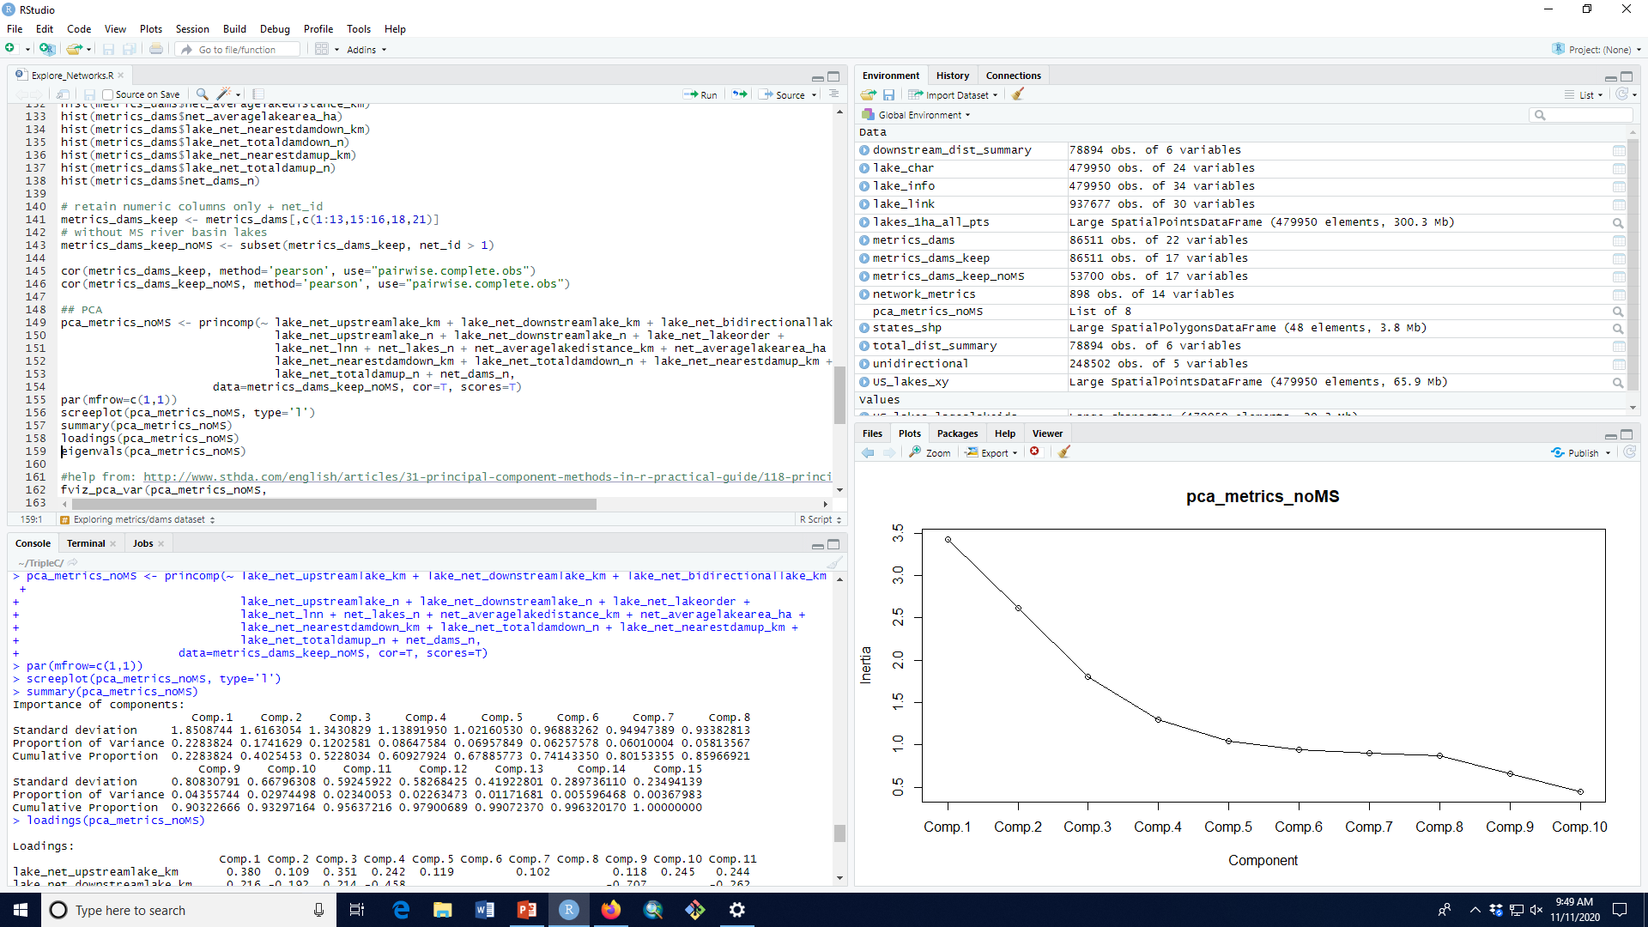
Ran without MS river basin

Slide 9
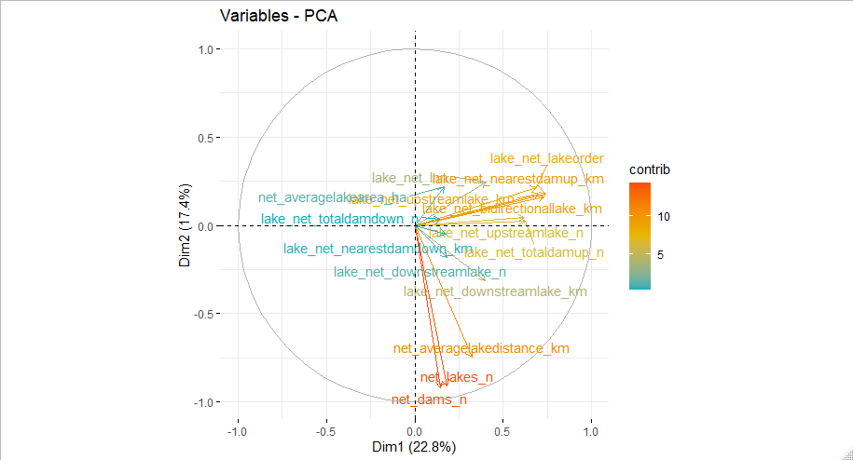
Notable strong correlations: r > 0.5
net_lakes_n, net_dams_n; r = 0.91
lake_net_upstreamlake_n, lake_net_totaldamup_n; r = 0.91
net_lakes_n, net_averagelakedistance_km; r = 0.67
lake_net_upstreamlake_km, lake_net_bidirectionallake_km; r = 0.78
net_averagelakedistance_km, net_dams_n; r= 0.59
lake_net_lnn, lake_net_lakeorder; r = 0.54
Ran without MS river basin

Slide 10
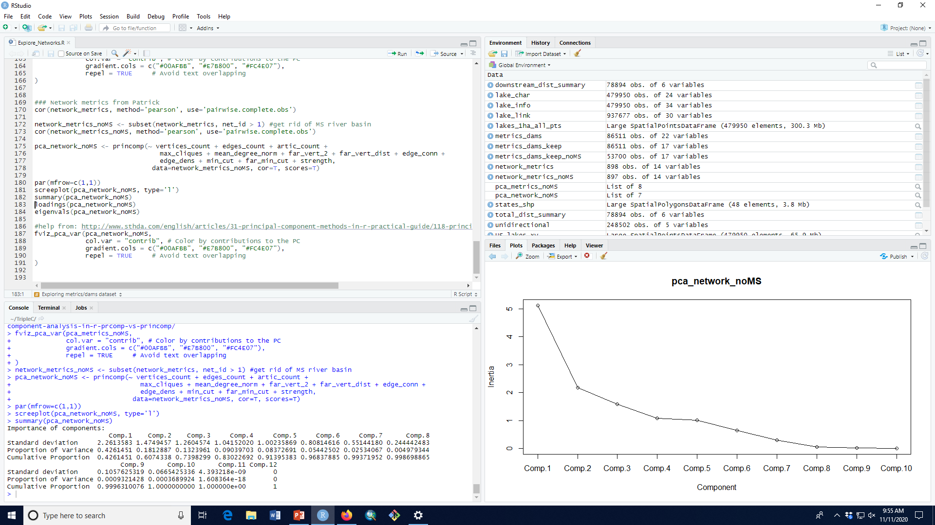
Ran without MS river basin

Slide 11
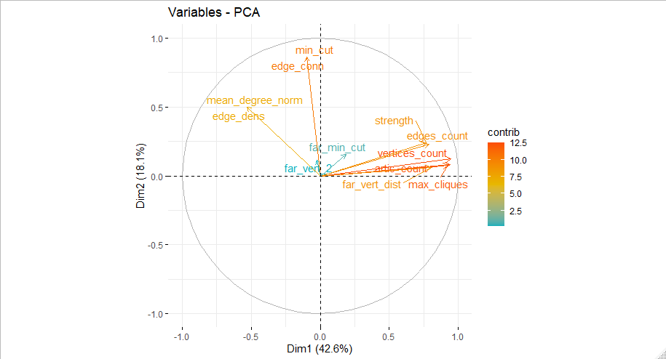
Ran without MS river basin

Slide 12
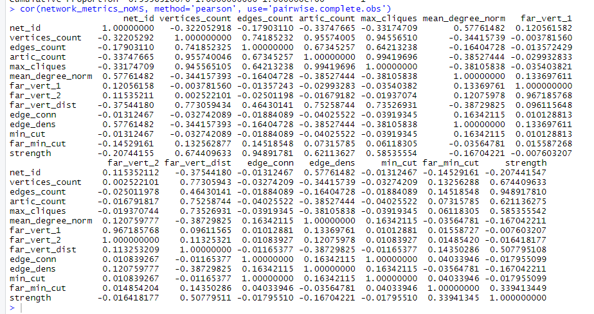
Ran without MS river basin

