Slide 1
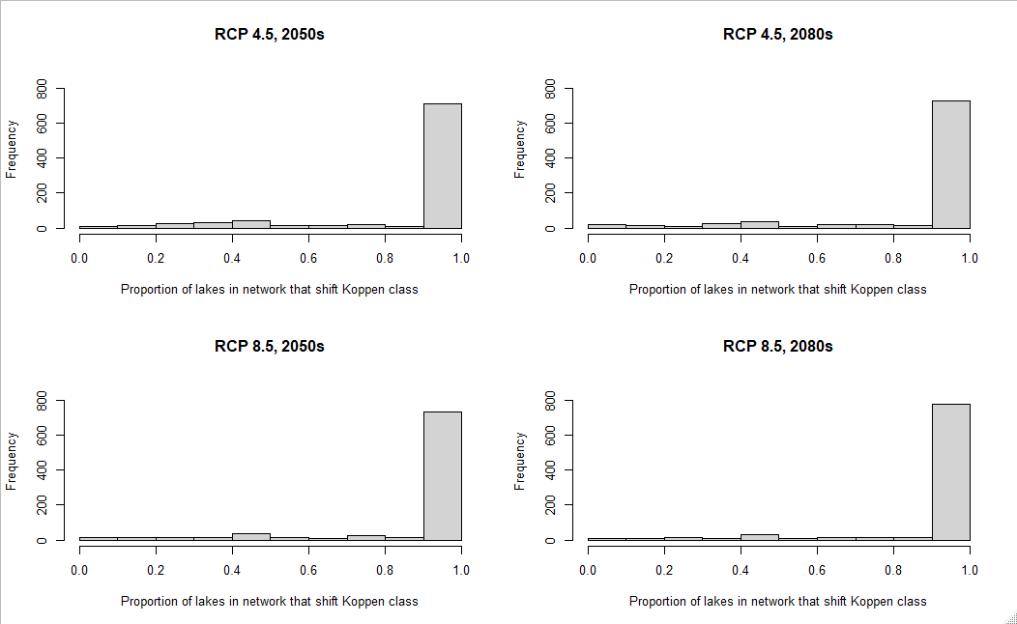
Most networks have most lakes shifting climate, but few networks relatively stable
Shifted climate within network
Stable climate within network

Slide 2
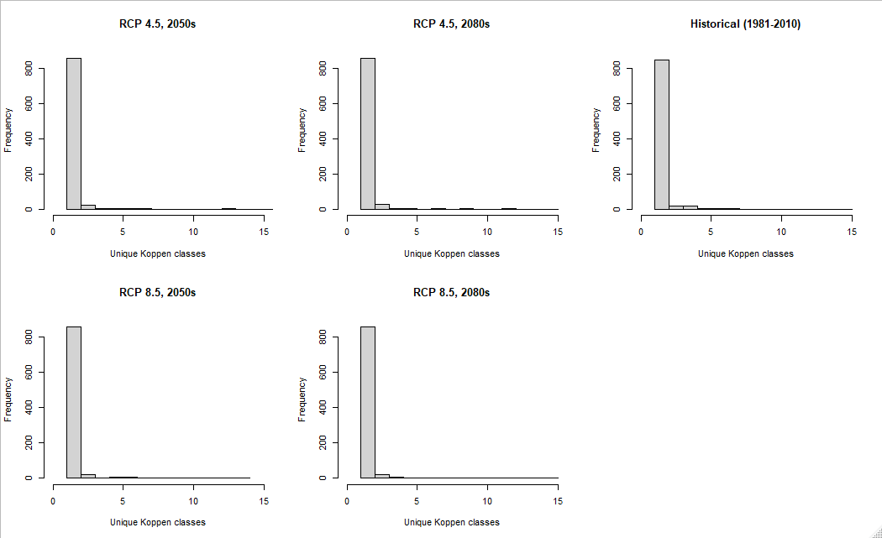
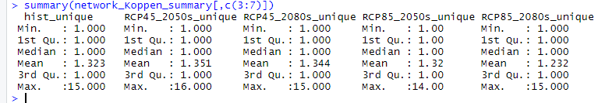
Perhaps slight loss of climatic diversity within networks, but most networks have low climatic diversity

Slide 3

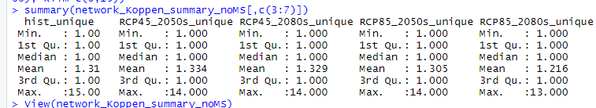
If remove MS river basin
Networks 2, 34, 52 highly diverse climatically

Slide 4
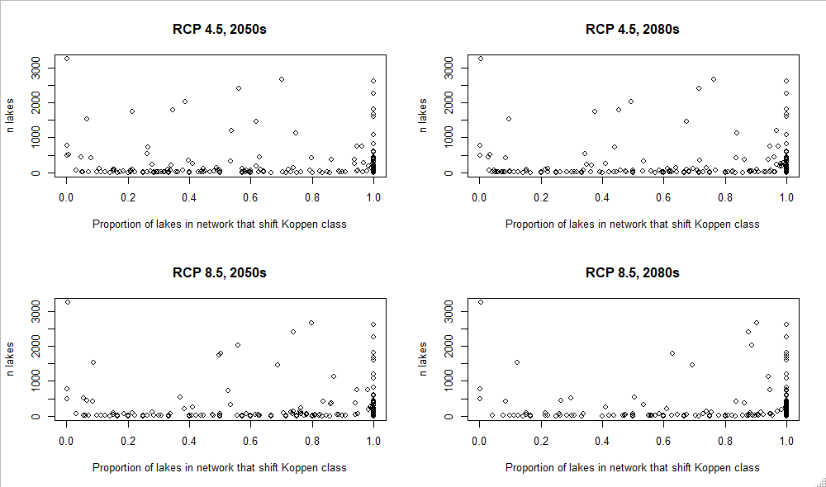
If remove MS river basin
Do networks with more lakes have more/less stable climate?

