Slide 1
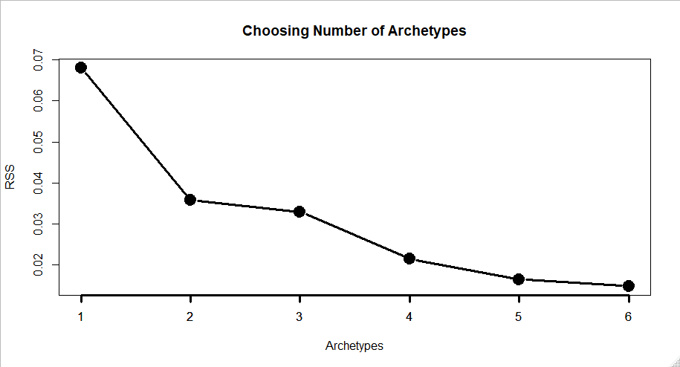

Slide 2
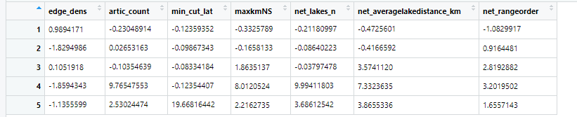
Archetypes
Data scaled as Ty did for clustering

Slide 3
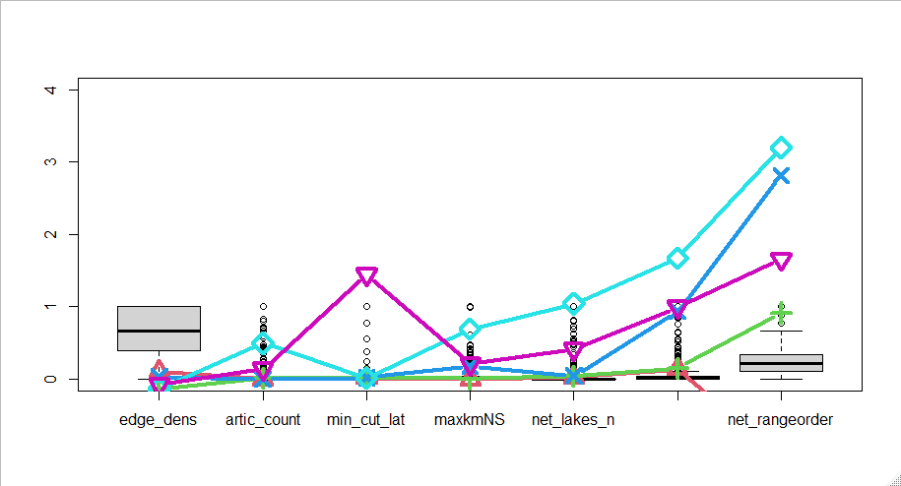
netaveragelakedistance_km

Slide 4
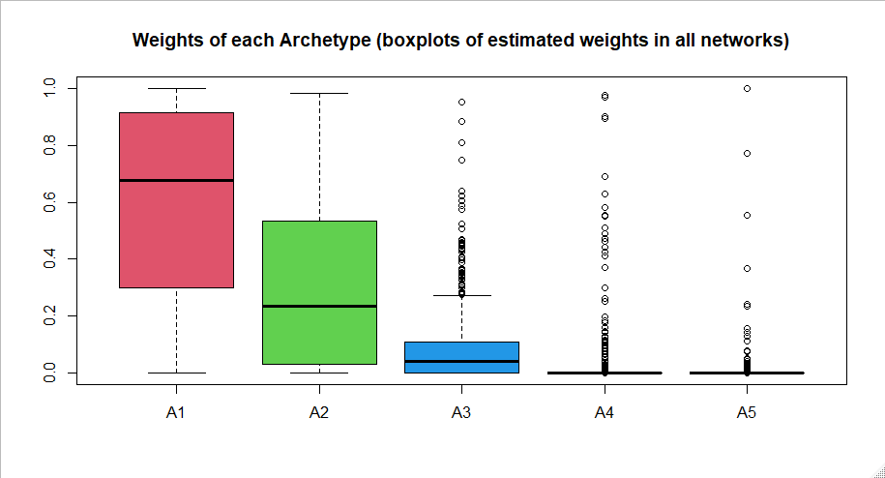

Slide 5
Number of networks with archetype weights above 0.5
A1: 554 (61.8%)
A2: 262 (29.2%)
A3: 11 (1.2%)
A4: 11 (1.2%)
A5: 3 (0.33%)

