Slide 1
Fig. 1. Conceptual diagram of network connectivity metrics and hub lakes

Slide 2
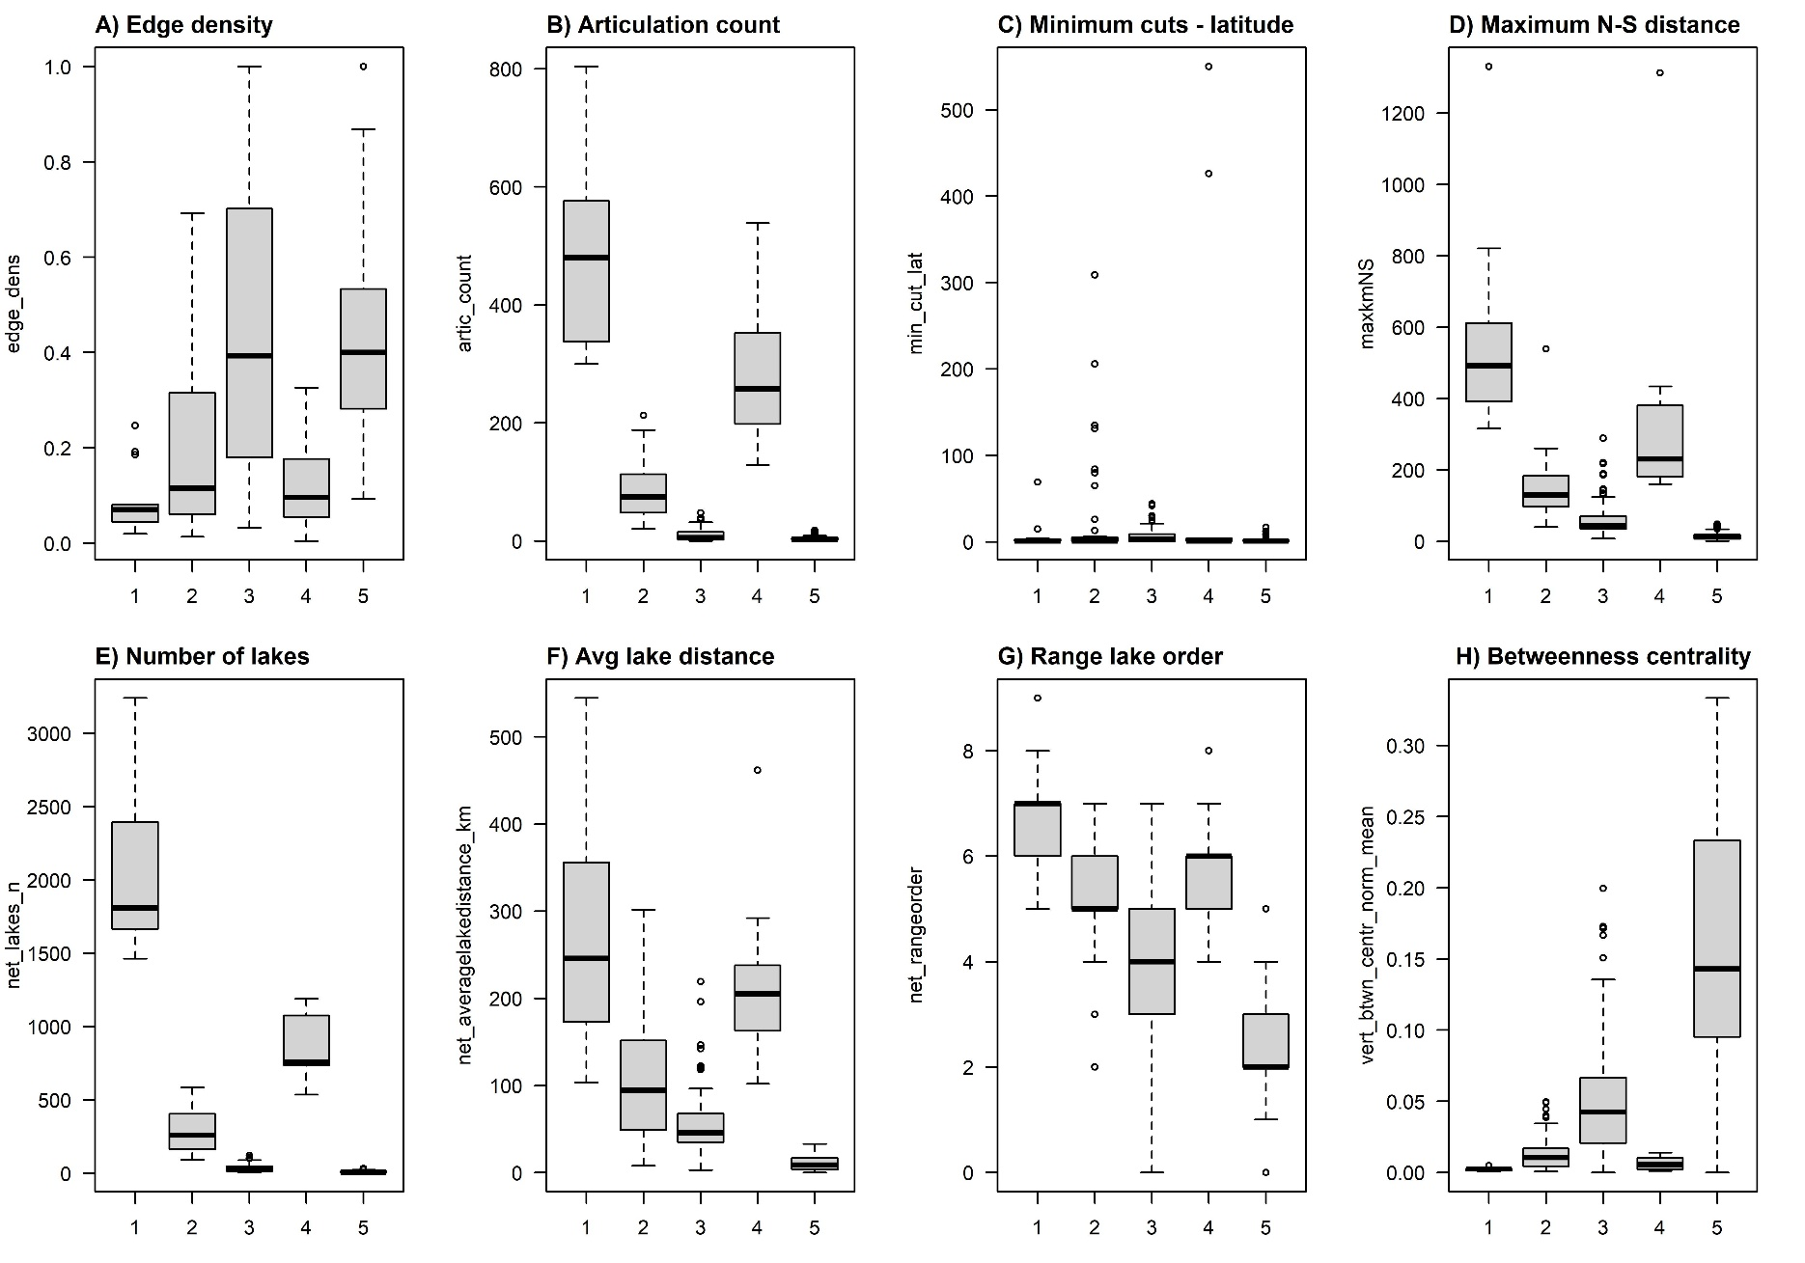
Fig. 2. Distributions of connectivity variables by across the five clusters. Thick black lines represent medians, boxes represent interquartile ranges (IQR), whiskers represent 1.5 times IQR and dots represent outliers.

Slide 3
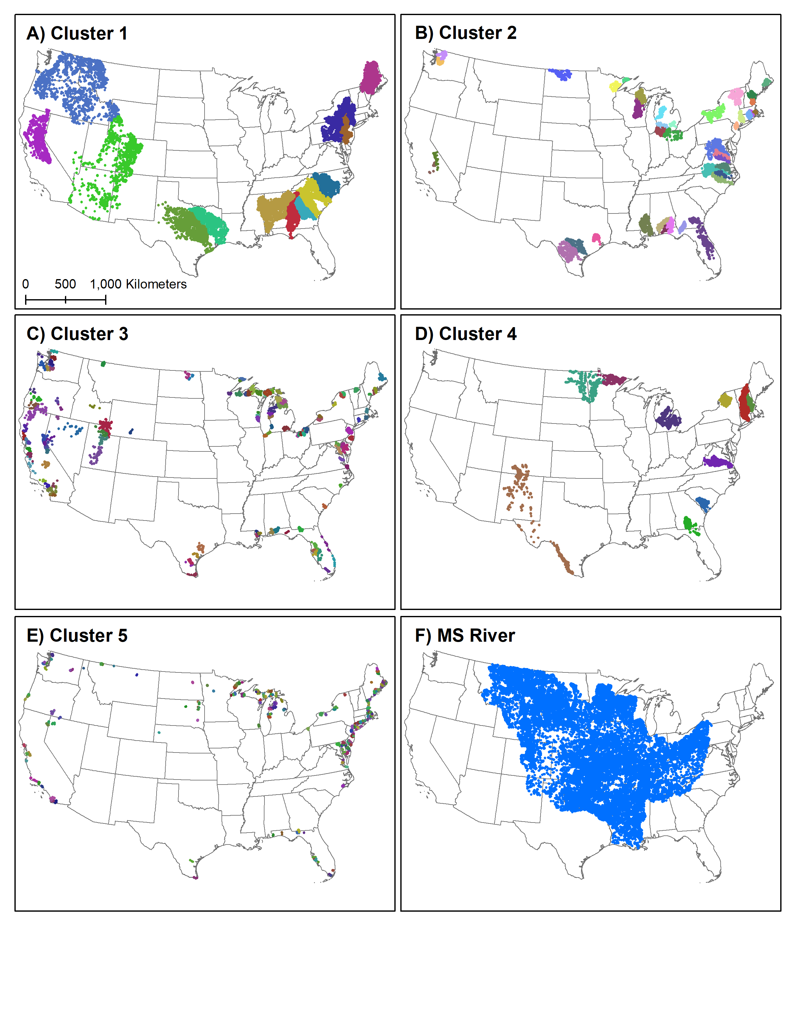
Fig. 3. A-E) Maps of the lakes in each of the five network clusters and F) the Mississippi River basin. Each dot represents a lake. Colors are unique to a network within A-F.

Slide 4
Fig. 4. Figure about network protection?

