Slide 1
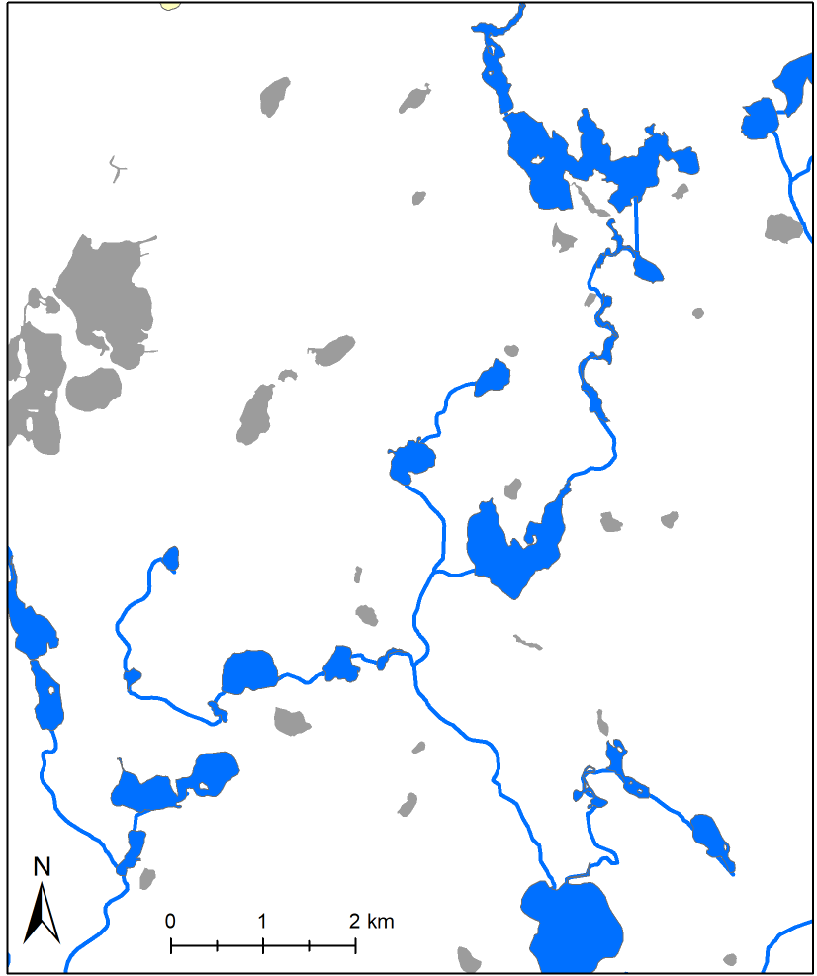
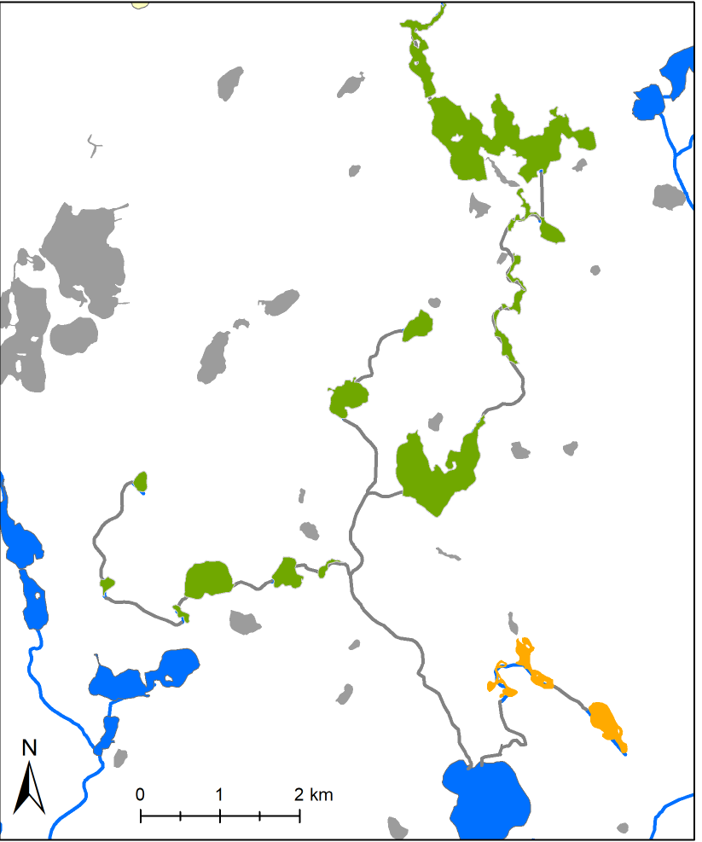
a)
b)
Original network
Isolated lake
Network fragment #1
Network fragment #2
Hub lake
Compromised hub lake

Slide 2
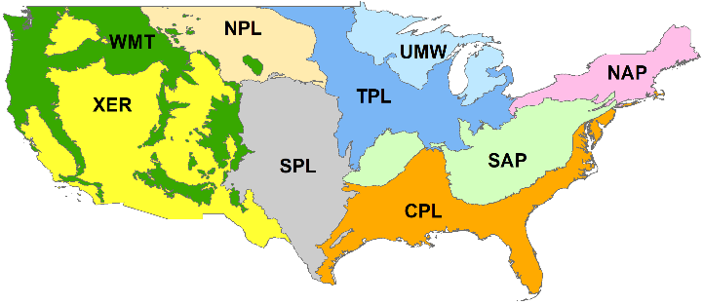

Slide 3
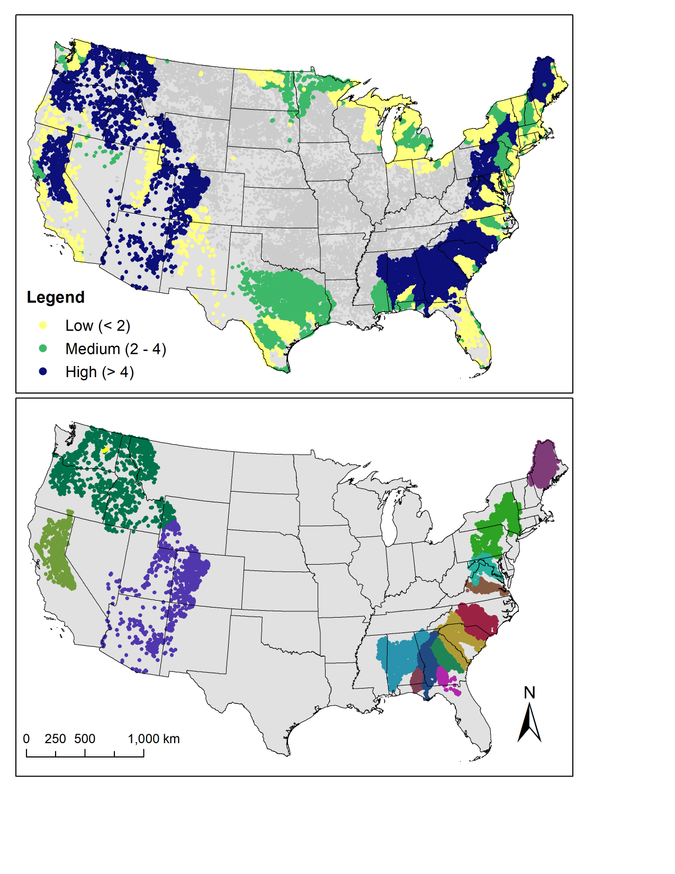
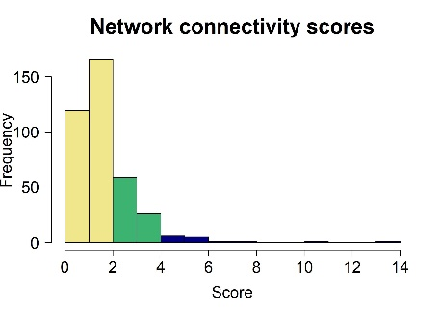
A)
B)

Slide 4
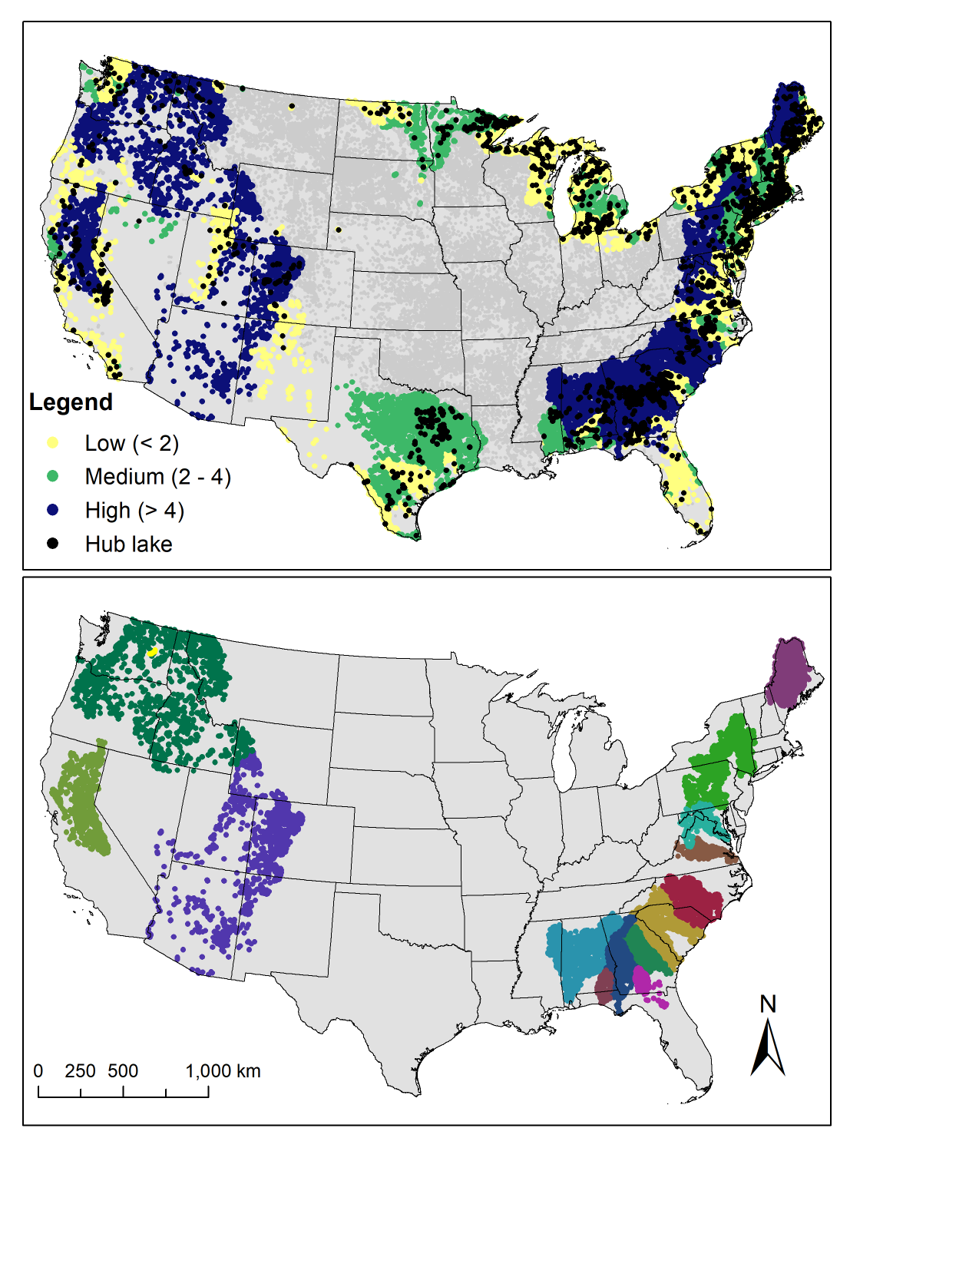
A)
B)

Slide 5
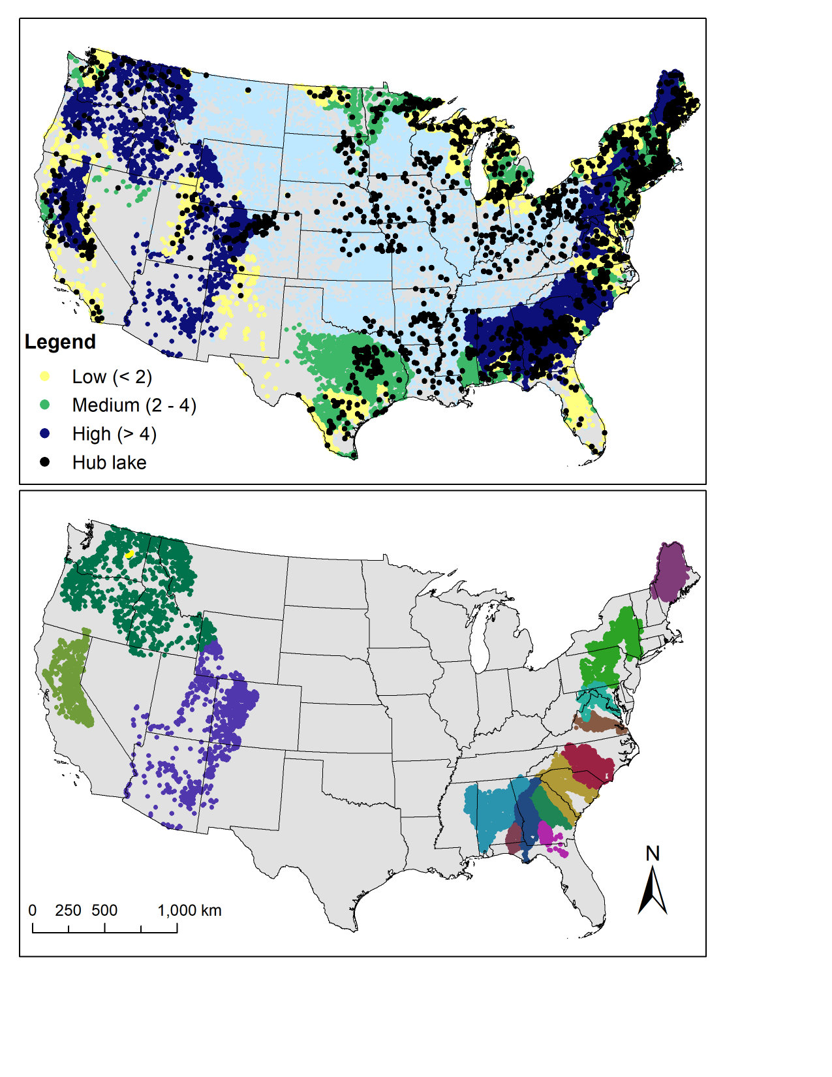
A)
B)
15
13
7
6
12
3
14
2
10
9
4
11
1
5
8

Slide 6
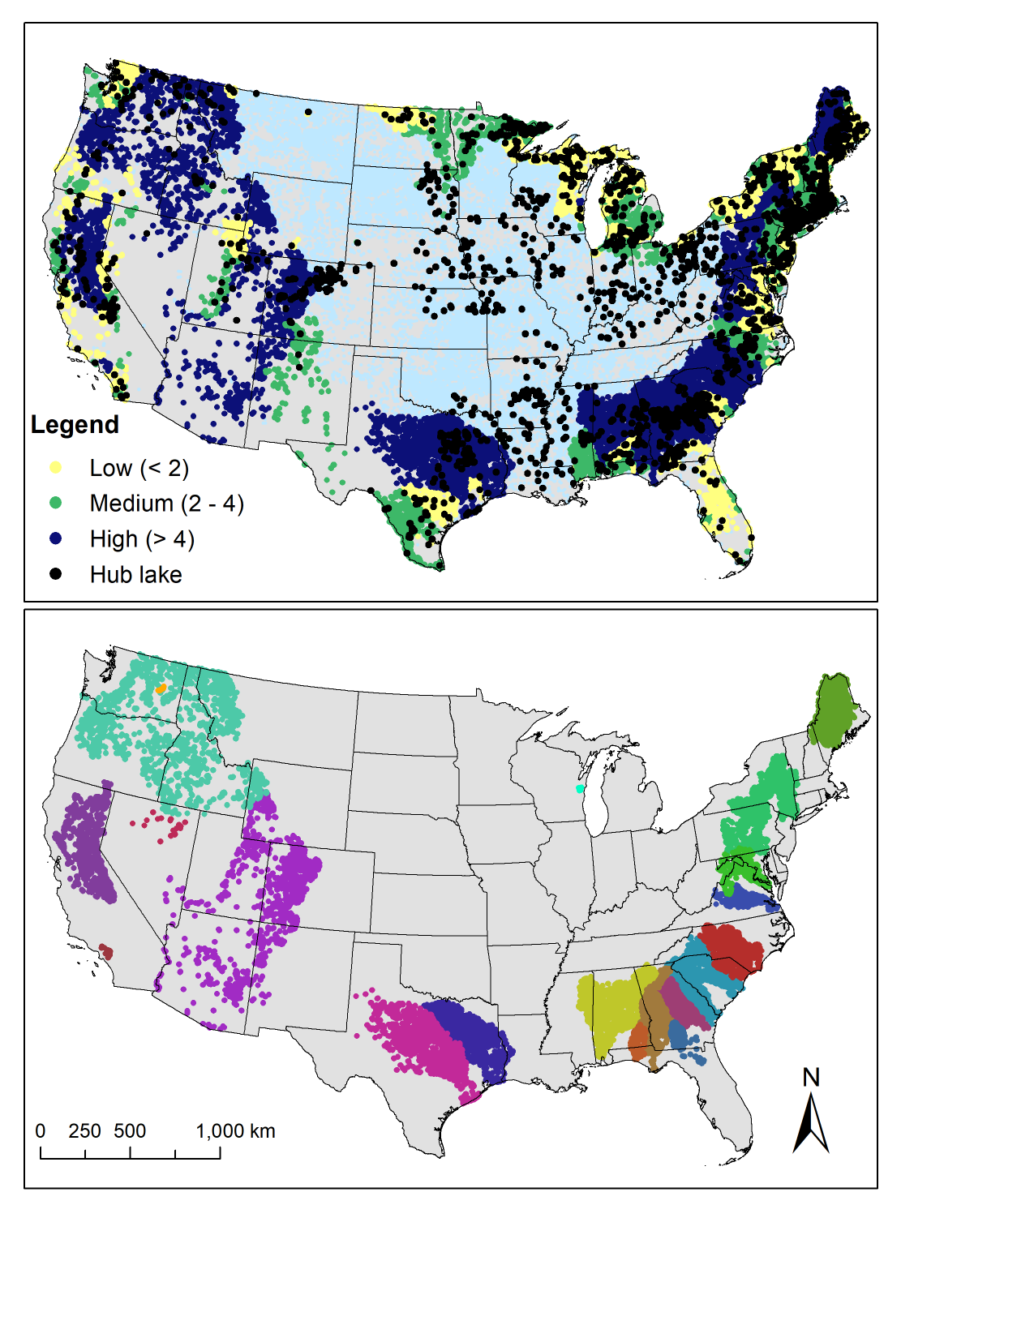
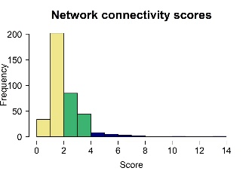
A)
B)
18
16
8
7
11
4
15
10
17
2
13
19
9
3
5
14
20
6
1
12
Notes:
WITH DAM RATE – wonky results

Slide 7
A)
(61%)
(34%)
(5%)
B)
18
16
8
7
11
4
15
10
17
2
13
19
9
3
5
14
20
6
1
12
Notes:
WITH DAM RATE – wonky results

Slide 8
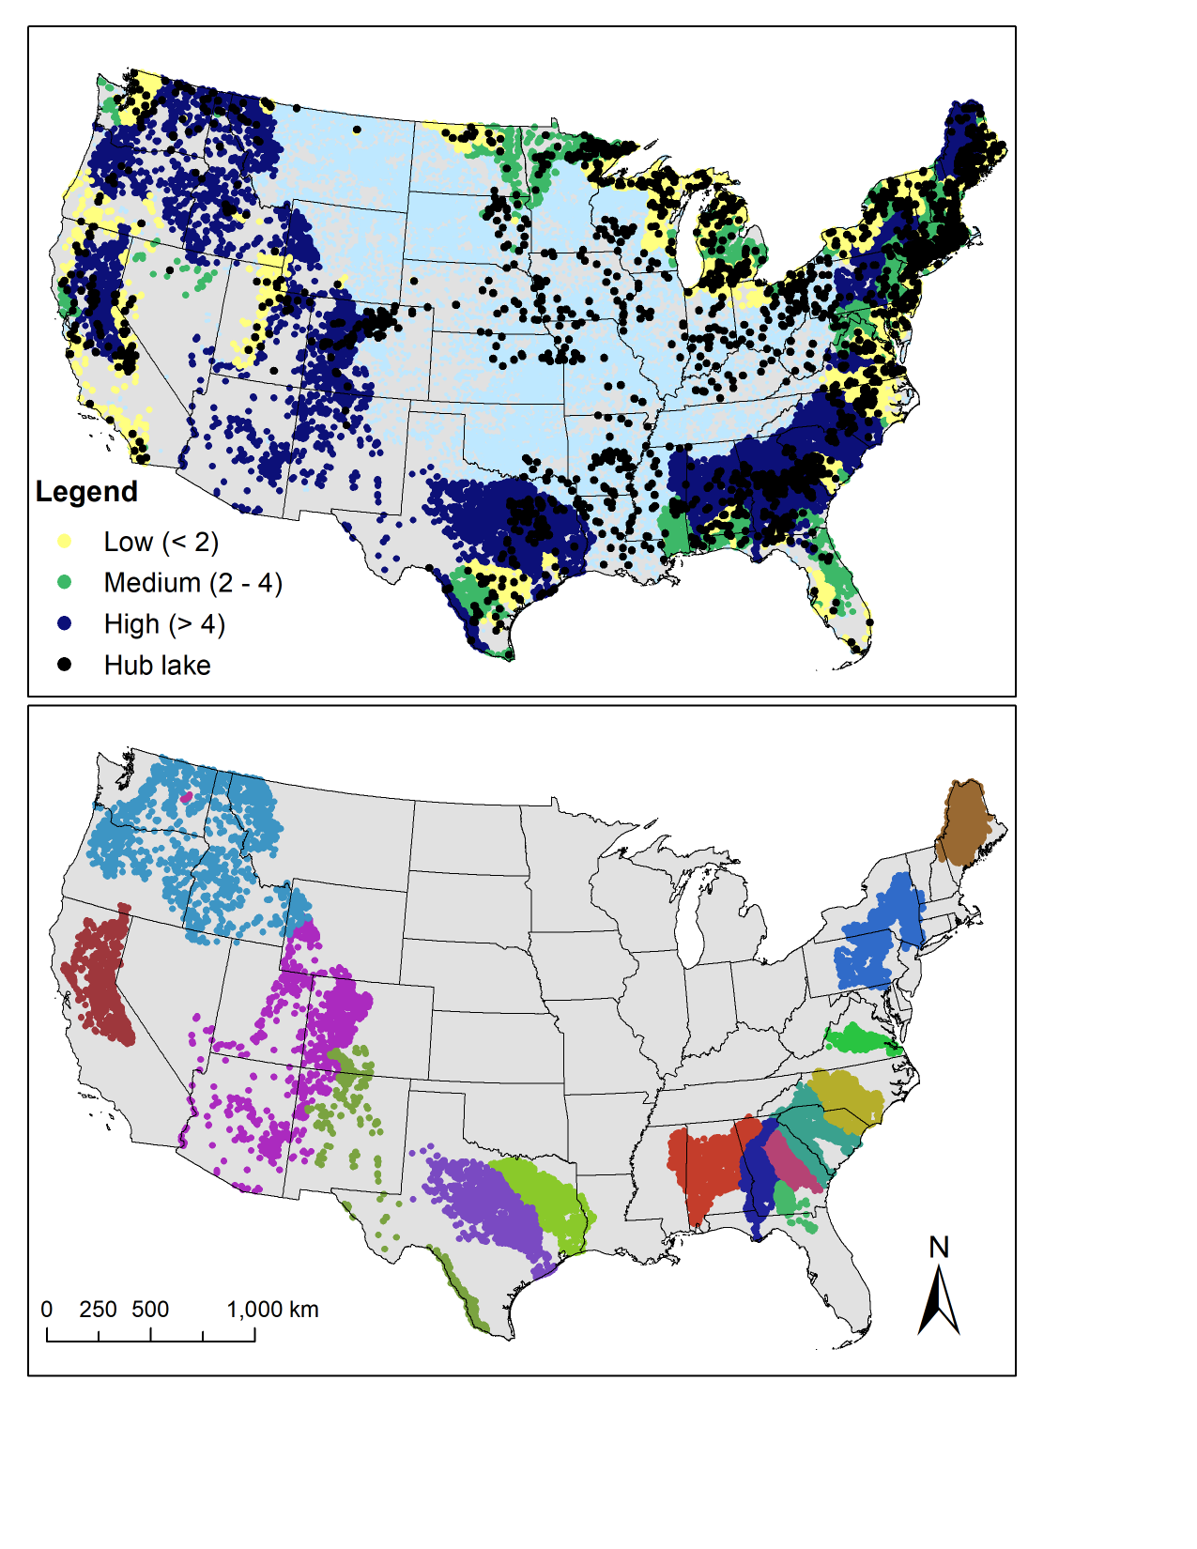
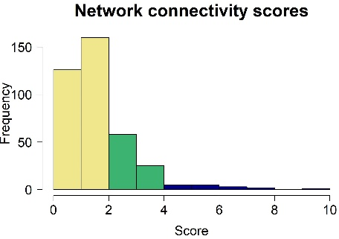
A)
(74%)
(22%)
(4%)
B)
16
13
2
1
6
7
4
15
9
12
11
3
14
5
8
10
Notes:
With dam rate and maxkmNS and 2 pcs

Slide 9
a)
(74%)
(22%)
(4%)
b)
16
13
2
1
6
7
4
15
9
12
11
3
14
5
8
10
Notes:
With dam rate and maxkmNS and 2 pcs

