Slide 1
CLUBVERSE
RNS INSTITUTE OF TECHNOLOGY
BENGALURU - 98
DEPARTMENT OF COMPUTER SCIENCE & ENGINEERING
DSA Mini Project Work Presentation
Project Team
Akash S : 1RN24CS016
Abhirama MB : 1RN24CS005
Akash HV: 1RN24CS015
Faculty In charge
Dr. Bhavanishankar K
Professor
Dept of CSE, RNSIT

Slide 2
AGENDA
Abstract
Introduction
Objectives
Data Structure Used
Flow diagram
Results[screen shot]
Conclusion
Future Enhancement

Slide 3
ABSTRACT
ClubVerse is a club management system implemented in C using an array of structures with linked lists.
Array of clubs, each club containing two singly linked lists (members & events)
Each club is stored in an array, while its members and events are managed dynamically using separate singly linked lists.
The system supports adding, deleting, searching, and displaying members and events through a menu-driven interface, demonstrating arrays, linked lists.

Slide 4
Introduction
Club management systems need to store and organize information about multiple clubs, their members, and events efficiently. Using an array of linked lists allows dynamic handling of members and events for each club without fixed size limitations.
This project demonstrates how real-world club operations—such as adding and removing members, managing events, and displaying club details—can be implemented using C and data structures.
It helps us to understand the practical use of arrays, linked lists, and dynamic memory allocation, improves programming skills, and shows how data structures make club management applications more organized and efficient.

Slide 5
Objectives
To develop a Club Management System using C and an array of singly linked lists.
To allow users to create and manage multiple clubs, each with its own members and events.
To enable dynamic addition, deletion, and searching of club members using linked lists.
To support event management, including adding, deleting, and displaying club events.
To maintain accurate member and event counts for each club.
To provide a menu-driven interface for easy user interaction and efficient club management.

Slide 6
Data Structure Used
An array of singly linked lists is used to store and manage club data dynamically. Each array element represents a club, and each club maintains separate linked list nodes for members and events, containing relevant details and a pointer to the next node.
This structure allows efficient insertion and deletion of members and events without shifting data, unlike simple arrays. It also supports flexible memory usage, as nodes are created and removed at runtime using dynamic memory allocation.
The combination of arrays and linked lists ensures better organization and scalability, making it suitable for applications where the number of clubs is fixed but the number of members and events varies dynamically.

Slide 7
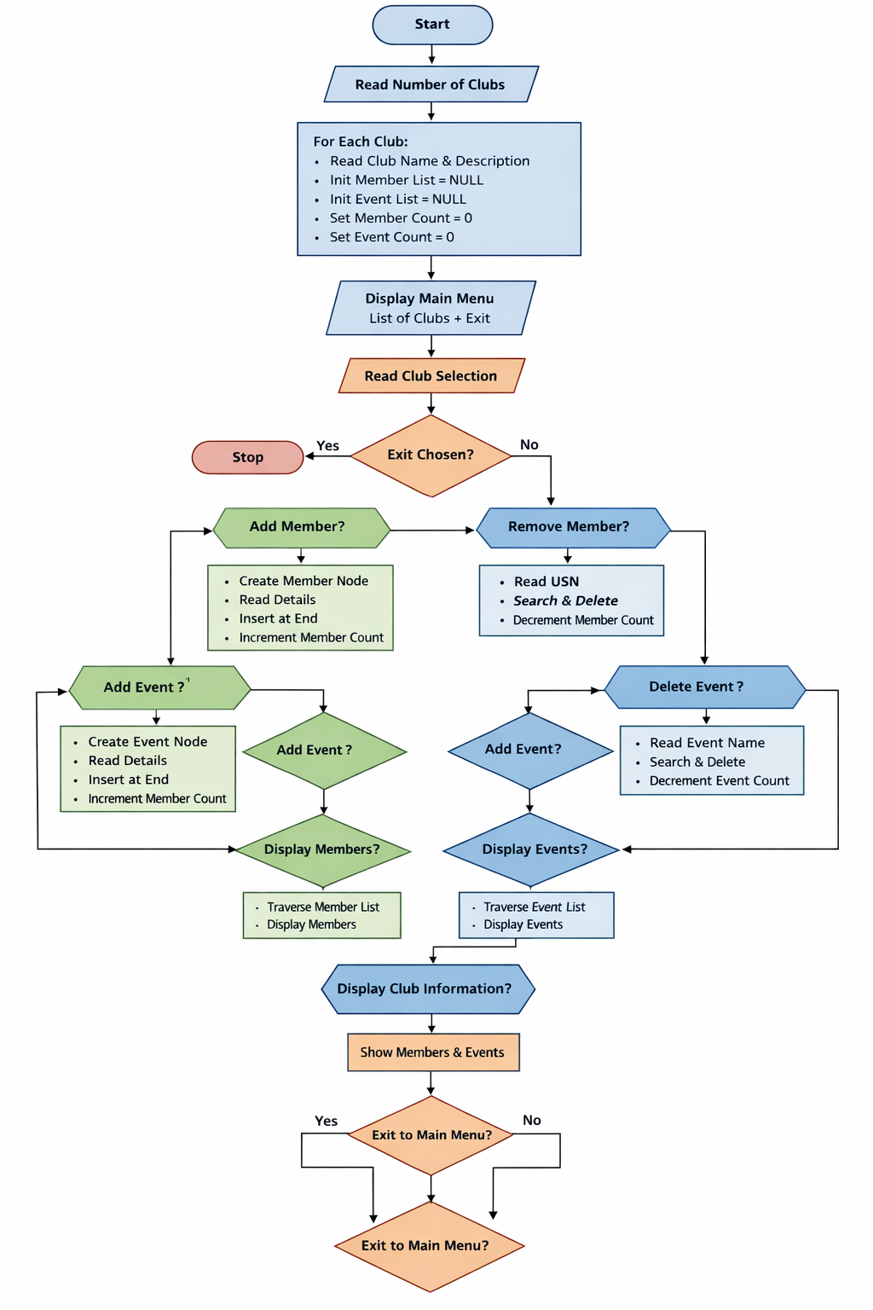
Flow diagram

Slide 8
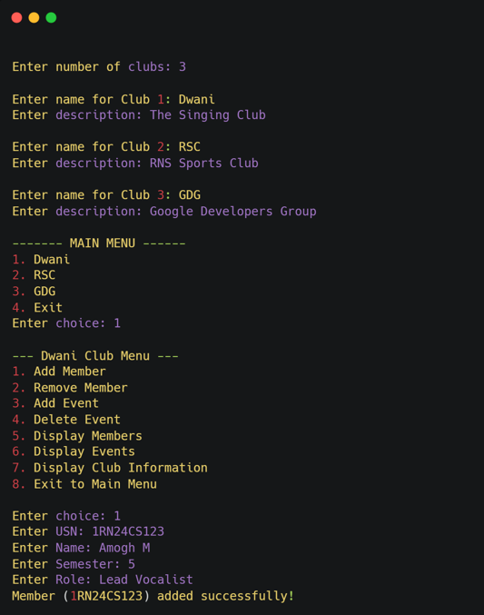
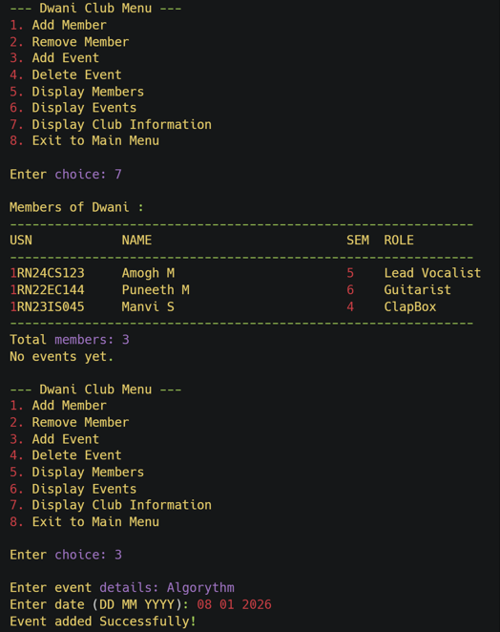
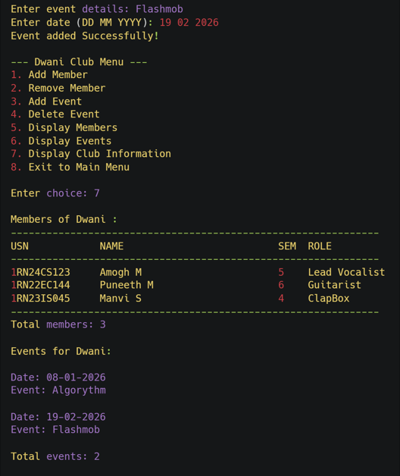
Results[screen shot]

Slide 9
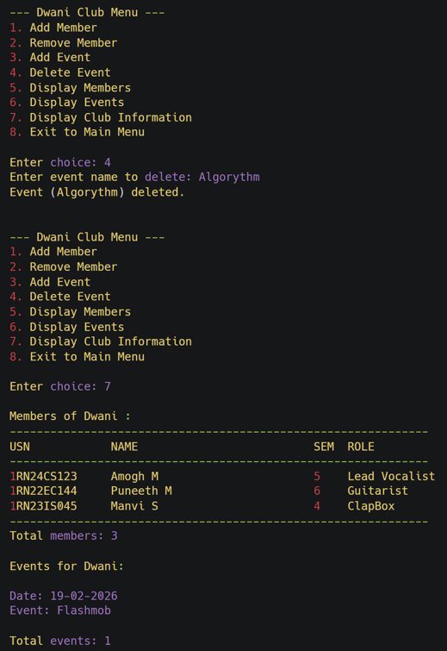
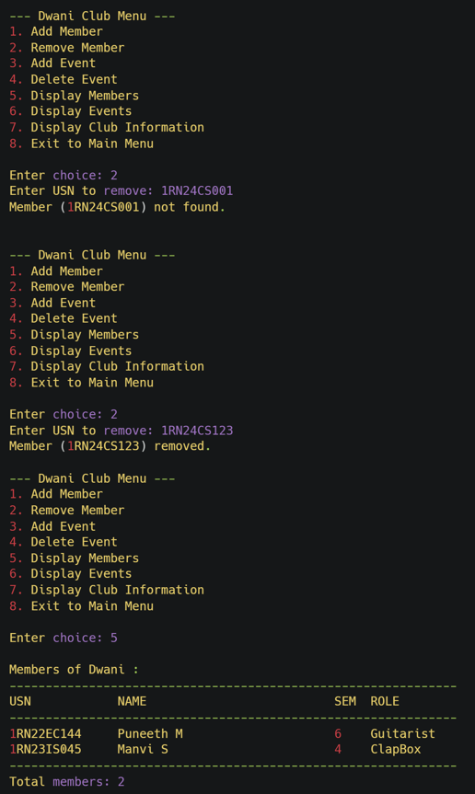
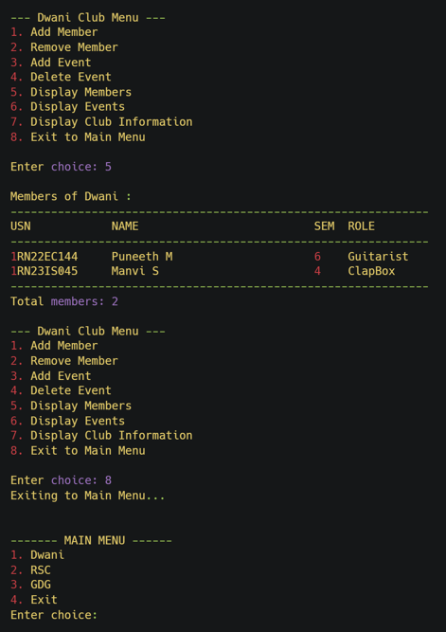
Results :

Slide 10
Conclusion :
This project successfully demonstrates how a Club Management System can be developed using C and an array of linked lists. It efficiently performs essential operations such as managing club details, adding and removing members, handling events, and displaying organized information. The system uses memory effectively for dynamic member and event management and clearly illustrates how data structures can be applied to manage real-world club activities in an organized and efficient manner.

Slide 11
Future Enhancement :
Add dynamic allocation for the club array to remove fixed size limitations and improve scalability.
Add file handling to permanently store and retrieve club, member, and event data.
Introduce user authentication and role-based access (admin, coordinator, member) for better security.
Add features for updating member roles, attendance tracking, and event registration.
Integrate a graphical user interface (GUI) to improve usability and user experience.
Implement member activity history and event participation tracking

Slide 12
Question...??

Slide 13
THANK YOU

