Slide 1
Coffee
Tuna Dalbeler

Slide 2

A BrIef hIstory of coffee
Ethiopian goat herder named Kaldi
Kaffa around the late 6th century.
Noticed a strange restlessness in his goats after they had eaten the berries of an unknown plant.

Slide 3
Waves of coffee
First wave. Instant coffee.
Growing coffee consumption exponentially
Second wave. Coffee chains.
The defining and enjoyment of specialty coffee.
Third wave. New coffee shops.
Purchasing coffee based on its origin and artisan methods of production.

Slide 4
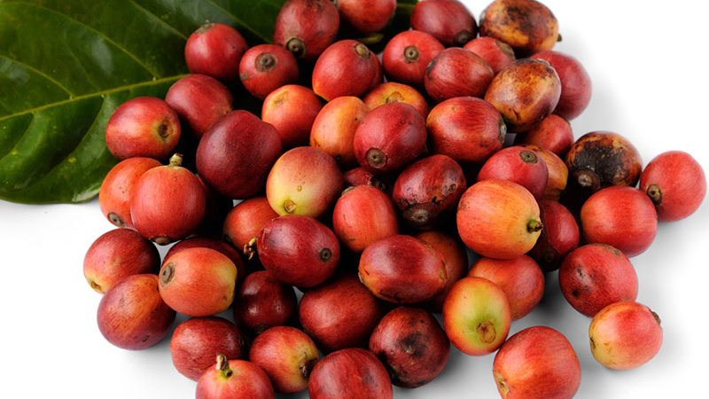
7 steps from seed to cup
1-Harvesting
2-Processing
3-Drying
4-Milling
5-Roasting
6-Grinding
7-Brewing

Slide 5
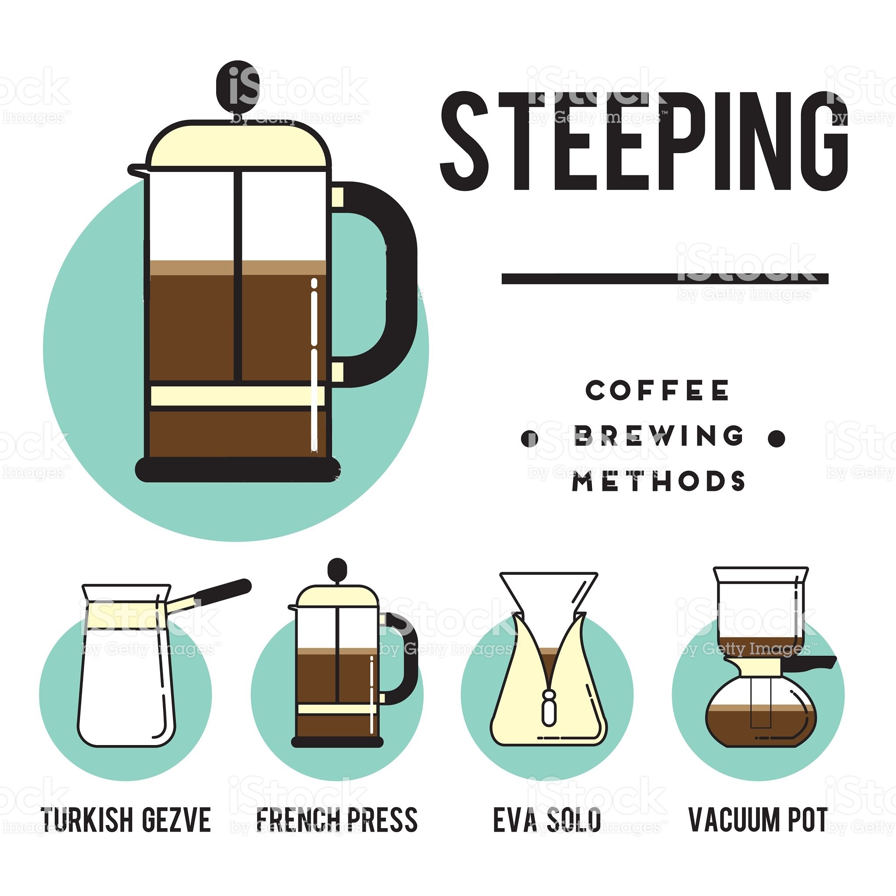
SteepIng
Simple. Coffee and water.
Primitive.
Easy.
Aromatic.

Slide 6
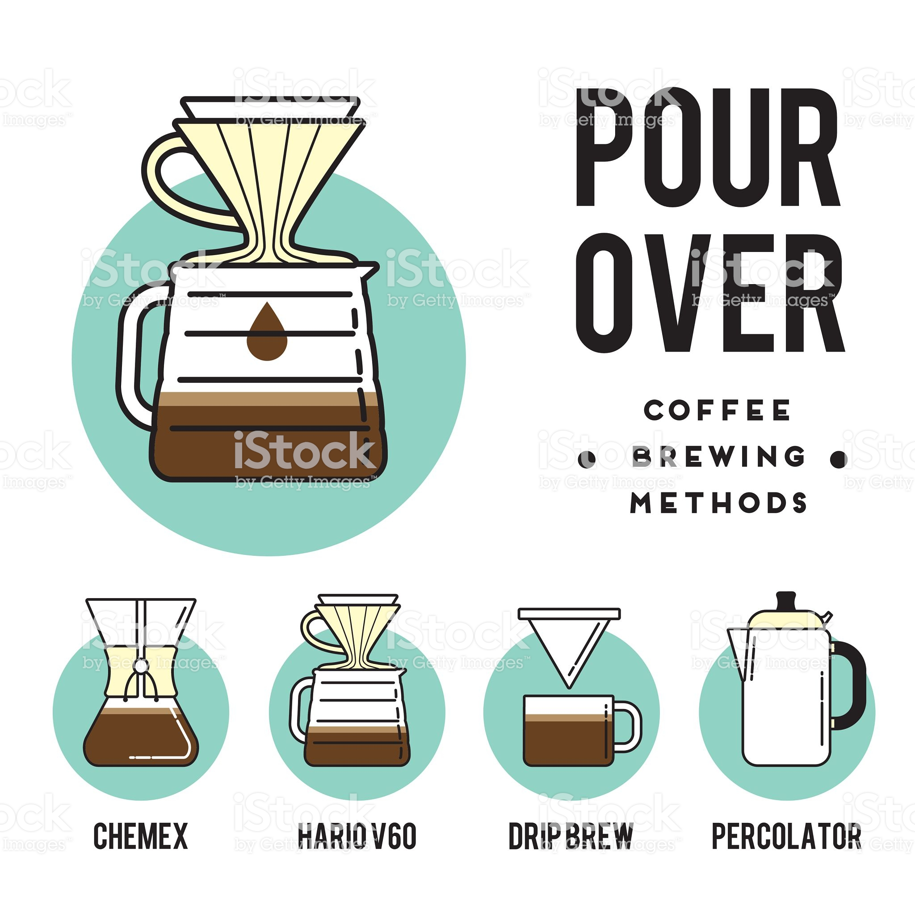
Pour-over /drIp
Filtering.
Orthodox.
Harder.
Does not include particles.

Slide 7
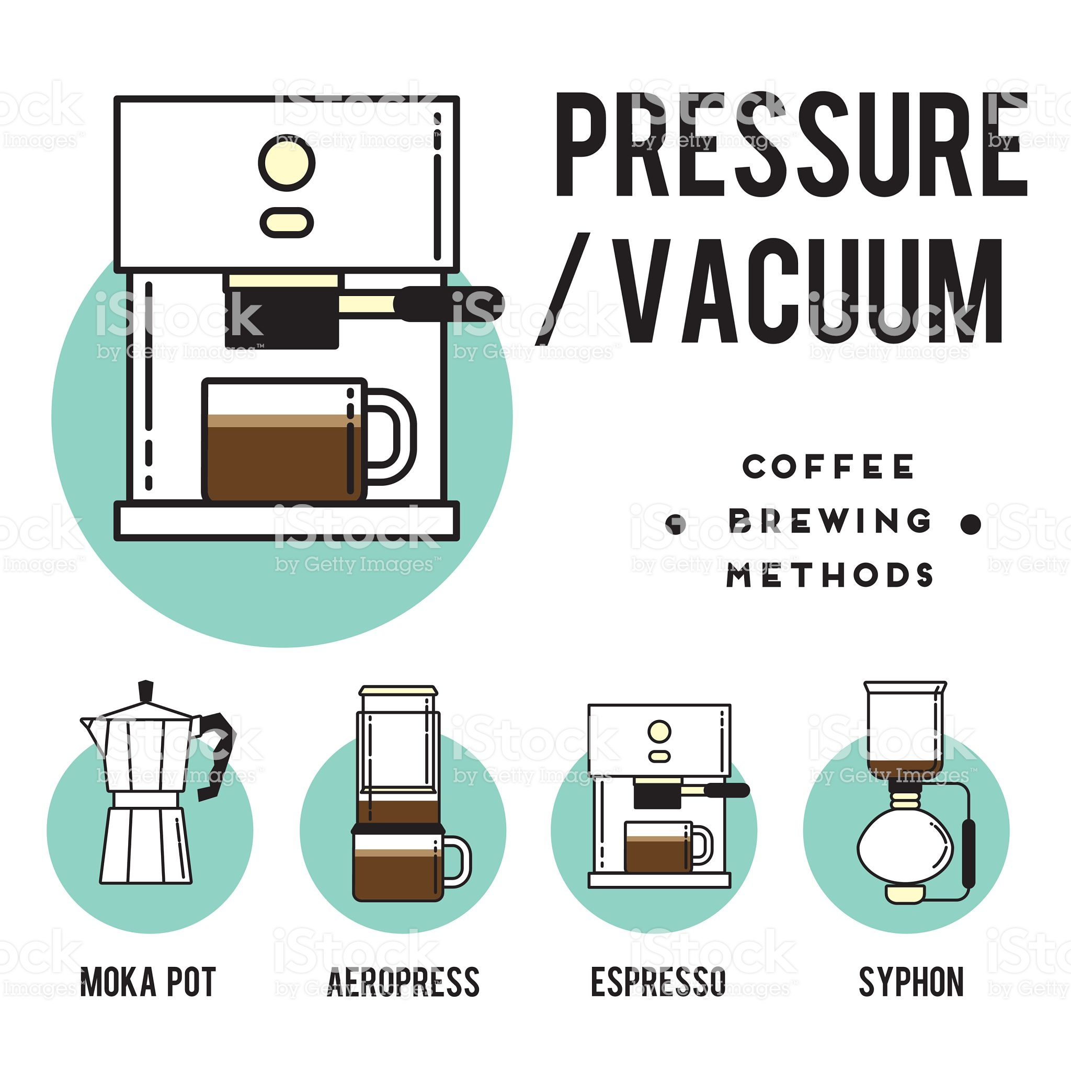
pressure
Less time. Less caffeine.
Expensive.
Fast.

Slide 8
