Slide 1
Robots and unemployment
Tuna Dalbeler

Slide 2
Index
How to imagine robots?
Will robots take out jobs?
What is industry 4.0?
Will we ever run out of jobs?
Referances

Slide 3

R.U.R.
Karel Čapek
Rossum's Universal Robots
"Robota" means forced labour
Robots are bionic not mechanical

Slide 4
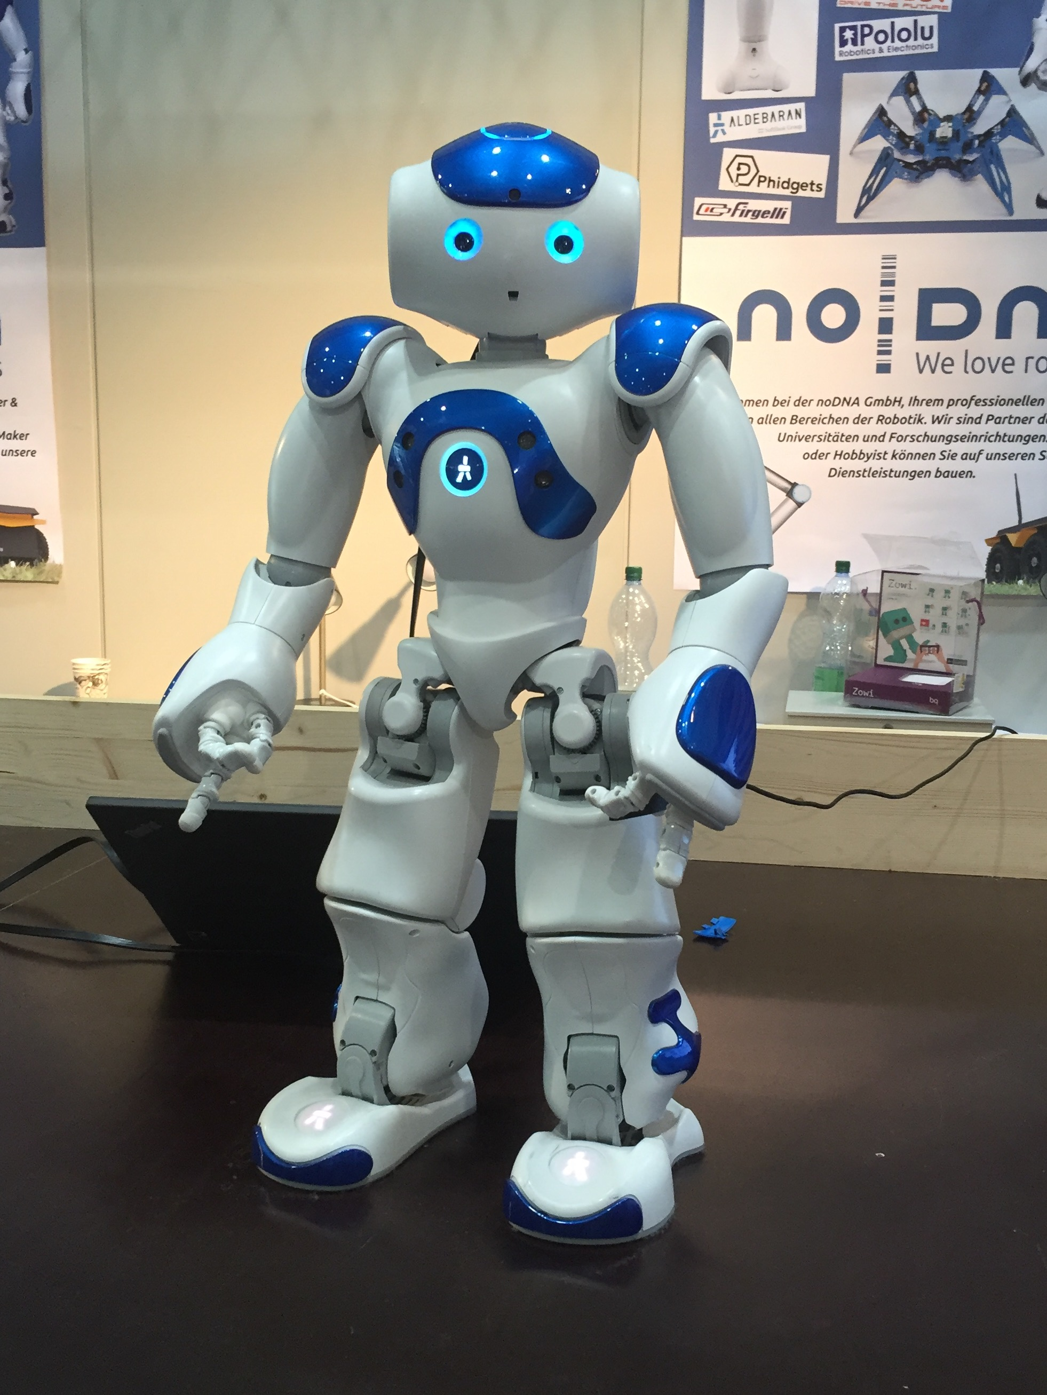
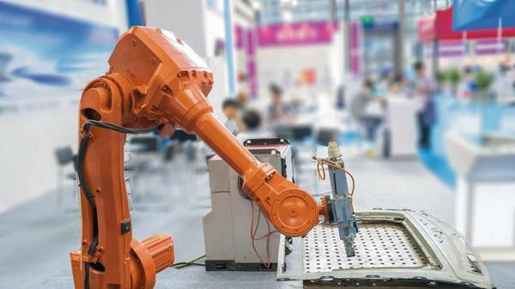

Slide 5
Wıll robots take our jobs?
In China, over 60,000 workers were rendered jobless in May 2016, when Foxconn decided to replace them with robots in order to lower the labor expenses and make the workplace more efficient .
RIAGA, O., 2016. Unemployment in the age of Industry 4.0 – What would you want to become if you didn’t have to work? [online] Available at: <http://www.kachwanya.com/2016/08/08/the-age-of-industry-4-0/>

Slide 6
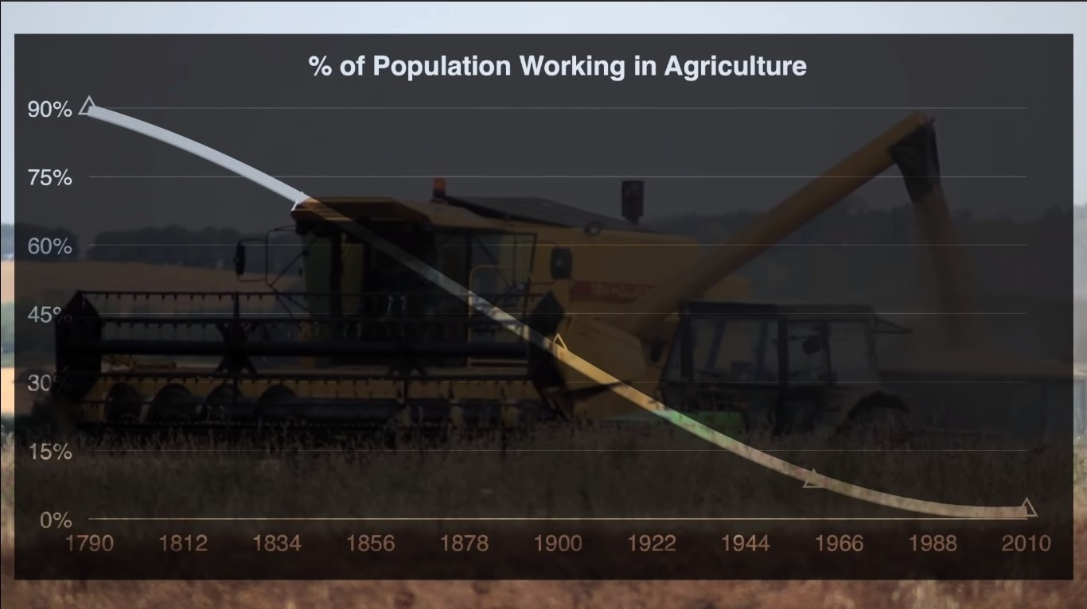
Notes:
https://www.youtube.com/watch?v=7Pq-S557XQU

Slide 7
Industry 4.0
Industry 4.0 means fourth industrial revolution
First Industrial revolution - England (1750-1850) | Steam machine by James Watt (1765)
Second Industrial revolution – Britain, Germany, USA (1870 - 1914) | Electric
Third industrial revolution (since around 1960) | Computers

Slide 8
INDUSTRY 4.0
"It is expected that the cost of transport and communication will drop, logistics will be more efficient and trading costs will fade away. At the same time, workers might be replaced by technologies and that shall disrupt the labor market."
SCHWAB, K., 2016. Fourth Industrial Revolution: what it means, how to respond.[online]
Digitalization and Internet
Effects all sectors.
MAŤOVČÍKOVÁ, D. (2017). Industry 4.0 as the Culprit of Unemployment. IWKM, 12, 71–78.

Slide 9
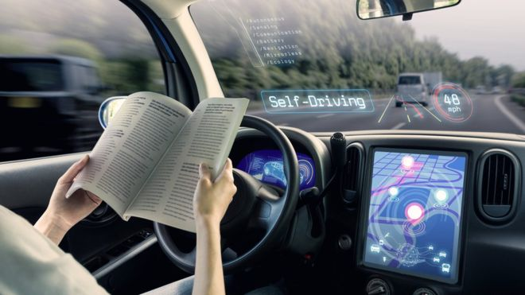
Example of "Auto"- mobıles
Autonomus
Self driving cars
Truck – Taxi drivers replaced.

Slide 10
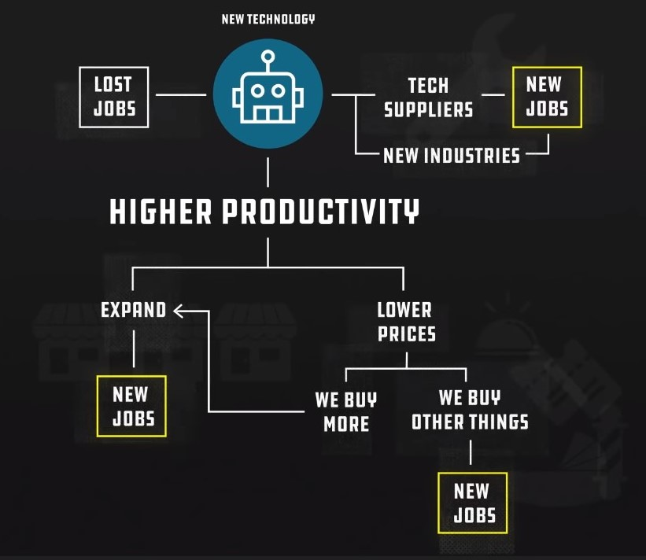
Wıll we ever run out of jobs?

Slide 11
Referances
Autor, D.(2017, Feb.). Will automation take away all our jobs? [Video File]. Retrived from youtube.com/watch?v=th3nnEpITz0
CGP Gray. (2014). Humans need not apply. [Video File] Retrived from youtube.com/watch?v=7Pq-S557XQU
Vox. (2017). The big debate about the future of work, explained. [Video file]. Retrived from youtube.com/watch?v=TUmyygCMMGA
Ford, M. (2016). Rise of the robots: technology and the threat of a jobless future. New York, NY: Basic Books.

