Slide 1


KaamSet
Your dukaan’s
AI team
Describe the business.
Start your approved cloud team.
Track 3 · Autonomous AI Teammates
Proposed fit with Paytm for Business
Notes:
KaamSet provides ready merchant AI teammates. The Paytm for Business positioning is a proposed ecosystem extension, not an official partnership or an existing in-app deployment. Artwork is an original generated illustration, not a photograph of a real merchant. Source: implemented ready-team catalogue and current KaamSet product.

Slide 2
KaamSet
Problem Statement
Daily work competes with the counter
One owner
Counter
Bills, prices and quantities
The shop stays busy.
The work keeps piling up.
Customers
Enquiries, orders and bookings
Khata
Credit records and reminders
Online
Ready teammates give each recurring job an owner.
Posts, messages and follow-ups
02
Notes:
Problem framing is qualitative, grounded in the jobs the product implements. No time-saving, conversion or revenue benchmark is claimed. The merchant remains responsible for approved facts and commercial exceptions.

Slide 3




KaamSet
Proposed Solution
Meet the merchant team
Arjun
Naina
Tara
Naman
Counter Team
Khata Team
Online Dukaan
Business Insights
Reviewed bills from
lists, photos or voice
Credit explanations
and reminder plans
A catalogue storefront
and accepted orders
Collections, pending work
and owner summaries
Describe the business once. Review the facts. Start the relevant teammates.
03
Notes:
Source: src/foundation/workforce/kaamset-ready-teams.ts. Arjun prepares bills from catalogue facts and owner-reviewed quantities. Naina explains the immutable ledger and approved imported records. Tara publishes owner-approved catalogue data and captures customer-accepted orders with recorded stock reservation. Naman explains current recorded work. Owner-reported cash and credit remain distinct from provider-verified online payments.

Slide 4
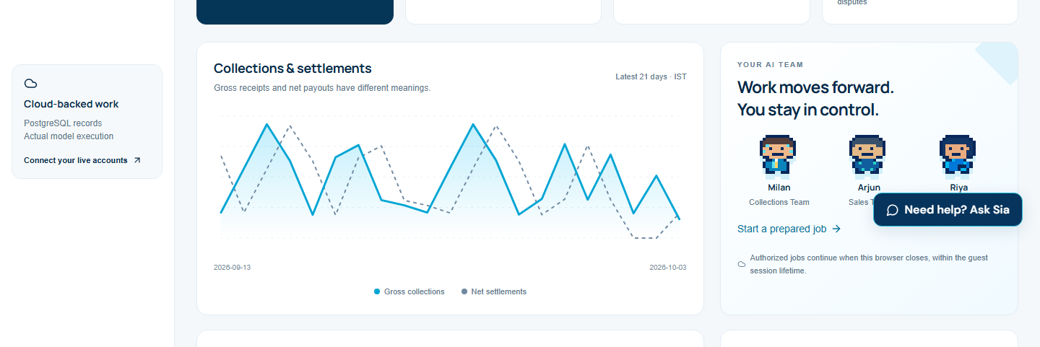
KaamSet
Merchant Demonstration
An unpaid invoice becomes useful completed work
Milan reads the accepted invoice. The owner can inspect every action.
Accepted invoice
₹2,480 outstanding
Actual model
+ approved sources
Demo request
+ customer payment
Saved result
+ linked records
Actual AI. Real cloud workers.
Source invoice, usage and saved receipts.
Naina flags an unsettled payout.
The owner reviews the result.
Fictional merchant. Simulated customer channels and payments. No money moves.
04
Notes:
Fresh verification on 5 October 2026: Milan completed DEMO-CAFE-2480 collection and stored a demo payment request; Milo quoted two sugar cases plus one tea case at approved prices for INR3180; Naina flagged already-paid but unsettled invoice DEMO-INV-0561 without sending a reminder. The screenshot is recorded verification from 3 October, not a live payment. Actual models and cloud processing operate; customer channel and payment transports are explicitly simulated. Paytm signature/status module exists but genuine Paytm payment verification requires merchant credentials.

Slide 5


KaamSet
Other Ready Teammates
The same team reaches beyond the counter
Riya
Vijay
Lakshya
Marketing Team
Website Team
Growth Team
Approved Instagram posts,
eligible comments and DMs
Your assets, design and copy
A published business URL
Public sources, prospect fit
and reviewed Gmail outreach
Also ready: Meera for Gmail, Milan for reminders, Sia for business help,
Kabir for customer requests and Ira for growth insights.
05
Notes:
Source: ready-team catalogue. Instagram requires a professional account and applicable permissions. Exact publishing content/plan needs approval. Lakshya searches public original sources and supports reviewed Gmail batches of up to ten recipients with deduplication and paced sends, not guaranteed sales. Vijay uses approved business assets and returns a public KaamSet URL. Website specialists: Aditi assets, Dev design, Kavya copy, Nisha validation; these include both model stages and trusted validation. Verification: VIJAY-LIVE-VERIFICATION.json demonstrates Gemini 3.1 Pro HIGH, an approved asset and a published URL returning HTTP 200.

Slide 6
KaamSet
USP + Technology
One business memory for every teammate
Approved facts,
records and assets
Shared business memory
Cognee + PostgreSQL
Ready teammate
with scoped actions
Language + reasoning
Cloud workers
BullMQ + Redis
Connected actions
Sarvam voice
Gemini Flash / Pro
Composio, WhatsApp Web
and Paytm modules
Browser closed, jobs continue. The owner can pause or take over.
React · TypeScript / Fastify · Railway API / worker · Vercel frontend
06
Notes:
Implemented architecture: TypeScript/Node Foundation API and worker on Railway; PostgreSQL with scoped access; Redis/BullMQ durable jobs; React/TypeScript interface on Vercel; supported app actions through Composio; cloud WhatsApp Web session; Sarvam transcription; Cognee source-backed business memory. Graph-derived statements never replace canonical approved facts. Exact-source retrieval and isolated dataset names protect scope. Routine LLM default is Gemini 3.7 Flash; website creation uses Gemini 3.1 Pro HIGH. Actual Sarvam and Cognee proof: ACCESSIBLE-CLOUD-VERIFICATION.json and RECORD-COGNEE-VERIFICATION.json. Jobs may wait for permission, owner approval, provider availability or budget. Background scans still occur; no claim of event-only execution.

Slide 7
KaamSet
Cost Optimisation
Spend reasoning where it earns its keep
Model routing
One real quote
Flash for recurring merchant work.
Pro HIGH for website creation.
Saved progress
Recorded model usage · 5 October 2026
Resume completed stages
without repeating their work.
Component | Recorded tokens
Input | 4,763
Output | 252
Total | 5,015
Bounded memory
Reuse unchanged indexes.
Retrieve relevant approved excerpts.
Predictable visuals
Reusable templates and
merchant-approved photos.
Gemini 3.7 Flash · one completed cafe quote.
Usage is observed; total delivery cost is unmeasured.
Tools, memory, voice, hosting and support add cost.
07
Notes:
Fresh actual-model receipt for job ff9bf09a-cd8e-4af8-a58f-4fbe2e319486, 5 October2026. Recorded inputTokens4763, outputTokens252; combined5015. This is one successful quote and excludes other workflow/model calls. No per-business total cost, percentage saving or achieved margin is claimed. Implementation controls: smaller-model routing, input/history/output caps, unchanged-source Cognee reuse, limited retrieval, stable job IDs, persisted stages, approved-photo templates and bounded guest allowance. Proposed INR900 delivery ceiling on the INR2999 plan is a pilot target, not measured.

Slide 8
KaamSet
Business Model
A monthly AI team for each business
Plan | Monthly price | Indicative scope
Dukaan | ₹999 | 2 active teammates
Business | ₹2,999 | 5 active teammates
Growth | ₹7,999 | All ready teammates
₹900
Subscription + approved extra usage
delivery-cost ceiling target
on the ₹2,999 plan
Optional setup and bounded website packages
add revenue when the merchant needs them.
Proposed pilot prices. Usage caps and five paid pilots will validate economics.
08
Notes:
Pricing is a proposal, not billing already implemented or validated willingness to pay. Prices are per business/month before taxes. Indicative scope and allowance amounts require pilot validation and billing implementation. Delivery-cost target <=INR900 for INR2999 is unmeasured, roughly 30% of subscription price; it is not an achieved gross margin. Delivery cost includes models, tools, memory, hosting and support. Acquisition, R&D and tax treatment remain separate. Start with five paid pilots, measure actual cost and retention. Optional assisted setup around INR999 once and a scoped website package around INR1999 once are hypotheses. Provider allowances are platform-wide, not a new free allowance per merchant. Sources: https://composio.dev/pricing , https://www.cognee.ai/pricing , https://www.sarvam.ai/api-pricing .

Slide 9

KaamSet
Impact & Benefits
Useful work. Reviewable results. A product you can try.
Try the proof
A prepared store. Your own isolated workspace.
Less repeated owner work
Collections, replies, records and a website—
with approvals and sources the owner can review.
2,699 unit tests passed from the clean source bundle.
Cloud completion and published-site evidence included.
Open the merchant demo
kaamset-web.vercel.app/merchant-lab
Proposed Paytm for Business extension. Merchant demo data is fictional.
09
Notes:
Paytm ecosystem figures: official Q1FY2027 investor presentation, June2026 operational KPIs, p17. Registered merchants are ecosystem scale, not KaamSet customers, an addressable paid-market estimate or committed distribution. Source: https://paytm.com/document/ir/financial-results/fy2026-27/Paytm_Earnings-Presentation_Q1-FY-2027_INR.pdf . This is a proposed ecosystem fit, not an official partnership. Product evidence: TEAMMATE-REPAIRS-CLOUD-VERIFICATION.json actual model and public search produced five sourced prospects after browser closure; Naina reviewed private-document write/export; VIJAY-LIVE-VERIFICATION.json live website with approved asset; ACCESSIBLE-CLOUD-VERIFICATION.json Sarvam and Cognee. Latest release passed 2699 unit tests/107 PostgreSQL journeys and all four Instagram account reads. These checks sent no real external messages/posts and made no payments. Demo uses fictional prepared records; API payment verification still requires merchant credentials. Pilot impact metrics: owner time saved, enquiries resolved, accepted orders, verified collections and repeat usage; no measured ROI is claimed. Demo: https://kaamset-web.vercel.app/merchant-lab

