Slide 1

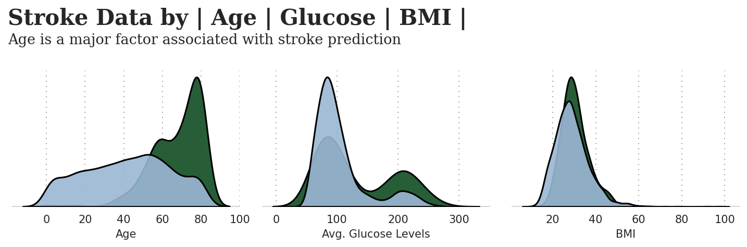
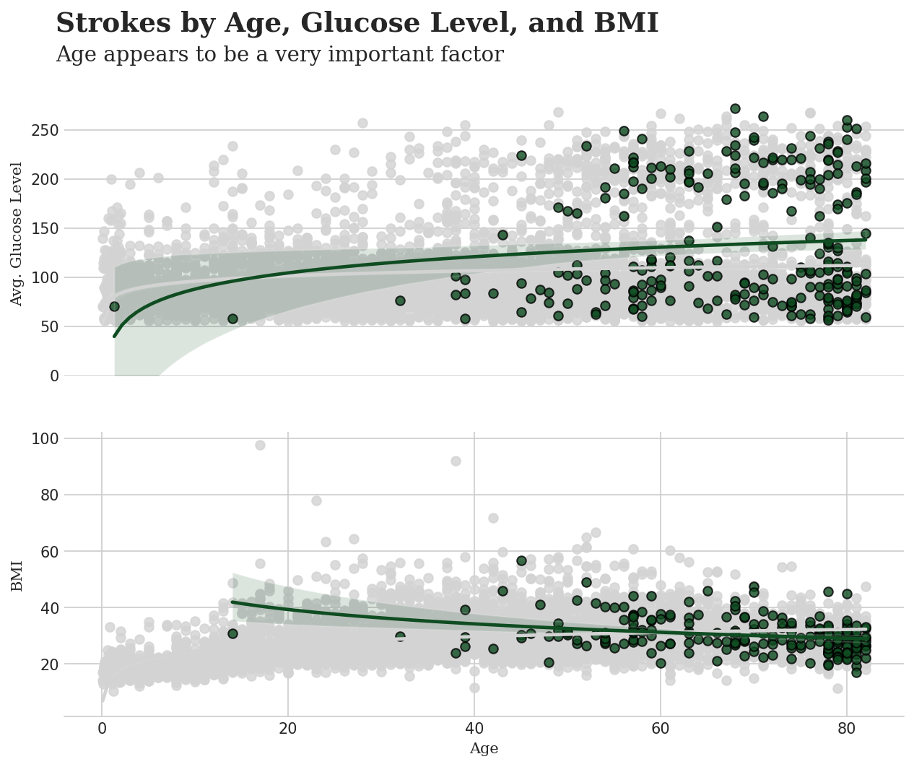
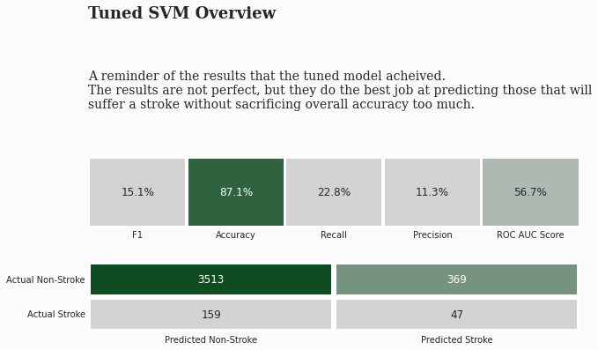
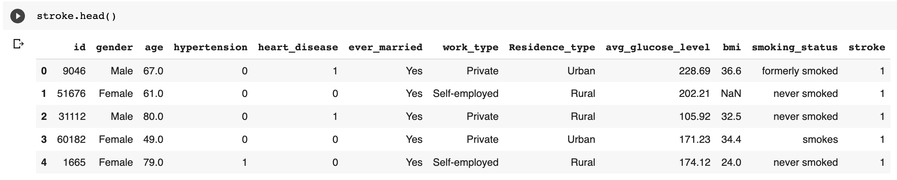
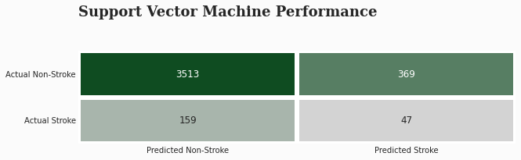
Computer Science Department
Final Project: Your project title
Course: Introduction to AI (CS156)
Course Instructor: Yulia Newton, Ph.D.
Kyle Louderback
Introduction/Background
Methodology
Analysis and Results
from each of the 10 folds. In this case, the mean F1 score is 0.9156213339565074. This suggests that the SVM model is performing well on the training data.
I have selected a classification problem for my term project. It is a dataset taken from Kaggle that is used to predict a stroke in patients based on several characteristics. It is important because being able to detect a stroke is vital to everyone’s health. The dataset provides many key characteristics about each patient to predict if they have had a stroke or not. According to the World Health Organization (WHO) stroke is the 2nd leading cause of death globally, responsible for approximately 11% of total deaths.
Algorithm
Application to the project
In the context of stroke patient data, this algorithm could potentially be used to predict the likelihood of a patient experiencing a stroke in the future, or to classify different types of stroke based on the patient's symptoms and medical history. Other possible applications include predicting the likelihood of a patient experiencing certain complications after a stroke, or predicting the chances of a patient making a successful recovery. These predictions could be used to guide clinical decision-making and help doctors provide the best possible care for stroke patients.
SVMs are a type of supervised learning algorithm that can be used for classification and regression tasks. In this case, the SVM is being used for classification. The pipeline is fitting the SVM to the training data using the fit method, and then using the fitted model to make predictions on the test data with the predict method.
Generally, support vector machines can be a good choice for many classification tasks, including medical diagnosis.
Preprocess the data: This is cleaning, transforming, and augmenting the data to make it suitable for the training model.
Split the data into training and test sets: This was done by randomly dividing the data into two sets: a training set, which is used to train the model, and a test set, which is used to evaluate the performance of the trained model.
Train the SVM model: This involves using the training data to fit the SVM model to the data. The model's parameters were adjusted to minimize the error on the training data.
Evaluate the performance of the model: This involved using the trained model to make predictions on the test data and comparing the predictions to the true labels to evaluate the model's performance.
Fine-tune the model and repeat steps 3 and 4: initially, the model's performance was not satisfactory, the hyperparameters of the model were adjusted and the training process was repeated to try to improve the performance.
Apply the model to make predictions on new data: Once the model has been trained and evaluated, it can be used to make predictions on new data. This involved using the model to predict the likelihood of a patient suffering a stroke, or to make other medical diagnosis decisions.
Test results
Similar to the training results, I used an F1 score metric. Overall, the accuracy of the test results came to approximately 87%.
Dataset description
Validation/cross-validation results
The metric being used for cross validation is the F1 score. The F1 score is a measure of a model's accuracy that considers both the precision and the recall of the model. It is calculated as the harmonic mean of the precision. It is typically used when the classes in a classification problem are imbalanced. The F1 score ranges from 0 to 1, with a higher value indicating better performance.
In this case, the F1 score is being used to evaluate the performance of the SVM model on the training data. The cross-validation procedure is splitting the training data into 10 folds, training the model on 9 folds and evaluating it on the remaining fold. This is repeated 10 times, with a different fold being used for evaluation each time. The final F1 score reported is the mean of the F1 scores obtained from each of the 10 folds.
Summary/Conclusions
Given the overall accuracy of the model, I think it does a good job based on the time allotted.
The results are not perfect, but they do the best job at predicting those that will
suffer a stroke without sacrificing overall accuracy too much.
This dataset is used to predict whether a patient is likely to get stroke based on the input parameters like gender, age, various diseases, and smoking status. Each row in the data provides relevant information about the patient. The data is available, and I have been able to download and import into my model.
The independent variables are a mixture of numerical and categorical data. As a result, I have one-hot encoded the categorical data and combine it with the rest.
Training results
The training results for the support vector machine (SVM) model are being evaluated using cross-validation with an F1 score metric. The F1 score is a measure of a model's accuracy that takes into account both the precision and the recall of the model. The code is fitting the SVM model to the training data using the fit method, and then using the cross_val_score function to evaluate the model's performance on the training data using 10-fold cross-validation. The final F1 score reported is the mean of the F1 scores obtained
Key References
Joshuaswords. “Predicting a Stroke [Shap, Lime Explainer & Eli5].” Kaggle, Kaggle, 5 May 2021, https://www.kaggle.com/code/joshuaswor ds/predicting-a-stroke-shap-lime- explainer-eli5#Welcome.
Moffitt, Chris. “Guide to Encoding Categorical Values in Python - Practical Business Python.” Pbpython.com, 2017, pbpython.com/categorical-encoding.html.
The dependent variable is a yes/no encoded to 1 or 0, to see if the individual has had a stroke or not. Since this is a binary classification problem, I intend to use a SVM model to predict the class.

