Slide 1
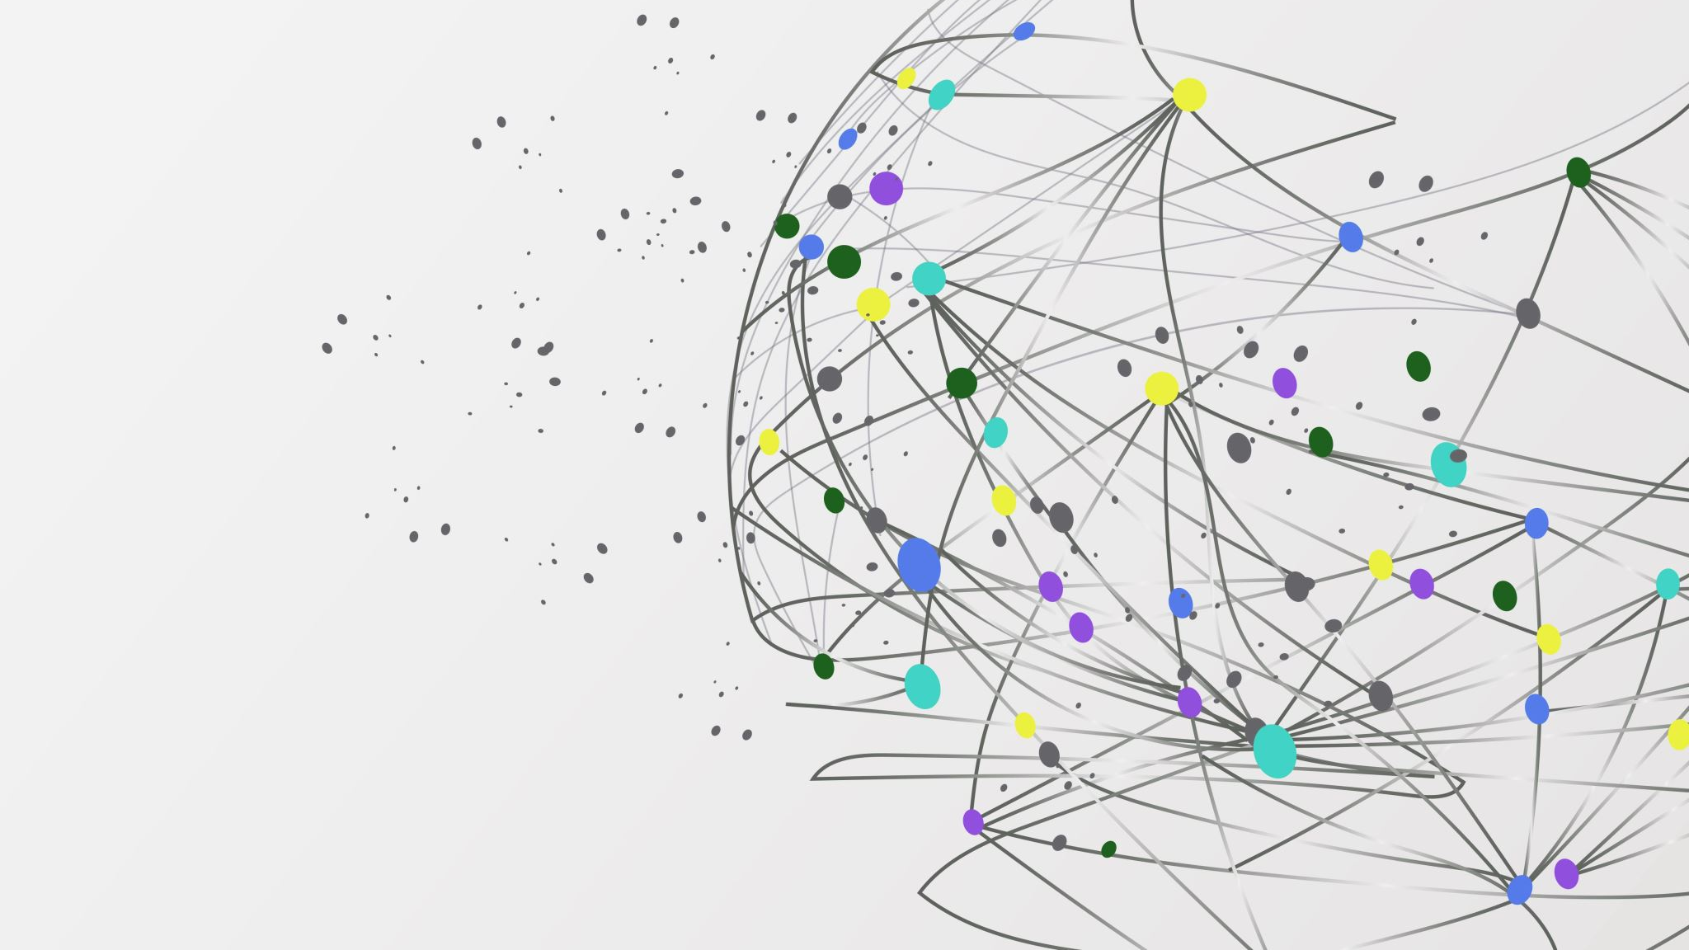

The Librarians
Dexter Estrada (Lead)
Kevin Ngo
Kyle Louderback
Nicholas Semaan

Slide 2


Progress
Name | Job
Kyle | Setup app.py, basic Flask app structure Setup routes for “/” and “/about”, “/form”, “/register”, “/login”, “/initdb”, “/book” Initialized DB
Kevin | Researched library for social sharing that works with Flask Framework Build form.py
Dexter | Started building out and mapping models.py Setup Virtual Environment Build models.py
Nicolas | Started building index.html, about.html, layout.html, form.html, register.html, login.html

Slide 3
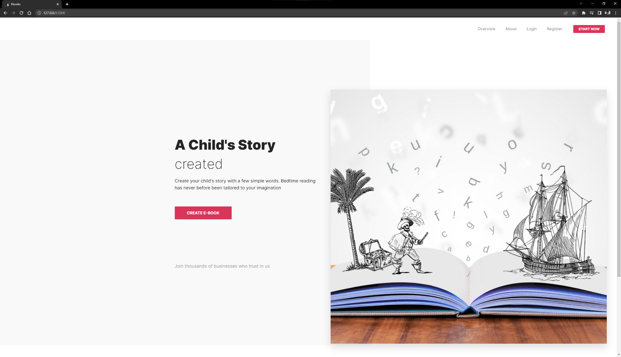
Progress
Environment is set up and running
Designed home.html, form.html, login.html, register.html
Added documentation to GitHub https://github.com/contactatfp/theLibrarians

Slide 4


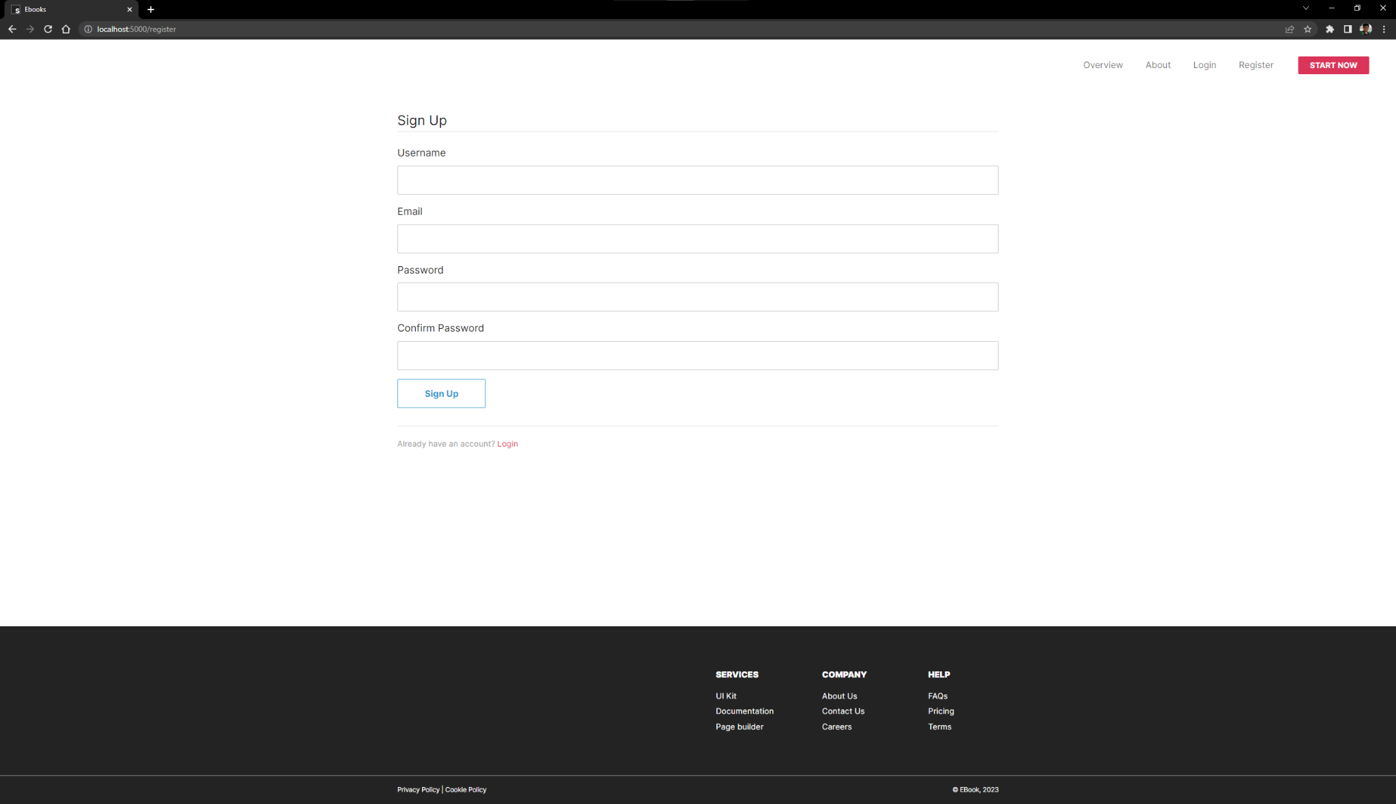
Use Case: Registration
A new user visits the site and clicks on the Register link on the homepage. They are taken to the Registration page where they fill out the registration form with their username, email, and password. After submitting the form, the user receives a confirmation message and is redirected to the homepage.

Slide 5
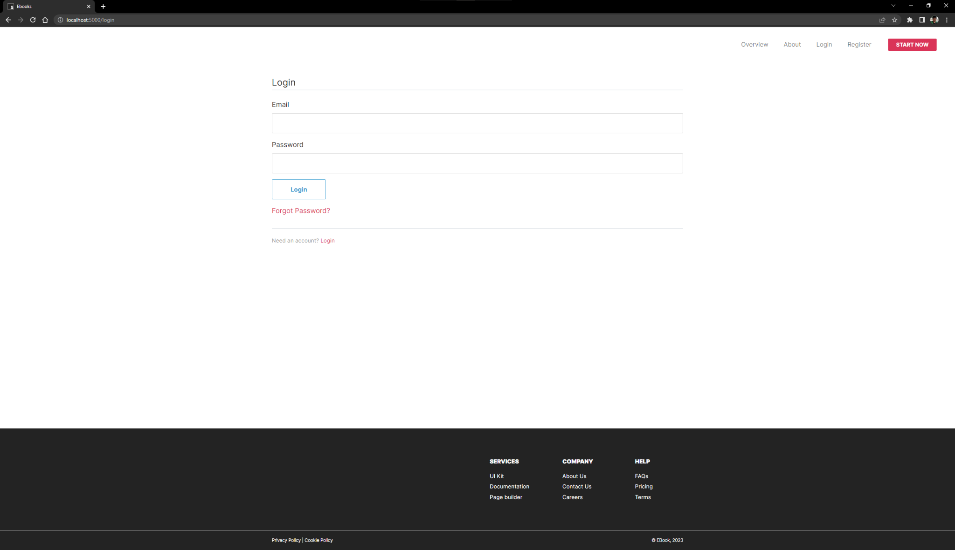
Use Case: Login
A registered user visits the site and clicks on the Login link on the homepage. They are taken to the Login page where they enter their email and password. After successful login, the user is taken to the homepage where they can access the other features of the application. To logout, the user clicks on the Logout link in the navigation bar and is redirected to the homepage.

Slide 6
Setup
Overview:
Built a Flask web application with instructions and requirements.txt
Users can create custom stories that align with a child's interests and reading level, making reading more engaging and enjoyable
https://github.com/contactatfp/theLibrarians/tree/main/docs
Importance of the Setup Page:
Provides a clear and concise guide on how to get started with the app
Helps users easily install the required dependencies, initialize the database, and start using the app
Improves the user experience by ensuring that users can easily and efficiently start using the app

Slide 7
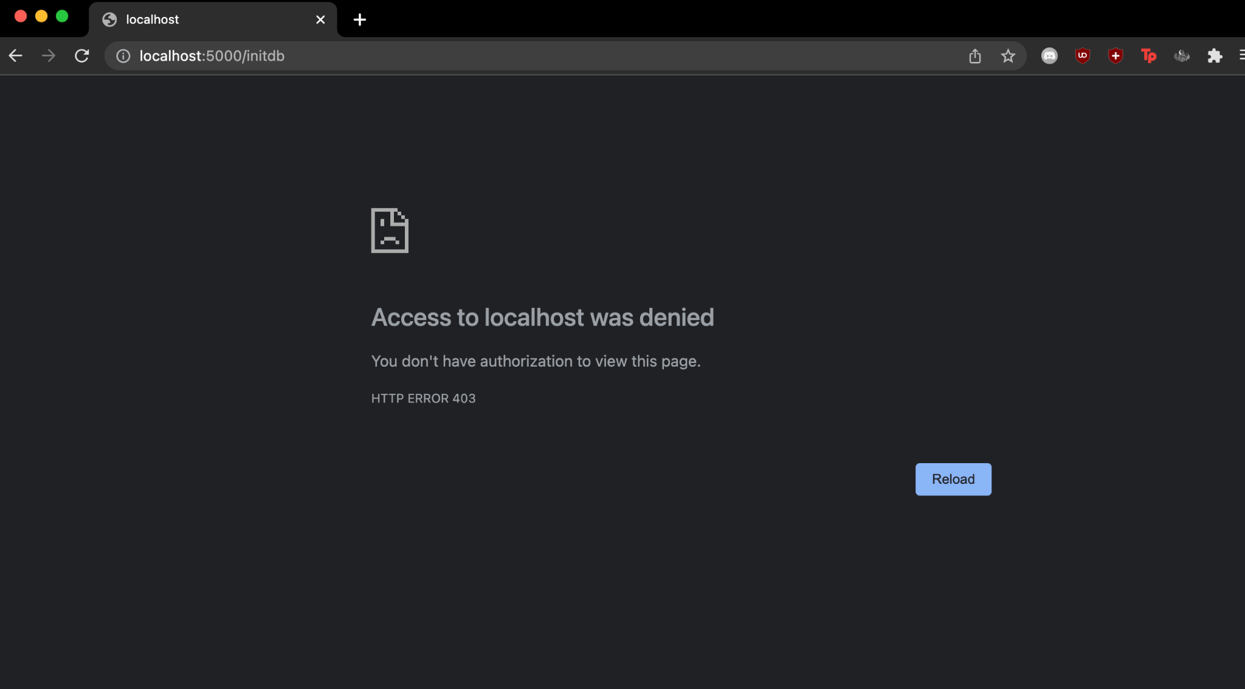
ThriveTodays’ Feedback
Henry
loves the clear documentation, project vision, progress
interested in hearing more about how you plan to program the Book Generation feature
Very thorough readme and use cases
Can see the flow of the book generation process very clearly
expert_users setup was well written and easy to follow but:
HTTP ERROR 403 on step 5: navigating to localhost:5000/initdb

Slide 8
Response to Feedback
We have identified several spots in our instructions we need to fix
Separate step 2 and clarify changing directory to "dev" directory
Step 4 needs to be done in the "docs" directory
Before step 5, need to run "flask run" in the "dev" directory before accessing localhost

