Slide 1
THE LIBRARIANS
Dexter Estrada
Kevin Ngo
Kyle Louderback
Nicholas Semaan

Slide 2
PROGRESS
​MILESTONES | COMPLETED
Registration, Login/Logout, About, and Form | DONE
Book Generation feature | DONE
Preview and Download features | DONE
Share feature | IN PROGRESS
Additional Nice to Have Features | IN PROGRESS

Slide 3
THIS WEEK
HOSTING
Deploy to Azure
Multiple Sessions
BUGS/TESTING
Fixed UnicodeEncodeError
PROMPT RESEARCH
Engineer the best prompt for books
Engineer the best prompt for images

Slide 4
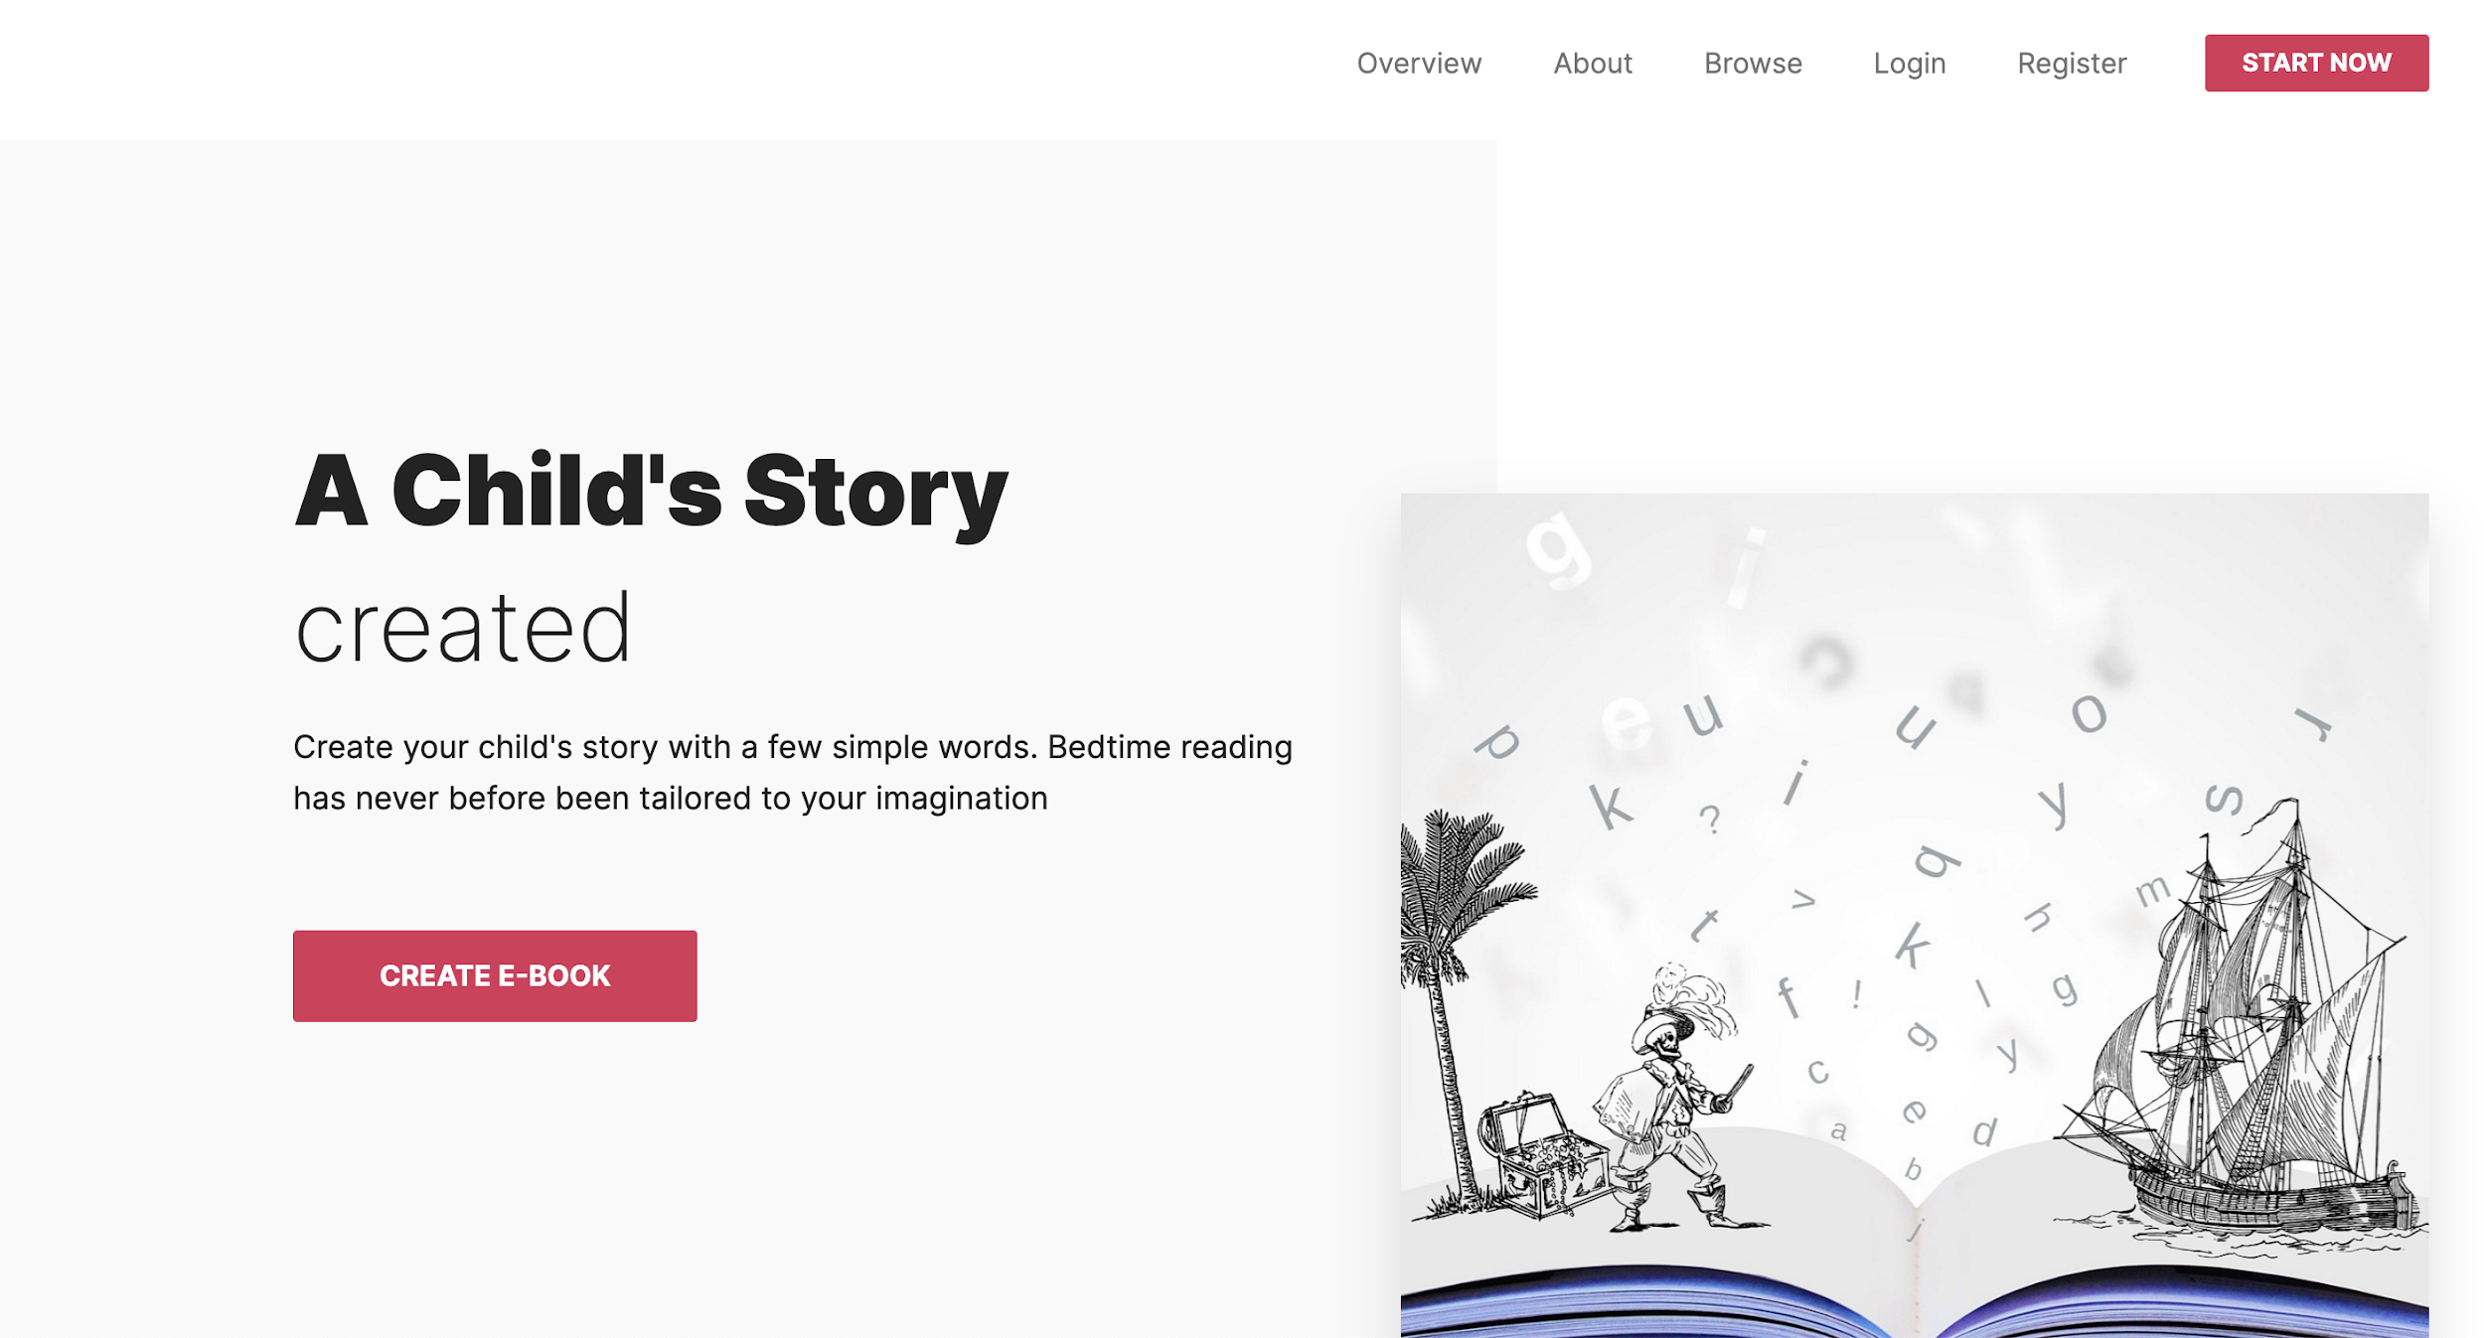
HOSTING
https://flask-ebook3.azurewebsites.net/
Azure
Session issues prevent login for multiple users on Azure, but not locally.
Working on fix, but open to ideas.

Slide 5
FEEDBACK
DeepCourse
FOR PARTNER | FROM PARTNER
EVERYTHING RUNS WELL WE LIKE YOUR PROGRESS INTERESTED TO SEE FURTHER TESTING PLANS BUILD WORKED WELL | NO ISSUES BUILDING EXCEPT ON SOME MACs (POTENTIAL PYTHON VERSION ISSUE) REDIRECT TO LOGIN WHEN TRYING TO CREATE E BOOK WHEN NOT LOGGED IN IMAGE DOES NOT LOAD WHEN BROWSING E-BOOKS GREAT UI LIKE ABILITY TO BROWSE BOOKS HOSTING HAS SESSION ISSUE WORKING ON IT OPEN TO IDEAS

