Slide 1
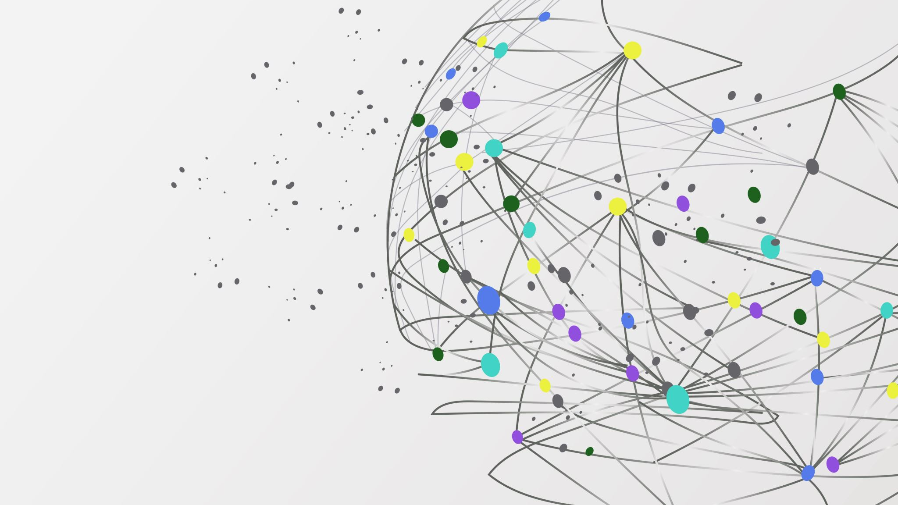

The Librarians
Dexter Estrada
Kevin Ngo (Lead)
Kyle Louderback
Nicholas Semaan

Slide 2


Progress
Name | Job
Kyle | Connections between front/backend (forms.html) Building test cases
Kevin | Helping build all.html, other front end if needed; connections Building test cases
Dexter | Connections between front/backend (revising schema and pages) Building test cases
Nicolas | Continue building index.html, about.html, layout.html, form.html, register.html, login.html Building test cases

Slide 3
Progress
Deployment on Azure
Bootstrap integration
User Registration connection
User Sign In connection

Slide 4
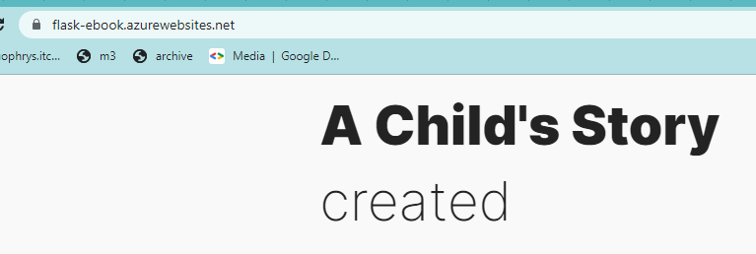
Deployment on Azure!
Deployed our website on Azure
Not ready to share yet
Still need to build locally to product test

Slide 5
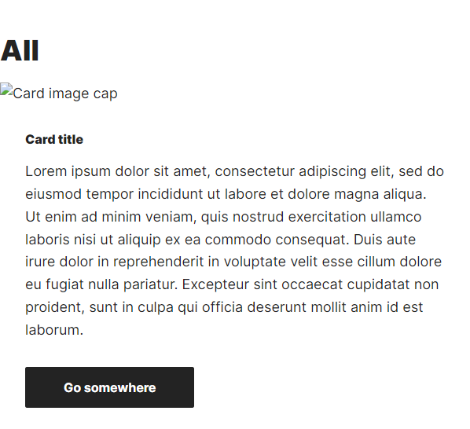
Bootstrap
Implemented Bootstrap into our project
Speed up templating of pages

Slide 6
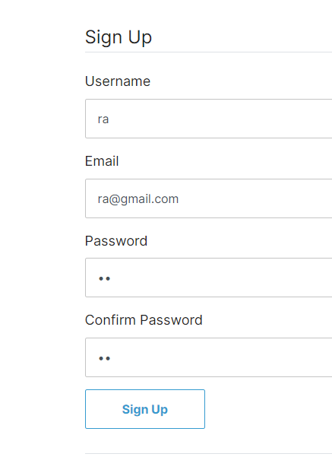
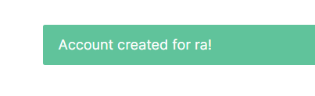
User Sign Up
Users can register accounts
Saved into database
Form validation

Slide 7
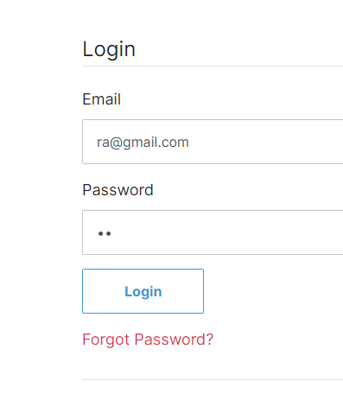
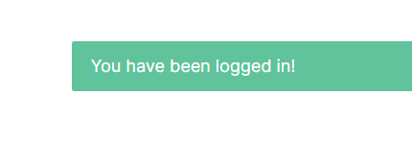
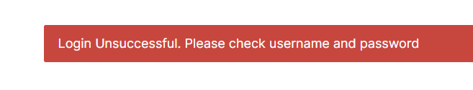
User Login
Uses saved users in db
Only logs in registered users
Gives error if not found

Slide 8
Milestones
M2: Registration, Login/Logout, About, and Form features are completed.
Need to connect
M3: Book Generation feature is completed
Need to iron out and connect
M4: Preview and Download features are completed.
M5: Share feature is completed.

Slide 9
Features Wanted
Text to speech
Good accessibility option for parents and children
Child may use it themselves if a parent can't read it for them
Extra feature, unlikely to be developed this semester
Positive feature
Might be straightforward to implement, but needs extra time
Need to research more APIs and then implement them/test them
Other features may be more impactful to implement first

Slide 10
Features Wanted
User reactions to stories
Good for user engagement, helps filter/search for good stories
Users can like/dislike, add reactions to a story
Extra feature, but may be developed this semester
Positive feature, very impactful feature
Need to tweak db schema, need graphics
Might be harder to implement, but might be possible to implement this semester

Slide 11


Test Plans
Registration: Verify that users can successfully create an account by filling out the registration form with their username, email, and password.
Login/Logout: Verify that users can successfully log in and out of their account to access the other features of the application.
Book Generation: Verify that the application successfully generates a children's book based on user input, including character names, ages, and story settings.
Preview: Verify that users can successfully preview the generated book and make changes if necessary.
Download: Verify that users can successfully download the generated book as a PDF.
Share: Verify that users can successfully share the generated book on social media.

Slide 12
Test Plans
Look into Postman
Look into Python's unittest package

Slide 13
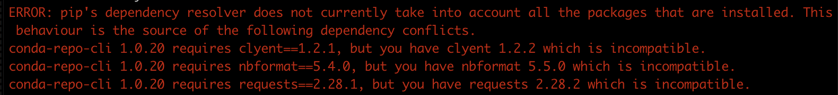
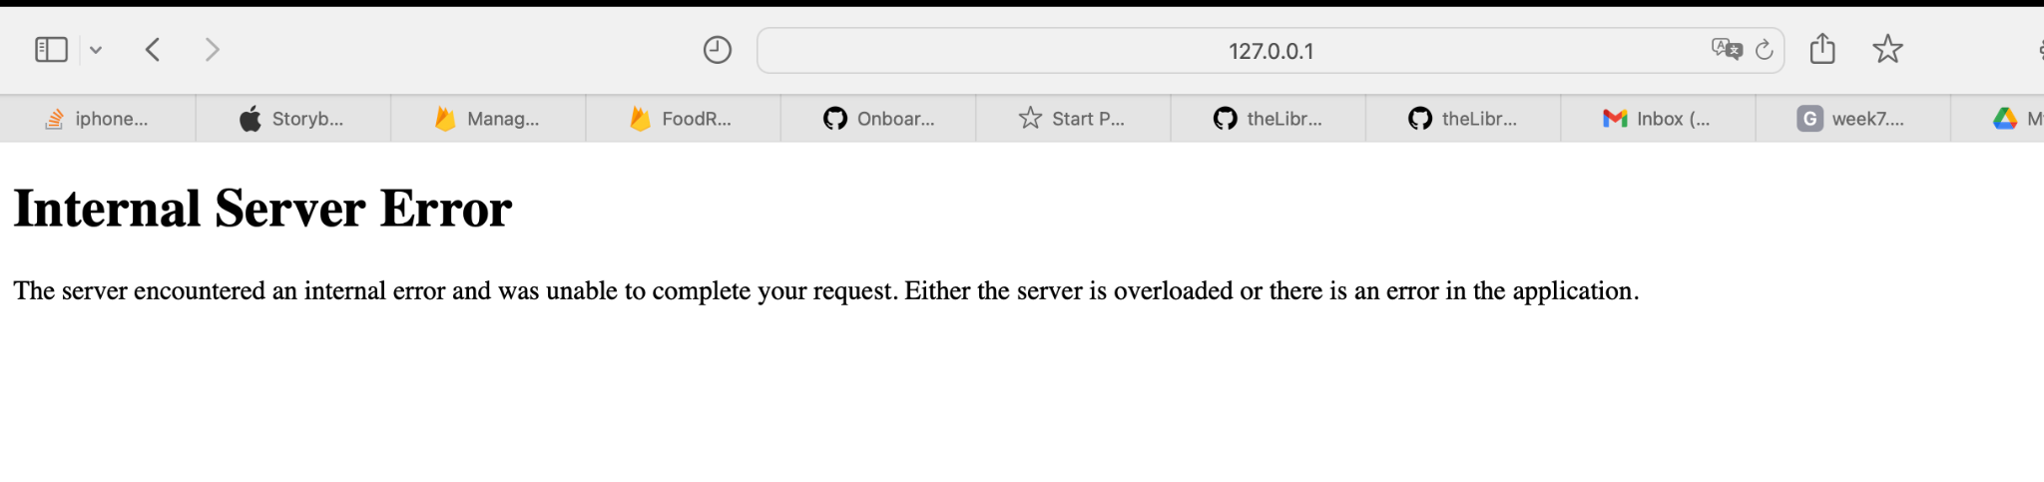
Partner Feedback
Feedback
ran into error running pip install -r requirements.txt gives this error
Error was resolved after asking team
Clean UI, pages all work
Creating books not implemented yet, directs to this
Account creation and login works properly

Slide 14
Response to Feedback
Our Feedback
A new virtual environment was needed for build

